Slide 1
Hybrid LSTM-Based Renewable Energy Forecasting and Grid Optimisation for Sustainable Power Management
Student Name: Srikar Kalle
Student ID: C00313529
Supervisor name: Dr Greg Doyle

Slide 2
Brief summary of dissertation
Higher levels of renewable energy (solar, wind) penetration into power systems have also brought problems of predictability and stability control as a result of intermittency and weather dependence.
An inefficient grid due to poor forecasting may result in increased costs of operation and even blackouts.
With an increased drive towards the net-zero initiative around the world, multiple data functionality needs to be introduced to forecasting tools powered by AI to enhance the precision and accuracy of their performance.

Slide 3
Objectives & Research Gap
Objectives
Combine multi-source information (weather and market) to model on environmental and economic.
Clean data by removing missing values and irrelevant features, and multicollinearity.
Construct and compare LSTM, Random Forest, and XGBoost-based models forecasting in terms of RMSE.
Model grid risks over forecast errors (under-supply, balanced, and over-supply).
Research Gap
The current approaches mainly utilize individual sources of data and do not develop synergy between weather and market factors.
Few comparative experiments between deep learning and ensembles.
The deficiency of models combining forecasting and risk simulation to check the imbalance between demand to supply.
Little interconnection between AI-powered predictions and practical decision-making in the energy markets.

Slide 4
Methodology Used
Data Collection & Integration
Weather Data (NASA POWER API)
Collected daily data (2015–2025) for 32 counties in Ireland & parts of Northern Ireland.
Data saved as county-specific CSVs for modular merging & site-level analysis and API rate-limits handled with request delays (time.sleep(1)).
Energy Market Prices (Yahoo Finance API)
Historical daily close prices (2015–2025) for 10 energy assets:
Renewables: FSLR, SPWR, ENPH, SEDG, NEE, Fossil Fuels: CL=F, BZ=F, NG=F, COAL.AX, XLE
Data merged into a multi-asset time-series matrix with dates as index & assets as columns.
Ensured time alignment with weather dataset for consistency.

Slide 5
Methodology Used
Cleaning / standardizing Data
Delete/imputed missing/corrupt data; standardized units of measure (e.g., terajoules to GWh).
Fixed classification anomalies within the different kinds of energy.
Feature Engineering
Time characteristics: month, season, year.
Lag variables: past generation and time-series forecasting ability.
Weather matching: matched weather information to power production dates.
Aggregation Techniques
Added monthly and yearly data to provide computational efficiency for details.
Had a one-week seasonality and avoided overfitting on daily variations.
Enhanced risk simulation and modeling of smart grid.

Slide 6
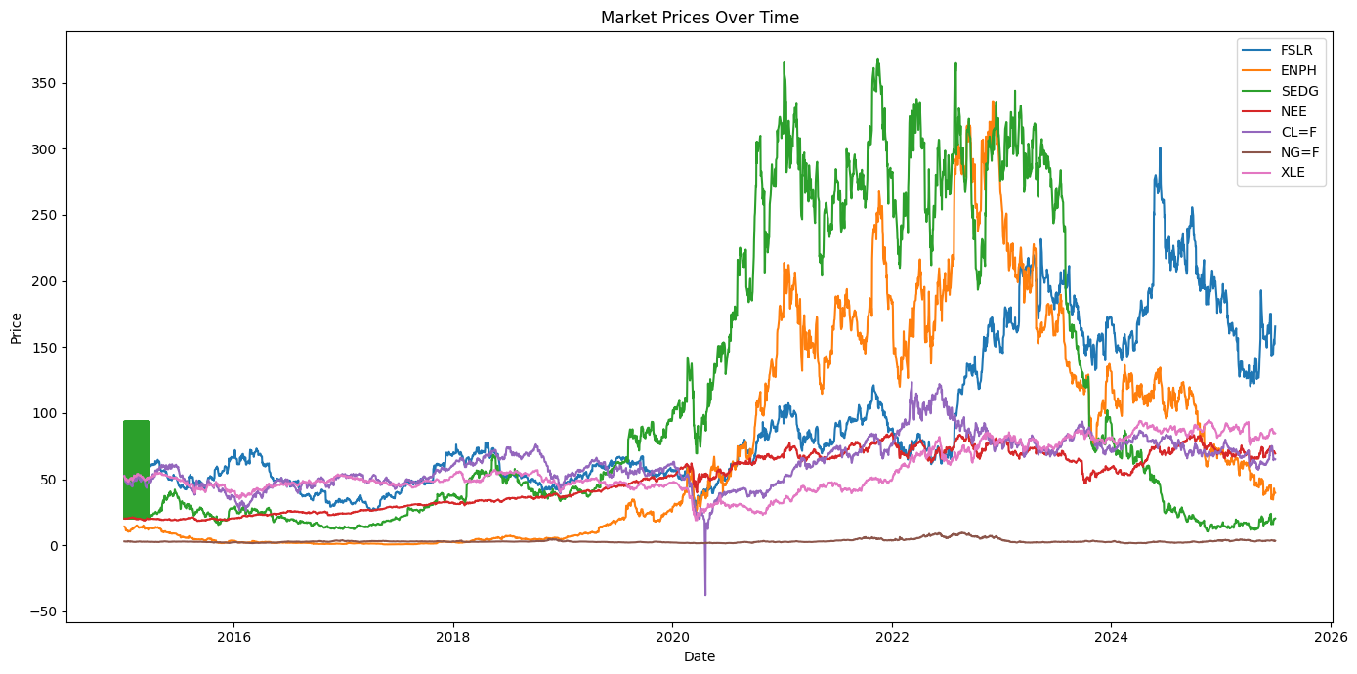
Findings
Line Plot for Market Prices (2015–2025)
Asset 7 (FSLR, ENPH, SEDG, NEE, CL=F, NG=F, XLE) learning over the past 10 years.
FSLR and ENPH exhibit sharp post-2020 growth but are very volatile; SEDG peaked from 2018-2021 and slowed.
NEE steadily increases; CL=F & XLE climb moderately; NG=F stays at the same level.
The period between 2018 and 2022 was the period of maximum growth, post-2022 the trends indicate that the market is going to correct/change structurally.

Slide 7
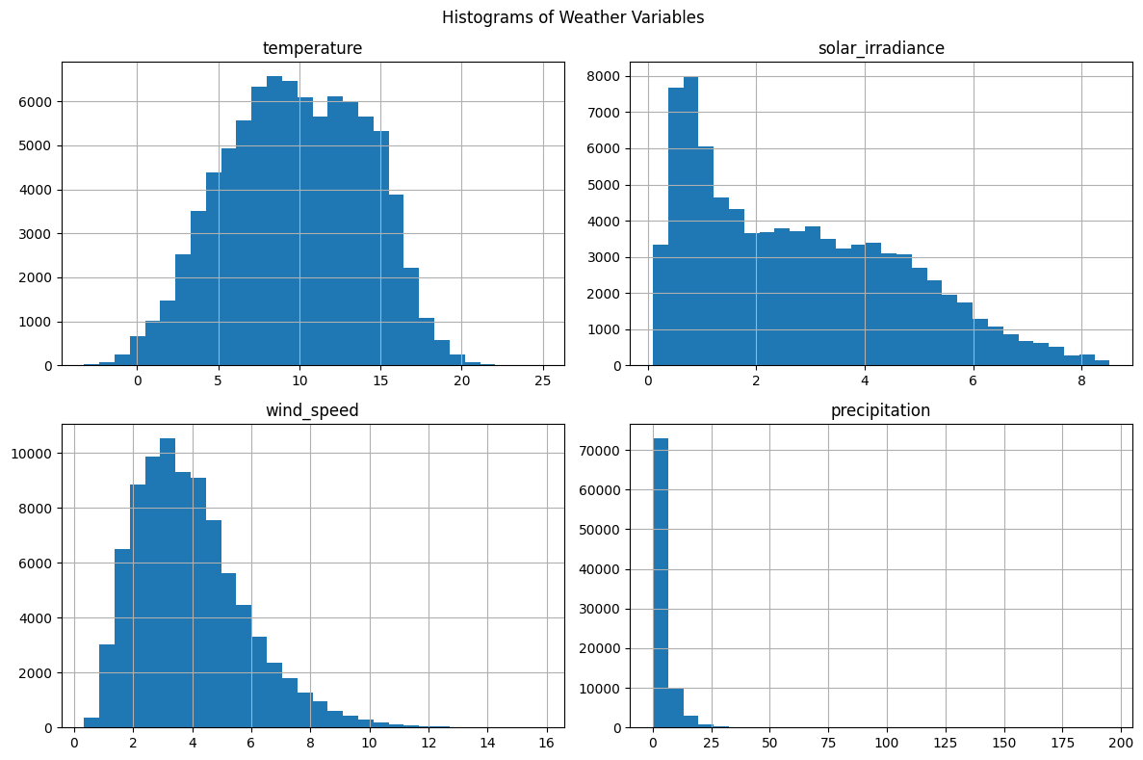
Findings
Histogram of Weather Variables
Temperature: Bell-shaped, averaging 1012 o C room temperature, stable, moderate climate.
Solar Irradiance: Right-tailed with many low values and some peaking, frequent seasonal/geographic variance.
Wind Speed: Right-skewed, and the vast majority is 2-4 m/s; there are some rare strong wind situations that impact the generation potential.
Precipitation: Extremely skewed to the right, mainly drought-free days and frequent heavy rainfall with a few highs and lows that affect the hydropower/water management sector.

Slide 8
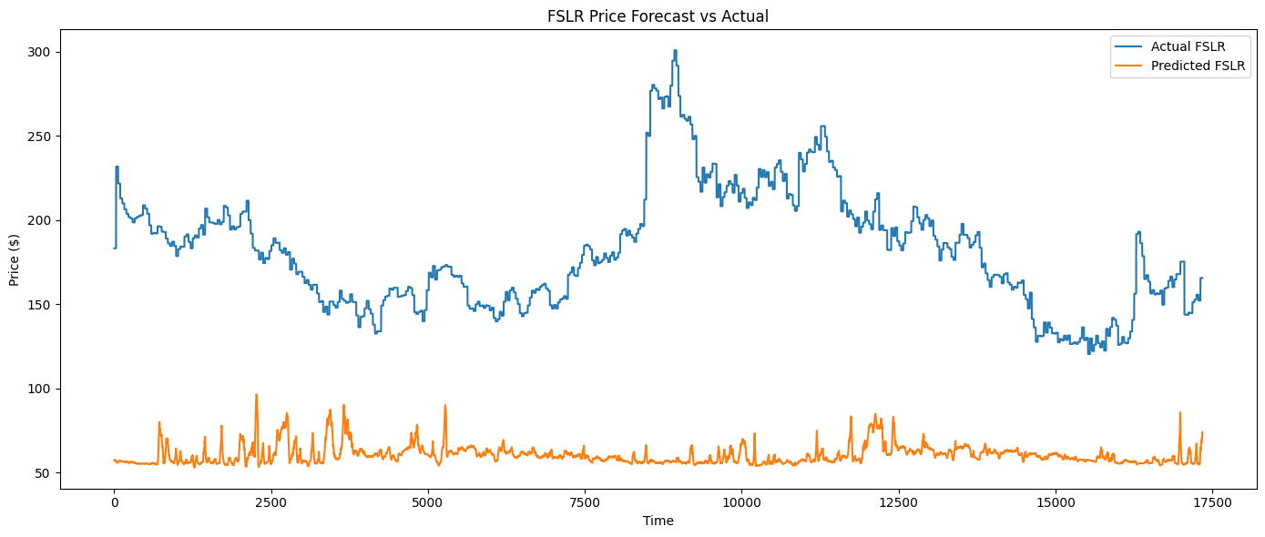
Evaluation
LSTM Model
Purpose: It records the sequential stock price trends that depend on time.
Data Setup: Trained with FSLR prices + weather features (temperature, solar irradiance, wind speed, rainfall); features scaled with MinMaxScaler.
Architecture: 2 LSTM layers (64, 32), overfitting dropout, dense output layer; Adam optimizer & MSE loss.
Performance: RMSE of 126.22 underestimates prices, has problems with fluctuation, as its features are limited and training is not simple.

Slide 9
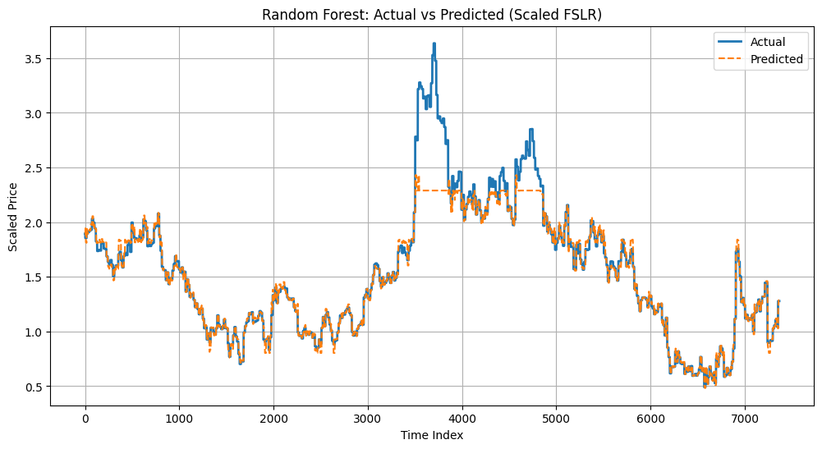
Evaluation
Random Forest Regressor
Strategy: Ensemble of decision trees in non-linear relationships; make use of technical indicators (moving averages, RSI, lags, etc.).
Data Processing: StandardScaler scaling features; no shuffle used on 80/20 train-test split to maintain time-series sequence.
Performance: RMSE = 0.1960 - high match with the real prices; predictions almost coincide with the actual data.
Optimization: Optimization using GridSearchCV (max depth=20, min samples leaf=2, min split=5, 50 estimators) helped to improve generalization and tendencies toward overfitting.

Slide 10
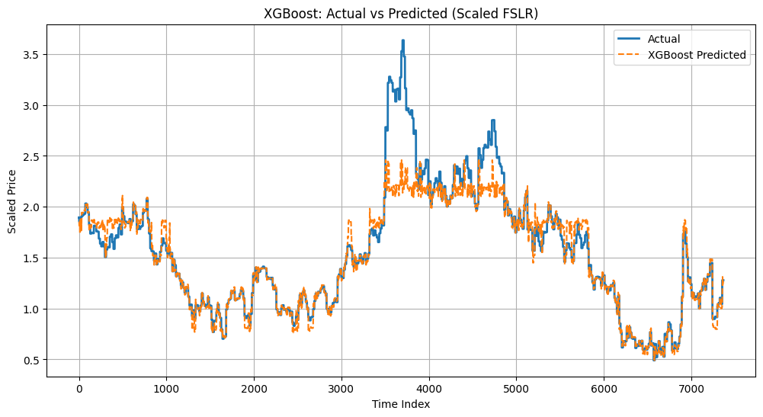
Evaluation
XGBoost Regressor
Method: Gradient boosted trees are constructed sequentially in order to mitigate errors of previous version; efficient with structured data.
Setup: learning rate=0.1, max depth=5, 100 estimators, fixed random state; trained with the same dataset as Random Forest.
Performance: RMSE = 0.223 - a bit greater than Random Forest, but also very accurate.
Insights: Trend predictions are very much near to what is really happening within the market, hence reflecting all the market trends, albeit with slight variations in errors.

Slide 11
Discussion (This learner shall relate findings to the theoretical/ policy discussion in the literature review.
Model Performance: Random Forest and XGBoost performed better than LSTM, and literature on the use of ensembling techniques has indicated that they are commonly more powerful in financial forecasting.
Policy Implications: A high level of accurate predictions eliminates the element of uncertainty in renewable energy investments and aids policymakers and those who invest.
Complexity Vs Practicality Experiments: It indicate that ensemble models that are simpler may prove more practical and transparent than deep learning complex methods.
Risk Management: The validity of the models can reduce the forecasting errors, as most of the theories aim to reduce the uncertainties in a volatile market situation.

Slide 12
Conclusions and recommendations (An overall assessment of findings and suggestions for future research.)
Conclusions
The model that performed best was Random Forest, and it had the lowest RMSE and the most consistent predictions as compared to the LSTM and XGBoost models.
LSTM made poor results with the minimum possible features, and the complexity of capturing such volatile changes in price.
The XGBoost demonstrated similar results as a competition but a bit less precise than Random Forest, and still, a useful model to work with structured data.
The results prove that ensemble approaches are more accurate than deep learning in line with the present context of prediction of renewable energy stocks.
Recommendations
Add feature of wider scope (macroeconomic, policy data) and learn better deep learning model.
Explore a hybrid base model (e.g., LSTM + Random Forest) to jointly use sequential learning + stability of the combination.
Perform longer time series experiments in order to better project the model.
Policy integration study should be considered further, aiming at incorporating the results of the model in renewable investment considerations.

