Slide 1
RESCUE WHEEL
Tripurari Venkata Srikar
Soma Harshith kumar
Satvik Joshi
Sabbani Arun
-Malla Reddy College Of Engineering and Technology

Slide 2
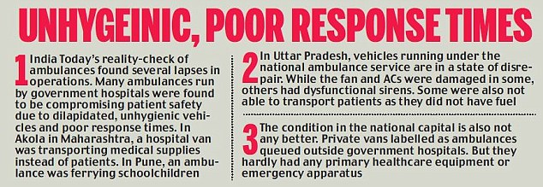
problem statement
In emergency situations such as accidents or sudden medical crises, the immediate transportation of individuals to a healthcare facility can be a matter of life and death. Our project aims to create a comprehensive emergency transportation booking system that can save lives in situations such as accidents or sudden medical crises. We recognize that the current system for booking emergency transportation nearby is often inefficient and unreliable, resulting in delays, inadequate care, and sometimes tragic outcomes. Here are the few challenges faced by the emergency services to reach any medical crisis or accidents
Delays in transportation can worsen a patient’s condition.
Emergency services are not optimally utilized
Safety protocols

Slide 3
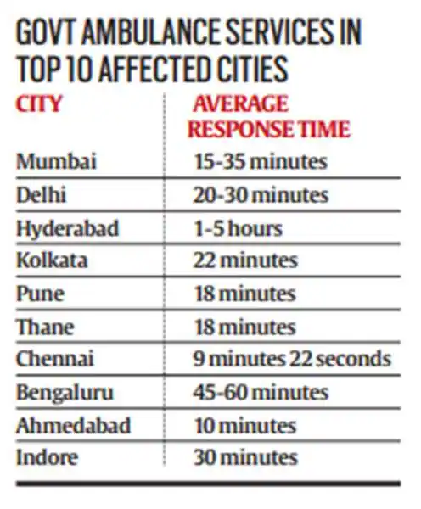
problem statement
Traffic Jams
Reaching remote areas
Here is the news article about Emergency medical services in India click here to visit the article.
To address this critical issue, we propose the development of a comprehensive emergency transportation booking system aimed at rescuing people from accidents or medical emergencies.
We aim to create a detailed solution that significantly improves the efficiency and effectiveness of emergency medical transportation, ultimately saving lives and reducing impact of medical emergencies.

Slide 4

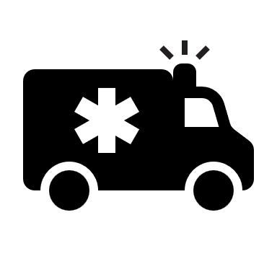
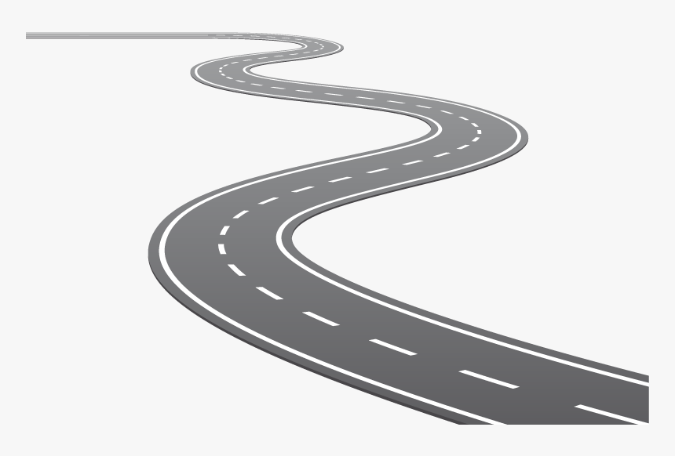



Proposed solution / your big Idea (200 words)
Rescue Wheel :
Rescue wheel who has his own vehicle
Rescue Wheel uses ML algorithms to track nearby vehicle from patients location to provide service.
This application connects the nearby employers to help them to get into hospitals from accidents.
Helpline no:###

Slide 5
Proposed solution (200 words)
Rescue Wheel :
To address this problem, we propose a detailed solution for that will leverage the latest technologies and best practices to ensure that people who need urgent medical attention can be quickly transported to a healthcare facility with all the necessary precautions. Our objective is to create a user- friendly, efficient, and secure emergency transportation booking system. Our proposed service name is Rescue Wheel. Rescue Wheel allows individuals to request emergency transportation with ease.
Rescue Wheel Ensures that all vehicles are equipped with necessary medical supplies and follow strict safety and infection control protocols. we aim to create a comprehensive solution that significantly improves the efficiency and effectiveness of emergency medical transportation, ultimately saving lives and reducing the impact of medical emergencies on individuals and communities.
our emergency transportation system uses Machine Learning (ML) to find the easiest and most efficient path from the patient to the hospital. It uses Real time data analysis which collects and analyzes real time data like traffic congestion, weather conditions etc.
These ML algorithms take account into all the available data and predict the optimal route from the patient’s location to the hospital.

Slide 6
How does your innovation accelerate change with the power of Technology?
(200 words)
Rescue Wheel is a combination of both technology and medical emergency transportation. It uses Smart routing, real-time monitoring and predictive analysis. Users can access Rescue wheel from any smart device or can also use a registered toll free number to provide a service
Rescue Wheel uses Machine Learning and other technologies to improve medical emergency transportation like
Machine Learning models can predict optimal rotes for transportation including traffic data, weather etc.
Machine Learning plays a crucial role in navigation and decision making of vehicle selection and safe transportation.
The deployment of 5G networks enables Rescue wheel to be more reliable on communication between emergency vehicles and healthcare facilities to improve response time.
Rescue Wheel uses Bluetooth technology to initial diagnosis of the patient and provides a report to doctors and nurses before arriving to the hospital
This application connects the nearby employers to help them to get into hospitals from accidents.

Slide 7
Conclusion
We conclude that the Rescue Wheel is vital for saving both time and lives, acting as a central point for accessing medical assistance. Every minute in an emergency situation can determine life or death, making the Rescue Wheel's services crucial. Additionally, it offers support for less urgent medical needs, further emphasizing its importance in promoting public health and well-being. Rescue Wheel excels in emergency situations, it's versatile enough to offer other services that may not be as urgent but are still important for overall well-being.

Slide 8
Thank you

