Slide 1

Option 2: Health Insurance- Capstone Project
Srikar Vedula

Slide 2
Background
90% of the people in the US are insured
66% of employees are covered by Private health insurance

Slide 3
Goals
Provide exploratory data analysis on the dataset
Understand the relationship between Individual rate, Couple rate, and Depenedant rate and see how they are all related. How does the AV relate to the rates?
Apply the Time series model to forecast how the prices will trend

Slide 4


Slide 5
Hypothesis
Predict the sales trajectory/ trend as time passes
Predict the relationship between the Individual Rate and the Couple/Codependancy Rate.
Predict Rate with AV value

Slide 6
Exploratory Data Analysis

Slide 7
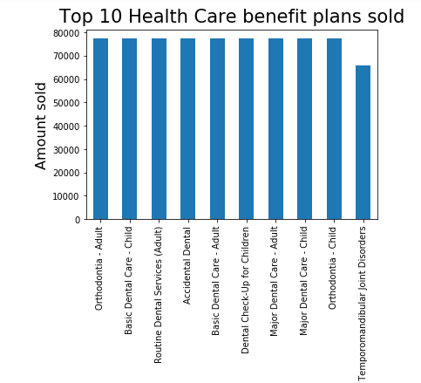

Slide 8
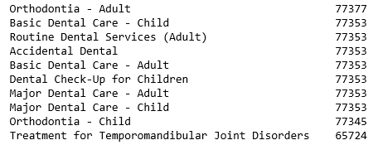
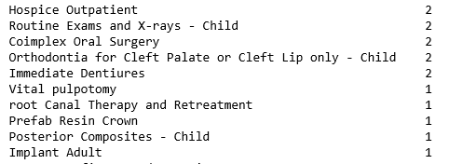
Top 10 Benefit plans
Bottom 10 benefit plans

Slide 9
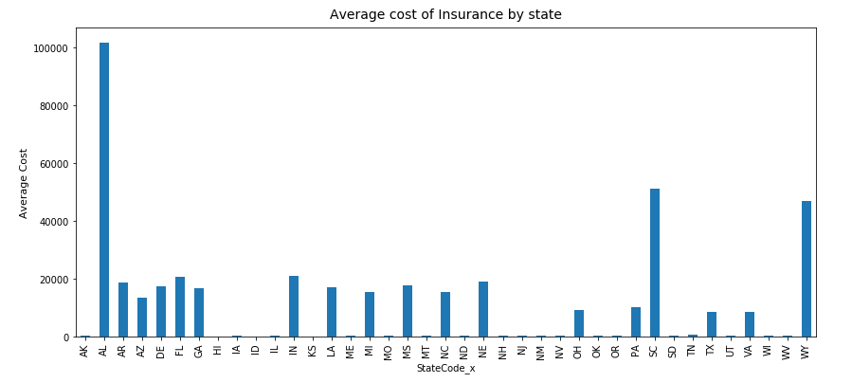
How expensive are insurance plans by state?

Slide 10
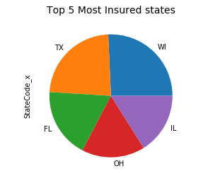
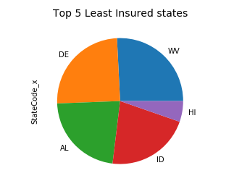
Most/Least Insured States

Slide 11
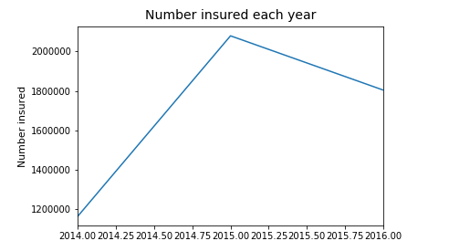

Slide 12


Slide 13
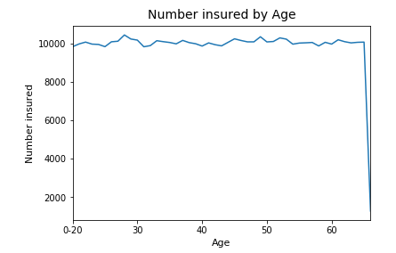

Slide 14
Linear Regression model

Slide 15
Model 1: Relationship between Couple/Dependent vs Individual Rate

Slide 16
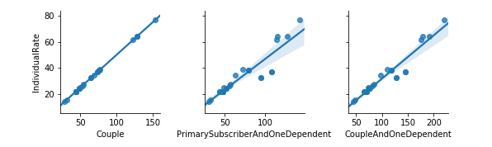

Slide 17
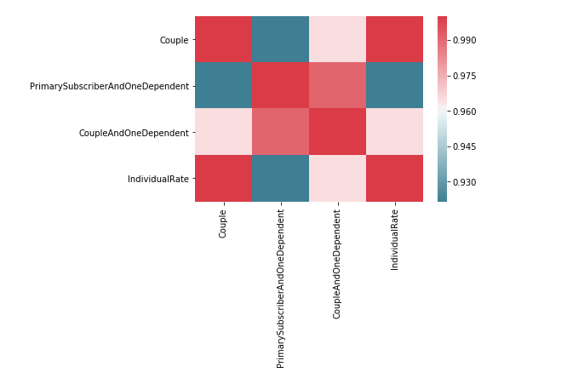

Slide 18
Prediction Results:
RMSE: 13.912514114263885
Accuracy: 99.99999328701217 %

Slide 19
Model 2: Relationship between Individual Rate vs AV
What is AV?
% of costs of the benefit plan that will be covered by health insurance companies
Prediction: Strong positive relationship between AV and Rate

Slide 20
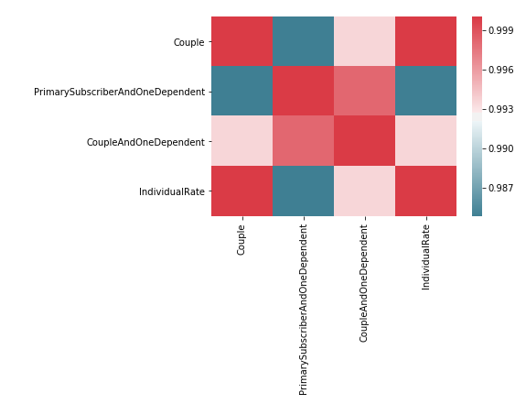

Slide 21
Prediction Results:
RMSE: 19.502271976487712
Accuracy: 99.99999020188253 %

Slide 22
Time Series Model

Slide 23
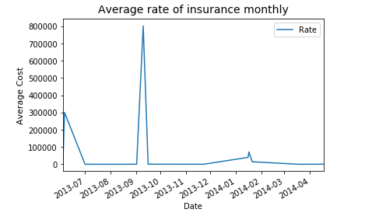

Slide 24
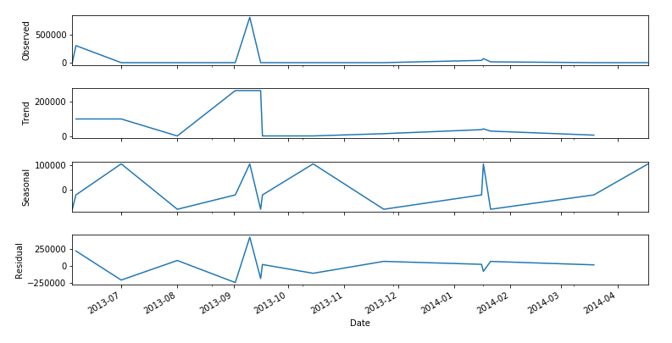
Decomposition

Slide 25
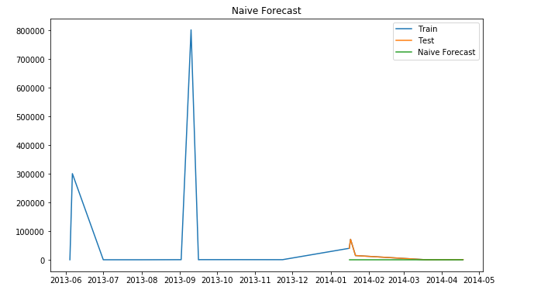
Method 1: Naïve Forecast
RMSE: 36777.23347180845

Slide 26
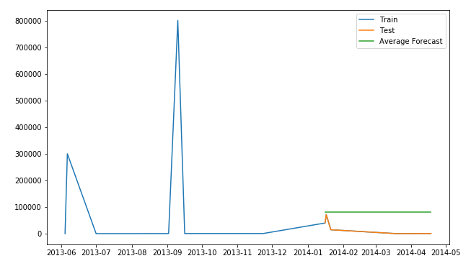
Method 2: Simple Average
RMSE: 62870.083291250514

Slide 27
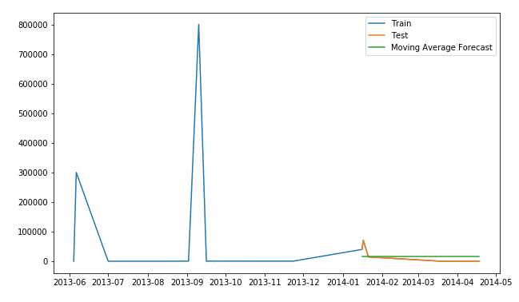
Method 3: Moving Average
RMSE: 28775.95205935369

Slide 28
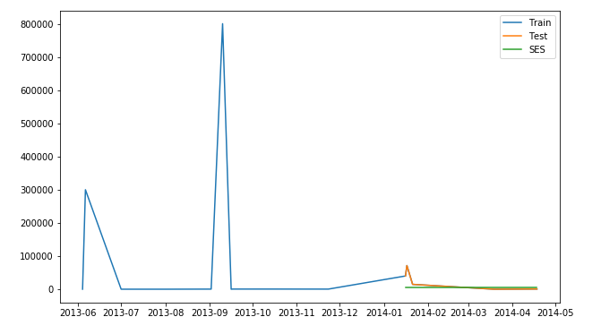
Method 4: Simple Exponential Smoothing
RMSE: 33818.097310680525

Slide 29
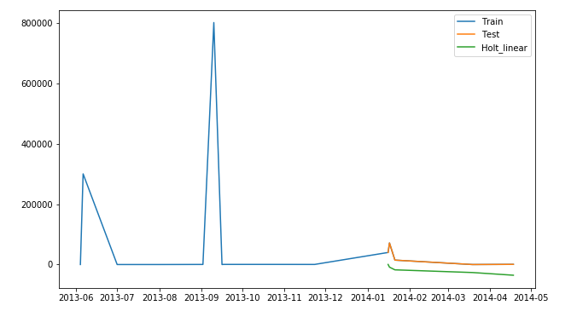
Method 5: Holt’s Linear Trend
RMSE:46941.21779413684

Slide 30
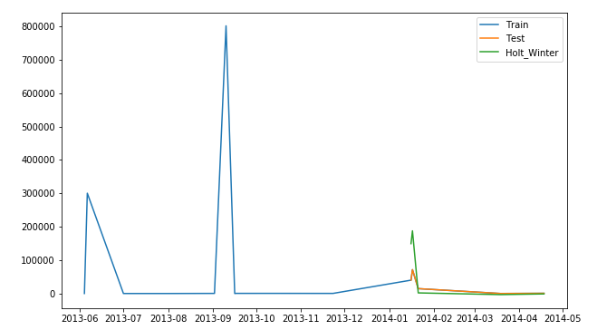
Method 6: Holt-Winters Method
RMSE:71622.94267948088

Slide 31
Conclusion
Dental plan is the most insured in the US
Insurance rates for the dental plans tend to decrease over time
Moving Average Forecast is the ideal time series model that can accurately predict the insurance rate for subsequent months
Strong linear relationship between different types of rates
Higher the insurance rate, higher % coverage is given

Slide 32
Thank you

