Slide 1
NEUROVISIONX
A Deep Neural Framework for Multi-Disease Prediction and Explainable Clinical-Support
Presented by
Santhosshi M - CH.SC.U4CSE23242
Sri Khyathi N - CH.SC.U4CSE23252

Slide 2
PROBLEM STATEMENT
  Medical diagnosis often requires analyzing different types of patient data, including symptoms, clinical parameters, and medical images.
  Traditional diagnostic workflows may require separate tools for different diseases, making assessment less centralized.
  Manual interpretation of MRI scans and chest X-rays can be time-consuming and requires medical expertise.
  Existing prediction systems may lack visual explanations to help users understand model predictions.
  Managing patient diagnostic records and generating reports across multiple prediction modules can be challenging.
  There is a need for an integrated AI-based platform that supports disease prediction, explainable results, patient history management, and automated report generation.

Slide 3
MOTIVATION AND
SCOPE
Motivation:
Scope of Project:
  Symptom-Based Prediction: Predict possible diseases from reported symptoms across 41 disease classes.
  Clinical Data Analysis: Predict heart disease and diabetes using structured health parameters.
  Medical Image Analysis: Classify brain MRI scans and chest X-rays for brain tumor and pneumonia detection.
  Explainable AI: Generate Grad-CAM visualizations to highlight image regions influencing predictions.
  Patient Management: Store and retrieve diagnostic history using an SQLite database.
  Automated Reporting: Generate downloadable PDF reports containing prediction details.
  Unified Interface: Provide access to the different modules through a Streamlit application.
  To leverage deep learning for assisting in the early identification of potential diseases.
  To combine symptom analysis, clinical data prediction, and medical image classification in one platform.
  To reduce manual effort in analyzing medical data and support faster preliminary assessments.
  To improve interpretability using Grad-CAM visualizations for medical image predictions.
  To simplify patient record management and automated medical report generation.

Slide 4
OBJECTIVES
  To develop an integrated AI-based platform for preliminary disease prediction.
  To build a symptom-based disease prediction model covering 41 disease classes.
  To develop neural network models for heart disease and diabetes prediction using clinical data.
  To implement deep learning models for brain tumor classification from MRI scans and pneumonia detection from chest X-rays.
  To improve model interpretability using Grad-CAM visualizations.
  To maintain patient diagnostic history using an SQLite database.
  To automate medical report generation in PDF format.
  To provide a user-friendly, multi-page interface using Streamlit.

Slide 5
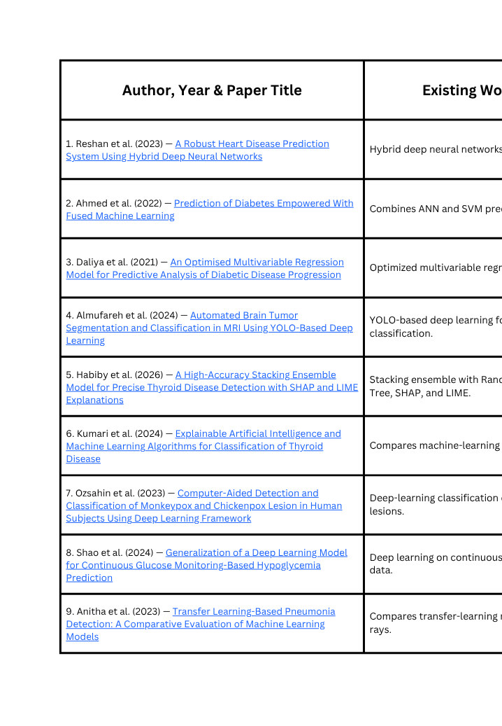
LITERATURE SURVEY

Slide 6
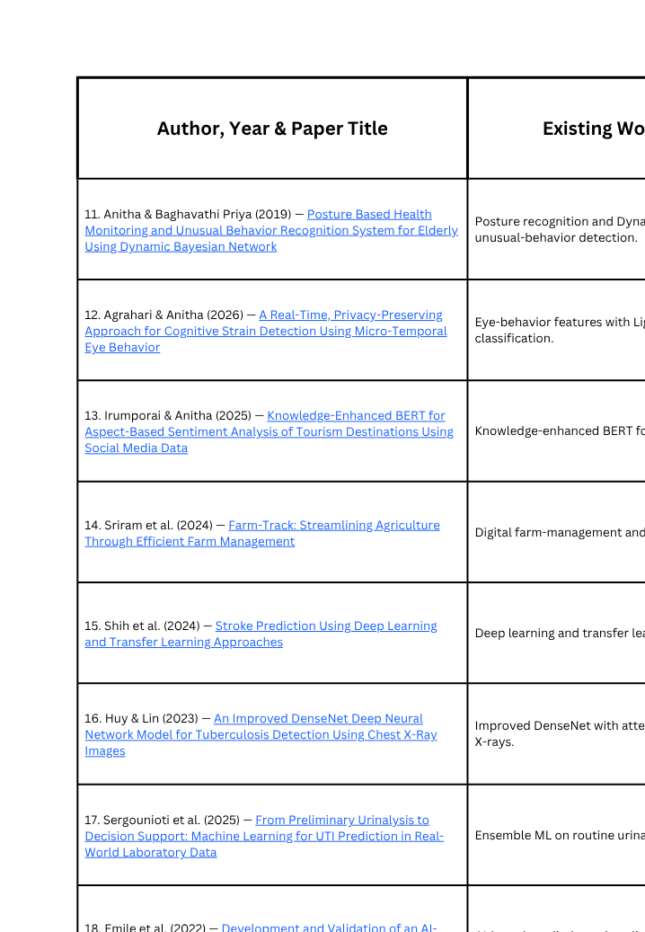

Slide 7
RESEARCH GAP
  Most existing studies focus on individual diseases, such as heart disease, diabetes, pneumonia, brain tumors, or tuberculosis, rather than providing multiple prediction modules in one platform.
  Many approaches use either structured clinical data, patient-reported symptoms, or medical images, with limited integration of these different data types into a unified diagnostic workflow.
  Several models emphasize prediction accuracy but provide limited interpretability, making it difficult for users to understand the factors influencing model outputs.
  Patient diagnostic history and report generation are often handled separately from disease prediction, limiting centralized record management.
  Model performance may vary across datasets and patient populations, highlighting the need for careful evaluation and external validation.
  These gaps motivate the development of NeuroVisionX, a modular AI-based platform integrating symptom-based prediction, clinical-data analysis, medical image classification, Grad-CAM visualization, patient history, and automated PDF reporting.

Slide 8
METHODOLOGY
Dataset Collection
Explainable AI
Collect symptom records, clinical datasets, brain MRI images, and chest X-ray images.
Apply Grad-CAM to highlight important image regions influencing brain tumor and pneumonia predictions
Data Preprocessing
Backend Integration
Clean data, encode categorical features, normalize numerical values, and resize medical images.
Integrate trained models into a common backend to process inputs and return predictions.
Model Development:
Patient History and Reporting
Develop separate neural network models for symptom-based disease prediction, heart disease, diabetes, brain tumor classification, and pneumonia detection.
Use SQLite to manage diagnostic records and generate downloadable PDF reports.
Model Training and Evaluation:
Frontend and System Testing
Train each model independently and evaluate performance using accuracy, precision, recall, and F1-score.
Develop a multi-page Streamlit interface and test prediction modules, database operations, explainability, and report generation.

Slide 9
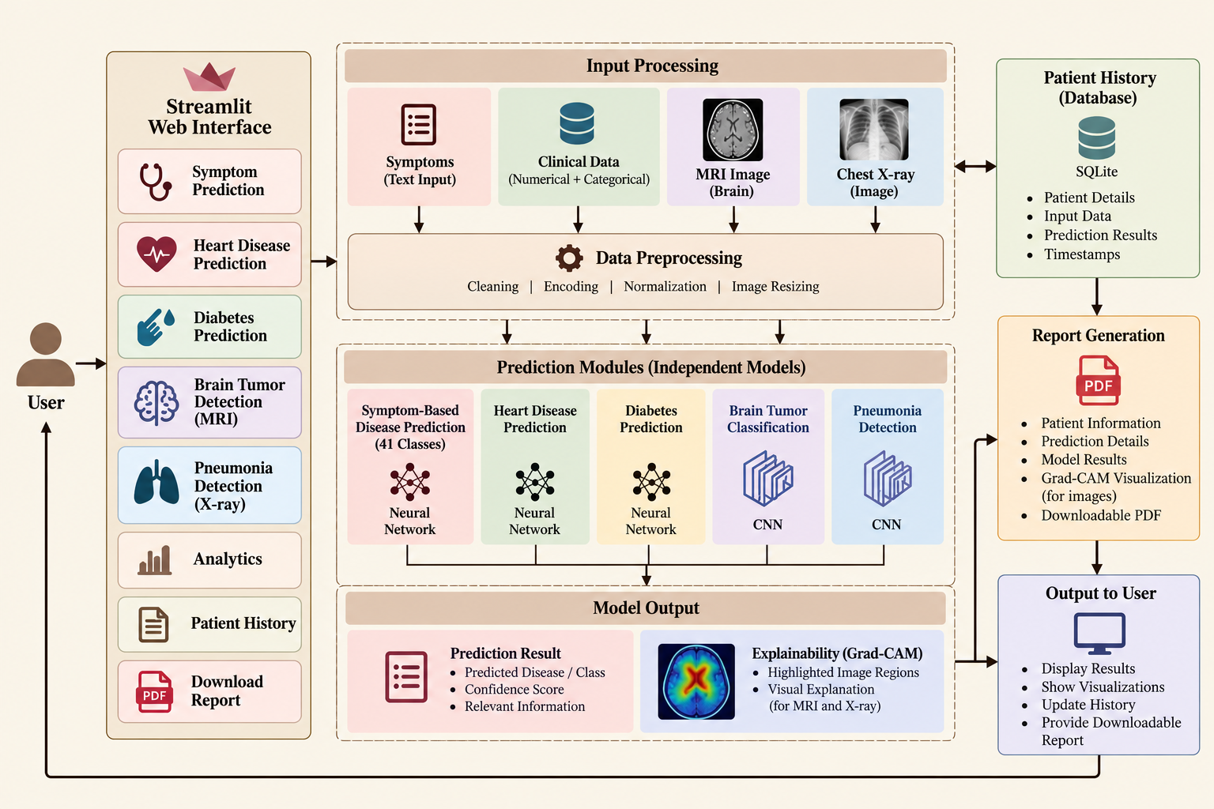
ARCHITECTURE FLOW

Slide 10
TECHNIQUES USED
Symptom-Based Classification
CNN & Transfer Learning
ANN
Heart disease and diabetes prediction using clinical data.
Disease prediction across 41 disease classes.
Brain tumor and pneumonia detection using EfficientNet-B0.
Image Preprocessing
Explainable AI
Model Evaluation & Reporting
Resizing and normalization of medical images.
Grad-CAM for image visualization and SHAP for feature importance in supported modules.
Performance metrics, SQLite patient history, and automated PDF reports.

Slide 11
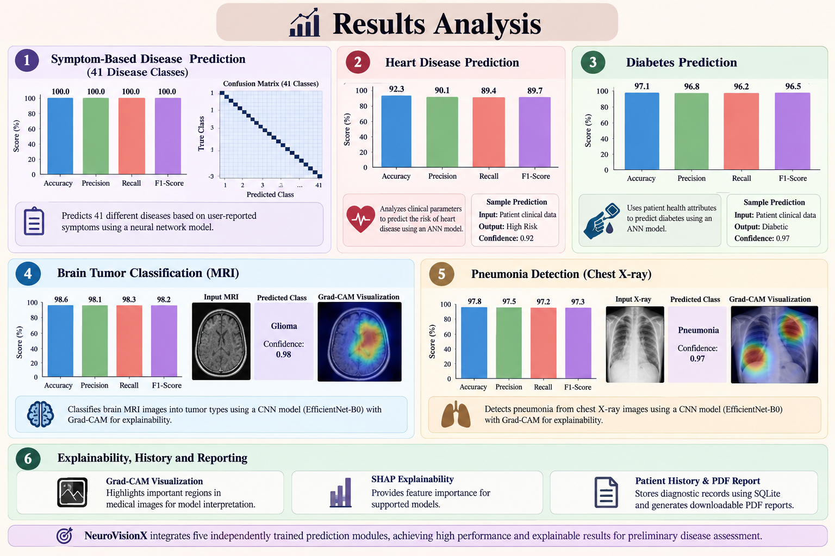
RESULTS & ANALYSIS

Slide 12
THANK YOU

