Slide 1

Project on Water Quality Prediction
Group-3
Group Members:
Amit Kumar Singh
Kommareddy Srinivasa Reddy
Mahadevaswamy L
Nishant Kumar Srivastava
Pratik Shivraj Swami
Mentor Name:
Mr. Ritesh Maury

Slide 2
Problem Statement: To classify water samples as potable or not based on features provided.
Features provided are:
ph
Hardness
Solids
Chloramines
Sulfate
Conductivity
Organic carbon
Trihalomethanes
Turbidity
Potability

Slide 3
Objective:
To implement a water quality prediction using machine learning technique. In this technique, our model is predict that the water is safe to drink (p) or not (not potable) using some parameters like ph value, conductivity, hardness etc..,

Slide 4
Project Work Flow:
Dataset:
Water potability
Data cleaning&
Pre processing
Visualizing
Data set
EDA
Hyper-parameters
Model Accuracy
Model selection &
Deployment
Splitting the data
Train& test
Feature Engineering
Comparing the model Accuracy
Model Building

Slide 5
Importing Libraries in Jupyter Notebook
Mainly used libraries are:
numpy
pandas
matplotlib and seaborn
sklearn
pickle

Slide 6
Importing the Dataset as Data Frame using Pandas:
Data Frame details:
Loading the dataset using Pandas library.
The dataset has 3276 rows and 10 columns.
Missing Values
In the dataset the column ph has 491, Sulfate has 781 and Trihalomethanes has 162 missing values

Slide 7
Exploratory Data Analysis:(EDA)

Slide 8
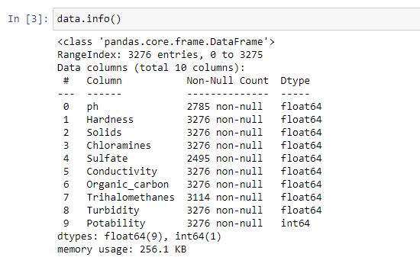
Exploratory Data Analysis:
data.info( ) - dtypes of columns and how many non-null values there are in those columns.

Slide 9

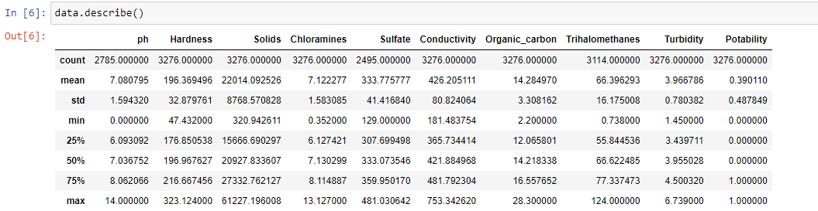
data.shape – gives the number of rows and columns of the dataset.
data.describe( ) – gives the statistical summary of dataset.

Slide 10
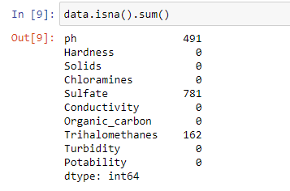
Handling Missing Values:
data.isna( ).sum( ) – gives the sum of the null values of the particular columns in the dataset.
Imputing the missing values with KNNImputer.

Slide 11
Balancing the Dataset
The dataset is imbalanced due to large difference between Potability Classification
To overcome the above oversampling is done to make the dataset balanced one
Method used:
oversample = SMOTE()
X, y = oversample.fit_resample(X,y)

Slide 12
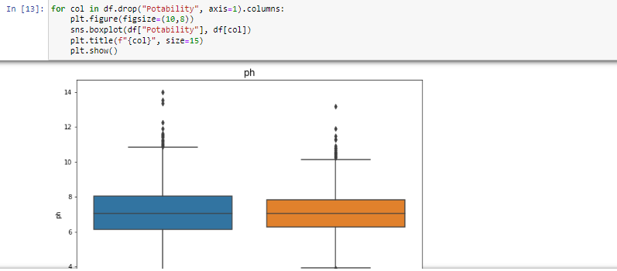
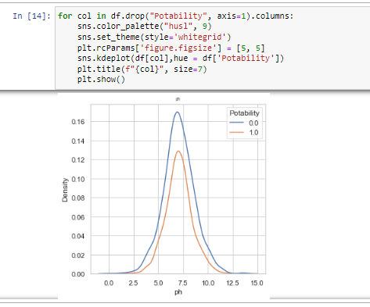
Data Visualization:
Visualizing the data using boxplot.
Visualizing kernel density estimate

Slide 13
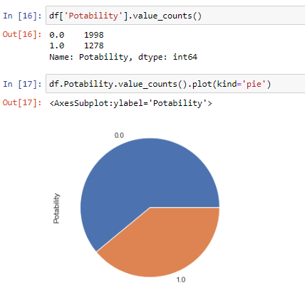
The Potability value counts.

Slide 14
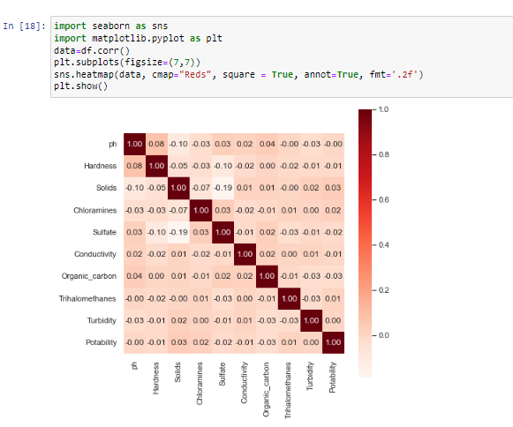
The correlation matrix of the dataset.

Slide 15
Modeling

Slide 16


Splitting The Dataset Into Training And Testing & Standardizing:
Separate the data set columns in to dependent and independent variables.
Split the dataset into train test parts.
The size of the train and test data.

Slide 17
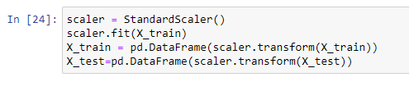
Standardisation of data.

Slide 18
Models with accuracy:
Models | Accuracy(%)
Support Vector Classifier | 75.6
Gradient Boosting Classifier | 71.4
Random Forest | 68.8
NuSVC | 64.6
KNN | 60.2
Decision Tree | 58.5
Gaussian Naive Bayes | 57.6

Slide 19
The finalized model with Hypermeter Tuning
The finalized model Gradient Boosting Classifier with accuracy of about 71.44 %.
Best parameters and accuracy are:
[['GB', {'n_estimators': 500, 'max_features': 'log2', 'max_depth': 9, 'learning_rate': 0.1}, 0.7144756219576631]

Slide 20
Deployment of the model

Slide 21
The deployment of the model is done using the streamlit library.
STEPS involved in Deployment
Install streamlit in Anaconda Navigator cmd editor
Select the best model with tuned hyper parameters and fit it with training data
Save the above file as classifier.pkl using pickle library
Write the python script for test input parameters to be displayed in streamlit environment and save its app.py file in the same directory
All the files namely .csv, app.py, .pkl are stored in the same working directory.
The app is launched using the command:
> streamlit run app.py

Slide 22
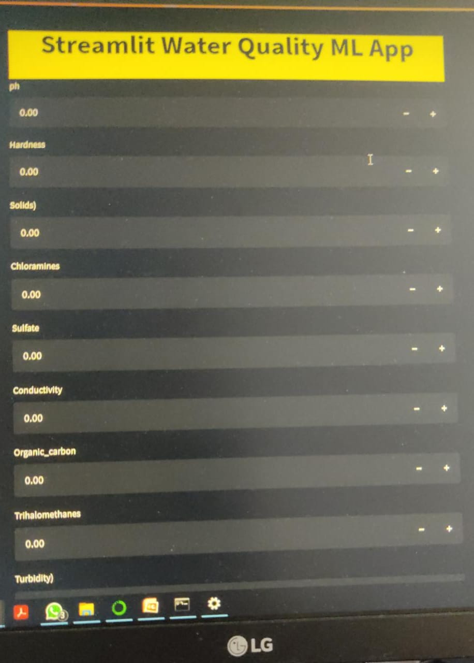
The App Display

Slide 23
Github links
S.No | Name | Github link
1 | Amit Kumar Singh | https://github.com/Amits4902/PROJECT
2 | Kommareddy Srinivasa Reddy | https://github.com/srikommareddy/MyProjects
3 | Mahadevaswamy L | https://github.com/Abhiswamy/Water_Potability
4 | Nishant Kumar Srivastava | https://github.com/NishantSrivastava03/ProjecT
5 | Pratik Shivraj Swami | https://github.com/pratikswami11111/Waterpotability.git

Slide 24
Major Work Division & Execution
S.NO | Name | Task Executed
1 | Amit Kumar Singh | Data Preparation, Modelling
2 | Kommareddy Srinivasa Reddy | Modelling, Deployment
3 | Mahadevaswamy L | Modelling, Hyperparameter tuning
4 | Nishant Kumar Srivastava | EDA, Modelling
5 | Pratik Shivraj Swami | Data Visualisation, Modelling

Slide 25
Thank You

