Slide 1

Risk prediction in Life Insurance Industry using Machine Learning
Mentor : Animesh
P. Bala Gangadhar
M. Sri Krishna
G. Swetha
A. Sree Charan

Slide 2
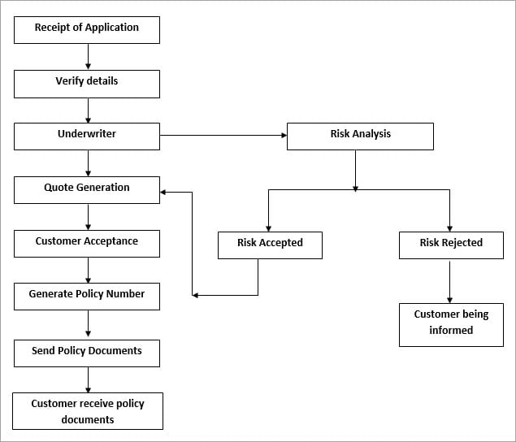
Introduction
In a one-click shopping world with on-demand everything, the Life insurance application
process is antiquated.
Customers provide extensive information to
identify risk classification and eligibility,
including scheduling medical exams, a
process that takes an average of 30 days.
The result? People are turned off.
This Life Insurance company wants to make it quicker and less labor intensive for new
and existing customers to get a quote while maintaining privacy boundaries.

Slide 3
Problem Statement
Develop a prediction model that accurately classify the Risk Level of a Life Insurance application

Slide 4
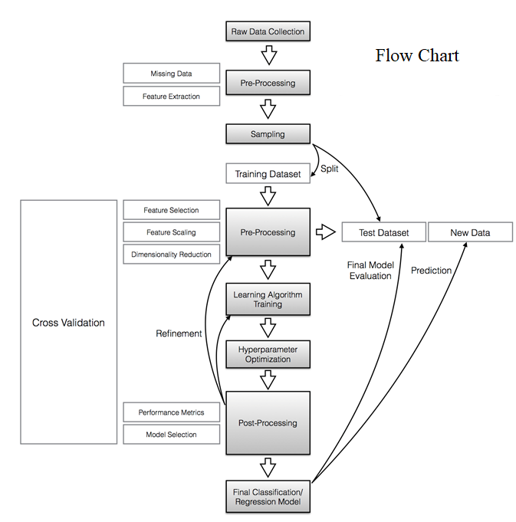
Data Understanding
Size of Data: 59381 x 128
Challenges in the Dataset:
Encoded Data
More than 50% of Missing Value
Imbalanced Data
Solution:
Column Reduction
Missing Value Imputation
Imbalanced Data Treatment:
SMOTE

Slide 5
Data Description
Variable | Data Type | Description
Product_Info_1,2,3,5,6,7 | Categorical Nominal | A set of normalized variables relating to the product applied for
Product_Info_4 | Numerical Continuous
Ins_Age | Numerical Continuous | Normalized age of applicant
Ht | Numerical Continuous | Normalized height of applicant
Wt | Numerical Continuous | Normalized weight of applicant
BMI | Numerical Continuous | Normalized BMI of applicant
Employmnt_Info_1,4,6 | Numerical Continuous | A set of normalized variables relating to the employment history of the applicant.
Employment_Info_2,3,5 | Categorical Nominal
InsuredInfo_1-6 | Categorical Nominal | A set of normalized variables providing information about the applicant.
Insurance_History_1,2,3,4,7,8,9 | Categorical Nominal | A set of normalized variables relating to the insurance history of the applicant.
Insurance_History_5 | Numerical Continuous
Family_Hist_1 | Categorical Nominal | A set of normalized variables relating to the family history of the applicant.
Family_Hist_2,3,4,5 | Numerical Continuous
Medical_History_1,10,15,24,32 | Categorical Nominal | A set of normalized variables relating to the medical history of the applicant.
Medical_History_2-9,11-14,16-23,25-31,33-41 | Numerical Discrete
Medical_Keyword_1-48 | Dummy Variables | A set of dummy variables relating to the presence of/absence of a medical keyword being associated with the application.
Response | Categorical | This is the target variable, an ordinal variable relating to the final decision associated with an application

Slide 6
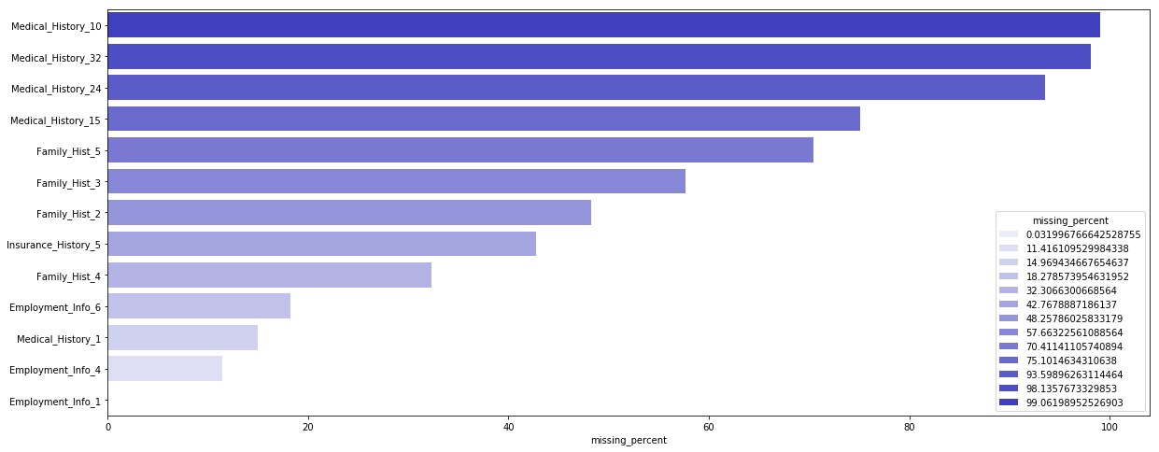
Exploratory Data Analysis
Percentage of Missing Values

Slide 7
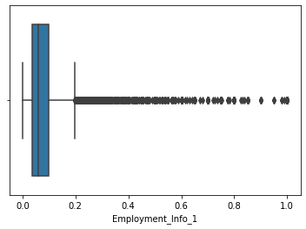
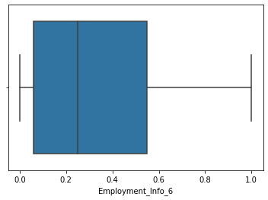
Data Processing
Missing Value Imputation
03
Employment_Info_4
A Numerical Continuous data type. Since it has more number of outliers and deletion of outliers is not permitted, Missing Values are imputed using median
01
02
04
Employment_Info_1
Employment_Info_6
Medical_History_1
A Numerical Continuous data type. Since it has more number of outliers and deletion of outliers is not permitted, Missing Values are imputed using median
A Numerical Continuous data type. Since it is right skewed, Missing Values are imputed using median
A Categorical Nominal data type. Since it has more number of outliers and deletion of outliers is not permitted, Missing Values are imputed using mode.

Slide 8
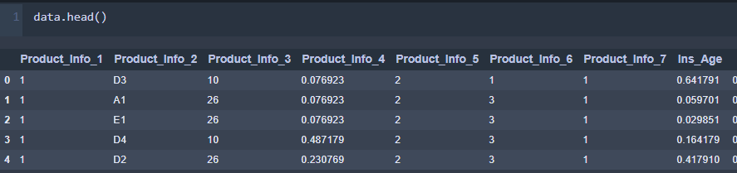
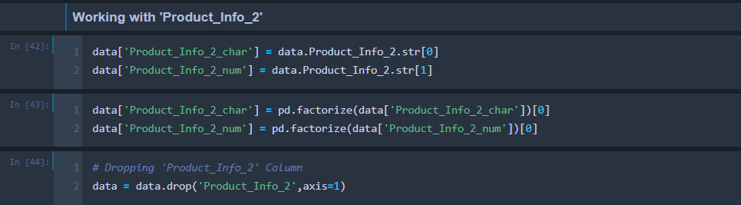
Data Processing
FEATURE ENCODING
From the above table, we can see that there is 'Product_Info_2' Column which is still Categorical, and it has to be
encoded.
Since it is Nominal Categorical Variableit is splited with characters into one
column and numbers into another and
finally each column is encoded.
After encoding is done the original
column 'Product_Info_2' is dropped.
Final Shape of Dataset after cleaning : 59381 x 119

Slide 9
Classification Modelling
01
Logistic Regression
02
k Nearest Neighbors
Logistic model (or logit model) is used to model the probability of a certain class or event existing such as pass/fail, win/lose, alive/dead or healthy/sick. This can be extended to model several classes of event also.
KNN algorithm is one of the simplest classification algorithm and it is one of the most used learning algorithm. KNN is a non-parametric, lazy learning algorithm.
03
Decision Tree Classifier
04
Random Forest
Decision Tree Classifier, repetitively divides the working area into sub part by identifying lines.
A random forest is a data construct applied to machine learning that develops large numbers of random decision trees analyzing sets of variables

Slide 10
Baseline Accuracy
Baseline accuracy defines the minimum performance of the classification model should have based on the data.
Baseline Accuracy = column with max no. of counts / Total no. of counts
= count( Risk Level 8) / count(All Risk levels)
= 19489/59381
= 0.3282
A Classification model will be considered as Good only if it outperforms the Baseline Accuracy.

Slide 11
Accuracy of Base Models
47.8%
30.3%
40.2%
47.6%
Logistic Regression
k NN
Decision Tree Classifier
Random Forest

Slide 12
Accuracy of Models
Hyper parameters Turning
 | k NN
 | p = 1 n_neighbors = 39
37.08%
30.3% without parameter turning
 | Decision Tree
 | min_samples_leaf: 5, max_leaf_nodes : 7, 'max_depth’: 4, 'criterion':‘entropy'
46.65%
40.2% without parameter turning
 | Random Forest
 | 'n_estimators': 88, 'max_features': 9, 'criterion': 'gini'.
52.62%
47.6% without parameter turning

Slide 13
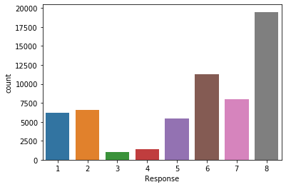
Techniques to handle Imbalance Data
Sampling with SMOTE(Synthetic Minority Over-Sampling TEchnique)
Target Variable Data Distribution
Each Response represents the Risk level of the applicant.
Response 1 represents the Risk level to be HIGH where as Response 8 represents Risk level to be LOW.
From the Figure, it is found that the data is imbalanced with Risk Level 8 dominating over the others, this may misclassify and result in wrong prediction. Hence a technique called SMOTE is implemented to handle imbalanced data.

Slide 14
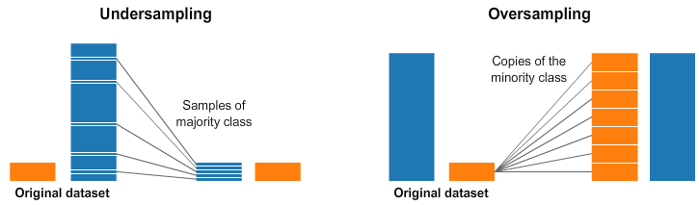
Sampling Techniques

Slide 15
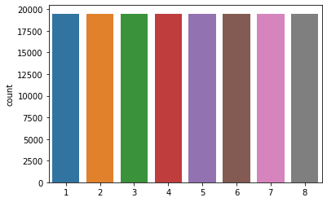
Graphical Representation of Target Variable
Imbalanced Data to Balanced Data using SMOTE
Imbalanced Data
Balanced Data
Size of Imbalanced Data:
59381 X 118
Size of Balanced Data:
155912 X 118
Proportionately distributed

Slide 16
Accuracy of Base Models with SMOTE
44.4%
67.8%
53.3%
65%
Logistic Regression
k NN
Decision Tree Classifier
Random Forest

Slide 17
Accuracy of Models with SMOTE
Hyper parameters Turning
 | k NN
 | 'p': 35, 'n_neighbors': 4
68.75%
67.8% without parameter turning
 | Decision Tree
 | min_samples_leaf: 6, 'max_leaf_nodes': 7, 'max_depth': 3, 'criterion': 'gini'
55.85%
53.3% without parameter turning
 | Random Forest
 | 'n_estimators': 98, 'max_features': 4, 'criterion': 'gini'
72.97%
65% without parameter turning

Slide 18
Evaluation Metrics
Models | Accuracy | Precision | Recall | F1 Score
Logistic Regression | 48% | 45% | 48% | 44%
k NN | 30% | 27% | 30% | 28%
Decision Tree | 40% | 40% | 40% | 40%
Random Forest | 47% | 44% | 47% | 48%
Logistic Regression (SMOTE) | 49% | 46% | 47% | 46%
k NN (SMOTE) | 73% | 72% | 73% | 71%
Decision Tree (SMOTE) | 55% | 54% | 56% | 55%
Random Forest (SMOTE) | 75% | 75% | 75% | 74%

Slide 19
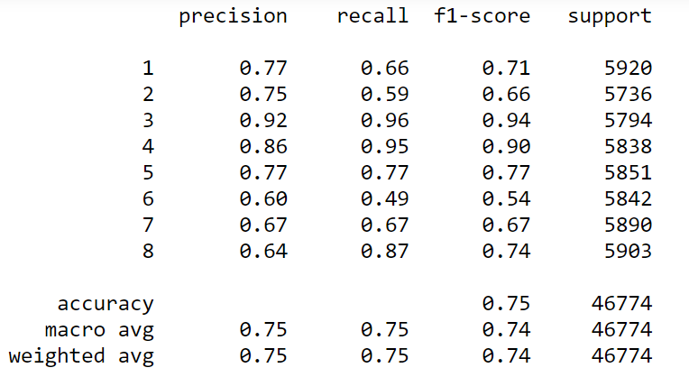
Conclusion
Out of all the models, Random Forest with Balanced data using SMOTE Technique has Outperformed all the models with
Test Accuracy : 75%
Precision, recall, f1-score for all the 8 Classes are Displayed Below
This is the Random Forest Model with balanced Data build with Hyper parameters n_estimators=96,max_features=4,criterion='gini', which has improved Precision and recall scores.

Slide 20
Thank you

