Slide 1
THEORY OF COMPUTATION

Slide 2
UNIT III: GRAMMARS AND PUSH DOWN AUTOMATA
Context-free Grammars
Derivations ( Leftmost and Rightmost)
Parse Trees
Ambiguity
Normal Forms (CNF & GNF)
Pushdown Automata
Pumping Lemma for CFL
Closure Properties of Context-free Languages

Slide 3
Context-free Grammars
A context-free grammar (CFG) is a 4-tuple (V, T, P, S) where
V is a finite set of variables or non-terminals
T is a finite set of terminals (V ∩T = ∅)
P is a set of productions or substitution rules of the form where A is a symbol in V and α is a string over V ∪ T.
S is a variable in V called the start variable.

Slide 4
Shorthand notation for productions
When we have multiple productions with the same variable on the left like
E → E + E
E → E * E
E → (E)
E → N
N → 0N
N → 1N
N → 0
N → 1
Variables: E, N
Terminals: +, *, (, ), 0, 1
Start variable: E
we can write this in shorthand as
E → E + E | E * E | (E) | 0 | 1
N → 0N | 1N | 0 | 1

Slide 5
Example 1:
Construct the CFG for the following L= {0^{n}/n≥1}.
Solution:
The CFG is
S → 0A | 0
A → 0A | ε
Example 2:
Construct the CFG for the language L= {0^{n} 1^{n} | n=1}.
Solution:
S → 0B1 | 01
B →ε

Slide 6
Example 3:
Consider the alphabet ∑= {a, b, (, ), +, *,., ε}. Construct a context free grammar that generates all strings in ∑* that are regular expressions over the alphabet {a, b}.
Solution:
S → S + S
S → S. S
S → S *
S → (S)
S → a | b | ε

Slide 7
Example 4:
Find the language generated by the grammar S →aSb, S → ab.
Solution:
S → aSb
→ aaSbb
.
.
.
→ a^{n}Sb^{n}
→ a^{n}b^{n}
L (G) = {ab, aabb, aaabbb…….}
Therefore,
L (G) = { a^{n}b^{n}/ n ≥1}

Slide 8
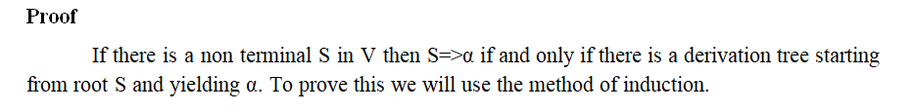
Relationship between derivation (Leftmost and Rightmost) and derivation trees Theorem Let G = (V, T, P, S) be a context free grammar. Then S=>α if and only if there is a derivation tree in grammar G which gives the string α.

Slide 9
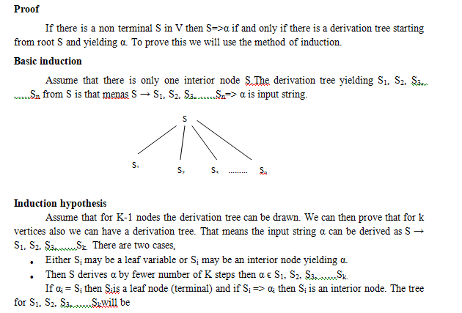

Slide 10
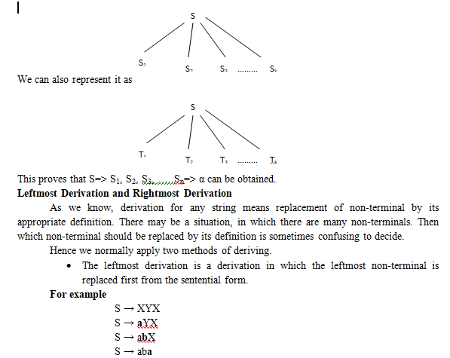

Slide 11
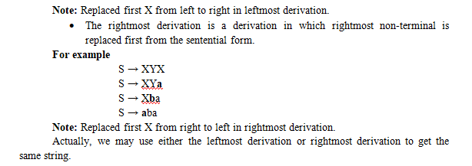

Slide 12
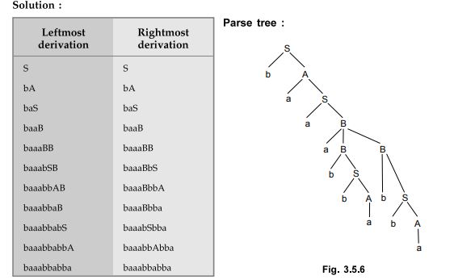
Example – 1
Let G be the grammar S →aB | bA
A → a | aS | bAA
B → b |bS | aBB
for the string baaabbabba. Find left most derivation, right most derivation
and parse tree.

Slide 13
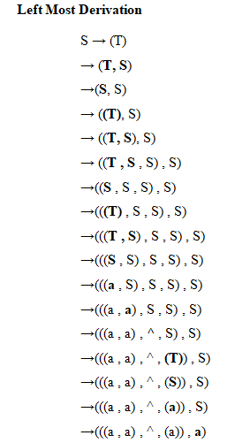
Example – 2
Consider the following grammar for list structures, S → a | ^ | (T)
T →T , S | S
Find the leftmost derivation and rightmost derivation for (((a , a) , ^, (a)) , a).

Slide 14
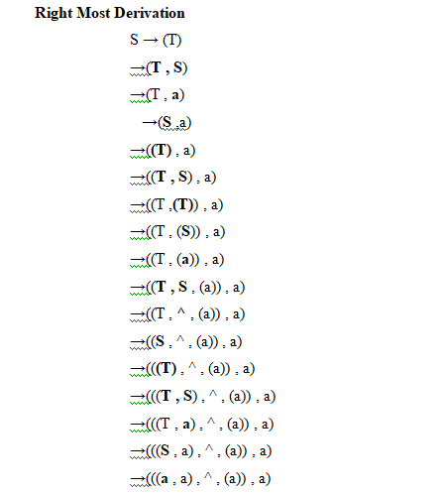

Slide 15
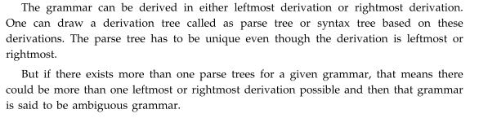
Ambiguity

Slide 16
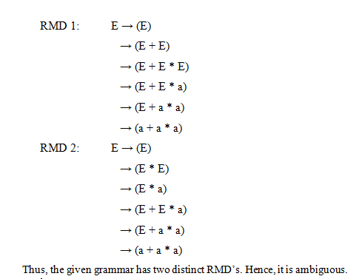
Example – 1
Show that the grammar E →E + E | E *E | (E) | a is ambiguous.

Slide 17
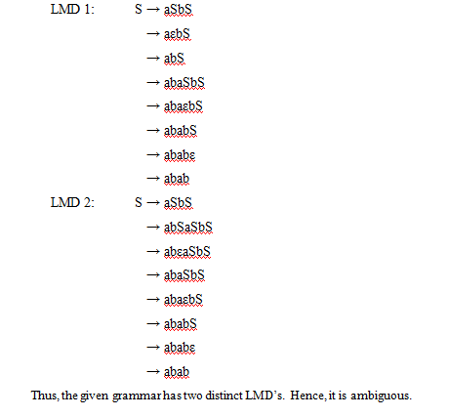
Example – 2
Show that the following grammar is ambiguous.
S →aSbS | bSaS | ε

Slide 18
Normal Forms
Chomsky Normal Form
The grammar is said to be in Chomsky normal form, if all the productions in G are in the following formats,
Non-terminal → Non-terminal. Non-terminal (A → BC)
Non-terminal → terminal (A → a)
Before converting the given grammar into CNF, check whether the given grammar is in reduced form which means remove all useless symbols, unit productions and null productions. Then this reduced grammar can be changed to CNF.

Slide 19
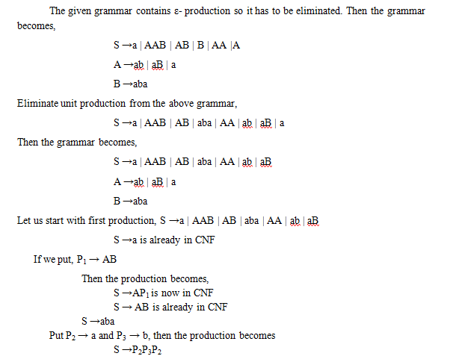
Example – 1
Reduce the following grammar S →a | AAB
A →ab | aB | ε
B →aba | ε
to Chomsky normal form.

Slide 20
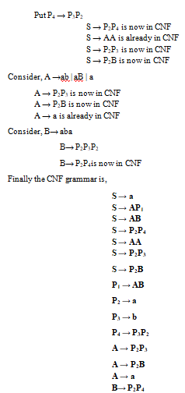

Slide 21
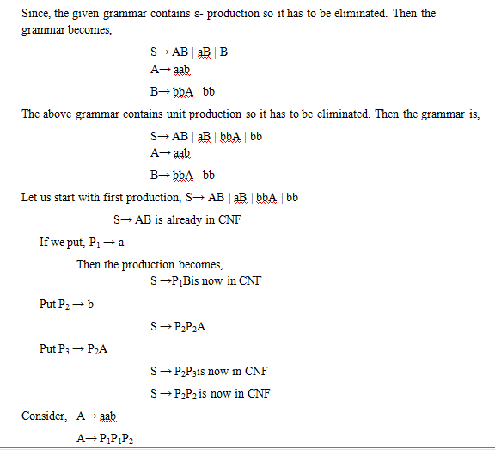
Example – 2
Convert the grammar into CNF.
S→ AB | aB
A→ aab | ε
B→ bbA

Slide 22
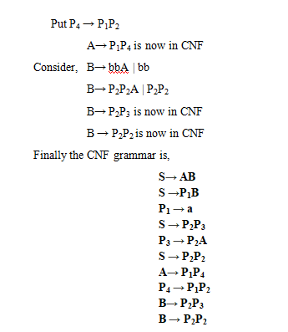

Slide 23
Normal Forms
Greiback Normal Form (GNF)
The grammar is in GNF, if the production is of the form A→ aα where A is the variable, a is the terminal and α is the collection of non-terminals.
The production rule for GNF is
Non-terminal → One terminal . Any number of non-terminals
For example:
S → aABD is in GNF
A → a is in GNF
B → BbB is not in GNF

Slide 24
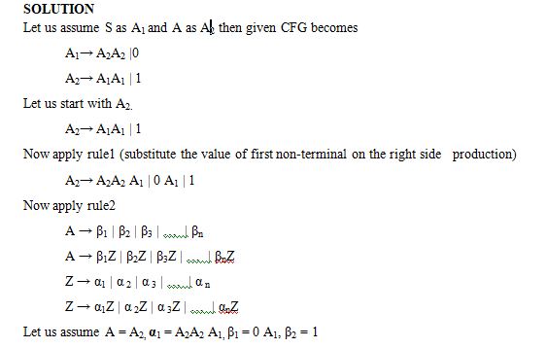
Example – 1
Find the GNF equivalent of the grammar
S→AA |0, A→SS | 1

Slide 25
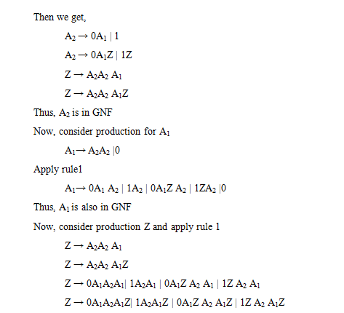
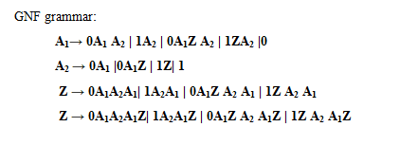

Slide 26
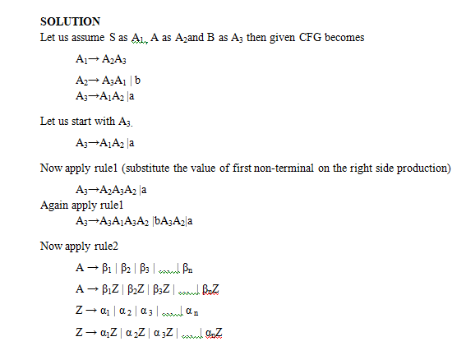
Example – 2
Convert the following grammar into Greiback normal form.
S→ AB
A→ BS | b
B→SA |a

Slide 27
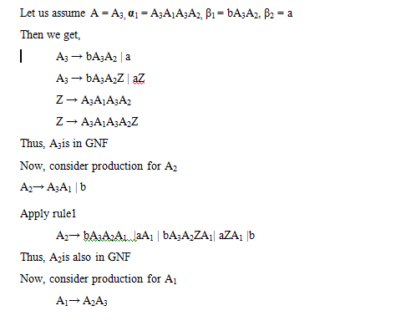

Slide 28
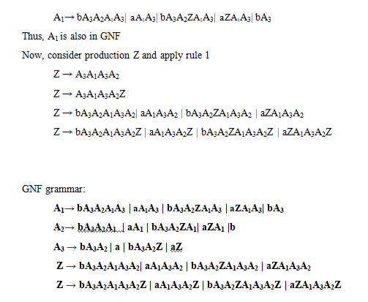

Slide 29
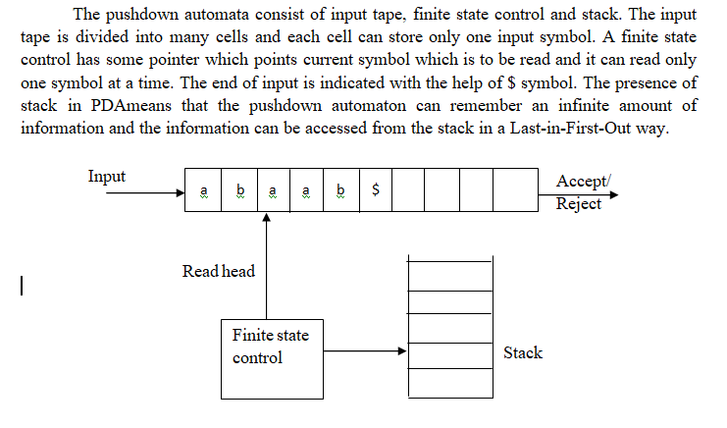
Pushdown automata (Block diagram)

Slide 30
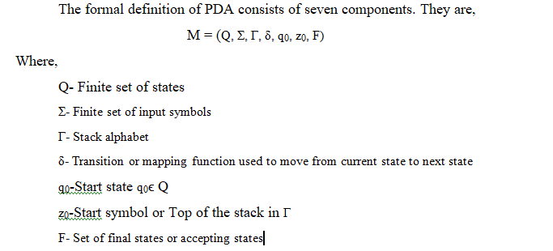
Formal definition of pda

Slide 31
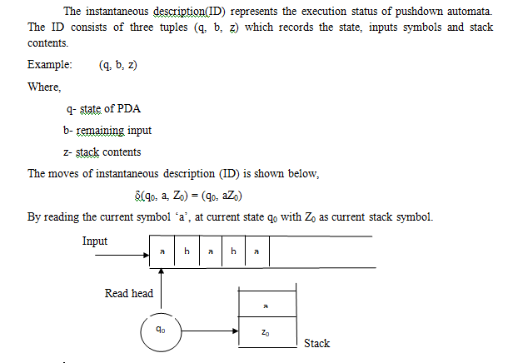
Instantaneous Descriptions of PDA

Slide 32
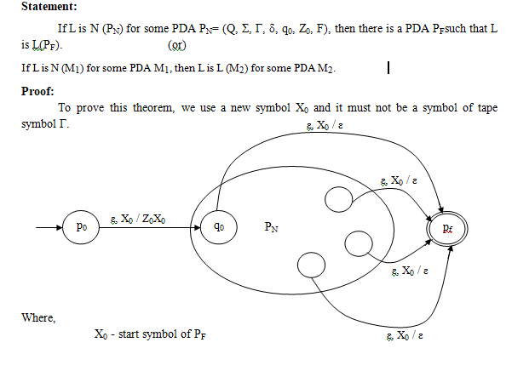
Theorem: Language acceptance from empty stack to final state

Slide 33
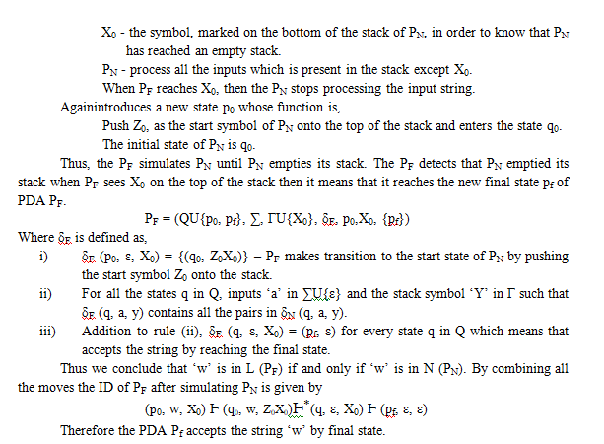

Slide 34
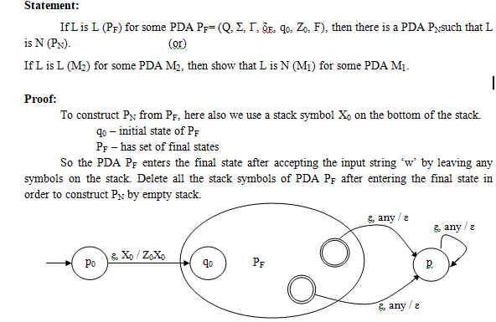
Theorem: Language acceptance from final state to empty stack

Slide 35
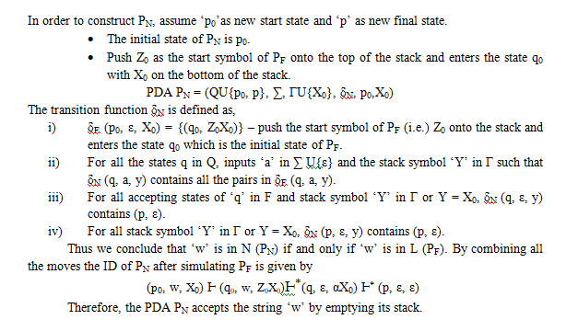

Slide 36
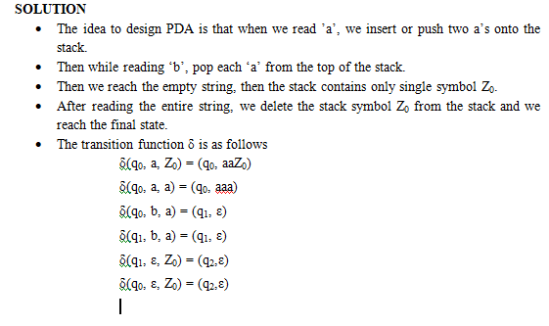
Example – 1
Construct a PDA for the language L = {a^{n}b^{2n}|n ≥ 0}

Slide 37
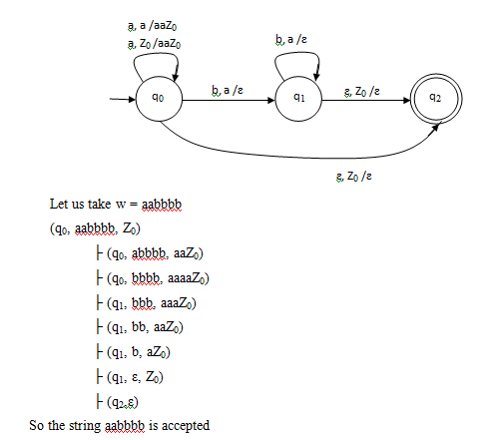

Slide 38
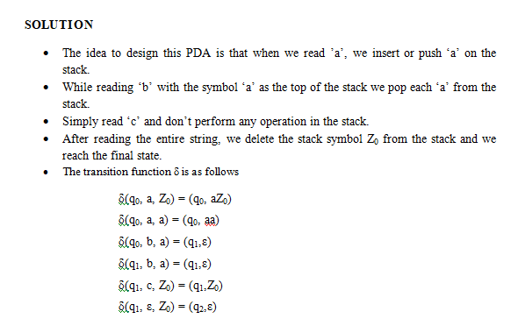
Example – 2
Construct a PDA accepting by empty stack for the language L ={a^{m}b^{m}c^{n} |m,n≥l}.

Slide 39
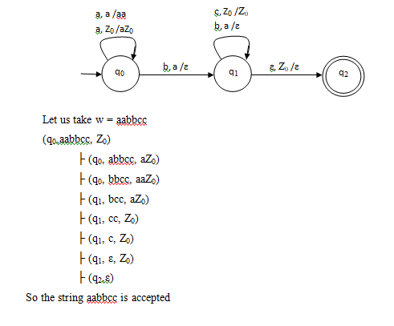

Slide 40
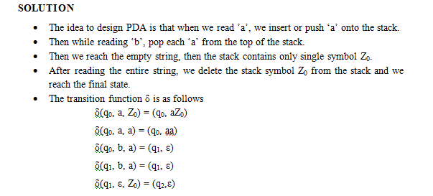
Example – 3
Construct a Pushdown automata to accept the language L = {a^{n}b^{n} | n ≥ 1}
by empty stack and by final state.

Slide 41
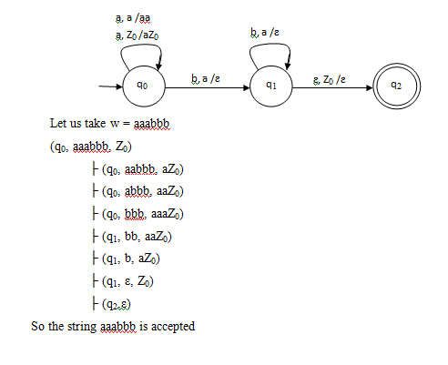

Slide 42
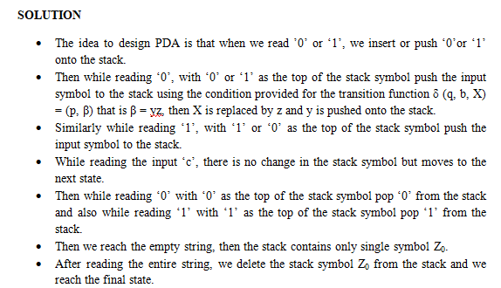
Example – 4
Construct the PDA for the Language L= {wcw^{R} |wis in (0+1)*} by empty stack.

Slide 43
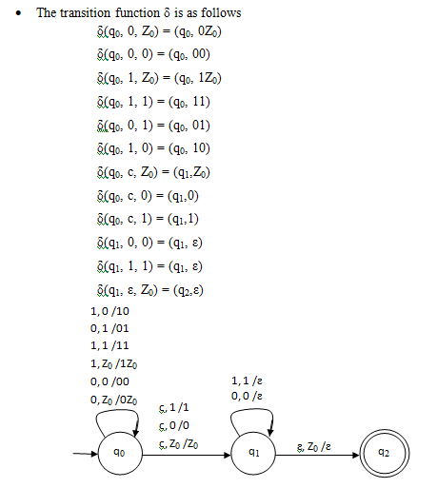

Slide 44
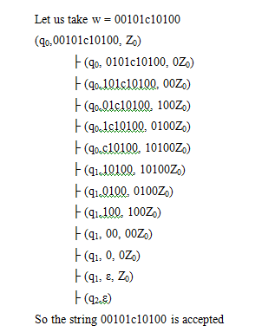

Slide 45
PUMPING LEMMA FOR CFL

Slide 46
Pumping lemma for CFL
Pumping lemma is used to prove that the given language is not context free. The pumping lemma for CFL is the same as that of pumping lemma for regular language.
The difference is in pumping lemma for CFL, breaking the strings Z = pqrst as five parts whereas in regular language, break the string as three parts Z = uvw.
Methods for proving the given language is not context free
Assume a given language ‘L’ as context free language.
Choose sufficiently a long string z from given language L.
Then the length of the string |Z| ≥ n.
Break the string as Z=pqrst and satisfy the two Conditions.Theyare,
|qrs| ≤ n
|qs| ≥1 or qs ≠ ε
Find a suitable value for i, so that pq^{i}rs^{i}tis not in ‘L’.
Hence, proved that the given language is not context free.

Slide 47
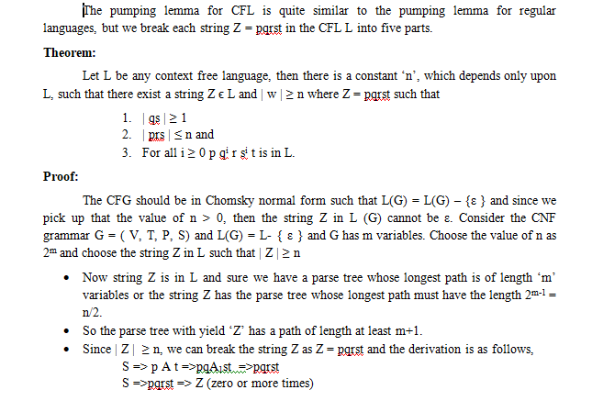
Theorem: Pumping Lemma for CFL

Slide 48
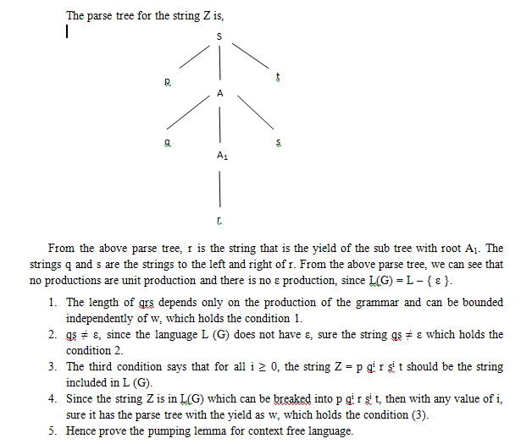

Slide 49
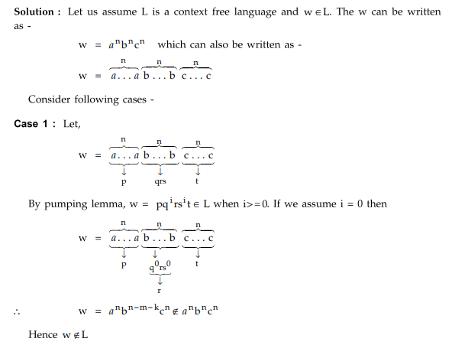
Example -1:

