Slide 1
THEORY OF COMPUTATION

Slide 2
UNIT IV: Turing machine
Definition of Turing Machine
Church-Turing Thesis
Programming Techniques for Turing Machine Construction
Modifications of the Basic Turing Machine Model
Multi Tape
Multihead
Non-deterministic Turing Machines
Chomskian hierarchy of languages
Problems in Turing Machine

Slide 3
Turing machine
Turing machine can solve any problem that a modern computer can solve.The Turing machine can be formally defined as follows,
M= (Q, ∑, Γ, δ, q₀, ∆ or B, F)
Q- Finite set of states
∑- Finite set of input alphabets
Γ- Set of all tape symbols or External symbols
δ - Transition function
q₀-Starting state
∆- Blank symbol or End marker
F- Set of final or accepting states

Slide 4
Church-Turing Thesis
Any mechanical computation can be performed by a Turing Machine
There is a TM-n corresponding to every computable problem
We can model any mechanical computer with a TM
The set of languages that can be decided by a TM is identical to the set of languages that can be decided by any mechanical computing machine
If there is no TM that decides problem P, there is no algorithm that solves problem P.
All of these statements are implied by the Church-Turing thesis

Slide 5
Programming Techniques for Turing Machine Construction
These are the four different techniques used to construct an efficient Turing machine which functions as powerful as conventional computer.
Storage in the state
Multiple tracks
Subroutines
Checking of symbols

Slide 6
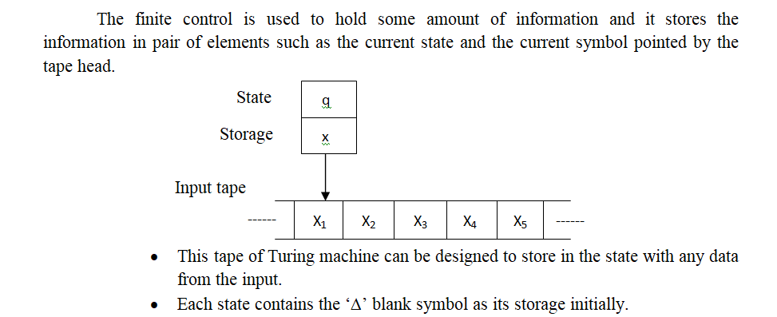
Storage in the state or finite control

Slide 7
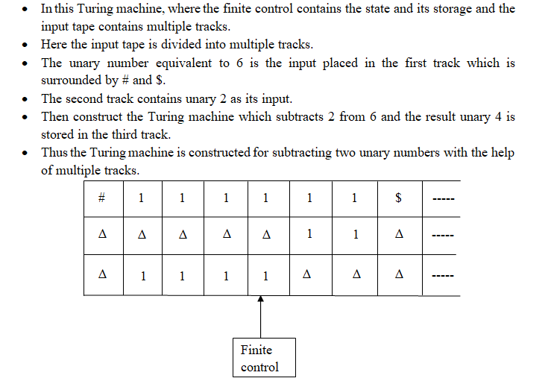
Multiple tracks

Slide 8
Subroutines
Some tasks need to be performed repeatedly which can be done using subroutines.
The subroutines are also called as function.
The set of states in the subroutine has one start state and another state namely the return state.
The subroutines of the Turing machine perform some task simultaneously.

Slide 9
Checking of symbols
The checking of symbols is an effective way of recognizing the language by Turing machine. The Turing machine can be extended by using checking off symbols.
The input symbol is placed in the input tape and the tape head is moved either left or right.
The symbol which is read is marked by special character.
This method is used by the Turing machine for the languages that contains the repeated strings and to compare the length of the two strings.

Slide 10
Modifications of the Basic Turing Machine Model

Slide 11
Multi Tape
The Multi-tape Turing machine has a finite control state and finite number of tapes. Each tape in the multi-tape Turing machine is divided into cells and each cell can hold any symbol.
The finite sequence of input symbols is placed on the input tape.
All other cells of all the tapes hold blank symbols.
The finite control is in the initial state and the control head of the first tape is at the left end of the input.

Slide 12
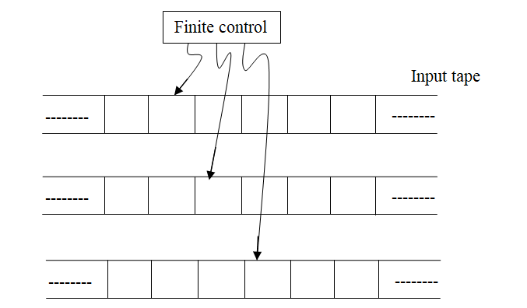
Multi Tape
The moves of Multi-tape Turing machine depend on the following factors.
State of the finite control
Symbol scanned by each tape head

Slide 13
Multi Head
A Multi-head Turing machine is a single tape TM having N heads reading symbols on the same tape.
In one steps all the heads sense the scanned symbols and move or write independently.
In one move the heads may move left, right or remain stationary.

Slide 14
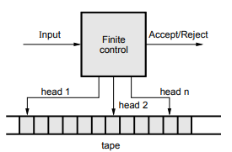
Multi head

Slide 15
Non deterministic Turing machine
It is similar to deterministic Turing machine except that for any input symbol and current state it has number of choices.
A string is accepted by a Non deterministic Turing machine If there is a sequences of moves that heads to a final state.

Slide 16
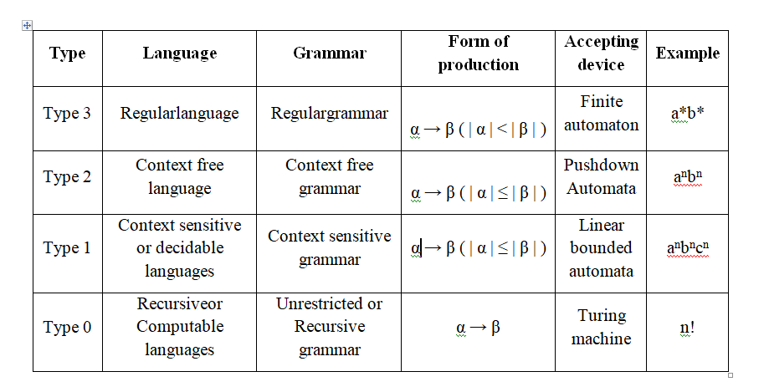
Chomskian hierarchy of languages

Slide 17
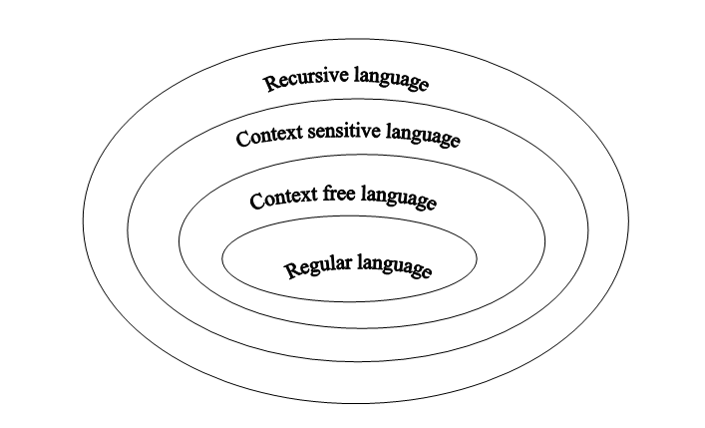
Chomskian hierarchy of languages

Slide 18
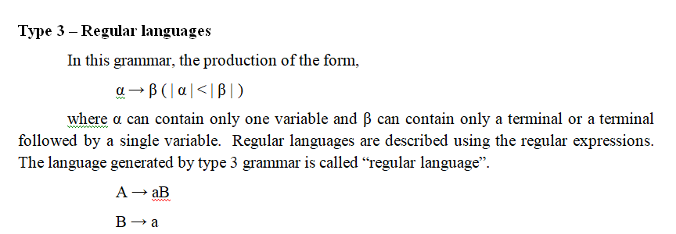
Chomskian hierarchy of languages

Slide 19
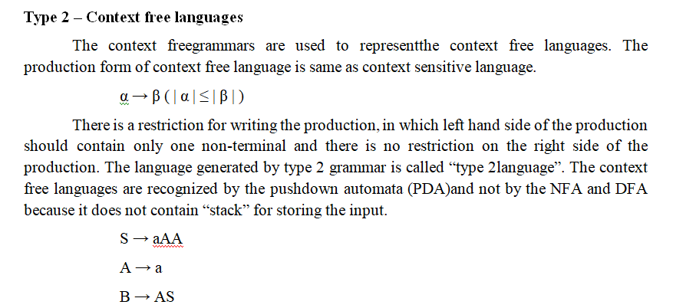
Chomskian hierarchy of languages

Slide 20
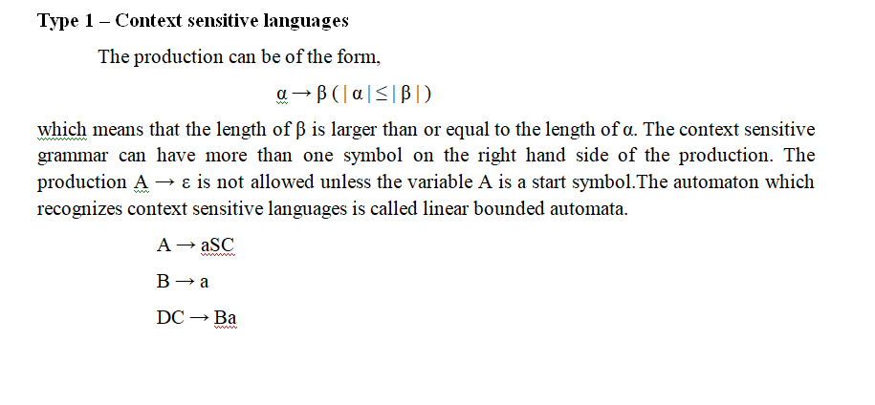
Chomskian hierarchy of languages

Slide 21
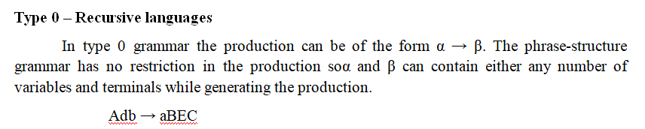
Chomskian hierarchy of languages

Slide 22
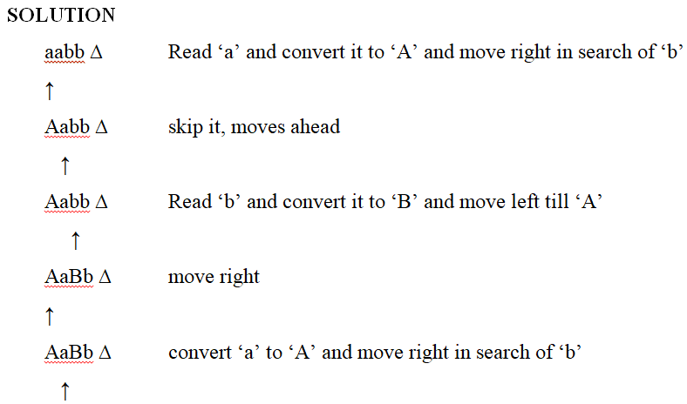
Problems about Turing machine
1. Construct a Turing machine M for the language L = {a^{n} b^{n} | n ≥ 1}.

Slide 23
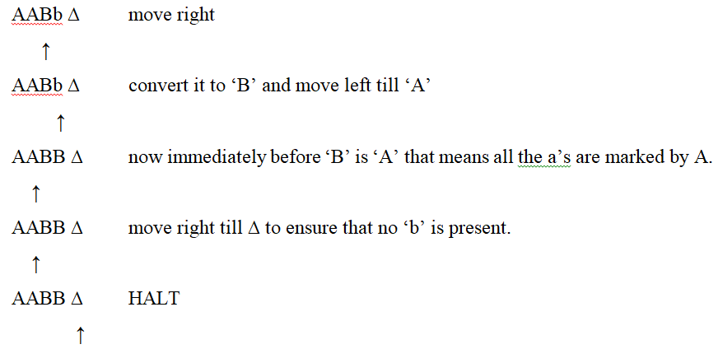

Slide 24
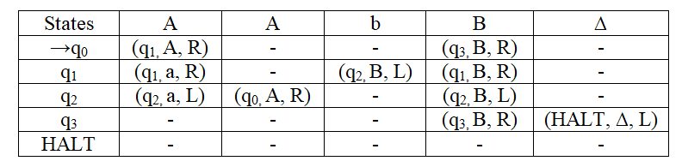
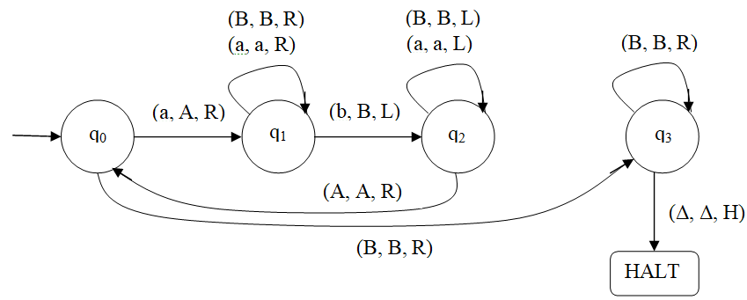

Slide 25
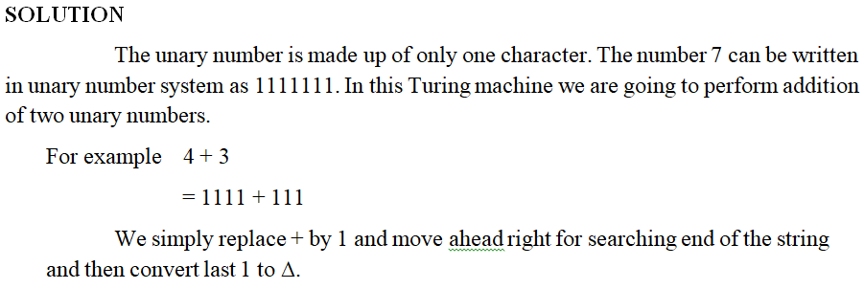
2. Explain Turing machine as a computer of integer functions with an example. or Design a Turing machine that computes x+y where x and y are positive integers.

Slide 26
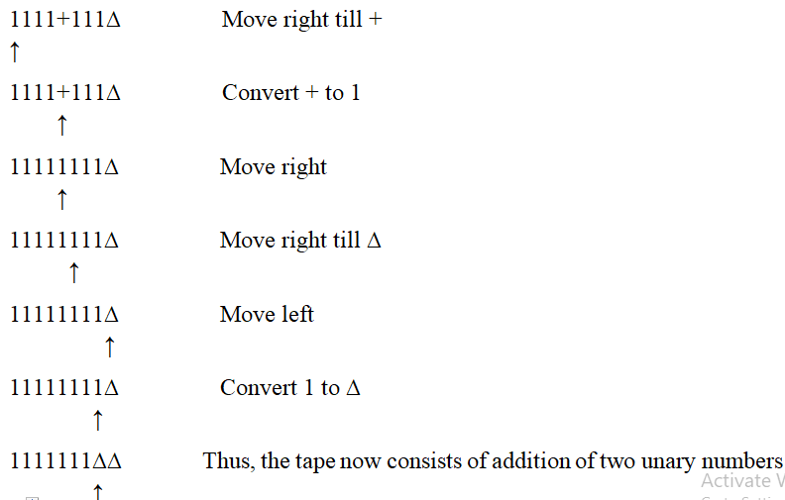

Slide 27
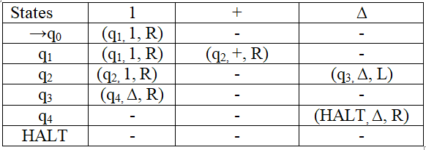
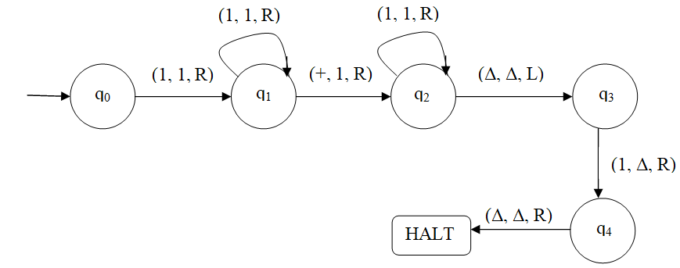

Slide 28
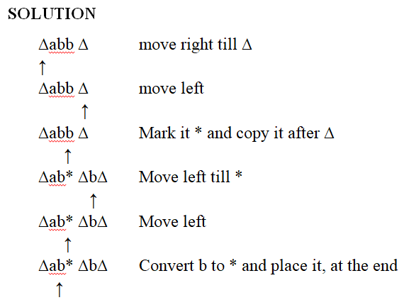
3. Design a Turing machine which reverses the given string {abb}.

Slide 29
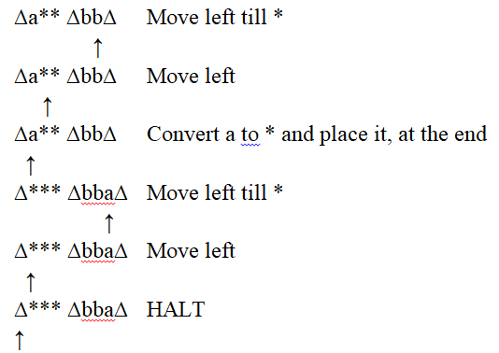

Slide 30
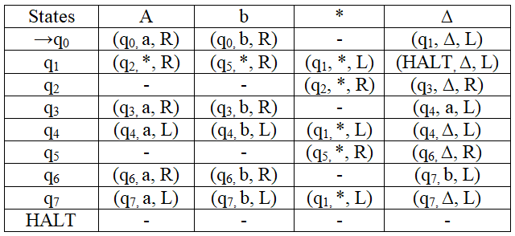

Slide 31
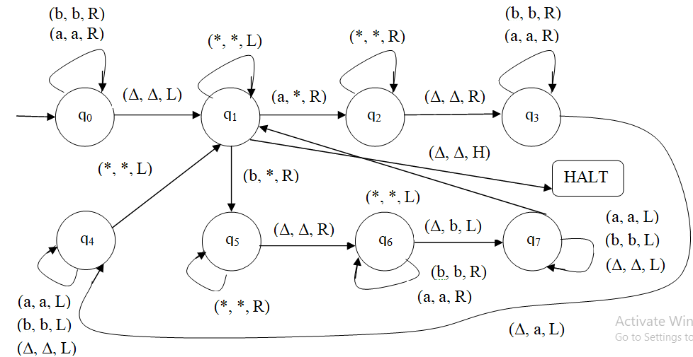

Slide 32
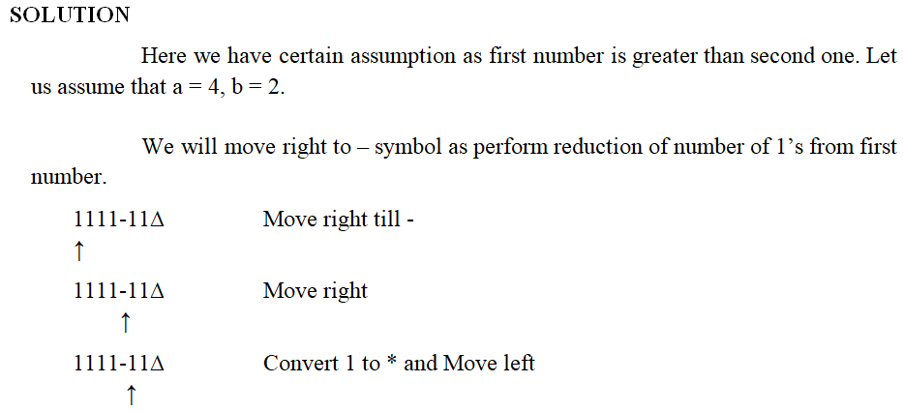
4. Construct a Turing machine to perform proper subtraction.

Slide 33
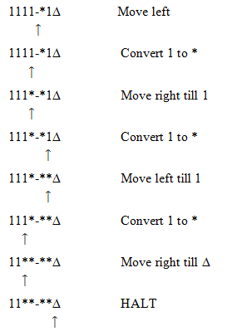

Slide 34
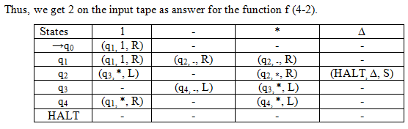
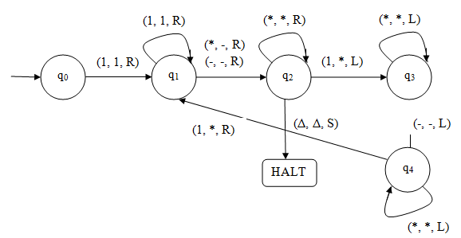

Slide 35
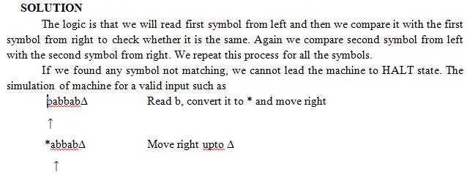
5. Design a Turing Machine for checking the palindrome of the string of even length.

Slide 36
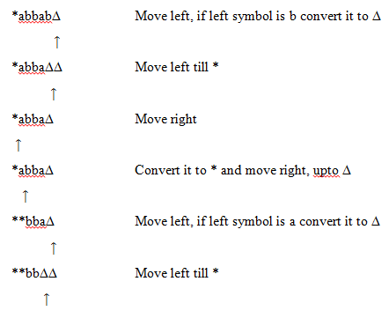

Slide 37
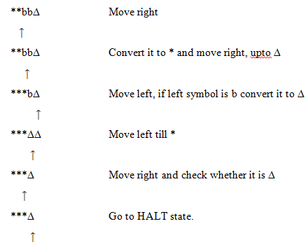

Slide 38
