Slide 1
THEORY OF COMPUTATION

Slide 2
UNIT V: RECURSIVELY ENUMERABLE LANGUAGES AND UNSOLVABLE PROBLEMS
Recursive And Recursively Enumerable Languages
Diagonalization Language
Universal Turing Machine
Code for Turing Machine
Halting problem
Post‟s Correspondence Problem
The Classes of P and NP

Slide 3
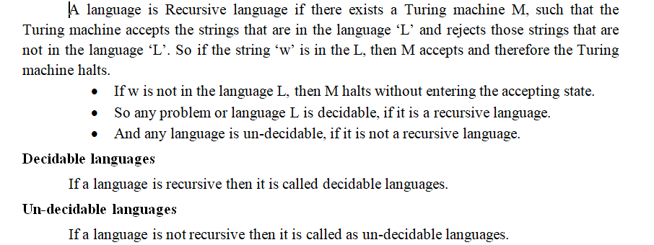
Recursive And Recursively Enumerable Languages

Slide 4
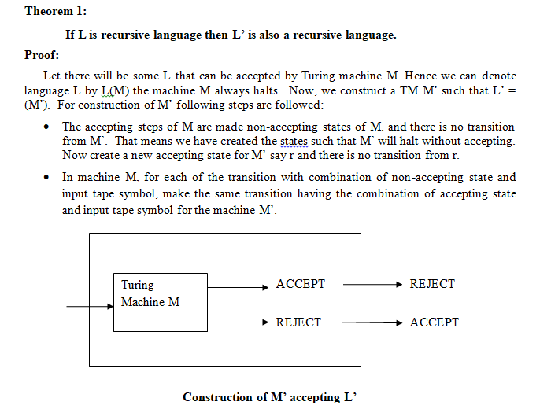

Slide 5
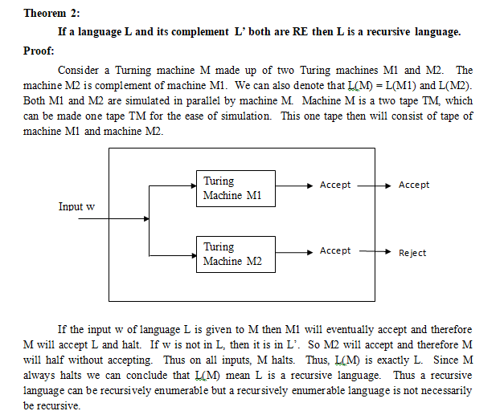

Slide 6
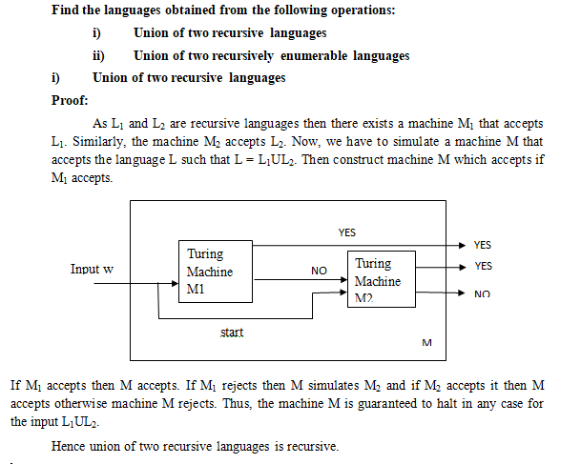

Slide 7
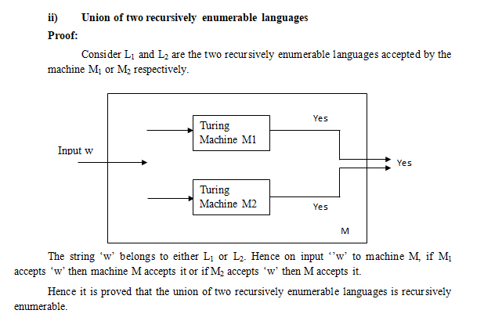

Slide 8
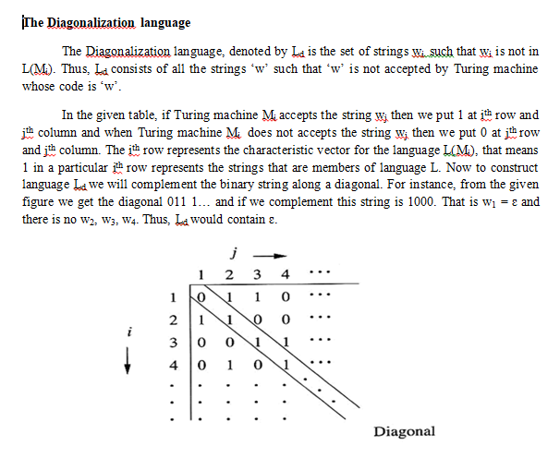
Diagonalization Language

Slide 9
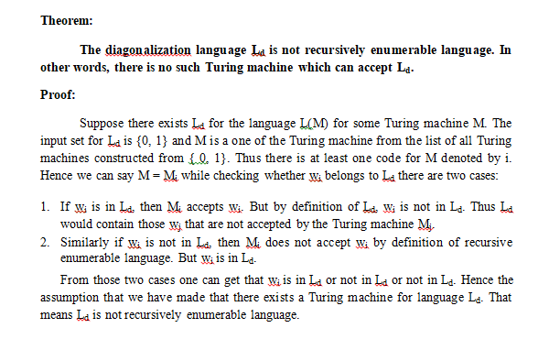

Slide 10
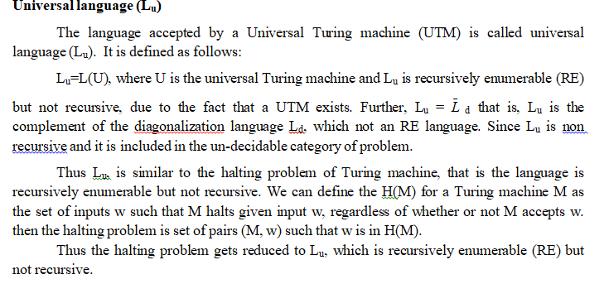
Universal Turing Machine

Slide 11
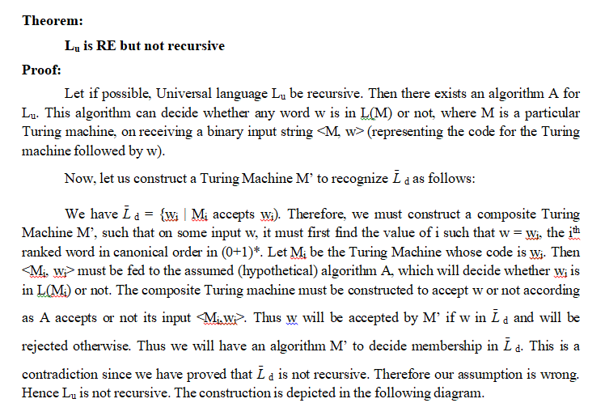

Slide 12
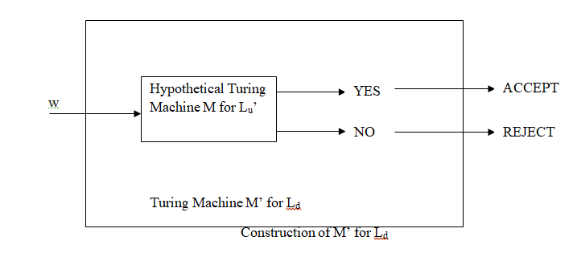

Slide 13
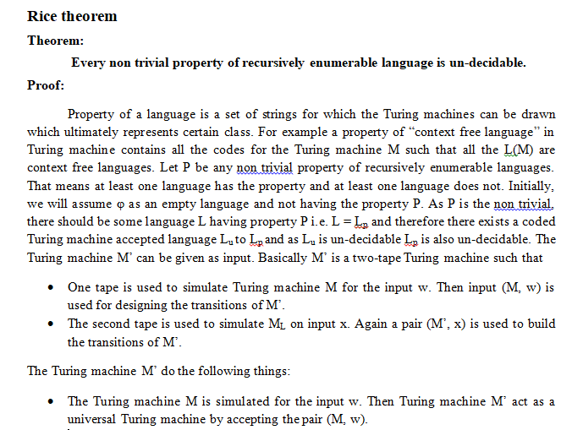

Slide 14
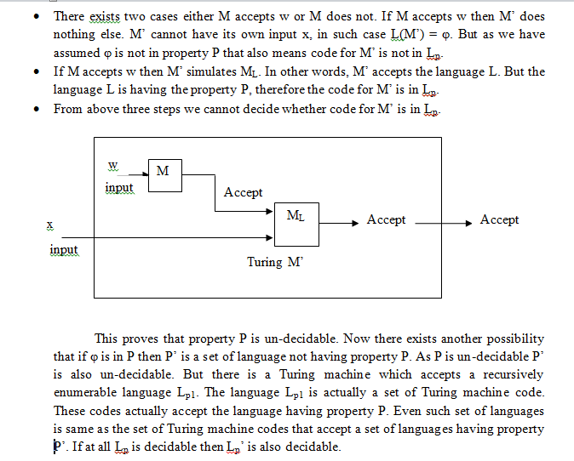

Slide 15
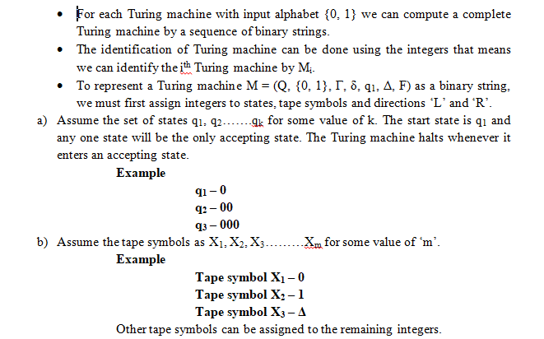
Code for Turing Machine

Slide 16
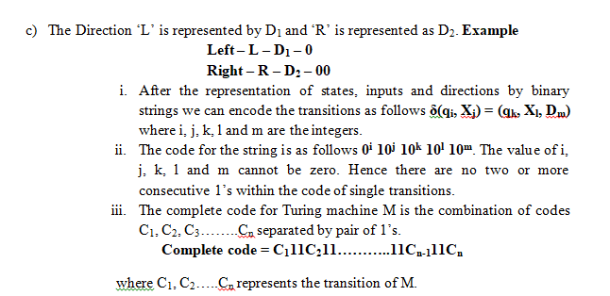

Slide 17
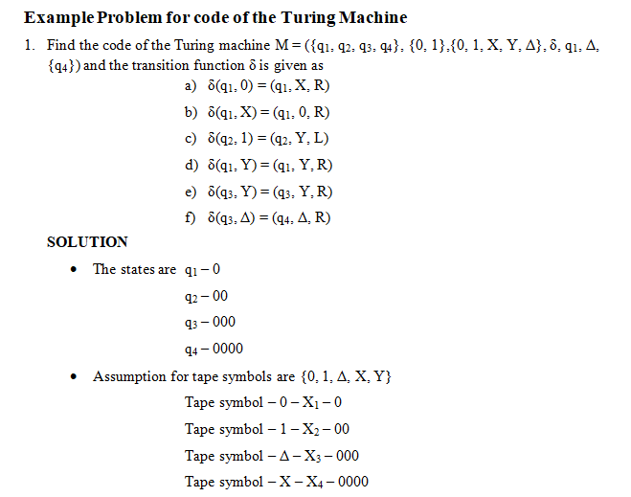

Slide 18
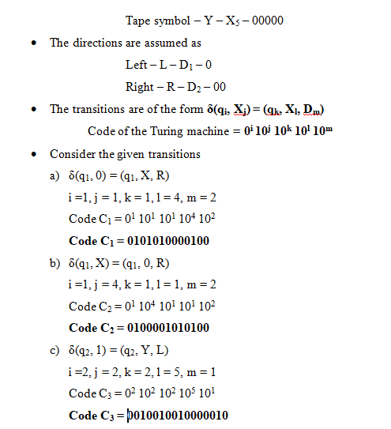

Slide 19
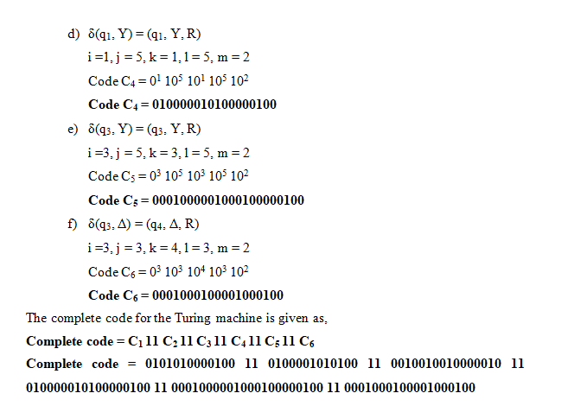

Slide 20
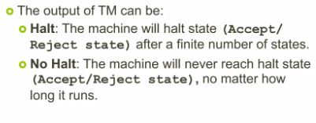
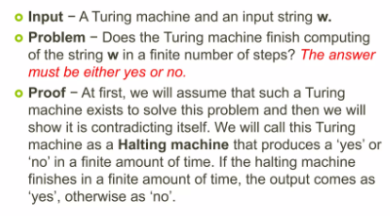
Halting problem

Slide 21
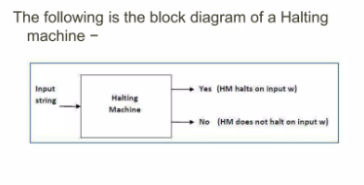

Slide 22

Post correspondence problem

Slide 23
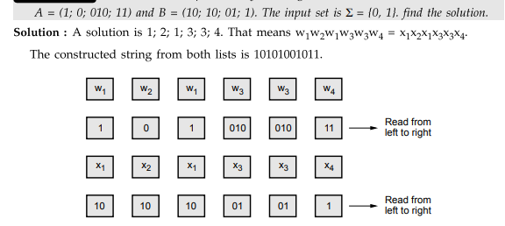
problem 1 :

Slide 24
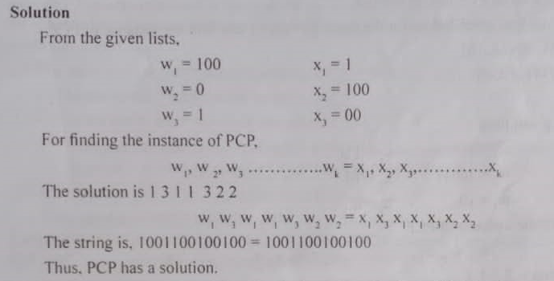
Problem 2

Slide 25

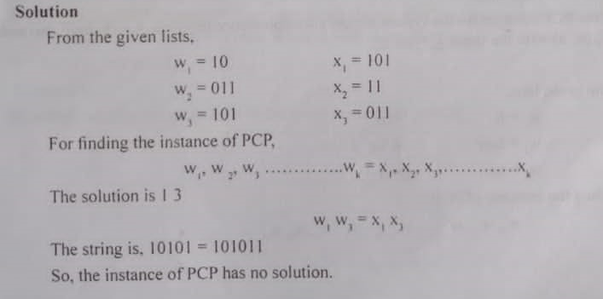
Problem 3

Slide 26

Modified pcp

Slide 27


Slide 28
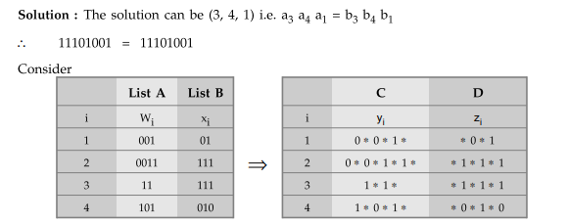
Problem 1

Slide 29
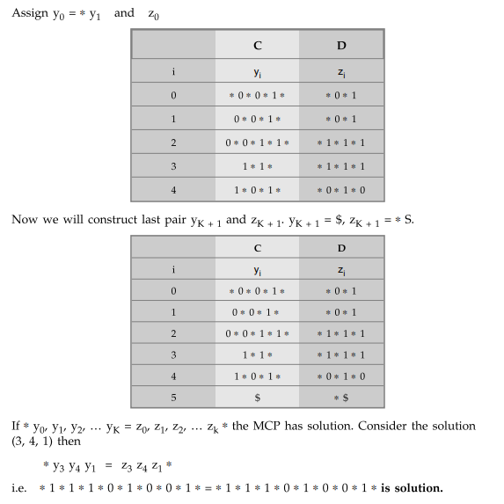

Slide 30
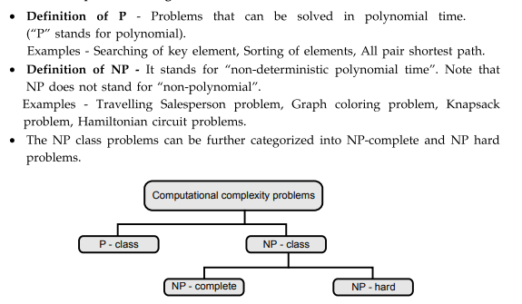
The Classes of P and NP

Slide 31

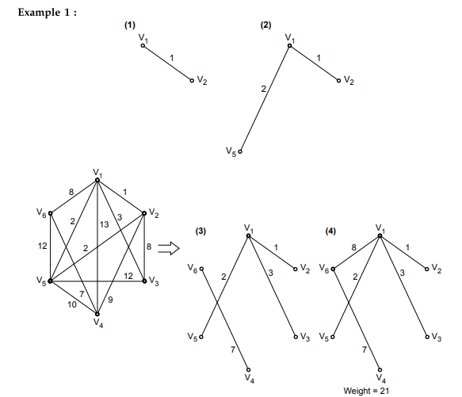

Slide 32

