Slide 1

UEC3942: Introduction to Sensors and Actuators
Unit III: Acoustic Wave Sensors
Presentation by: Dr. C. Annadurai
Associate Professor/Dept. of ECE SSN College of Engineering

Slide 2
Learning Outcomes
Overview
To understand the
principles, technology, and applications of acoustic sensors,
acoustic wave technology: overview and propagation modes

Slide 3
Objectives
Overview
Brief overview (Physics, Transduction, Types, and Industry use-cases).

Slide 4
What is an Acoustic Sensor?
Introduction
Definition: A device that converts sound pressure waves (mechanical energy) into electrical signals.
The "Microphone" vs. "Sensor" distinction.
The distinction between a "microphone" and a "sensor" lies in their scope and primary function: a microphone is a specialized type of transducer designed to convert sound waves into electrical signals, whereas a sensor is a broader, top-level classification for any device that detects and measures physical properties.
All microphones are acoustic sensors, but not all sensors are microphones.

Slide 5
Key Differences
Introduction
Focus: A microphone focuses on the quality of sound capturing, while a "sound sensor" (or acoustic sensor) may focus on detecting the presence, intensity (decibels), or specific frequency of a sound without high-fidelity recording.
Usage: Microphones are commonly used for audio recording and
and
communication. Sensors are used for detection, measurement, automation.
System Role: Sensors are often considered the "input" or detector in a system, while a microphone is an input transducer.
Example - Privacy: An "acoustic sensor" in a camera might only measure decibel levels (metadata) to trigger an alert, while a microphone would record the actual audio.
In many applications, a microphone acts as the sensing element within a broader "sound sensor" package.

Slide 6
The Physics of Sound
Introduction
Wave properties: Frequency (f), Wavelength Amplitude.
The speed of sound in different media (ν = 𝑓𝜆).
(λ), and

Slide 7
How They Work?
➢ Introduction
Transduction Principles:
How we get from a vibration to a voltage?
Main types: Piezoelectric, Capacitive, and Fiber Optic.
Piezoelectric Sensors:
Mechanism: Crystals (like Quartz or PZT) generating a charge under mechanical stress.
Pros: Durable, no external power needed.
Capacitive (Condenser) Sensors:
Mechanism: A flexible diaphragm acting as one plate of a capacitor.
Common in high-fidelity audio and MEMS.

Slide 8
How They Work?
➢ Introduction
MEMS Technology (Micro-Electro-Mechanical Systems)
The "silicon revolution" in acoustics.
Why your phone has 3+ tiny acoustic sensors?
Sensor Specifications:
Sensitivity, Signal-to-Noise Ratio (SNR), Frequency Response, and Dynamic Range.

Slide 9
Why your phone has 3+ tiny acoustic sensors?
➢ Introduction
To significantly improve audio quality for calls, video recordings, and voice assistant interactions.
Instead of relying on one microphone, manufacturers place these MEMS sensors at different locations - usually the bottom, top, and near the rear cameras - to achieve several, critical functions:
Active Noise Cancellation (ANC)
Improved Video Audio (Stereo/Directional)
Voice Assistant Accuracy
Echo Reduction:
In summary, these microphones are strategically placed to ensure clear communication, high-fidelity video recording, and accurate voice recognition.

Slide 10
Types of Acoustic Sensors
Introduction
Classification by Frequency: Infrasonic (< 20 Hz), Audible (20 Hz - 20 kHz), and Ultrasonic (> 20 kHz).
Ultrasonic Sensors: Proximity sensing and distance measurement (Time of Flight).
Surface Acoustic Wave (SAW) Sensors: Using waves traveling along the surface of a material to detect gas, temperature, or pressure.
Hydrophones: Underwater acoustic sensing; designed for high-pressure environments.
Geophones: Low-frequency sensors used for seismic monitoring and oil exploration.

Slide 11
Key Applications
Introduction
Consumer Electronics: Voice assistants (Alexa/Siri), noise cancellation (ANC), and smartphones.
Industrial Maintenance (Condition Monitoring): Detecting bearing failure or gas leaks via ultrasonic signatures.
Healthcare & Medical: Ultrasound imaging and wearable heart-
rate monitors (phonocardiography).
Automotive & Aerospace: Parking sensors, engine knock sensors, and structural health monitoring.
Defense & Security: Sonar, sniper detection systems, and
perimeter security.
Environmental Monitoring: Tracking wildlife (bioacoustics) and monitoring noise pollution.

Slide 12
Introduction to Acoustic Wave Sensors
➢ Introduction
Definition: Versatile devices that use mechanical or acoustic waves as their primary detection mechanism.
Core Function: Waves propagate through or on the surface of a material; changes to the propagation path affect the wave’s velocity and/or amplitude.
Commercial Context: While used for 60 years in telecommunications (filters), they are now emerging in automotive, medical, and industrial sensing.

Slide 13
Key Advantages of Acoustic Sensors
Introduction
Sensitivity & Reliability: Inherently rugged, highly sensitive, and intrinsically reliable.
Competitive Pricing: Cost-effective compared to other high-sensitivity sensing technologies.
Passive Operation: Some designs allow for wireless interrogation without an internal power source.
Broad Applications: Capable of measuring torque, tire pressure, vapors, humidity, temperature, and mass.

Slide 14
The Physics of Piezoelectricity
Introduction
Discovery: Discovered by Pierre and Paul-Jacques Curie in 1880.
The Piezoelectric Effect: The production of electrical charges through mechanical stress.
Reciprocity: Applying an electrical field creates mechanical stress, and vice versa.
Sensor Mechanism: An oscillating electric field creates a mechanical wave that propagates through a substrate before being converted back to an electric field for measurement.

Slide 15
Common Substrate Materials
Introduction
Quartz (SiO₂): Most common; unique because specific "cut angles" can minimize temperature dependence or maximize it for temperature sensing.
Lithium (LiNbO₃):
Tantalate (LiTaO₃) & Lithium Niobate
Frequently used but always exhibit linear
temperature dependence.
Emerging Materials: Gallium arsenide (GaAs), zinc oxide (ZnO), and lead zirconium titanate (PZT).

Slide 16
Fabrication Process
Introduction
Photolithography: Manufactured using a process similar to Integrated Circuits (ICs), but without junctions.
Step-by-Step:
Polishing/cleaning the piezoelectric substrate.
Uniform metal deposition (usually aluminum).
UV light exposure through a mask to define the pattern.
Result: The remaining metal forms an Interdigital Transducer (IDT).

Slide 17
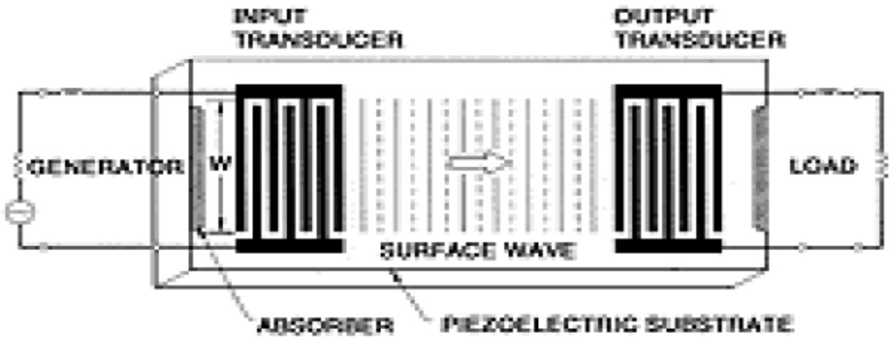
The Interdigital Transducer (IDT)
Introduction
Function: One IDT converts electrical energy into mechanical wave energy; the other converts it back.
Design Variables: Sensor performance is maximized by adjusting the length, width, position, and thickness of the IDT fingers.
Signal Path: The IDT provides the electric field needed to displace the substrate, launching the wave across the sensing surface.

Slide 18
Classification of Propagation Modes
Introduction
Bulk Waves: Propagate through the interior of the substrate. Example:
Quartz Crystal Microbalance (QCM) or Thickness Shear Mode (TSM) resonator.
shear-horizontal acoustic plate mode (SH-APM).
Surface Waves: Propagate along the surface of the substrate. Example:
Surface Acoustic Wave (SAW) sensor.
shear-horizontal surface acoustic wave (SH-SAW).
Determining Factors: Mode is distinguished by velocity and displacement direction, depending on material and boundary conditions.

Slide 19
Transverse and Shear Wave Motion
Introduction
Transverse/Shear Waves: Particle displacement is normal (perpendicular) to the direction of wave propagation.
Shear Horizontal (SH): Displacement is parallel to the sensing surface.
Shear Vertical: Displacement is normal (perpendicular) to the sensing surface.

Slide 20
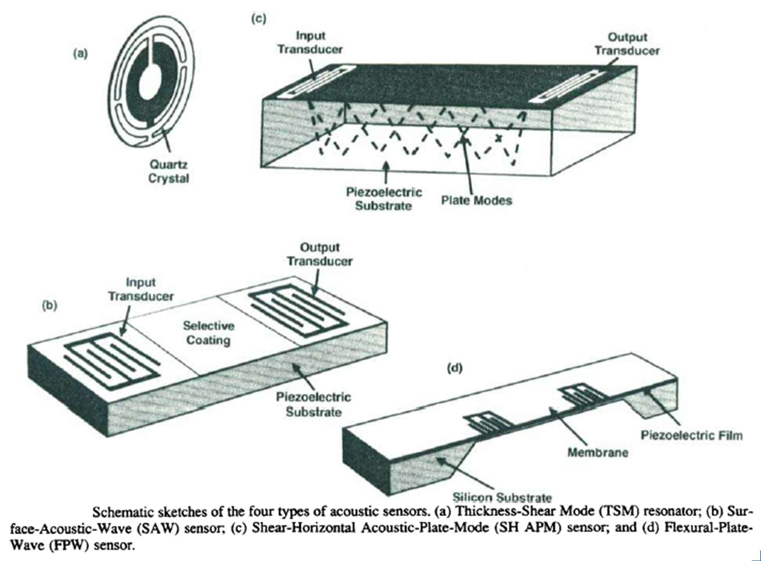
Types of Acoustic Wave Sensors
Introduction

Slide 21
Fluid Operation Challenges
Introduction
Liquid Constraints: Only a subset of sensors operate efficiently in contact with liquids.
Shear Horizontal Motion: TSM, SH-APM, and SH-SAW waves propagate primarily in shear horizontal motion, which does not radiate significant energy into liquids, making them ideal for liquid-phase sensing without excessive damping.
SAW Limitations: Standard SAW sensors have surface- normal displacement that radiates compression waves into liquid, causing excessive damping.

Slide 22
Comparative Analysis of Acoustic Wave Sensors
Introduction
Best Environment
Sensor Type
Wave Type
Key Use Case
Metal deposition rates
Telecommunic ations filters
Bio-sensing in fluids
Emerging research sensors
TSM
Bulk (Shear)
Gas & Liquid
Gas or Vacuum
Gas & Liquid
SAW
Surface
Surface (Shear)
SH-SAW
FPW/Lamb
Plate Waves
Gas & Liquid

Slide 23
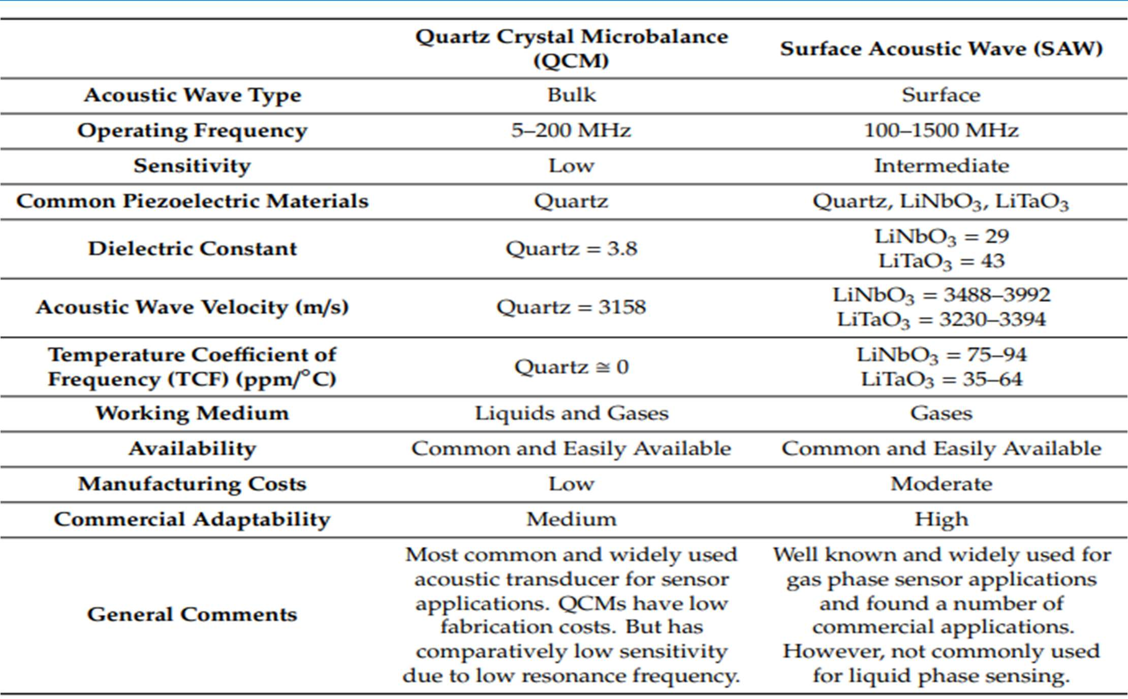
Overview of Acoustic Wave Devices
Introduction

Slide 24
Conclusion and Emerging Trends
Introduction
Versatility: Acoustic sensors are competitively priced, rugged, sensitive, and reliable.
Wireless Capability: Some devices can be passively and wirelessly interrogated without an internal power source.
Future Modes: Promising new modes include flexural plate waves (FPW), Love waves, and Lamb waves.

Slide 25
Test your understanding
Define the reciprocal nature of the piezoelectric effect.
Distinguish between a Bulk Wave and a Surface Wave.
Name four emerging materials with commercial potential for acoustic wave substrates.
Describe the role of Interdigital Transducers (IDTs) in acoustic wave
devices.
Compare the suitability of SAW, TSM, and SH-APM sensors for operation in liquids.
Detail the photolithographic fabrication process for acoustic wave
devices.
Explain how acoustic wave devices function as sensors and list their industrial/commercial applications.
Discuss the selection of piezoelectric substrate materials and the
specific advantages of Quartz.

Slide 26
References
D. S. Ballantine et. al., Acoustic Wave Sensors: Theory, Design and Physico-Chemical Applications, Academic Press, 1997.
https://pmc.ncbi.nlm.nih.gov/articles/PMC6833005/pdf/sen sors-19-04395.pdf
https://industry.plantautomation-technology.com/ whitepapers/1485944904-acoustic-wave-technology- sensors.pdf

