Slide 1

UEC3942: Introduction to Sensors and Actuators
Unit III: Capacitive Pressure Microsensors
Presentation by: Dr. C. Annadurai
Associate Professor/Dept. of ECE SSN College of Engineering

Slide 2
Learning Outcomes
Overview
To understand the construction, working principles, and real-world applications of Capacitive Pressure Microsensors.

Slide 3
What is a Microsensor?
Overview
Definition of MEMS (Micro-Electro-Mechanical Systems).
Transition from macro-scale sensors to micro-scale.
The role of pressure sensing in modern electronics.

Slide 4
Why Capacitive Sensing?
Introduction
High sensitivity.
Low power consumption devices).
Low temperature sensitivity sensors.
(ideal for battery-operated
compared to piezoresistive

Slide 5
Construction & Design
Introduction
Fundamental Structure
The sensor consists of two conductive plates separated by a gap.
One plate is fixed (stiff substrate).
One plate is flexible (the diaphragm).
Materials Used
Substrate: Silicon or Glass.
Diaphragm: Polysilicon, Silicon Nitride, or Monocrystalline Silicon.
Insulation: Silicon Dioxide

Slide 6
Construction & Design
Introduction
Fabrication Process (The "How")
Surface Micromachining: Building layers on top of the wafer.
Bulk Micromachining: Etching into the wafer to create the cavity.
Wafer Bonding: Sealing two wafers together to create a
vacuum reference.

Slide 7
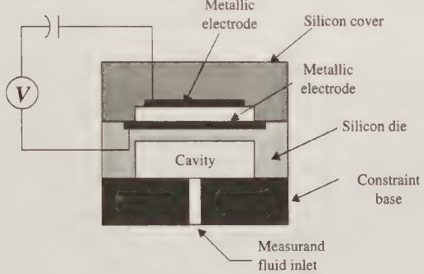
Schematic Diagram
Introduction
Parallel-plate capacitive pressure microsensor

Slide 8


Working Mechanism
Introduction
The Physics of Capacitance
The basic formula:
where:
C = Capacitance
ε = Permittivity of the material in the gap
A = Area of the plates
d = Distance between plates

Slide 9
Working Mechanism
Introduction
Step 1: Pressure Application
External pressure acts on the flexible diaphragm.
The diaphragm deflects toward the fixed backplate.
Step 2: Gap Displacement
As the diaphragm moves, the distance (d) decreases.
Because d is in the denominator, capacitance (ΔC)
increases.
Step 3: Signal Conversion
The change in capacitance (ΔC) is converted into an
electrical signal (Voltage or Frequency).
This is usually handled by an on-chip CMOS circuit.

Slide 10

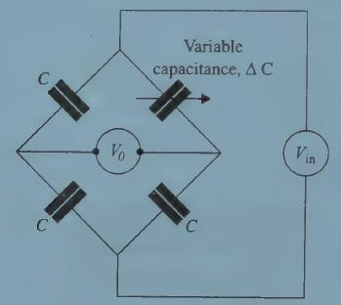
Bridge circuit for capacitance measurements
Introduction
The variable capacitance can be measured by measuring
the output voltage V₀.
voltage
bridge
from a
circuit is
of
The output
capacitance non-linear capacitance variation.
to the change
due to pressure
This nonlinear input/output relationship is indicated in the above equation.

Slide 11
Sensitivity Factors
Introduction
Diaphragm thickness (thinner = more sensitive)
Diaphragm radius
Initial gap distance

Slide 12
Performance & Comparison
Introduction
Advantages of Capacitive Sensors
Power: Extremely low power draw.
Durability: High mechanical overpressure capability.
Noise: Lower "thermal noise" than resistive counterparts.
Limitations
Non-linearity: The 1/d relationship isn't perfectly linear.
Stray Capacitance: Parasitic signals from the housing can interfere.
Complexity: Requires more sophisticated readout
electronics.

Slide 13
Applications
Introduction
Automotive Industry
TPMS (Tire Pressure Monitoring Systems).
Manifold Absolute Pressure (MAP) sensors for engine control.
Consumer Electronics
Altimeters in smartphones and smartwatches.
Touchscreens (specifically force-sensing touch).
Medical Applications
Disposable blood pressure sensors.
Intracranial pressure monitoring.
CPAP machines for sleep apnea.
Industrial & Aerospace
HVAC system monitoring.
Aircraft altimeters and airspeed indicators (Pitot tubes).

Slide 14
Conclusion
➢ Introduction
Summary: Capacitive microsensors are the "gold standard" for low-power, high-precision sensing.
Future: Integration with AI for "smart" edge sensing and further miniaturization (NEMS).

Slide 15
Test your understanding
Define MEMS in the context of pressure sensing.
State the relationship between capacitance and diaphragm deflection.
What is "Stray Capacitance" in microsensors?
Compare and contrast Surface Micromachining and Bulk Micromachining.
Describe the basic construction of a capacitive pressure microsensor.
Explain two major applications of MEMS pressure sensors in the automotive industry.
Explain the complete working mechanism of a capacitive pressure microsensor. Supplement your answer with a neat schematic diagram.
Discuss the advantages and limitations of capacitive microsensors over piezoresistive microsensors.
Why are capacitive sensors gaining popularity in the medical and mobile sectors?

Slide 16
References
Tai Ran Hsu, MEMS and Microsystems Design and
Manufacture, Tata McGraw Hill, First Edition, 2002.

Slide 17
Thank you

