Slide 1

UEC3942: Introduction to Sensors and Actuators
Unit III: Flexural Plate Wave (FPW) Acoustic Sensors
Presentation by: Dr. C. Annadurai
Associate Professor/Dept. of ECE SSN College of Engineering

Slide 2
Learning Outcomes
Overview
To understand the working principle, types of surface waves, advantages, fabrication, and applications of Flexural Plate Wave (FPW) acoustic sensors.

Slide 3
Introduction
Overview
Expanding on our acoustic sensor series, the Flexural Plate Wave (FPW) sensor represents a significant shift in design.
Unlike QCM substrates, membrane.
This allows
or SAW, which use
the FPW sensor
thick or semi-infinite
uses an ultrathin
for even higher sensitivity and unique
interactions with liquids.

Slide 4
What is an FPW Sensor?
Overview
Definition: A type of acoustic wave sensor where the wave propagates through a thin membrane (plate) with a thickness (d) much less than the acoustic wavelength (λ).
Key Characteristic: The wave "flexes" the entire
thickness of the membrane, rather than just the surface.
Sensitivity: Often significantly higher than QCM or SAW due to the extremely low mass of the vibrating membrane.

Slide 5
Structure and Geometry
Introduction
Substrate: Usually, a silicon wafer with a micromachined cavity.
The Membrane: Typically made of Silicon Nitride (Si₃N₄)
or Silicon Carbide (SiC), often less than 2-3 micrometers thick.
Transduction: Piezoelectric layer (like Zinc Oxide or AlN) deposited on the membrane with Interdigital Transducers (IDTs).

Slide 6
Working Principle
Introduction
Wave Generation: Similar to SAW, an AC voltage at the input IDT creates a mechanical wave.
The "Flex": The wave travels as a "Lamb wave" in the lowest-order antisymmetric mode (A₀).
Phase Velocity: The wave speed is much lower than the
speed of sound in liquids, which is a critical advantage.
Equation: 𝜈 =
𝐵
𝑀
where B is the bending stiffness and M is
the mass per unit area.

Slide 7
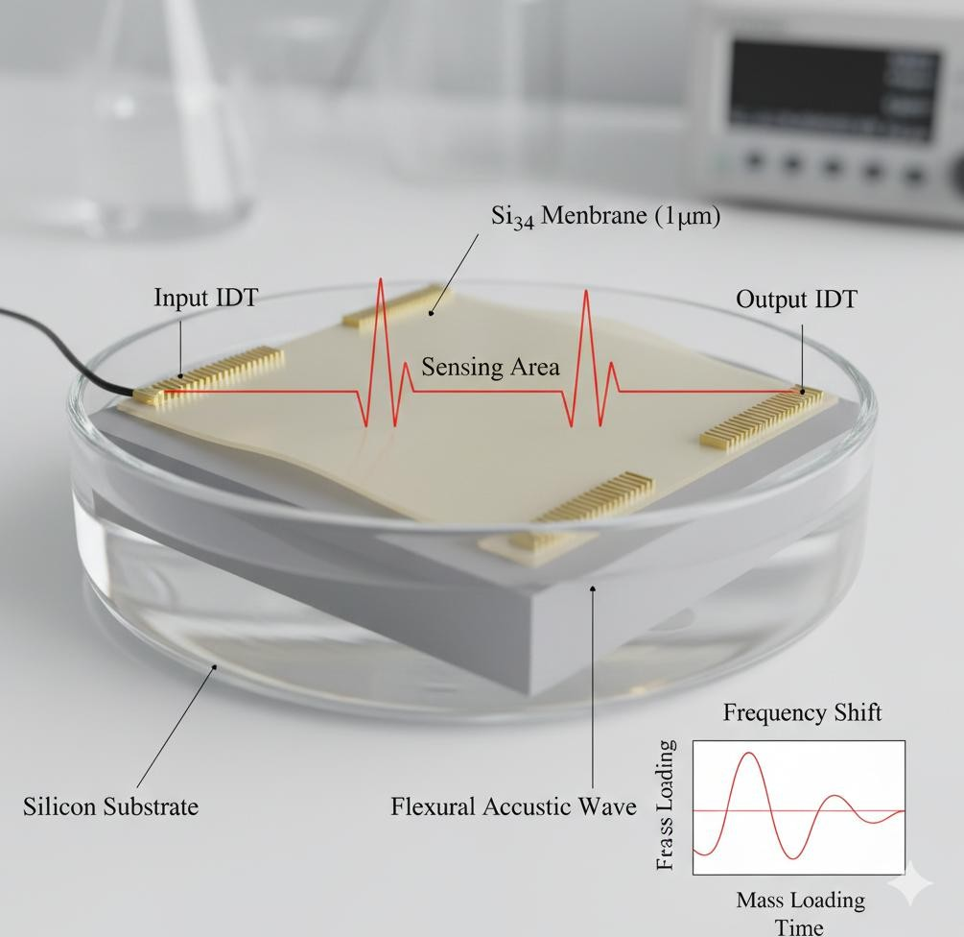
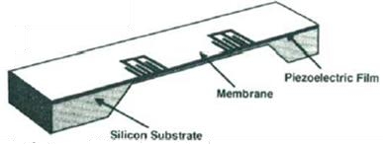
Schematic Layout
Introduction
Flexural Plate Wave (FPW) Acoustic Sensor

Slide 8
Advantages in Liquid Sensing
Introduction
The Liquid Problem: Most acoustic sensors (like Rayleigh-SAW) lose energy (attenuation) when touching liquid because the wave "leaks" into the fluid.
The FPW Solution: Because the phase velocity in an FPW
sensor is typically lower than the speed of sound in water (<1500 m/s), the wave does not radiate energy into the liquid.
Result: Excellent performance in biosensing and chemical analysis within aqueous environments.

Slide 9
Sensing Mechanisms
Introduction
Mass Loading:
Particles binding to the membrane
increase the mass per unit area (M), significantly decreasing the wave velocity and frequency.
Viscosity: Changes in the liquid's thickness/drag affect the wave's damping.
Internal Stress: Changes in the membrane's tension (e.g., from thermal expansion or thin-film stress) shift the
frequency.

Slide 10
Comparison: FPW vs. SAW vs. QCM
Introduction
Feature | QCM | SAW | FPW
Substrate | Bulk Crystal | Thick Substrate | Thin Membrane
Frequency | 5-30 MHz | 100+ MHz | 2-20 MHz
Liquid Operation | Good | Poor (Rayleigh) | Excellent
Sensitivity | Moderate | High | Ultra-High

Slide 11
Fabrication (MEMS Process)
Introduction
Bulk Micromachining: Using anisotropic etching (like KOH or Bosch process) to create the "well" or cavity under the membrane.
Thin Film Deposition: Sputtering the piezoelectric layer and gold electrodes.
Scalability: Since it uses standard Silicon processing,
thousands of sensors can be made on a single wafer, lowering costs.

Slide 12
Key Applications
Introduction
Biosensors: Real-time detection of bacteria, viruses, and cells in blood or buffer.
Chemical Sensing: Detecting low concentrations of gases or
vapors in the environment.
Microfluidics: Integrated "Lab-on-a-Chip" systems where the sensor also acts as a micro-pump (acoustic streaming).
Viscosity/Density Meters: Industrial monitoring of fluid properties.

Slide 13
Conclusion
Introduction
Summary: FPW sensors offer a unique combination of high mass sensitivity and low energy loss in liquids.
Future: Moving toward CMOS-integrated FPW arrays for
multi-analyte detection.
Challenges: Improving the mechanical robustness of the ultrathin membranes for harsh industrial use.

Slide 14
Test your understanding
Define the "Flexural" nature of the wave in an FPW sensor.
Mention one disadvantage of using an ultrathin membrane in
industrial sensor design.
Explain why "Acoustic Streaming" occurs in FPW devices and how it can be used for microfluidic applications.
Evaluate the performance of FPW sensors against QCM and SAW
sensors for "Lab-on-a-Chip" biosensing.
Describe the typical layers that make up an FPW sensor "stack".
Discuss the three primary ways an FPW sensor detects a target
analyte: Mass Loading, Viscous Loading, and Internal Stress. Explain how each of these physical changes alters the sensor's output signal (frequency and phase).

Slide 15
References
D. S. Ballantine et. al., Acoustic Wave Sensors: Theory, Design and Physico-Chemical Applications, Academic Press, 1997.
Vinod Kumar Khanna, Nanosensors: Physical, Chemical,
and Biological, CRC Press, Second Edition, 2021.
https://pmc.ncbi.nlm.nih.gov/articles/PMC6833005/pdf/sen sors-19-04395.pdf
https://industry.plantautomation-technology.com/ whitepapers/1485944904-acoustic-wave-technology- sensors.pdf

Slide 16
Thank you

