Slide 1

UEC3942: Introduction to Sensors and Actuators
Unit I: Fibre Optic Sensors
Presentation by: Dr. C. Annadurai
Associate Professor/Dept. of ECE SSN College of Engineering

Slide 2
Learning Outcomes
Overview
At the end understand
of the session, the students will be the working principle,
able to
characteristics, and
applications of fibre optic sensors.

Slide 3
Introduction to Distance Measurement
Introduction
Overview of non-contact measurement techniques.
The transition from traditional interferometry to modern fibre optic methods.
Measuring strain, pressure, and small movements.

Slide 4
Principles of Light Interferometry
Introduction
Basic Setup: Light from a laser passes through semi- reflecting glass plates.
Mechanism: An interference pattern is created between light reflected from an outward beam and a returning beam.
Detection: Bright and dark illumination changes on a screen correspond to movement.

Slide 5
Measuring Movement with Interferometers
Introduction
Sensitivity: Movement of 1/4 wavelength of light changes the light path by 1/2 wavelength.
Digital Counting: A photocell and amplifier convert light changes into electronic measurements of movement.

Slide 6
Limitations of Standard Interferometry
Introduction
Temperature Sensitivity: Changing temperatures are difficult to compensate for.
Complexity: Requires elaborate light paths to ensure interfering beams travel equal distances.
Distance Constraint: Limited by the "coherence distance" of the laser source (usually several meters)

Slide 7
Advantages of Non-Physical Connections
Introduction
No physical wires or semiconductor strips are required between measured points.
The main body of the device and the reflector can be in different locations.

Slide 8
Fiber Optic Sensor
Introduction
A fibre optic sensor is a device that uses optical fiber to measure a variety of physical quantities like temperature, strain, pressure, displacement, or chemical concentrations.
The sensor works by sending light through the fiber and detecting changes in the light's properties (intensity, phase, polarization, or wavelength) caused by the external influence.

Slide 9
How they work?
Introduction
A basic fiber optic sensor system consists of an optical source (like an LED or laser), the optical fiber itself, a sensing element (or transducer), an optical detector, and a processing unit.
Principle of Operation:
Light travels through the fiber core by total internal reflection.
The external physical parameter being measured modulates one or more properties of this light signal within the fiber or an attached external component.
The detector then measures these changes to determine the value of the physical quantity.

Slide 10
Types of Fiber Optic Sensors
Introduction
Fiber optic sensors are broadly classified based on the sensing location (intrinsic or extrinsic) and the operating principle (intensity, phase, or wavelength modulation).
Intrinsic Sensors: In this type, the optical fiber itself is the sensing element. The physical quantity (e.g., temperature or strain) directly acts upon the fiber to modify the light's properties within the fiber.
Extrinsic Sensors: Here, the fiber acts as a conduit to carry light to and from an external sensing device, where the actual measurement takes place. This is useful for measurements in inaccessible places, like inside an aircraft jet engine.

Slide 11
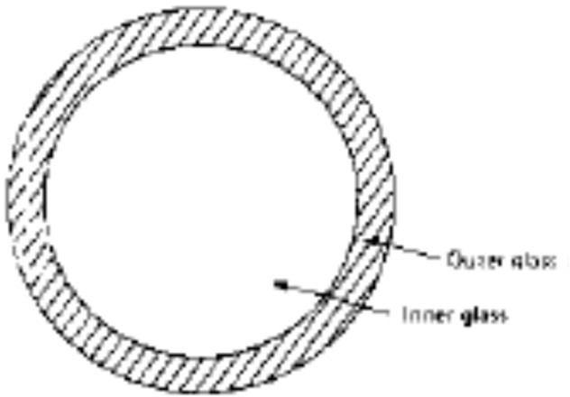
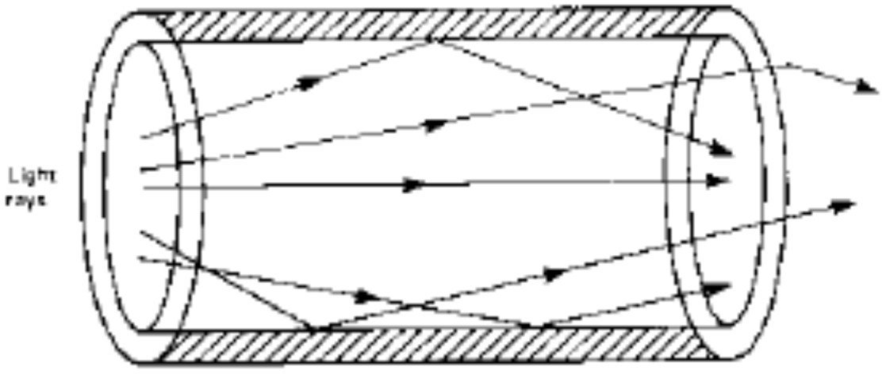
Optical Fibre Construction
Introduction
Materials: Composed of coaxial layers of transparent glass or plastics.
Structure: Consists of an "Inner glass" (core) and an "Outer glass" (cladding).
Core – Inner light carrying path in the inner layer
Cladding – Outer layer that keeps light in the core via reflection

Slide 12
Working Principle: Refractive Index
Introduction
The outer glass layer has a lower refractive index (R.I.) than the inner layer.
This difference in "refractivity" ensures light is trapped within the core.
Light passing from a dense material (inner glass) to a less dense material is refracted away from the original direction.
At specific "glancing angles," the beam is completely reflected back into the fibre.

Slide 13
Fibre Bending and Light Paths
Introduction
Straight Fibre: Low number of internal reflections.
Bent Fibre: Increased number of reflections, leading to a longer travel distance for the light.
Increased travel distance in a bent fibre causes a change in the time needed for light to pass through.
This results in a detectable "change of phase".

Slide 14
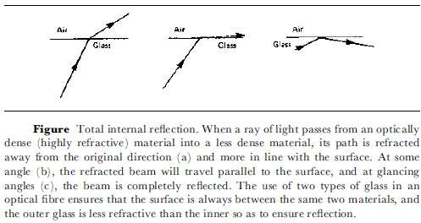
Total Internal Reflection
Introduction

Slide 15
Fibre Optic Sensor Mechanism
Introduction
Setup: One "static fibre" (reference) and one "measuring fibre".
Operation: Moving jaws force the measuring fibre into a corrugated shape.
Light from the distorted fibre is compared to light from the static fibre.
If the sensing path changes by even a fraction of the wavelength, the interference pattern shifts from bright to dark. This allows for detecting incredibly small movements.
A prism and photocell are used to obtain and measure the resulting interference pattern.

Slide 16
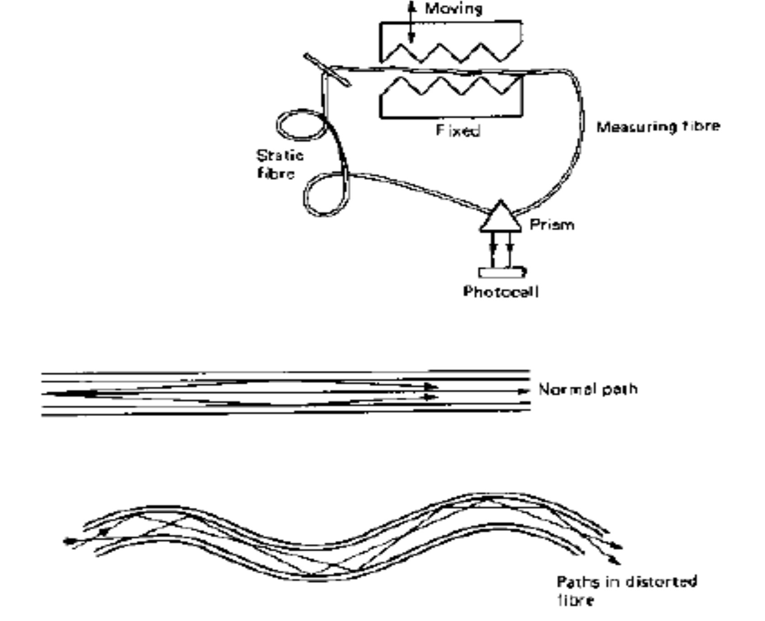
Using Optical Fibres to sense small distance changes
Introduction

Slide 17
Sensitivity Comparison
Introduction
Fibre optic sensors are generally less sensitive than direct (open-path) interferometry.
However, they are more versatile for industrial and environmental use.

Slide 18
Environmental Advantages
Introduction
Effective in surroundings where standard light beams cannot penetrate, such as dark liquids.
Capable of operating in harsh environments where mechanical connections are impractical.

Slide 19
Calibration Requirements
Introduction
There is no simple linear relationship between physical movement and light delay.
The sensor must be calibrated over its entire operational range to ensure accuracy.

Slide 20
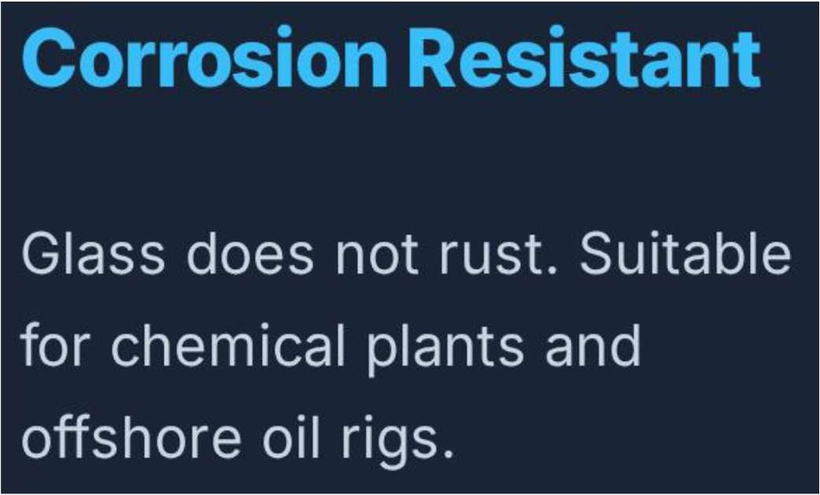
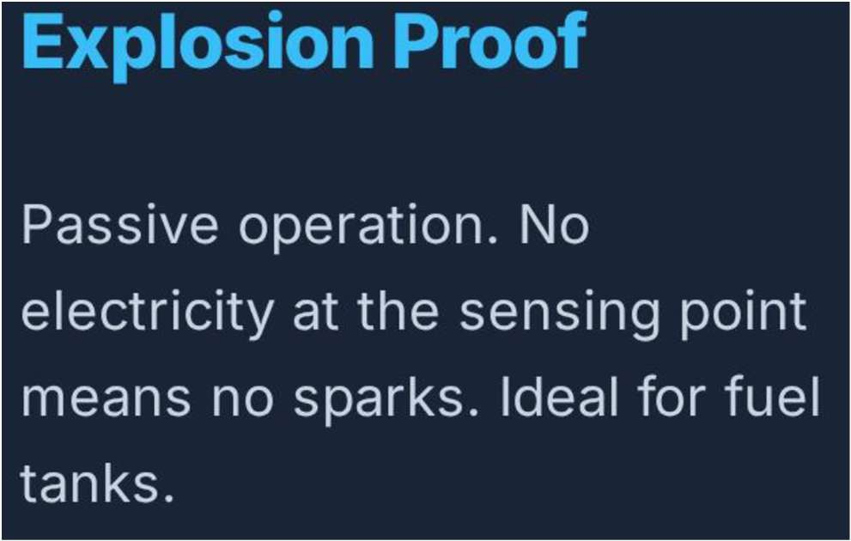
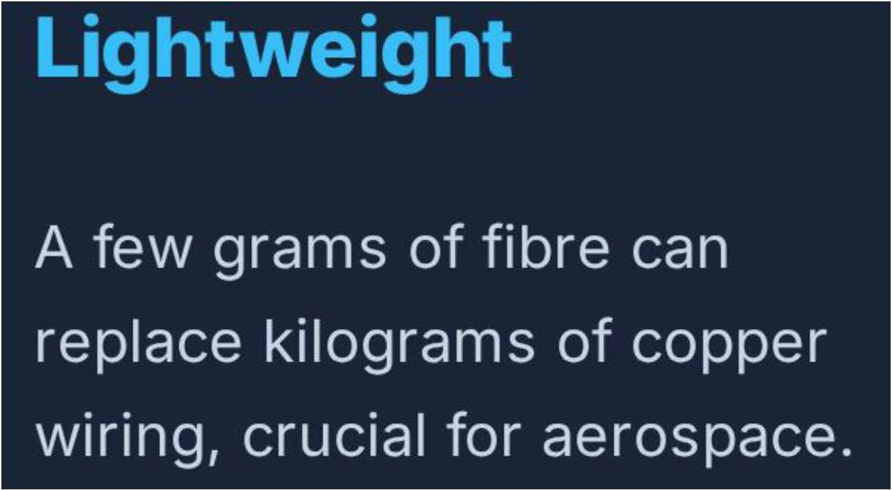
Fibre Optic Characteristics
Introduction

Slide 21
Key Advantages
Introduction
Fiber optic sensors offer several benefits over traditional electronic sensors, particularly in harsh environments:
Immunity to Electromagnetic Interference (EMI): Because they use light signals instead of electrical signals, they are not affected by electrical noise or magnetic fields.
Safety in Hazardous Environments: They do not conduct electricity or create
sparks, making them flammable or explosive
intrinsically safe for use in
environments (e.g., in coal mines or near jet fuel).

Slide 22
Key Advantages
Introduction
Environmental Resilience: They can operate over a very wide temperature range and are resistant to chemical corrosion and radiation.
Remote and Distributed Sensing: A single fiber can support multiple sensors along its length (multiplexing) or act as one continuous, long-distance sensor, which allows for monitoring over many kilometers.
Compactness and Lightweight: Their small size and flexibility allow them to be integrated into complex or small structures, such as in medical devices or the wings of airplanes.

Slide 23
Common Applications
Introduction
Fibre optic sensors are used across many industries:
Structural Health Monitoring: Embedded within bridges, dams, pipelines, and buildings to monitor strain, vibration, and temperature in real-time.
Energy Sector: Used for downhole temperature and pressure measurements in oil and gas wells, where conditions are extremely harsh.
Biomedical Field: Employed in medical devices for in vivo sensing, blood
flow measurement, and monitoring physiological parameters like heart and respiratory rates.
Industrial Automation: Used for precise object detection, liquid level sensing, and monitoring in chemical-processing plants.
Electrical Infrastructure: For monitoring high-voltage areas like transformers and switchgear, where EMI would interfere with conventional sensors.

Slide 24
Summary of Characteristics
Introduction
Non-contact: No wires between the sensor and the target.
High Sensitivity: Detects movement wavelengths.
Versatile: Works in opaque environments.
in fractions of
Stable: Uses reference fibres to compensate for environmental changes.

Slide 25
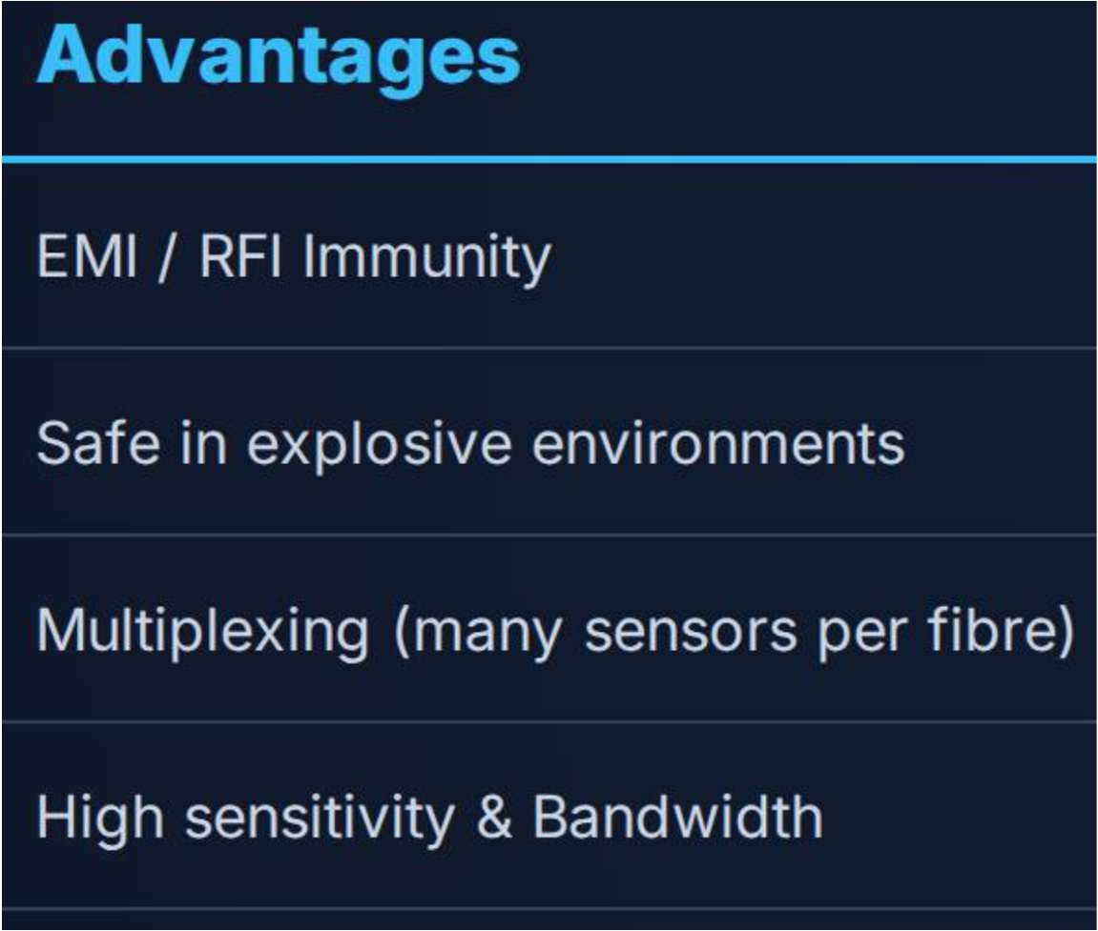
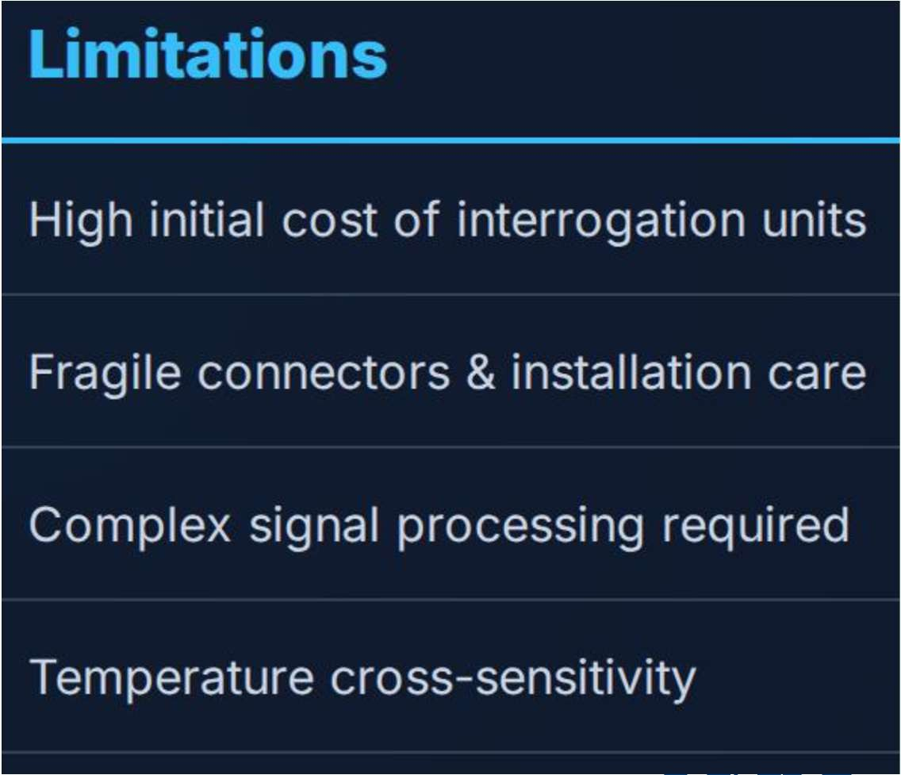
Summary: Pros & Cons
Introduction

Slide 26
Conclusion & Future Outlook
Introduction
Fibre optic sensors provide a robust alternative to electronic strain gauges.
Ongoing developments in glass and plastic materials continue to expand their utility.

Slide 27
Test your understanding
Define Pressure and Stress: Explain the distinction between these two terms as applied to liquids and solids.
Explain the "Coherence Distance" of a laser: Why is this a limiting factor for interferometers?
State the function of a photocell in an interferometer: How is the light signal converted for measurement?
What happens to light reflections when an optical fibre is bent? Describe the impact on the light's travel distance.
Describe the construction of an optical fibre.

Slide 28
Test your understanding
Explain the working principle of total internal reflection.
Compare standard interferometry with fibre optic methods.
Discuss the use of a "static fibre" in sensing.
Explain the complete working mechanism of a displacement sensor using optical fibres.
Analyze the challenges and solutions in laser interferometry for measurement.

Slide 29
Textbook
Ian R Sinclair, Sensors and Transducers, Third Edition, 2001 (Units I & II).
Ramon PallásAreny, John G. Webster, Sensors and Signal conditioning, John Wiley and Sons, Second Edition, 2000.

