Slide 1

UEC3942: Introduction to Sensors and Actuators
Unit II: Light transducers
Presentation by: Dr. C. Annadurai
Associate Professor/Dept. of ECE SSN College of Engineering

Slide 2
Learning Outcomes
Overview
Understand the mechanisms and applications of light transducers from incandescent bulbs to modern fluorescent systems.

Slide 3
Introduction to Light Transducers
Introduction
Core Concept: The conversion between electrical and light energy has been vital for over a century.
Basic Method: Most commonly, electrical energy is converted into light by heating a coil of wire until it reaches a high temperature.
Efficiency: This incandescent method has the lowest conversion efficiency of common light transducers.

Slide 4
Evolution of the Light Bulb (Early Designs)
Introduction
Carbon Filaments: Early bulbs used carbon filaments, which were extremely fragile.
Oxidation Prevention: Bulbs were evacuated (vacuum) to prevent the carbon from oxidizing.

Slide 5
Improvements by Swan and Edison
Introduction
Material Shift: The metal tungsten replaced carbon as the filament material.
Gas Filling: Introduced the use of argon gas inside the bulb.
The Argon Advantage: Being inert, the gas avoided oxidation while its pressure reduced the evaporation of the filament metal.

Slide 6
Failure Mechanisms in Filament Lamps
Introduction
Glass Blackening: Caused by tungsten vapour condensing on the glass interior.
Longevity: Early tungsten lamps failed in under an hour; modern gas-filled lamps have greatly extended life.
Spectrum: Biased toward the red end, making them unsuitable for accurate colour matching.

Slide 7
Introduction to Gas-Discharge Lamps
Introduction
Efficiency: Typically, at least five times more efficient than filament lamps.
Low-Pressure Types: Early versions used gases like neon.
Voltage Requirements: Required high voltages ranging from 1 kV to 15 kV.

Slide 8
Neon Signs and Gas Mixtures
Introduction
Composition: Modern "neon" signs rarely use pure neon.
Customization: A mixture of gases is used to achieve specific desired colours.
Spectrum: Light is often monochromatic (one single colour) based on the predominant spectral lines of the gas.

Slide 9
Street Illumination: Mercury and Sodium
Introduction
Vapour Sources: These lamps use vapours of liquids and solids rather than just gases.
Pressure Effects: At low pressures, colour discrimination is nearly impossible.
Broad Spectrum: Higher pressures broaden the light spectrum to yield more acceptable results.

Slide 10
High-Pressure Sodium Lamps
Introduction
Fog Visibility: The orange-red predominance in the light makes them more visible in fog.
Applications: Extensively used for motorway and main road illumination.

Slide 11
Gas-Discharge Characteristics
Introduction
Striking Voltage: No current passes through the lamp until a critical "striking" (ignition) voltage is reached.
Ignition: Once the gas is ignited, the voltage across the lamp drops.

Slide 12
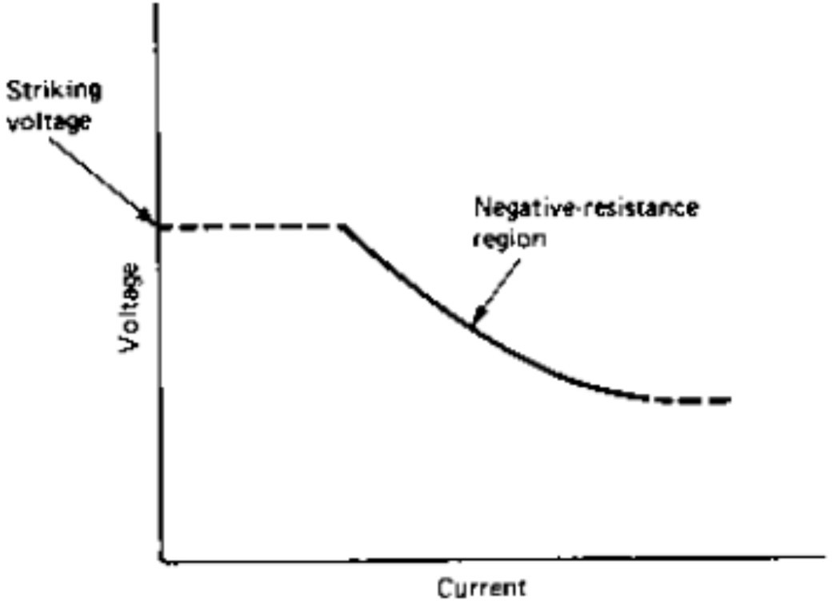
The Negative-Resistance Region
Introduction
Definition: A characteristic where voltage drops as the current increases.
Hazard: Without external control, this would cause the lamp to draw excessive current and burn out.

Slide 13
Discharge Lamp Control Gear
Introduction
AC Operation: Usually operated on AC power.
Current Limiting: Requires an inductor (choke) in series with the supply.
Transformer Use: Used if the running voltage is higher than the normal supply voltage.

Slide 14
Fluorescent Tubes: A Dual Conversion
Introduction
Complexity: More physically complex than simple discharge tubes.
Serial Conversion: Incorporates two energy conversions in series to produce light.

Slide 15
Fluorescent Conversion Steps
Introduction
Step 1:
Discharge Mechanism: Electrical energy creates a discharge through low-pressure mercury vapour.
Primary Output: This results in light that is mostly in the violet and ultraviolet (UV) range.
Step 2:
Phosphor Coating: The tube is coated internally with a phosphor material.
Frequency-Changer: The phosphor acts as a frequency-changer, converting UV light into the visible range.

Slide 16
Phosphor Composition
Introduction
Material: Metal silicates with controlled amounts of impurities.
Versatility: Small composition changes result in different conversion efficiencies and light spectrums.
Relation to CRT: These materials are essentially the same as those used for cathode ray tube coatings.

Slide 17
Sunlight and Colour Matching
Introduction
Sunlight Versions: Specific phosphors can mimic mid- day sunlight for professional colour matching.
Warm Versions: Domestic tubes are biased toward red to mimic the feel of incandescent lamps.

Slide 18
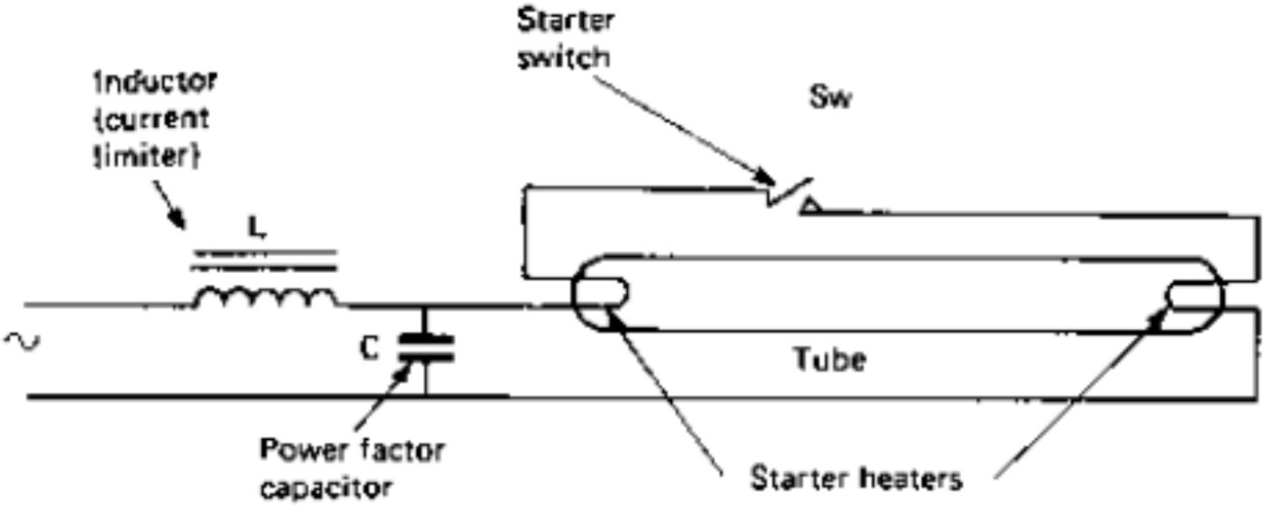
Switch-Start Circuits
Introduction
Components: Uses an inductor (choke), a power factor capacitor, and a starter switch.
Mechanism: A thermal timeswitch heats the filaments and then breaks the circuit.
Back-EMF: Breaking the contact generates a high voltage that strikes the ignition.

Slide 19
Environmental Factors in Starting
Introduction
Mercury Vaporization: Mercury must be vaporized to reach sufficient pressure for starting.
Cold Conditions: Low temperatures (e.g., in a winter garage) make starting difficult or impossible.

Slide 20
Quick-Start Circuits
Introduction
Mercury Vaporization: Mercury must be vaporized to reach sufficient pressure for starting.
Quick-Start: Employs a transformer with separate windings for the heater filaments and a high-impedance output higher than the ignition voltage. This allows the tube to light instantly without flickering.

Slide 21
Modern Electronic Converter
Introduction
Electronic Converters: Modern versions use electronic circuits to generate necessary voltages.
Compact Units: Allowing the control gear to be integrated into a single unit that fits domestic sockets.
Comparison: While electronic units are efficient and long-lasting, some integrated compact lamps still use the switch-start principle and suffer from slow warm-ups and flickering.

Slide 22
Comparison of Light Transducers
Introduction
Features
Incandescent Lamps
Gas-Discharge Lamps
Fluorescent Tubes
High; approximately five times that of incandescent lamps.
Highly flexible; depends on the internal phosphor coating.
Requires mercury vaporization and often a high-voltage back-EMF.
Requires a starter switch/choke or electronic converter.
Domestic use, offices, and professional colour matching.
Efficiency
Lowest conversion efficiency.
High; at least five times that of filament lamps.
Spectral Output
Biased toward the red end of the spectrum.
Often monochromatic or limited to specific spectral lines.
Starting Mechanism
Immediate upon heating the filament.
Requires a high "striking" or ignition voltage.
None required; connected directly to a source.
Requires an inductor (choke) or transformer to limit current.
Control Gear
Common Uses
Simple domestic lighting (historically).
Street illumination (Sodium/Mercury) and advertising signs.

Slide 23
Conclusion and Performance
Introduction
Efficiency: Fluorescent lamps remain roughly five times as efficient as incandescent lamps.
Limitations: Compact domestic types have a slow warm- up period, taking several minutes to reach full light output.

Slide 24
Test your understanding
Why are tungsten-filament lamps filled with argon gas rather than being evacuated?
Explain the difficulty of starting a fluorescent lamp in cold environments, such as a garage in winter.
With VI characteristics, illustrate the working principle of a gas-
discharge lamp.
Compare the efficiency and spectral characteristics of incandescent lamps versus gas-discharge lamps.
Explain the function of the control gear (inductor/choke) in a gas-
discharge lamp circuit.
Detail the "double conversion" process in a fluorescent tube and explain how different light colors are achieved.
Contrast the operation of "switch-start" fluorescent circuits with "quick-
start" and modern electronic converter systems.

Slide 25
Textbook
Ian R Sinclair, Sensors and Transducers, Third Edition, 2001 (Units I & II).

