Slide 1

UEC3942: Introduction to Sensors and Actuators
Unit II: Photodiodes, Phototransistors and Photovoltaic devices
Presentation by: Dr. C. Annadurai
Associate Professor/Dept. of ECE SSN College of Engineering

Slide 2
Learning Outcomes
Overview
Focus on the operating principles, characteristics, and
and
applications of photodiodes, phototransistors photovoltaic devices.

Slide 3
Introduction to Photodiodes
Introduction
Construction: Built like standard silicon diodes but without the opaque coating.
Mechanism: Light falls on a semiconductor junction, creating electron-hole pairs that allow the junction to conduct while reverse-biased.
Transparency: The absence of a coating allows light to reach and affect the junction conductivity.

Slide 4
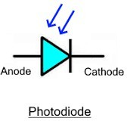
What is a Photodiode?
Introduction
A semiconductor device that converts light into electrical current.
Symbol: Standard diode symbol with two arrows pointing inward.
Key Fact: Usually operated in Reverse Bias mode.

Slide 5
Principle of Operation
Introduction
The Internal Photoelectric Effect.
Creation of electron-hole pairs region.
(EHPs) in the depletion
Formula for photon energy:
𝐸 = ℎP
where E must be greater than the bandgap E_{g}.
The photon must possess enough energy to bridge the forbidden gap of the semiconductor material to create a
charge carrier i.e., 𝐸 ≥ 𝐸_{g}

Slide 6
How it Works (Reverse Bias):
Introduction
No Light: A small dark current flows.
Light Strikes: Photons absorbed in the depletion region create electron-hole pairs.
Current Flow: The strong electric field sweeps these carriers across the junction, generating a photocurrent in the external circuit.
Intensity Matters: More light means more pairs, thus more current.
In essence, the photodiode translates light energy into a measurable electrical current, with it’s V-I curve mapping this light-dependent behavior.

Slide 7
Construction & Materials
Introduction
PN Junction structure.
Common materials: Silicon (Si) for visible light, Germanium (Ge) or InGaAs for Infrared.
Importance of the "Window" or lens.
Silicon's bandgap of approximately 1.1 eV makes it ideal for detecting light across the visible and near- infrared range.

Slide 8
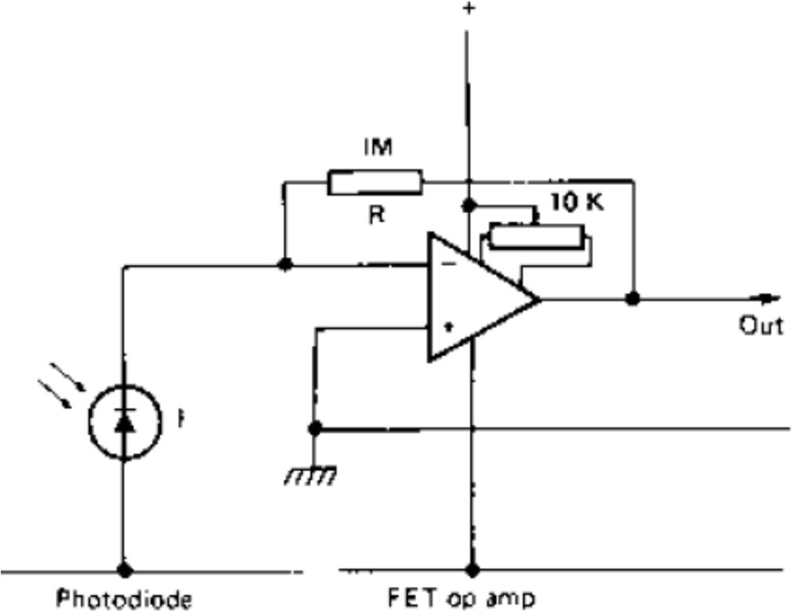
Modes of Operation
Introduction
Photovoltaic Mode (Zero Bias): Used in solar cells; no external power.
Photoconductive Mode (Reverse Bias): Faster response time; used for high-speed data.
Si Photodiode circuit under reverse bias

Slide 9
V-I Characteristics
Introduction
Graph showing "Dark Current" (current with zero light).
Linear relationship between incident light intensity and output current (I_{λ}).
Effect of increasing illumination on the reverse current curve.
For a typical Si photodiode, the peak spectral response is at 750 nm, which is in the near infrared, and the sensitivity is
0.7 µA/mW/cm².

Slide 10
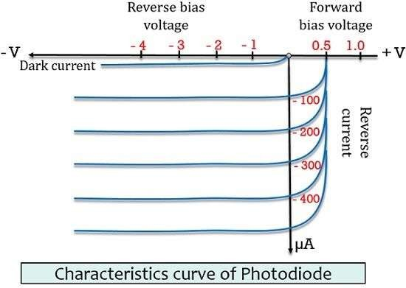
V-I Characteristics
Introduction

Slide 11
Sensitivity of Photodiodes
Introduction
Sensitivity: Measured in µA of current per mW/cm² of incident power.
Dark Current: The small amount of current (e.g., 1.4 nA) that flows when no light is present.
Temperature Sensitivity: Dark current doubles for every 10°C rise in temperature.

Slide 12
Advantages of Photodiodes over LDRs
Introduction
Linearity: The current plotted against illumination is reasonably linear.
Speed: Response times are approximately 250 ns.
High-Frequency Use: Suitable for modulated light beams carrying video signals due to high speed.

Slide 13
PIN and Avalanche Photodiodes (Special Types)
Introduction
PIN Diode: Features an Intrinsic layer to increase sensitivity.
Avalanche Photodiode (APD): Uses internal gain (impact ionization) for low-light detection.

Slide 14
Summary and Comparison
Introduction
Photomultipliers: Extremely sensitive, noiseless amplification, used for low light.
Photoresistors (LDRs): Rugged, high voltage/AC capable, but slow response times.
Photodiodes: Fast response, linear output, ideal for data/modulated signals.

Slide 15
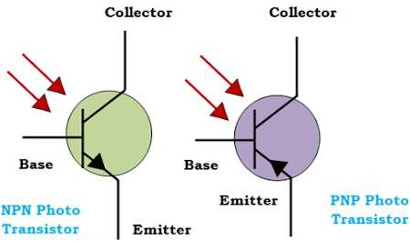
Introduction to Phototransistors
Introduction
What is it? A bipolar transistor that uses light instead of base current.
Symbol: Transistor symbol with inward arrows (often missing the base lead).
Core Advantage: Built-in gain/amplification i.e., The phototransistor provides internal current gain (β), making it much more sensitive to low light levels than a standard photodiode.

Slide 16
Construction and Symbol
Introduction
Physical structure: Large base-collector area to maximize light absorption.
Comparison: It acts like a photodiode integrated with a standard BJT.

Slide 17
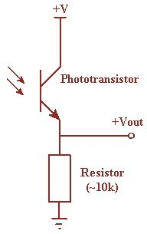
How it Works?
Introduction
Light hits the base-collector junction.
This junction is usually reverse-biased and large in area, acting like a photodiode that provides the current for the transistor.
This generated current acts as the base current (I_{B}).
The transistor amplifies this current:𝐼_{C} ≈ 𝛽 · 𝐼_{λ}.

Slide 18
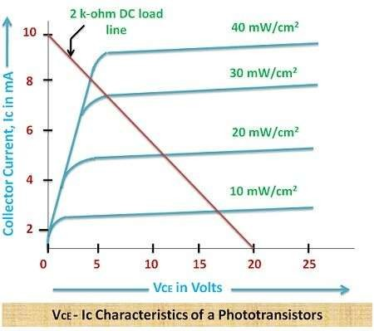
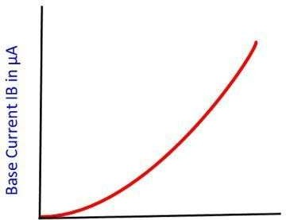
I-V Characteristics
Introduction
Irradiance, mW/cm²

Slide 19
Performance Characteristics
Introduction
Higher sensitivity compared to photodiodes.
Trade-off: Slower switching speeds (higher capacitance).
Relationship: Collector current vs. Illumination level.
Sensitivity: Since typically ranges from 100 to 1000, the output current of a phototransistor is hundreds of times larger than that of a standalone photodiode.
Linearity Note: While 𝐼_{λ} is linear with light, 𝛽 can vary
making
slightly with temperature and current levels,
phototransistors less linear than photodiodes at extreme ranges.

Slide 20
Comparison and Conclusion
Introduction
Feature
Sensitivity
Speed Linearity Dark Current
Photodiode
Lower
Very Fast (ns) Excellent Very Low
Phototransistor
Higher (due to gain)
Moderate (µs) Fair
Higher

Slide 21
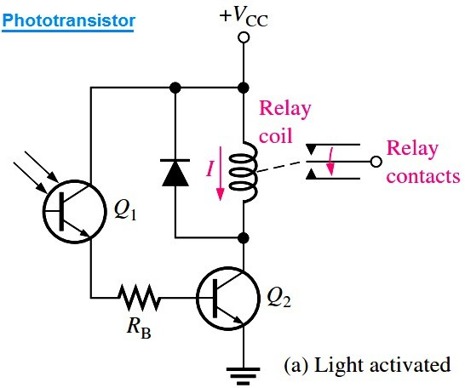
Practical Applications
Introduction
Photodiodes: Fiber optic
receivers,
smoke
detectors,
medical imaging.
Phototransistors: Light-activated relays, optoisolators, "Object present" sensors in assembly lines.

Slide 22
Summary of Core Differences
Introduction
Feature
Photodiode
Light-to-current converter.
High Speed: Ideal for MHz/GHz data rates.
Phototransistor
Light-to-current converter with gain.
Moderate Speed: Limited by internal capacitance.
Higher: Internal amplification (β) is built-in.
Non-Linear: Response varies with bias and gain.
Remote controls, object counters, relays.
Primary Function
Response Speed
Sensitivity
Lower: Requires external amplification.
Highly Linear: Current is proportional to light.
Fiber optics, precision light measurement.
Linearity
Best Used For

Slide 23
Phototransistors: Summary
Introduction
Explored the fundamental optoelectronic sensors.
While both convert light
principles of two critical
into electrical signals, their
internal mechanisms define their ideal use cases.
Choose a Photodiode when your application demands high speed (e.g., high-speed telecommunications) or precision measurement where linearity is critical.
Choose a Phototransistor when your application requires a stronger output signal without extra circuitry and high switching speed is not a priority (e.g., a simple light detector).

Slide 24
Introduction to Photovoltaic Devices
Introduction
Definition: A Photovoltaic (PV) cell, commonly known as a solar cell, is a solid-state semiconductor device that converts light energy directly into electrical energy.
The Physics: The operation is based on the Photovoltaic Effect, first observed in 1839. Unlike thermal solar power, PV devices have no moving parts.
Key Materials: Crystalline Silicon (c-Si): The industry standard (95% market share).
Thin-Film: Cadmium Telluride (CdTe) and CIGS.
Emerging Tech: Perovskites and Organic PVs.

Slide 25
Working Principle: From Photons to Electrons
Introduction
Absorption: Photons from sunlight strike the cell. If their energy (ℎP) is greater than the semiconductor's bandgap (E_{g}), they are absorbed.
Carrier Generation: The absorbed energy excites electrons from the valence band to the conduction band, creating electron-hole pairs.
Charge Separation: An internal electric field at the P-N
Junction separates these charges pushing electrons toward the N-type layer and holes toward the P-type layer.
Current Flow: When an external load is connected, the electrons flow through the circuit to reach the holes, creating a Direct Current (DC).

Slide 26
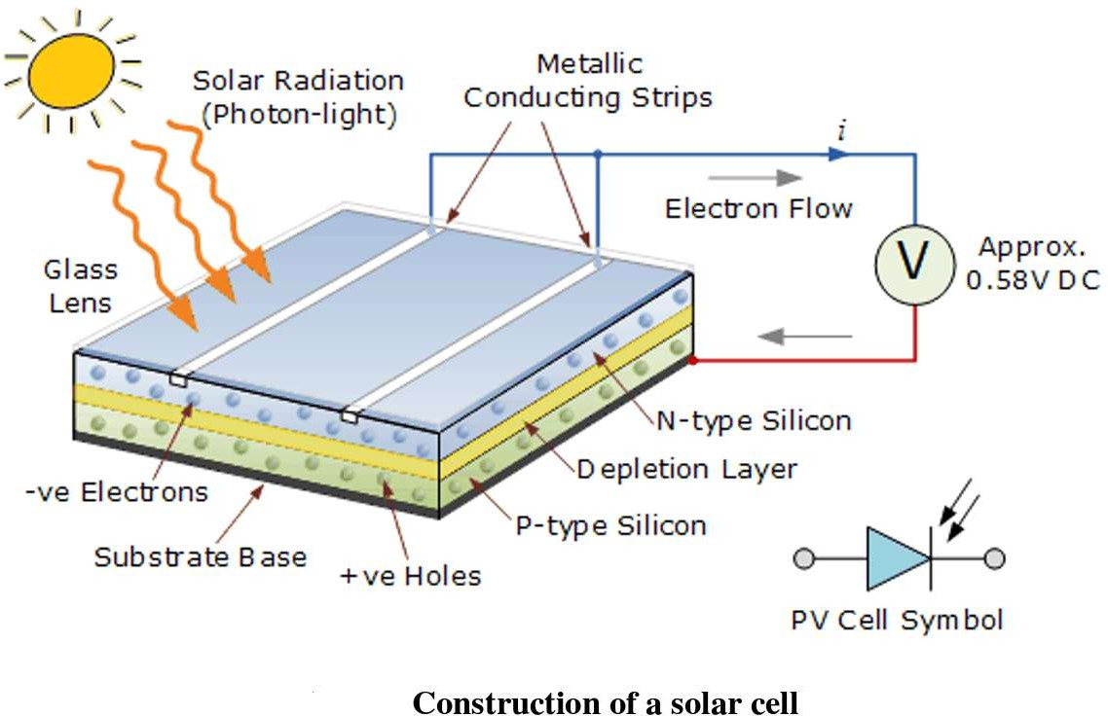
Construction
Introduction

Slide 27
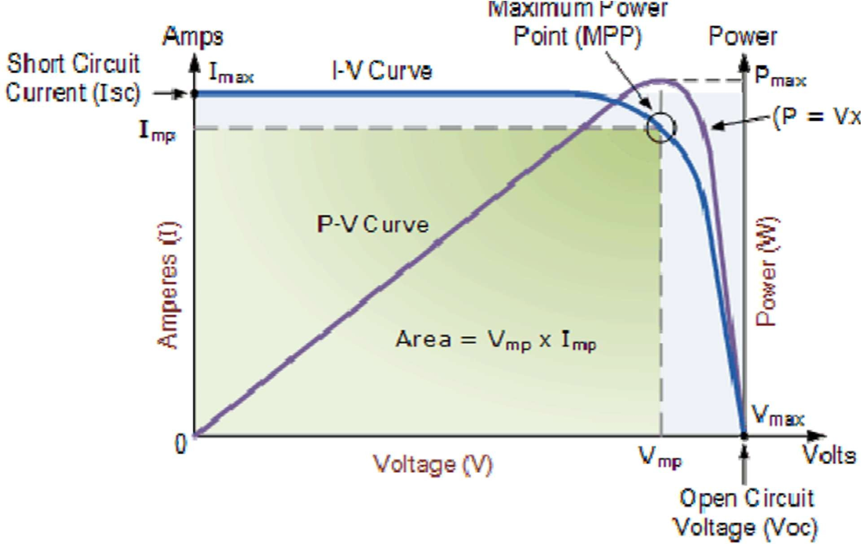
V-I Characteristics
Introduction
^{𝑉}mp ^{× 𝐼}mp
𝐹𝑖𝑙𝑙 𝐹𝑎𝑐𝑡𝑜𝑟 =
^{𝑉}oc ^{× 𝐼}sc
Typically, 0.7-0.82 for silicon

Slide 28
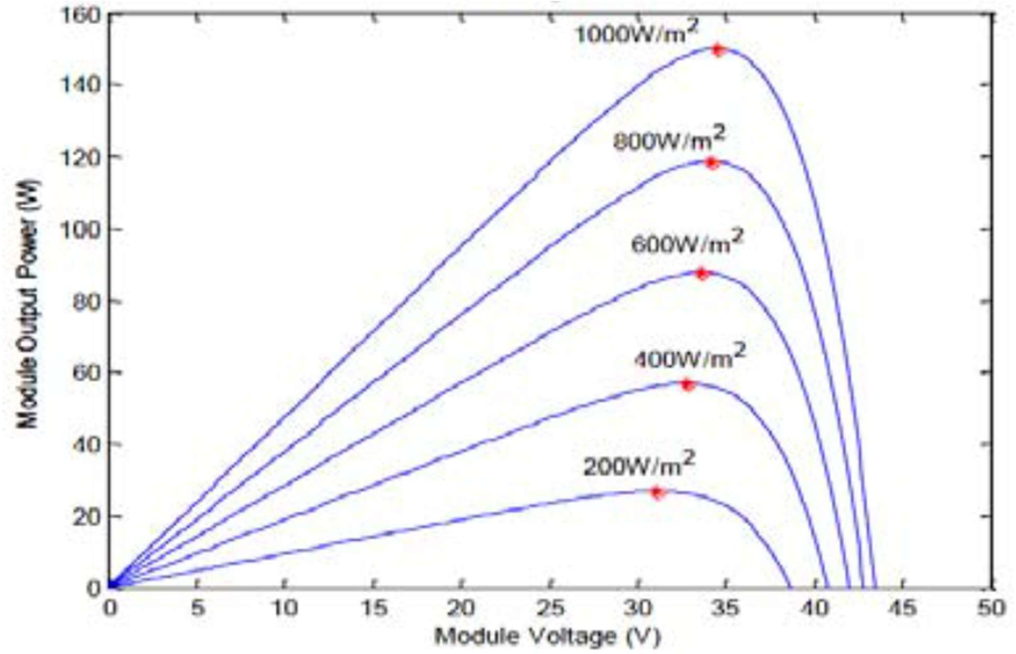
P-V Characteristics at different irradiance levels
Introduction

Slide 29
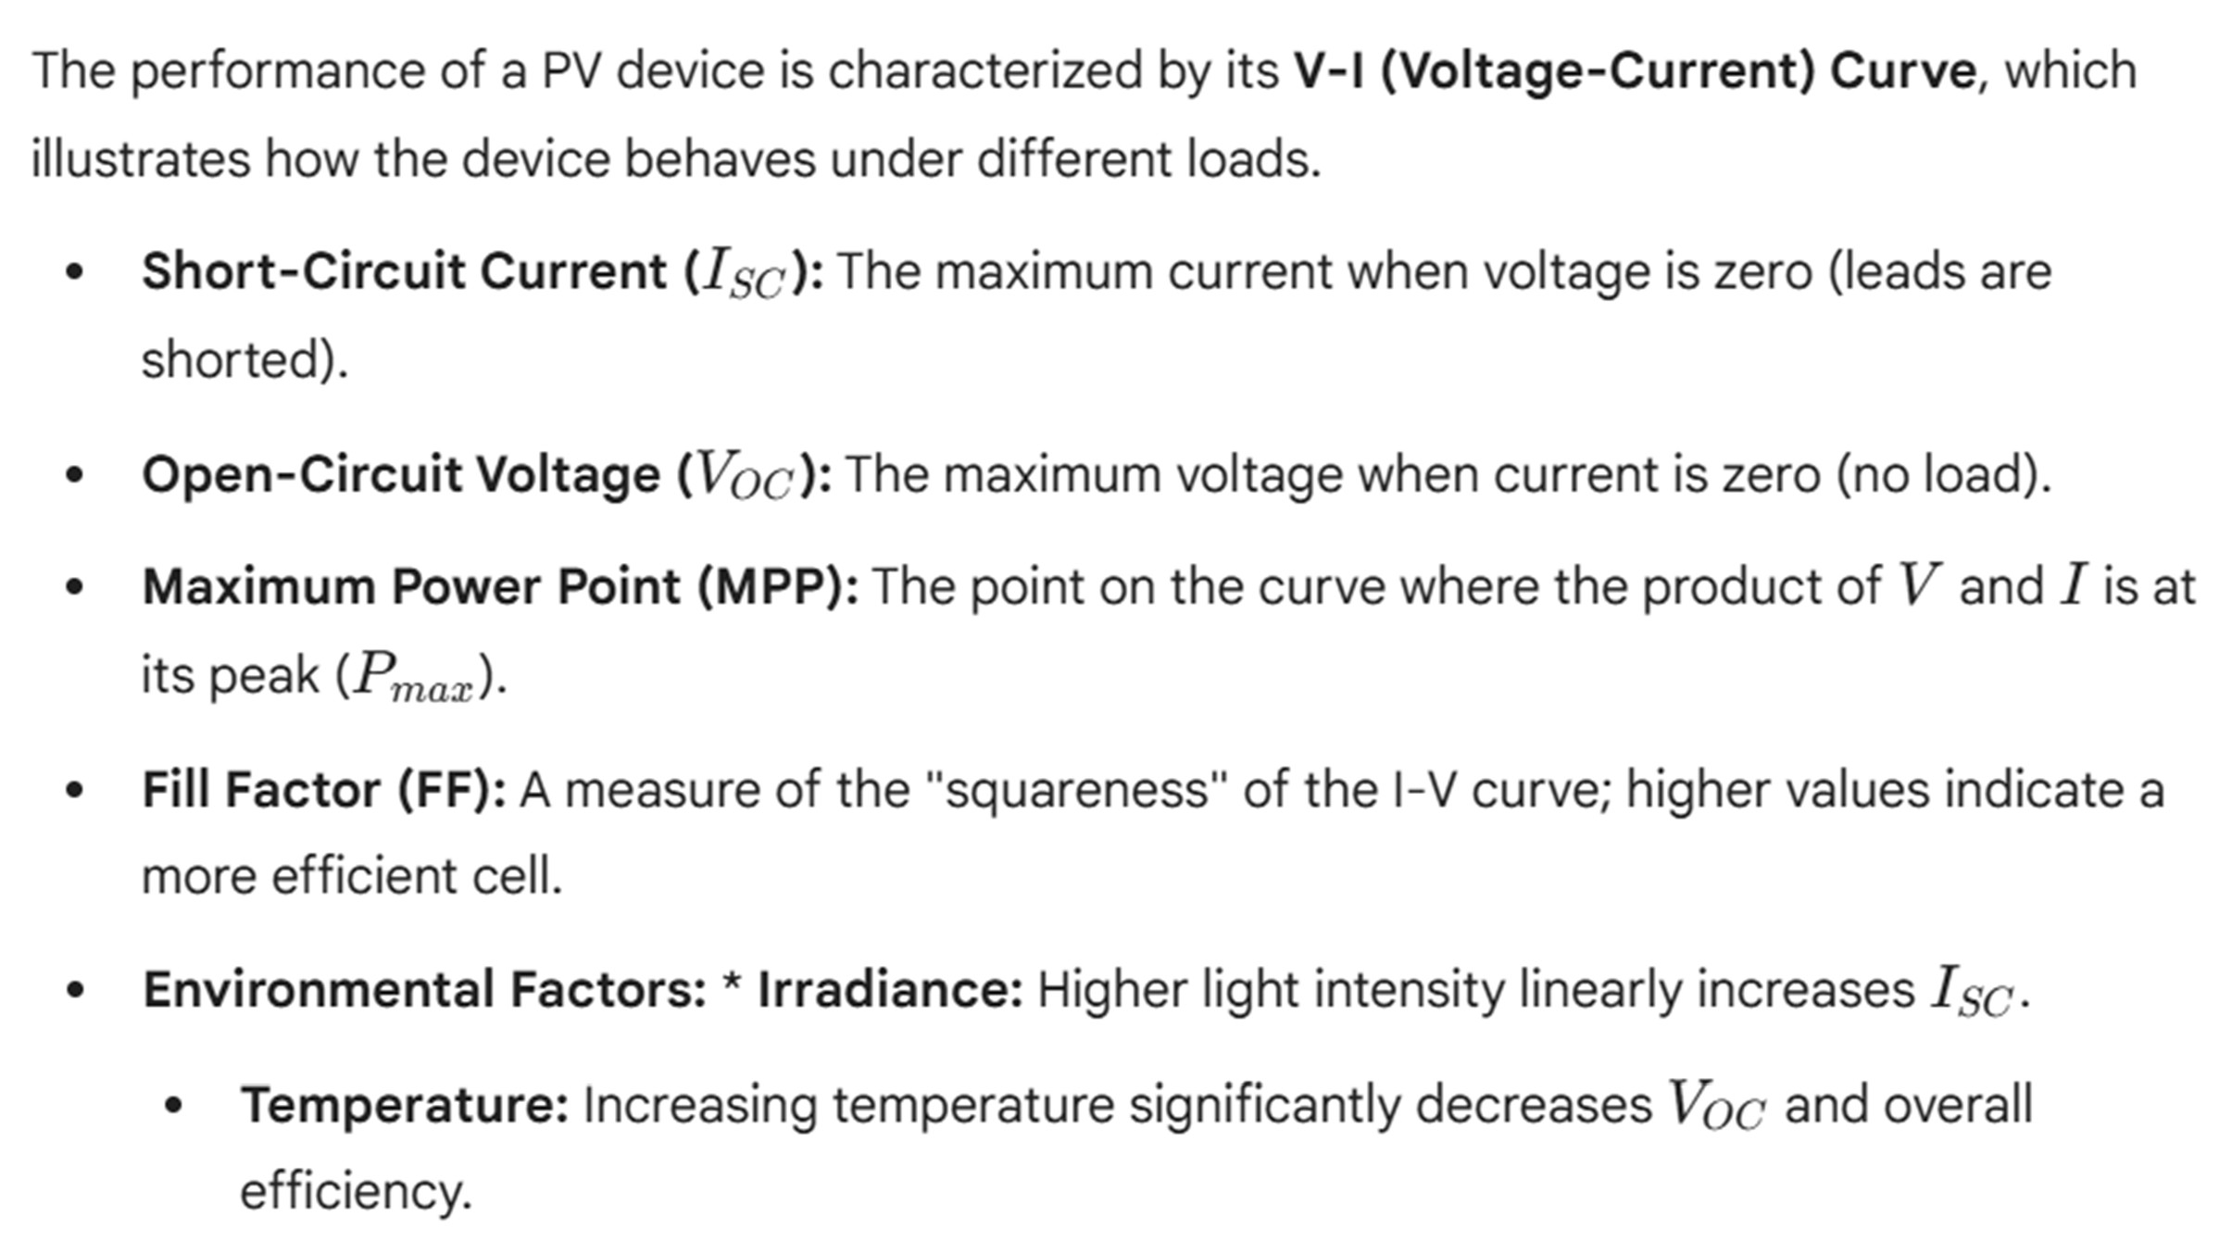
V-I Characteristics
Introduction

Slide 30
Key Characteristics & Efficiency
Introduction
Efficiency: The ratio of electrical power output to the incident solar power.
Standard Commercial Efficiency: 15% – 22%.
Lab Records (Multi-junction): ~47%.
Scalability:
Cell: The basic unit (~0.5 to 0.6V).
Module (Panel): Multiple cells connected (typically 60 or 72 cells).
Array: Multiple modules connected together to reach the
desired power output.
Dark Current: The small leakage current that flows in the absence of light.

Slide 31
Applications of Photovoltaic Devices
Introduction
Consumer Electronics: Calculators, wristwatches, and portable power banks.
Residential & Commercial: Rooftop solar systems (BIPV - Building Integrated Photovoltaics) for energy independence.
Remote & Off-Grid: Powering weather stations and seismic
sensors in remote locations.
Solar Water Pumping for agricultural irrigation in rural areas.
Space Exploration: Satellites and the International Space Station rely almost exclusively on high-efficiency PV arrays.
Utility Scale: Massive solar farms providing gigawatts of clean energy to the national grid.

Slide 32
Summary
➢ Introduction
The core difference between PE and PV is where the light-excited electrons go:
Photoelectric Effect ejects electrons completely out of a material (often into a vacuum),
Photovoltaic Effect excites electrons within a material, causing them to move into a different layer (like in a semiconductor junction) to generate voltage and current, powering devices like solar panels.
Photoelectric involves emission, whereas photovoltaic involves
internal charge separation and flow, producing both current and voltage without needing to escape the material entirely.

Slide 33
Test your understanding
Define "Dark Current" in a photodiode.
Draw the circuit symbol for a photodiode and a phototransistor.
Explain the working principle of a photodiode with a neat diagram and V-I characteristics.
Compare Photodiodes and Phototransistors based on sensitivity, speed, and application.
Describe the construction, V-I characteristics, and applications of phototransistors. How does the base current relate to light intensity?
Define the 'Fill Factor' (FF) of a solar cell.
Explain the V-I characteristics of a photovoltaic cell with a neat diagram.
Describe the construction and working principle of a P-N junction solar cell. Discuss its major applications in modern energy systems.
Write the difference between photoelectric and photovoltaic effect.

Slide 34
Textbook
Ian R Sinclair, Sensors and Transducers, Third Edition, 2001 (Units I & II).
Ramon PallásAreny, John G. Webster, Sensors and Signal conditioning, John Wiley and Sons, Second Edition, 2000.

