Slide 1

UEC3942: Introduction to Sensors and Actuators
Unit III: Piezoresistive Pressure Microsensors
Presentation by: Dr. C. Annadurai
Associate Professor/Dept. of ECE SSN College of Engineering

Slide 2
Learning Outcomes
Overview
To understand the construction, working principles, and real-world applications of Piezoresistive Pressure Microsensors.
To explore the MEMS-based Pressure Sensing Technology.

Slide 3
What is a Microsensor?
Overview
Definition of MEMS (Micro-Electro-Mechanical Systems).
Transition from macro-scale sensors to micro-scale.
The role of pressure sensing in modern electronics.
Why use piezoresistive materials? (High sensitivity,
established manufacturing).

Slide 4

What is the Piezoresistive Effect?
Introduction
Definition: The change in electrical resistivity semiconductor when mechanical strain is applied.
Key Formula:
(ρ) of a
The Mathematics of Piezoresistivity:
The resistance (R) of a conductor is defined by its
geometry and its resistivity:
where ρ is resistivity, L is length, and A is cross-sectional area. When a sensor is strained, all three variables can change.

Slide 5

Expanded: The Mathematics of Piezoresistivity
Introduction
The Fundamental Derivation
By taking the natural log and differentiating the resistance
formula, we arrive at the relative change in resistance:
Geometry vs. Material Properties
For a wire with Poisson’s ratio (𝜈) and axial strain (𝜖 = ^{𝑑𝐿}):
𝐿
represents
Dimensional Change: The term (1 + 2𝜈)𝜖
how the physical shape changes (getting longer and thinner).
Piezoresistive Change: The term dρ/ρ represents the change in the crystal's internal electrical properties.

Slide 6

Expanded: The Mathematics of Piezoresistivity
Introduction
The Gauge Factor (GF)
The Gauge Factor is the measure of sensitivity. It is the ratio of relative change in resistance to mechanical strain:
Material | Typical Gauge Factor (GF) | Dominant Factor
Metals | ≈ 2.0 | Geometric change
Silicon (p-type) | 100 to 170 | Piezoresistive effect (Δρ)
The "Piezoresistive Effect" in silicon is primarily caused by a change in the electrical resistivity (ρ) due to changes in carrier mobility.

Slide 7
Why Silicon Wins?
Introduction
In semiconductors like Silicon, the term is massive because mechanical stress alters the energy bands and carrier mobility.
In p-type silicon, stress changes the "hole" mobility.
The math shows that Silicon is nearly 50–80 times more sensitive than standard metal foil gauges.
While metal sensors rely on "stretching" the wire, silicon microsensors rely on "changing the nature" of the material itself. This is why we can make them so small yet so incredibly precise.

Slide 8
Piezoresistivity in Silicon
Introduction
Why Silicon? It has a high "Gauge Factor" (GF) compared to metals.
Effect of crystal orientation on sensitivity.

Slide 9
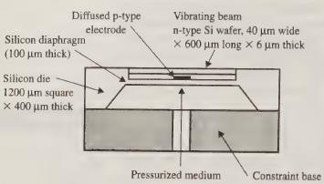
Construction
Introduction
A thin n-type silicon beam is installed across a shallow
cavity at the top surface of the silicon die.
A p-type electrode is diffused at the surface of that cavity under the beam.
The p- and n-type silicon layers are doped with,
respectively boron and phosphorus.

Slide 10
Construction
Introduction
The beam is made to vibrate at its resonant frequency by applying an ac signal to the diffused electrode in the beam before the application of the pressure to the diaphragm.
The stress induced in the diaphragm (and the die) will be transmitted to the vibrating beam.
The induced stress along the beam causes a shift in the resonant frequency of the beam.
This shift in the resonant frequency of the beam can be correlated to the induced stress and thus to the pressure applied to the silicon diaphragm.

Slide 11
Construction
Introduction
This type of signal transduction is insensitive to
temperature and provides excellent linear output signals.
The disadvantage of such sensors is the cost to fabricate them.
Material Selection:
Substrate: Single-crystal Silicon.
Piezoresistors: P-type or N-type doped silicon.

Slide 12
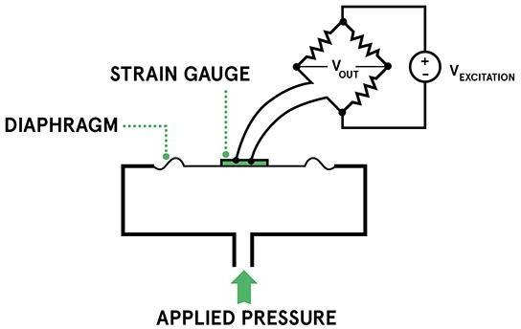
Construction
Introduction
A silicon diaphragm strain gauge.
When pressure is
has an embedded piezoresistive
applied, the diaphragm deforms,
inducing strain on the piezoresistive elements.
This strain resistance, detected
changes the which is
using a
Wheatstone bridge circuit.

Slide 13
Working Mechanism
Introduction
The Sensing Process (Step-by-Step)
Pressure difference (ΔP) acts on the diaphragm.
Diaphragm deflects.
Mechanical Strain to Electrical Signal
Deflection creates mechanical stress at the edges.
Piezoresistors experience strain, changing their resistance.
Signal Output
The Wheatstone bridge becomes unbalanced.
Output Voltage (V_{out}) is proportional to the input pressure.
Sensitivity Factors
Diaphragm thickness (h) and radius (a).
Doping concentration of the resistors.

Slide 14
Fabrication (The "Micro" Part)
Introduction
MEMS Fabrication Overview
Photolithography and Etching.
Bulk Micromachining
Anisotropic silicon etching (using KOH or TMAH) to create the diaphragm from the backside.
Resistor Integration
Ion implantation or diffusion to "embed" the piezoresistors into the silicon.

Slide 15
Applications
Introduction
Automotive Applications
TPMS (Tire Pressure Monitoring Systems).
Manifold Absolute Pressure (MAP) sensors efficiency.
for engine
Industrial & Consumer Electronics
Altimeters in smartphones and drones.
Industrial HVAC pressure control.
Biomedical Applications
Invasive blood pressure monitoring (catheter-tip sensors).
Respiratory monitoring devices.

Slide 16
Conclusion
➢ Introduction
Summary of benefits: miniaturization, high cost involved in fabrication.
Future: Integration with IoT and AI-driven calibration.

Slide 17
Test your understanding
Define Gauge Factor and state its significance in microsensor design.
Explain the role of the diaphragm in a piezoresistive pressure sensor.
List two advantages of using MEMS-based pressure sensors over traditional mechanical gauges.
Draw the circuit diagram of a Wheatstone bridge integrated with four
piezoresistors. Explain how it compensates for temperature fluctuations.
Briefly explain why the piezoresistive effect is more pronounced in semiconductors (like Silicon) than in metals.
Describe the complete energy conversion process in a piezoresistive
pressure sensor, starting from the application of fluid pressure to the
generation of an electrical output voltage. Include the relevant mathematical equations for stress and resistance change.
Discuss two critical applications of these sensors in the medical field
and two in the automotive industry.

Slide 18
References
Tai Ran Hsu, MEMS and Microsystems Design and
Manufacture, Tata McGraw Hill, First Edition, 2002.

Slide 19
Thank you

