Slide 1

UEC3942: Introduction to Sensors and Actuators
Unit III: Quartz Crystal Microbalance (QCM) Sensors
Presentation by: Dr. C. Annadurai
Associate Professor/Dept. of ECE SSN College of Engineering

Slide 2
Learning Outcomes
Overview
To understand the working principles, technology, and applications of Quartz Crystal Microbalance (QCM) acoustic sensors.

Slide 3
What is a QCM?
Overview
Definition: An ultra-sensitive weighing device that measures mass changes per unit area by measuring the change in frequency of a quartz crystal resonator.
Sensitivity: Capable of detecting mass changes at the nanogram scale (10⁻⁹ grams).
Core Principle: It utilizes the Acoustic Wave phenomenon, specifically Thickness Shear Mode (TSM) and uses waves that travel through the bulk of the crystal.
Application: Precision Mass Sensing through Piezoelectric Resonance

Slide 4
The Piezoelectric Effect
Introduction
The Foundation: QCM
relies on the piezoelectric
properties of quartz.
Inverse Piezoelectric
Effect: Applying an alternating
current (AC) voltage across the crystal causes it to oscillate (vibrate) at its resonant frequency.
Why Quartz? High mechanical stability, low temperature sensitivity (AT-cut crystals), and excellent frequency-to- mass correlation.

Slide 5
Anatomy of a QCM Sensor
Introduction
The Crystal:
Typically, a thin, circular disk of "AT-cut"
quartz.
Electrodes: Gold, Silver, or Platinum electrodes are deposited on both sides to provide the electrical field.
Mounting: Held in a specialized cell that allows one or both sides to be exposed to the sample (gas or liquid).

Slide 6
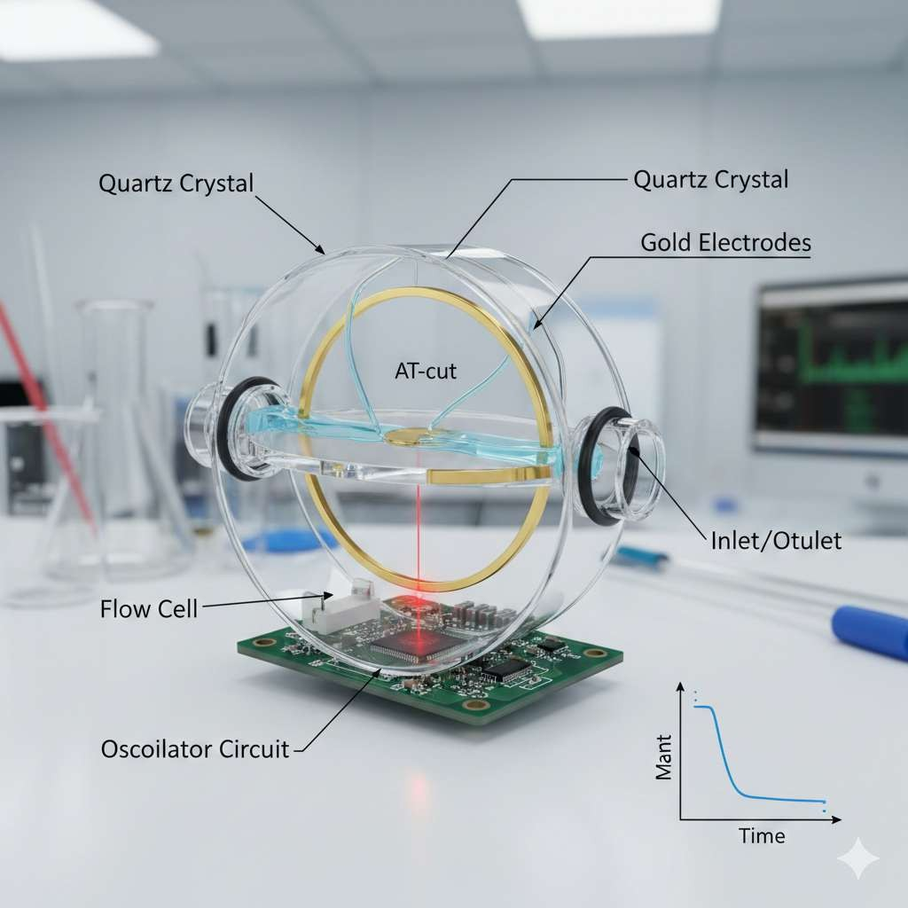
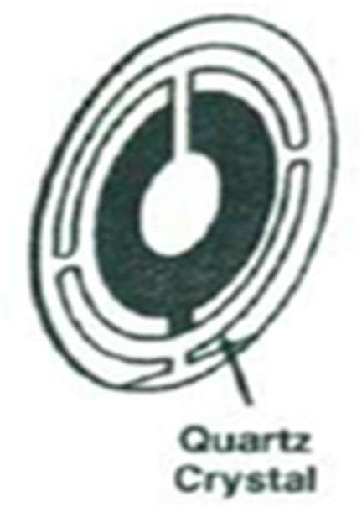
Anatomy of a QCM Sensor
Introduction

Slide 7
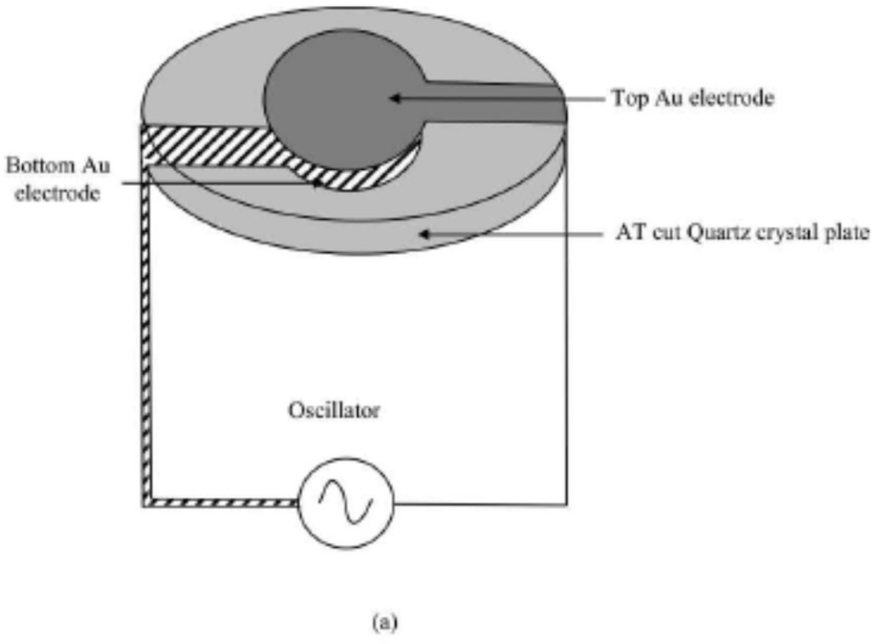
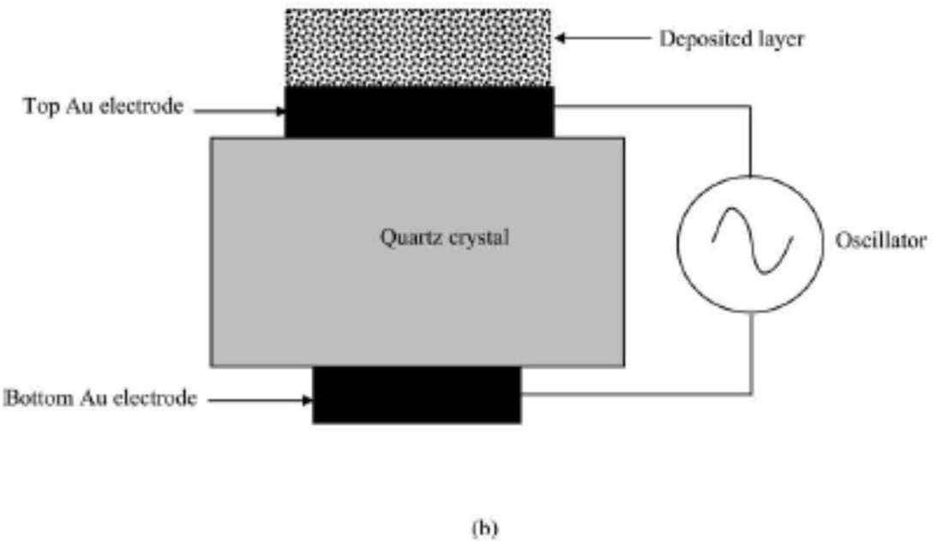
Anatomy of a QCM Sensor
Introduction
QCM (a) Schematic Diagram and (b) Cross-section

Slide 8
The Sauerbrey Equation
Introduction
Sauerbrey the change in
The Mathematical Link: In 1959, Günter
established the linear relationship between frequency (Δf) and the change in mass (Δm).
Equation:
2ƒ²
∆𝑓 = − ⁰
∆𝑚
A ρ_{g}μ_{g}
Key Variables:
f₀: Resonant frequency
A: Active vibrating area
ρ_{q}: Density of quartz
µ_{q}: Shear modulus of quartz

Slide 9
The Sauerbrey Equation
Introduction
According to the Sauerbrey equation, if a rigid layer is evenly deposited on one or both the electrodes, the resonance frequency decreases proportionally to the mass of the adsorbed layer.
The resonance frequency changes as a linear function of the mass of material deposited on the crystal surface.
The mass-sensitive area is situated in the central part of the resonator, covering approximately the area where the two electrodes overlap.

Slide 10
Under what conditions does the Sauerbrey equation apply?
Introduction
The Sauerbrey equation is derived by treating the deposited mass as though it were an extension of the thickness of the underlying quartz.
Hence, it is only strictly applicable to uniform, rigid, thin-film deposits.
In certain situations, the Sauerbrey equation does not hold; citable instances are when the added mass is
(i) not rigidly deposited on the electrode surface(s),
(ii) slips on the surface, or
(iii) is not deposited evenly on the electrode(s).

Slide 11
QCM in Liquids (QCM-D)
➢ Introduction
Beyond Mass: Standard QCM assumes a rigid film. In liquids, energy is lost to the medium.
Dissipation (D): Measures how quickly the oscillations die out when the power is cut.
Insights:
Low D: Rigid, thin film.
High D: Soft, viscoelastic, or "floppy" film (e.g., polymers, cells).

Slide 12
Experimental Setup
➢ Introduction
Oscillator Circuit: Drives the crystal at its resonant frequency.
Frequency Counter: Captures real-time shifts as molecules bind to the surface.
Temperature Control: Essential, as frequency is highly sensitive to thermal fluctuations.
Flow Cell: Directs the analyte over the sensor surface.

Slide 13
Key Applications
➢ Introduction
Biosensing: Detecting DNA hybridization, protein-protein interactions, and antibody-antigen binding.
Environmental: Monitoring gas pollutants or heavy metals in water.
Material Science: Studying polymer thin-film growth and electrochemical deposition.
Vacuum Processes: Measuring thin-film thickness during metal evaporation/sputtering.

Slide 14
Advantages and Limitations
Introduction
Advantages
Real-time, label-free detection
Extremely high mass sensitivity
Works in both gas and liquid phases
Small sample volumes required
Limitations
Highly sensitive to temperature/pressure
Maximum mass load limits
Complex data analysis for soft films
Fragile crystal components

Slide 15
Conclusion
➢ Introduction
QCM is a versatile tool for probing the "nanoworld."
It bridges the gap between simple mass measurement and complex material characterization (viscoelasticity).
Future Outlook: Integration with Lab-on-a-Chip devices and advanced nanomaterial coatings for higher selectivity.

Slide 16
Test your understanding
Define "Thickness Shear Mode" (TSM) in the context of QCM.
Why is gold commonly used as the electrode material for QCM crystals?
State and explain the Sauerbrey Equation. What are the key assumptions that must be met for this equation to remain valid?
Compare the behavior of a QCM sensor in a vacuum/gas environment
versus a liquid environment.
Describe the role of "Dissipation monitoring" in modern acoustic
sensing. How does it help differentiate between a rigid biofilm and a soft polymer layer?
Sketch the typical experimental setup of a QCM system and explain the function of each component (the crystal, oscillator circuit, and frequency counter). Discuss the importance of temperature control in these measurements.

Slide 17
Test your understanding
7. Derive or explain the physical significance of the shear modulus (µ_{q}) and density (ρ_{q}) of quartz in determining the fundamental resonant frequency. How does the thickness of the quartz disk influence the base frequency and the resulting mass sensitivity?

Slide 18
References
D. S. Ballantine et. al., Acoustic Wave Sensors: Theory, Design and Physico-Chemical Applications, Academic Press, 1997.
Vinod Kumar Khanna, Nanosensors: Physical, Chemical, and Biological, CRC Press, Second Edition, 2021.
https://pmc.ncbi.nlm.nih.gov/articles/PMC6833005/pdf/sen sors-19-04395.pdf
https://industry.plantautomation-technology.com/ whitepapers/1485944904-acoustic-wave-technology- sensors.pdf

