Slide 1

UEC3942: Introduction to Sensors and Actuators
Unit III: Surface Acoustic Wave (SAW) Sensors
Presentation by: Dr. C. Annadurai
Associate Professor/Dept. of ECE SSN College of Engineering

Slide 2
Learning Outcomes
Overview
To understand the working principle, types of surface waves, limitations, and applications of Surface Acoustic Wave (SAW) sensors.

Slide 3
Introduction to SAW Technology
Overview
Definition: A class of Micro-Electro-Mechanical Systems (MEMS) that rely on the modulation of surface acoustic waves to sense physical or chemical phenomena.
The "Surface" Advantage: Because the energy is concentrated on the surface, the sensor is extremely sensitive to any surface changes (mass loading, viscosity, or conductivity).
Frequency Range: Typically operates in the MHz to GHz range.
While QCM uses waves that travel through the bulk of the crystal, SAW sensors use waves that travel strictly along the surface.

Slide 4
Working Principle
Introduction
Piezoelectric Transduction: SAW sensors consist of a piezoelectric substrate (like Lithium Niobate) with Interdigital Transducers (IDTs) on the surface.
Mechanism:
An electrical signal is applied to the Input IDT.
The inverse piezoelectric effect converts the electrical signal into a mechanical Surface Wave.
The wave travels across the "Delay Line" (sensing area).
The Output IDT converts the mechanical wave back into an electrical signal.

Slide 5
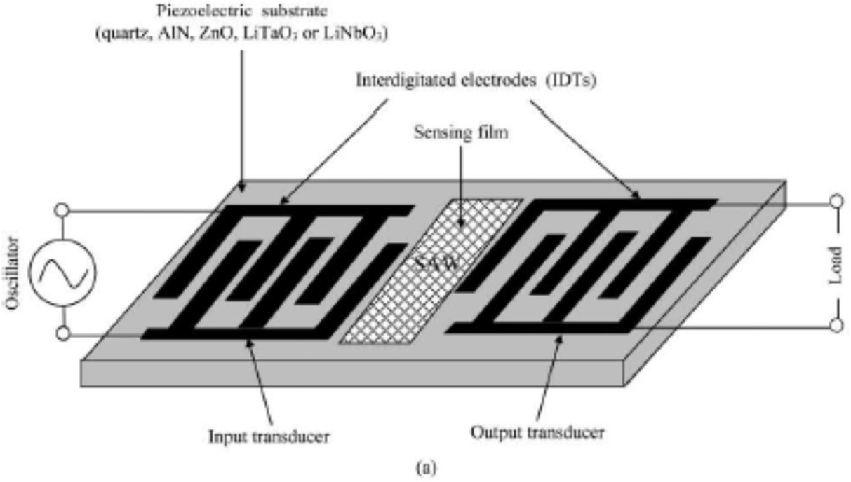
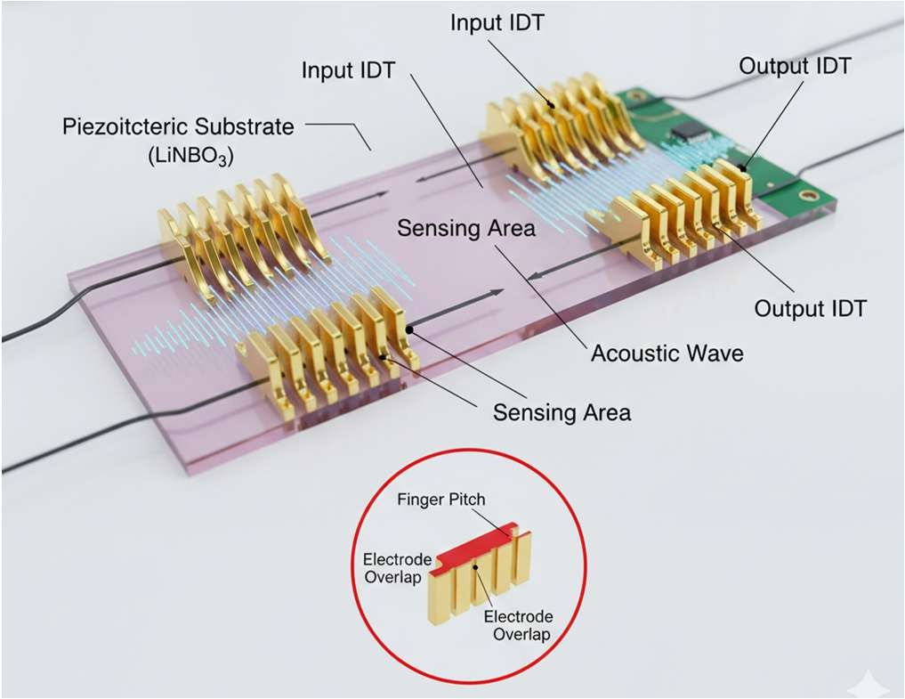
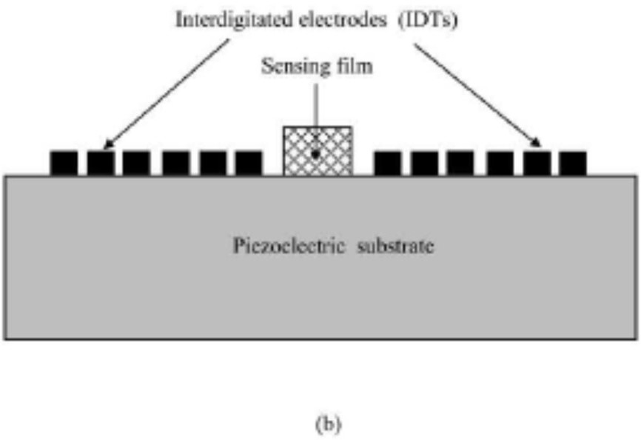
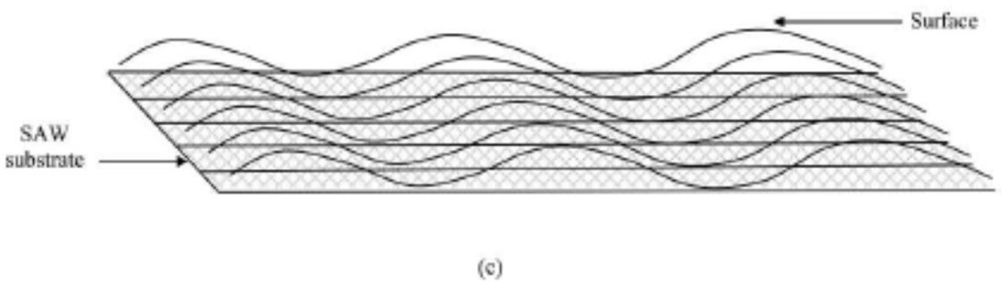
Working Principle
Introduction
Surface acoustic wave (SAW) device:
(a) schematic layout, (b) cross-sectional diagram, and (c) SAWs.

Slide 6
Working Principle
Introduction
SAW sensors
consist of the gas-sensitive material
deposited between the input and output interdigitated transducers (IDTs).
The input IDT creates electric fields alternating in time and space, which penetrate into the piezoelectric substrate and generate mechanical stresses through the piezoeffect.
In this way, the transducer produces SAWs, which propagate on the surface. These waves are detected by the output transducer.

Slide 7
Working Principle
Introduction
The gas gets adsorbed onto the sensitive film when the SAW sensor is exposed to it at room temperature and/or at elevated temperature, which, in turn, changes the conductivity of the film.
This conductivity change affects the velocity of the SAW traveling across the film and gives rise to a frequency change, which corresponds to the percentage of the gas molecules adsorbed by the film.

Slide 8
Delay Line
Introduction
A delay line is a circuit designed to introduce a calculated delay into the transmission of a signal.
An acoustic delay line delays the propagation of a sound wave by circulating it through a liquid or solid medium.
SAW delay lines are used as sensitive mass detectors by virtue of changes in SAW velocity.
Decreasing the SAW device area increases the operating frequency (f) and dramatically improves the mass sensitivity (the mass detection limit is proportional to 1/f³, assuming that noise is linear in f).

Slide 9
Key Components: The IDT
Introduction
Interdigital Transducers (IDTs): These are comb-like metallic structures deposited on the substrate.
Design Factors:
Finger Pitch: Determines the wavelength (λ) and operating frequency.
Aperture: The overlap of the fingers, affecting the signal strength.
Equation: The resonant frequency is defined by f = ν/λ, where ν is the phase velocity of the wave.

Slide 10
Types of Surface Waves
Introduction
Rayleigh Waves: Common in gas-phase sensing; have both longitudinal and vertical shear components.
Love Waves: Shear-horizontal waves guided by a thin layer; ideal for liquid-phase sensing because they don't dissipate energy into the fluid as easily as Rayleigh waves.
STW (Surface Transverse Waves): High-velocity waves used for high-sensitivity applications.

Slide 11
Sensing Mechanisms
Introduction
How the sensor "detects" changes:
Mass Loading: Particles landing on the surface slow down the wave (frequency shift).
Viscoelastic Changes: Changes in the "stickiness" of a coating attenuate the signal.
Acouso-electric Effect: Changes in the electrical conductivity of the surface layer affect wave velocity.
Environmental Factors: Temperature, pressure, and strain alter the crystal lattice and path length.

Slide 12
SAW vs. QCM (Comparison)
Introduction
Feature Wave Path Frequency Sensitivity
QCM (Bulk Wave) Through the crystal 5–30 MHz
High
SAW (Surface Wave)
Along the surface 100 MHz – 2 GHz
Ultra-High (Surface focus)
Mostly Gas (Rayleigh)/ Liquid (Love)
Micro-scale (mm scale)
Environment
Gas & Liquid
Size
Larger (cm scale)

Slide 13
Wireless and Passive Sensing
➢ Introduction
A Unique Feature: SAW sensors can be operated wirelessly and without a battery (passive).
How it works: An RF pulse is received by an antenna connected to the IDT, converted to a SAW, reflected back by "reflectors," and re-transmitted.
Benefit: Ideal for harsh environments (high heat, rotating parts) where wiring is impossible.

Slide 14
Industrial & Research Applications
➢ Introduction
Gas Sensing: Detecting VOCs, CO2, or humidity using specialized polymer coatings.
Automotive: Real-time Tire Pressure Monitoring Systems (TPMS).
Biomedical: Label-free detection of pathogens or biomarkers in microfluidic channels.
Aerospace: Structural health monitoring and high- temperature turbine sensing.

Slide 15
Conclusion & Future Trends
➢ Introduction
Summary: SAW sensors offer high sensitivity, wireless capability, and a small footprint.
Future Trends:
Integration with CMOS electronics.
Development of Nanomaterial coatings (Graphene, Carbon Nanotubes) for sub-parts-per-billion sensitivity.
Use in 5G/6G filters and frequency control.

Slide 16
Test your understanding
Define the "Delay Line" configuration in a SAW sensor.
Mention two environmental factors that can cause a frequency shift in a SAW sensor.
Explain the "Acousto-electric effect" and its significance in SAW chemical sensors.
Compare Rayleigh waves and Love waves in terms of particle displacement and their suitability for biosensing in aqueous solutions.
Using a neat diagram, explain the complete transduction process in a SAW sensor from the input electrical signal to the output signal.
Discuss how "Mass Loading" on the sensing area translates into a measurable frequency shift.

Slide 17
References
D. S. Ballantine et. al., Acoustic Wave Sensors: Theory, Design and Physico-Chemical Applications, Academic Press, 1997.
Vinod Kumar Khanna, Nanosensors: Physical, Chemical, and Biological, CRC Press, Second Edition, 2021.
https://pmc.ncbi.nlm.nih.gov/articles/PMC6833005/pdf/sen sors-19-04395.pdf
https://industry.plantautomation-technology.com/ whitepapers/1485944904-acoustic-wave-technology- sensors.pdf

