Slide 1

UEC3942: Introduction to Sensors and Actuators
Unit III: Shear Horizontal Acoustic Plate Mode (SH-APM) Sensors
Presentation by: Dr. C. Annadurai
Associate Professor/Dept. of ECE SSN College of Engineering

Slide 2
Learning Outcomes
Overview
To understand the working principle, types of surface waves, advantages, and applications of Shear Horizontal Acoustic Plate Mode (SH-APM) sensors.

Slide 3
Introduction to SH-APM
Overview
Definition: An acoustic sensor that utilizes shear horizontal waves propagating through the bulk of a thin piezoelectric plate.
Key Feature: The particle displacement is parallel to the sensor surface and perpendicular to the direction of wave propagation.
Evolution: Developed to provide the sensitivity of SAW sensors while maintaining the liquid-phase stability of QCM.
This sensor is often considered the "cousin" of the FPW and SAW sensors, specifically engineered to solve the problem of signal loss in liquid environments.

Slide 4
Why "Shear Horizontal"?
Introduction
The Physics: In many sensors (like Rayleigh SAW), the wave has a vertical component that "pushes" into the liquid, causing massive energy leakage.
The SH Advantage: Because the movement is purely side-to-side (shear horizontal), there is no vertical displacement to compress the surrounding liquid.
Result: Minimal energy radiation into the fluid, allowing for a high Quality Factor (Q-factor) in liquids.

Slide 5
Device Structure
Introduction
Substrate: Typically, a thin plate of quartz (Z-prop, ST-cut) or Lithium Niobate (LiNbO₃).
Thickness: The plate is thin, but generally thicker than the membranes used in FPW sensors.
Transducers: Interdigital Transducers (IDTs) are placed on one side of the plate.
Dual-Sided Potential: One side can hold the electronics (IDTs) while the other side is exposed to the liquid, protecting the circuitry.

Slide 6
Working Principle
Introduction
Generation: IDTs excite the plate, generating multiple acoustic modes.
Wave Propagation: The wave travels by reflecting between the top and bottom surfaces of the plate.
Sensitivity: Since the wave "fills" the plate, both surfaces are sensitive to changes in the environment.

Slide 7
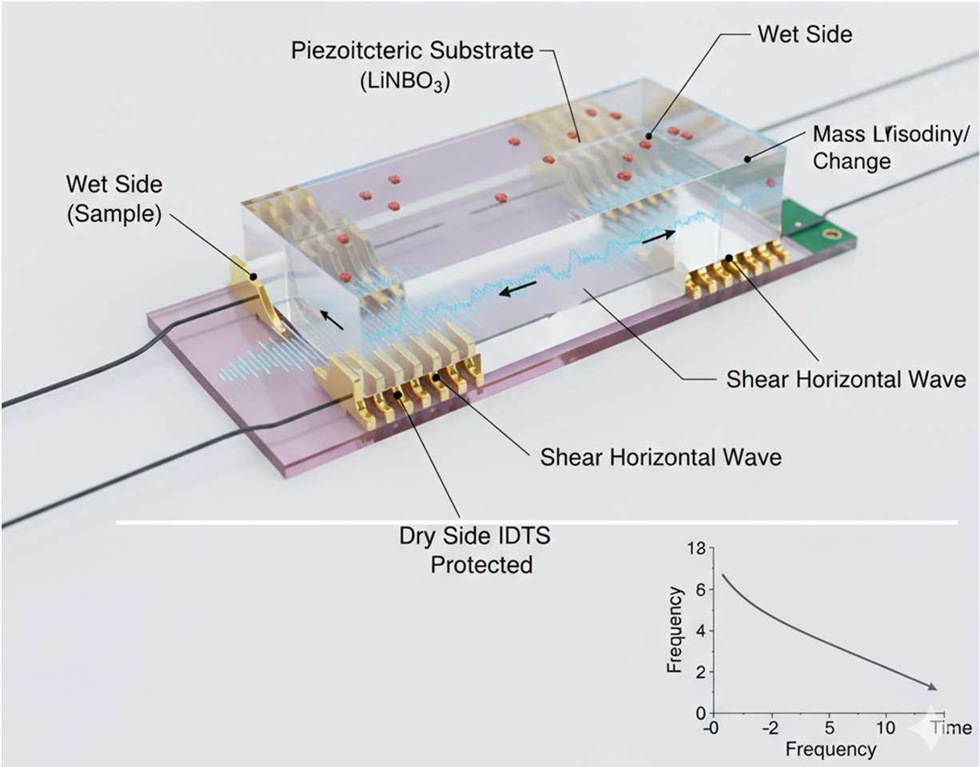
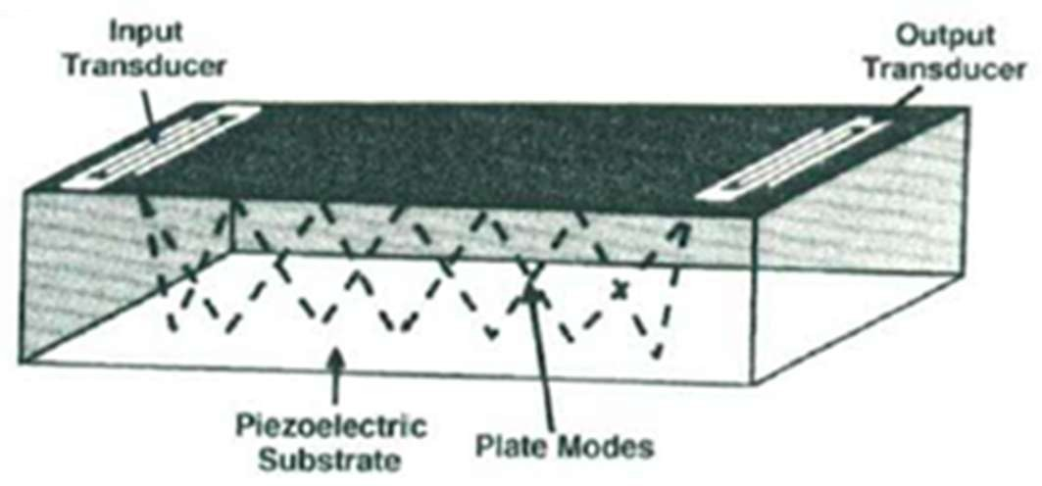
Schematic Layout
Introduction
Shear Horizontal Acoustic Plate Mode (SH-APM) Sensor

Slide 8
Sensing Mechanisms
Introduction
Mass Loading: Accumulation of molecules on the surface slows the wave velocity (𝜈).
Viscous Coupling: The "drag" from a viscous liquid penetrates a small distance into the fluid, affecting the wave amplitude and phase.
Electrical Loading: If the liquid has high conductivity, it can interact with the evanescent electric field of the piezoelectric plate.

Slide 9
Comparison with Other Acoustic Sensors
Introduction
SAW
(Rayleigh)
Elliptical (Vertical)
High High
Gas Sensing
Feature
FPW
SH-APM
Flexural (Vertical)
Low
Low (Fragile) Bio/Chemical
Shear Horizontal
Very Low High
Liquid/Viscosity
Motion
Liquid Loss Robustness Main Use

Slide 10
Advantages of SH-APM
Introduction
Mechanical Robustness: Unlike FPW, SH-APM uses a solid plate rather than a fragile micrometer-thin membrane.
Protection: Can be used in a "back-side" sensing configuration where the sensitive IDTs never touch the sample.
Versatility: Can measure mass, viscosity, and conductivity simultaneously.

Slide 11
Key Applications
Introduction
Real-time Bio-sensing: Monitoring blood coagulation or protein adsorption.
Chemical Process Control: Measuring the concentration of ionic species in solution.
Viscosity Sensing: Monitoring oil degradation or polymer curing in industrial settings.
Food Quality: Detecting contaminants or changes in liquid food consistency.

Slide 12
Comparing Quartz Cuts for Acoustic Sensors
Introduction
Quartz Cut
Type of Wave
Thickness
Shear Mode QCM
(TSM)
Common Sensor
Key Advantage
Zero temperature coefficient at room temperature; pure shear motion.
Excellent temperature stability for gas-phase sensors.
Ideal for liquid-phase sensing; allows SH waves that don't leak into fluids.
AT-Cut
Rayleigh Wave
ST-Cut
SAW
Shear Horizontal (SH)
Thickness Shear (Double Rotated)
SH-APM
/ Love-Wave
Rotated Y-Cut
High-Precision QCM
"Stress-Compensated"; resistant to mechanical and thermal shock.
SC-Cut

Slide 13
Master Summary of Acoustic Sensors
Introduction
Feature
QCM (Bulk)
SAW
(Surface)
100 – 1500
MHz
FPW (Plate)
SH-APM
(Plate)
Operating Frequency
5 – 30 MHz
2 – 20 MHz
20 – 200 MHz
Mass Sensitivity
Low (18ng/cm²)
High (10-100x QCM)
Ultra-High
Intermediate
Primary Wave Mode
Thickness Shear
Rayleigh / Love
Poor (Rayleigh loss)
High
Flexural (A₀ Mode)
Shear Horizontal
Liquid Operation
Reliable
Excellent
Excellent
Robustness
Fabrication Cost
Very High
Low (Fragile)
High
Low (Simple)
Moderate
High (MEMS)
Moderate

Slide 14
Conclusion
Introduction
The Perfect Balance: SH-APM provides a unique balance between the sensitivity of plate modes and the liquid- compatibility of shear waves.
Future Directions: Advancements in "Love Wave" structures (adding a guiding layer to SH-APM) to further confine energy and boost sensitivity.

Slide 15
Test your understanding
Define the "Evanescent Field" in the context of an SH-APM sensor.
Why does an SH-APM sensor have a higher power handling capability than an FPW (Flexural Plate Wave) sensor?
Explain the "Mass Loading" effect in SH-APM sensors. How does the accumulation of molecules on the "wet side" affect the phase velocity of the wave?
Describe the configuration of a "back-side" sensing SH-APM device. Why is this configuration critical for industrial and biomedical applications?
Compare SH-APM sensors with standard Rayleigh-wave SAW sensors. Why is the latter generally avoided for immersion in liquids?

Slide 16
Test your understanding
Describe the propagation of Shear Horizontal waves in a thin piezoelectric plate.
SH-APM sensors can measure mass, viscosity, and liquid conductivity simultaneously. Explain the physical principles behind how the sensor distinguishes between these three different parameters in a single measurement cycle.

Slide 17
References
D. S. Ballantine et. al., Acoustic Wave Sensors: Theory, Design and Physico-Chemical Applications, Academic Press, 1997.
Vinod Kumar Khanna, Nanosensors: Physical, Chemical, and Biological, CRC Press, Second Edition, 2021.
https://pmc.ncbi.nlm.nih.gov/articles/PMC6833005/pdf/sen sors-19-04395.pdf
https://industry.plantautomation-technology.com/ whitepapers/1485944904-acoustic-wave-technology- sensors.pdf

