Slide 1

UEC3942: Introduction to Sensors and Actuators
Unit II: Solid-State transducers
Presentation by: Dr. C. Annadurai
Associate Professor/Dept. of ECE SSN College of Engineering

Slide 2
Learning Outcomes
Overview
Understand the principles, construction, and applications of LEDs and Displays.

Slide 3
Introduction to Solid-State Transducers
Introduction
Developed following the invention of the transistor.
Utilize current flow in solid semiconductors.
Primary Example: Light Emitting Diodes (LEDs), which function as current-to-light transducers

Slide 4
LEDs vs. LCDs
Introduction
LED: A true current-to-light transducer.
LCD (Liquid Crystal Display): Strictly speaking, a light modulator rather than a sensor or transducer.
LCDs have recently taken the place of LEDs in some specific applications.

Slide 5
Basic LED Physics
Introduction
LEDs are semiconductor diodes.
They feature a comparatively conduction.
large
voltage
drop
during
The Process: When an electron meets a hole in the junction, they combine and release energy.

Slide 6
Radiation and Material Properties
Introduction
Energy is radiated if the semiconductor junction is transparent.
Silicon/Germanium: Release small amounts of infrared energy; material is non-transparent, so light is absorbed.
Compound Semiconductors: Transparent materials that allow visible light to escape.

Slide 7
Common LED Materials
Introduction
Gallium Arsenide (GaAs): The semiconductor used for visible radiation.
Gallium Phosphide: Frequently used construction.
first
compound
in modern LED
Gallium Arsenide Phosphide: Another predominant material for manufacturing.

Slide 8
Electrical Characteristics
Introduction
Forward Voltage: High, typically around 2.0 V.
Peak Reverse Voltage: Very small, approximately 3.0 V.
Caution: Correct polarity is vital to avoid burning out the device.

Slide 9
Physical Identification (Polarity)
Introduction
Modern Method: Identifying the cathode (negative) lead by making it shorter.
Risk: Identification is lost once leads are cut for fitting.
Older Method: A small flat area on the diode body identified the cathode.

Slide 10
Illumination and Current
Introduction
Intensity of illumination depends fairly linearly on the forward current.
Current Range: Typically, 2 to 30 mA.
Factors affecting current include physical size and required brightness.
Power Dissipation
Most LEDs can sustain power dissipation of approximately 100 mW.
Exception: Low-current LEDs designed specifically for battery-operated equipment.

Slide 11
Circuit Integration
Introduction
Current is governed by using a resistor in series.
IC Control: When controlled by an Integrated Circuit (IC), the resistor is often built-in, removing the need for separate wiring.

Slide 12
LED Colour Varieties
Introduction
Color is determined by the semiconductor material.
Predominant Colors: Red and Green.
Mixing Light: Placing red and green sources together produces yellow light.
close

Slide 13
Advanced LED Packages
Introduction
Twin Diodes: Allows a single package to switch between red, green, and yellow.
Flashing LEDs: Obtained by digital units in one package.
Standard Physical Forms:
combining LEDs with IC
Single LEDs are available in various shapes.
Predominant types:
Dot types
Bar types

Slide 14
Alphanumeric Displays
Introduction
LEDs are often supplied as preformed patterns rather than single units.
Bar-graph modules: Range from 5 to 30 segments.
Alphanumeric displays: The most common preformed type.

Slide 15
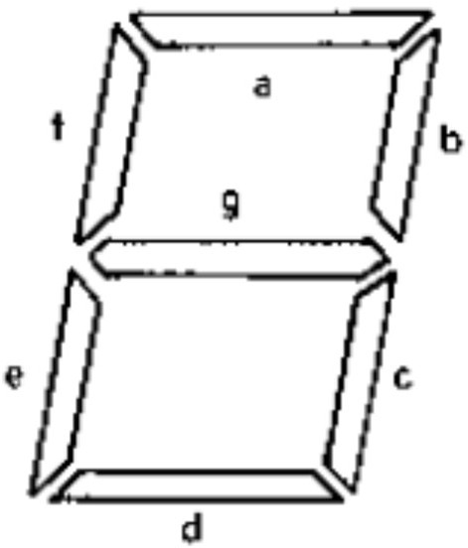
The Seven-Segment Display
Introduction
The most common alphanumeric format.
Uses seven bar-shaped segments to display numbers and a few letters.
Usually includes an 8th segment for a decimal point (left or right).

Slide 16
Driving Seven-Segment Displays
Introduction
Requires a decoder-driver IC.
Function: Converts binary representation into the specific pattern of bars required for each number.

Slide 17
Intensity Matching
Introduction
LEDs are available in intensity-matched forms.
Necessary for "column displays" where units are stacked.
Why? A diode with higher or lower intensity than its neighbors is very obvious to the eye.

Slide 18
Dot Matrix Displays
Introduction
An alternative to the seven-segment display.
Used for numbers, letters, and various alphabets.
Requires a sufficient number of dots per versatility.
unit for

Slide 19
Dot Matrix Patterns
Introduction
4 x 7 Pattern: Sufficient for digits and English capital letters.
5 x 7 Pattern: Allows for greater versatility in character representation.
Usually sold with controlling circuits built-in.

Slide 20
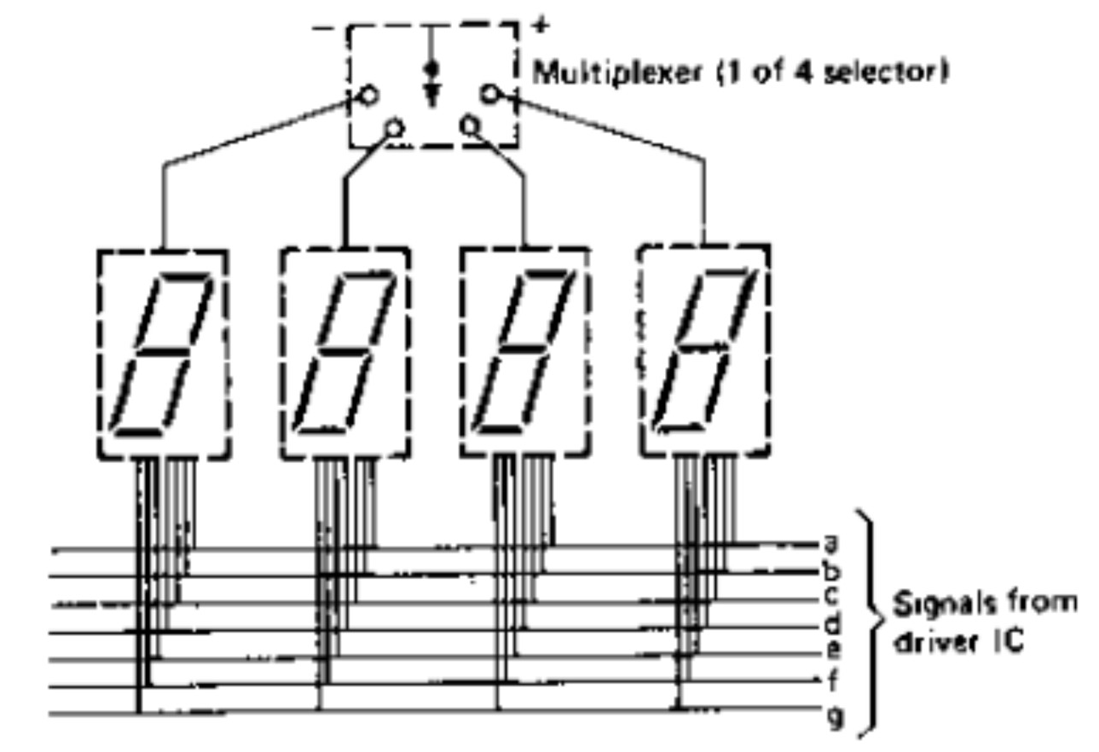
Multi-Digit Multiplexing
Introduction
Driving circuitry is usually integrated for multi-digit displays.
Multiplexed Basis: Display bars in identical positions on different units are connected in parallel.

Slide 21
How Multiplexing Works
Introduction
Multiplexing switches isolate the cathodes of all diodes except for one unit at a time.
Digits are displayed one at a time in rapid succession.
Input data must be synchronized to the switching rate.
Disadvantage: Power Consumption
LEDs consume significant power when used in quantity.
A small seven-segment display uses 15–20 mA per segment.
Worst-case: A four-digit display showing "8888" can draw at least 420 mA.

Slide 22
Suitability for Power Sources
Introduction
Mains Power: Current levels are reasonable.
Battery Power: Generally, out of the question for standard LEDs.
Exceptions: Car displays (secondary cells) or specialized low-current LEDs.

Slide 23
Conclusion & The Shift to LCD
Introduction
Because of high power needs, LCDs are preferred for portable devices (calculators, laptops).
Transition: While LEDs are excellent transducers, LCDs serve as more efficient light modulators for battery- operated gear.

Slide 24
Test your understanding
Why is correct polarity essential when connecting an LED?
How is yellow light typically produced using LED sources?
What is the purpose of "intensity matching" in LED column displays?
Explain the physical process by which an LED generates light.
Compare the advantages and limitations of seven-segment displays versus dot matrix displays.
Discuss the power consumption challenges associated with LED displays
in battery-operated equipment.
Describe the construction, identification, and electrical control of a single LED unit.
Explain the principle and necessity of "multiplexing" in multi-digit LED
displays.
What is "multiplexing" in the context of digital displays?

Slide 25
Textbook
Ian R Sinclair, Sensors and Transducers, Third Edition, 2001 (Units I & II).

