Slide 1

UEC3942: Introduction to Sensors and Actuators
Unit I: Temperature Sensors
Presentation by: Dr. C. Annadurai
Associate Professor/Dept. of ECE SSN College of Engineering

Slide 2
Overview
Learning Outcomes
At the end of the session, the students will be able to understand the types, working principles, characteristics, and applications of temperature sensors.

Slide 3
Introduction to Thermal Sensing
Introduction
Thermal sensing is a critical process used to detect fire, overheating, or the failure of cooling systems like freezers.
The bimetallic strip is considered the simplest type of thermal sensor.
All temperature sensors rely on changes that occur in materials as their temperatures change.
Types of Thermal Sensors:
Bimetallic Strip
Thermocouple
Resistance Thermometer (RTD)
Thermistor
Pyroelectric Detectors

Slide 4
Defining Heat and Temperature
Introduction
Heat is a form of energy measured in joules.
Temperature serves as a measure of the level of heat for a material while its physical state remains unchanged.
The relationship between temperature and energy is comparable to the relationship between voltage level and electrical energy.

Slide 5
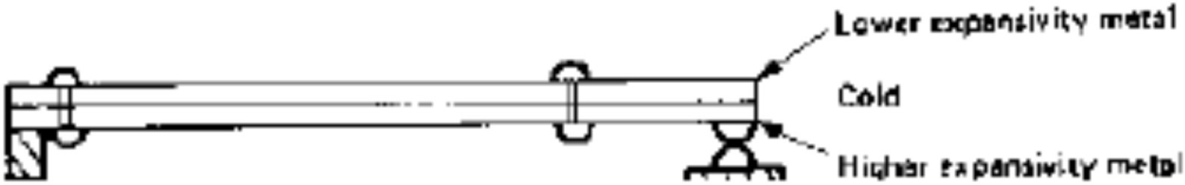
Construction of a Bimetallic Strip
Introduction
A compound strip is created by riveting or welding two layers of different metals together.
These metals are specifically chosen to have very different values of linear expansivity.
The strip can be manufactured in various shapes, including a straight strip, a spring shape, or a disc.

Slide 6

Working Principle
Introduction
Linear Expansivity: This is the fractional change of length per degree change of temperature.
Bending Action: Because the two metals expand by
to
different amounts when heated, the strip is forced bend.
Direction of Bend: When heated, the metal with the higher expansivity will be on the outer side of the curve

Slide 7
Common Metal Expansivity Values
Introduction
Linear expansivity values (multiply by 10⁻⁵ m for the value in K⁻¹):
Metal/Alloy Magnesium
Expansivity
2.6
Metal/Alloy Iron
Stainless Steel
Platinum Invar
Expansivity
1.2
Aluminium 2.4
1.0
Brass Copper
2.1
1.6
0.90
0.2

Slide 8
Sensitivity and Physical Forms
Introduction
Sensitivity: The sensitivity of the sensor depends on the length of the strip.
Spiral Strips: To increase sensitivity within a small space, the strip is often arranged into a spiral.
Proportionality: The amount of deflection is fairly precisely proportional to temperature changes if the temperature range remains small.

Slide 9
Characteristics – The Challenge of Hysteresis
Introduction
Simple bimetallic thermostats often suffer from large hysteresis.
For example, a thermostat set to 20° C might not open until 22° C and not close again until 18° C.
This leads to undesirable temperature swings that can make the thermostat ineffective for precise control.

Slide 10
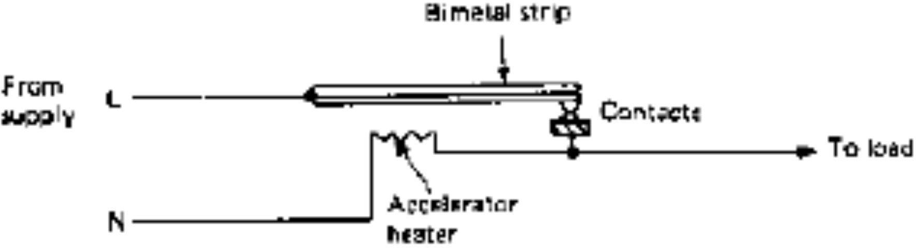
Improving Performance with Accelerators
Introduction
The Accelerator: A high-value resistor placed near the bimetallic element to reduce hysteresis.
Function: When the contacts close, the resistor generates heat, causing the thermostat to heat up faster than the room.
Benefit: This causes the contacts to open before the room overshoots the desired temperature.

Slide 11
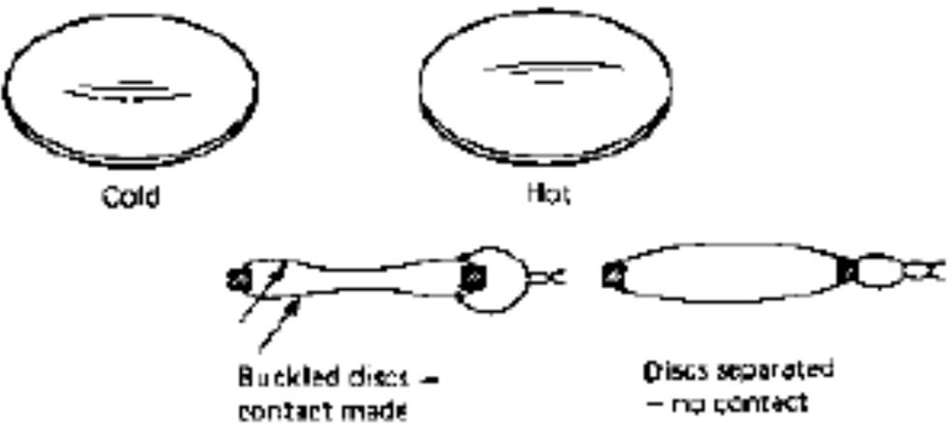
Bimetallic Discs for Overheating Protection
Introduction
Snap-over Action: Bimetallic discs buckle abruptly when a certain temperature is reached, providing a "snap" action without external assistance.
Applications: These are used extensively to protect electronic equipment and components.
Targets: They are commonly bolted to heat sinks, motors, transformers, and jug-kettles.

Slide 12
Applications and Maintenance
Introduction
Thermostats: Used for controlling room temperature and heating systems.
Safety Switches: Used for fire detection and overheating protection.
Maintenance: Long-element strips require periodic recalibration because they are subject to "creep" (gradual changes in the metal over time).

Slide 13
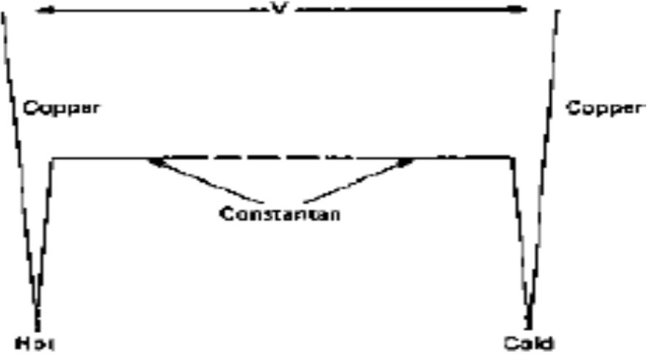
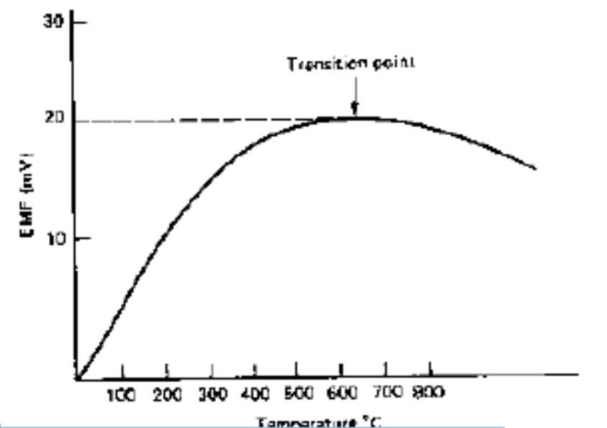
Introduction to Thermocouples
Introduction
Definition: A thermocouple is a primary sensing element used frequently in thermal sensors or switches.
Core Concept: It consists of two dissimilar metals joined together.
Basic Function: It converts temperature differences into a small electrical voltage (contact potential).

Slide 14
Working Principle (The Seebeck Effect)
Introduction
The Seebeck Effect: Thermocouples operate based on this phenomenon, where an EMF is generated due to temperature gradients.
Mechanism: A contact potential exists between dissimilar
metals; changes.
Voltage
this potential changes as the temperature
Detection: While a single junction's potential
cannot be measured alone, a circuit with two junctions at different temperatures produces a detectable voltage of a few millivolts.

Slide 15
Thermocouple Construction
Introduction
Junctions: A standard circuit features a "Hot" junction (sensing end) and a "Cold" junction (reference end).
Materials: Common examples include combinations like Copper and Constantan (an alloy of copper and nickel).
Circuit Design: Practical circuits must be designed so that only the intended junctions are exposed to different temperatures to avoid parasitic voltages.

Slide 16


Mathematical Modeling of EMF
Introduction
General Equation: The Electromotive Force (EMF) is calculated as:
Simplified Model: If the cold junction is held at 0°C, the equation becomes:
Constants: In these formulas, a, b, c, α, and β are specific constants determined by the types of metals used.

Slide 17
Performance Characteristics
Introduction
Linearity: For temperatures below the "transition point," the EMF is almost directly proportional to the temperature difference.
The Transition Point: Most thermocouples reach a peak voltage (turn-over point), after which the characteristic
reverses.
Limitations:
Because of this reversal and non-linear
behavior, thermocouples are typically useful only over a specific limited temperature range.

Slide 18
Common Thermocouple Types (Standard Codes)
Introduction
Notes
Most common; avoid reducing agents.
Attacked by oxygen or acids.
Ideal for low- temperature use.
High temperature; needs ceramic sheath.
Code | Metals | Range
Type K | NiCr / NiAl | 0 to 1100°C
Type J | Fe / CuNi | 0 to 800°C
Type T | Cu / CuNi | -200 to +400°C
Type S/R | PtRh / Pt | 0 to 1400°C

Slide 19
Signal Conditioning and Amplification
Introduction
Small Output: Outputs are very low (millivolts), often requiring amplification to be useful.
Amplifier Choice: "Chopper" type amplifiers are preferred due to their superior drift stability.
Switching: For on/off actions, a Schmitt trigger circuit is used to permit adjustment of the switching temperature bias.

Slide 20
Advantages of Thermocouples
Introduction
Physical Size: The sensing elements are very small, allowing them to fit into tight spaces.
Response Time: Their small mass allows them to respond quickly to rapidly changing temperatures.
Remote Sensing: The electrical nature of the output allows the reading circuitry to be located far from the actual sensor.

Slide 21
Related Thermoelectric Effects
Introduction
Peltier Effect: This is the reverse of the Seebeck effect (using electricity to create a temperature difference).
Kelvin Effect: Concerns EMF generated in a single conductor (no junction) when a temperature difference exists between two parts of that conductor.
Heat Release: When current flows through a conductor with a temperature gradient, heat is released at a rate proportional to the current and the gradient.

Slide 22
Practical Applications & Considerations
Introduction
Industrial Use: They are among the most important sensors used in industrial temperature measurement.
High-Temperature Measurement: Platinum/Rhodium types are specifically utilized for extreme heat environments.
Circuit Board Interference: Designers must be careful, as any metal-to-metal contact on a PCB can act as an unintended thermocouple and introduce errors.

Slide 23
Introduction to Resistance-Based Sensing
Introduction
Fundamental Concept: Both devices rely on the predictable change in electrical resistance of a material as its temperature changes.
Categories:
Metals: Positive Temperature Coefficient (PTC) — Resistance increases with temperature (e.g., Platinum).
Semiconductors: Coefficient (NTC) rises.
Primarily Negative
— Resistance decreases
Temperature as temperature

Slide 24
Resistance Thermometers (RTDs)
— Overview
Introduction
Standardization: Platinum resistance thermometers are used as secondary standards, calibrated from the primary gas-thermometer standard.
Industrial Shift: Advances in construction have allowed RTDs to replace thermocouples in many high-precision processes that require tighter temperature limits (e.g., within 0.1° C to 10° C).

Slide 25
Working Principle of RTDs
Introduction
Principle: The electrical resistance of a metallic conductor
(R) varies with temperature (T).
Linearity: Most metals exhibit a nearly linear relationship over a wide range.
Equation: The relationship is approximated by:
where α is the temperature coefficient of resistance.

Slide 26
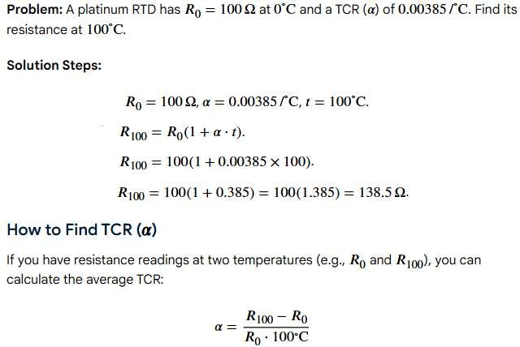

Sample Problem & Solution
Introduction

Slide 27
Material Selection: Why Platinum?
Introduction
Platinum: Serves as the international reference for temperatures between -270°C and +660°C.
Properties:
Highly stable both electrically and mechanically.
Minimal drift or aging effects.
Linear response and high chemical resistance.
Alternatives: Copper (inexpensive but low resistivity) and Nickel (limited range).

Slide 28
RTD Construction (Wire-Wound)
Introduction
Design: A fine platinum wire is wound into a spiral and inserted into a protective tube.
Housing: Often sealed within a hollow alumina (ceramic) rod using ceramic sealant to ensure mechanical stability.
Ruggedness: Built to withstand industrial environments while maintaining precision.

Slide 29
RTD Construction (Thin-Film)
Introduction
Method: A thin layer of platinum is deposited onto a ceramic substrate using plating techniques.
Advantages:
Significant cost reduction for mass production.
Small size: Sensors can be as small as 0.8 mm in diameter.
Highly resistant to vibration compared to wire-wound types.

Slide 30
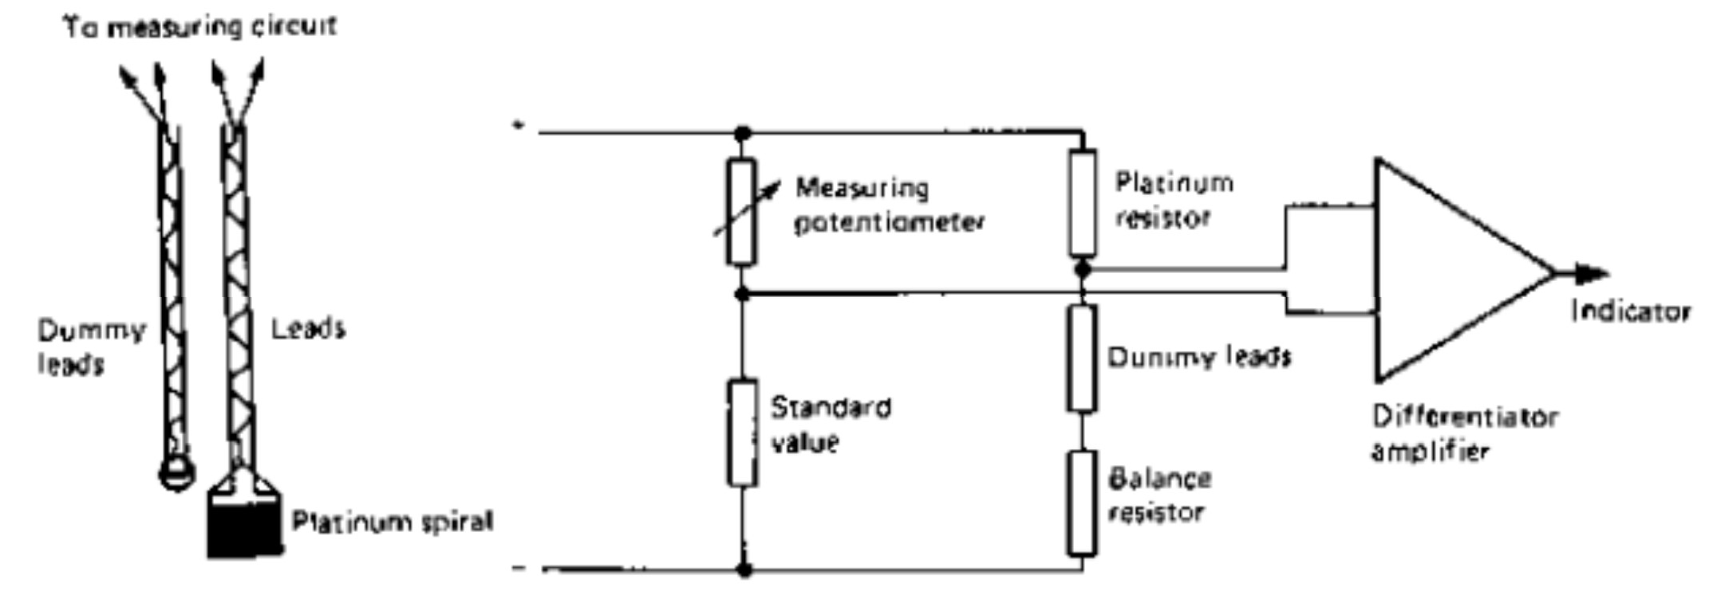
RTD Circuitry — The Wheatstone Bridge
Introduction
Measurement: Because resistance changes are small, a Wheatstone bridge is typically used to measure the variance.
Output: The bridge converts the resistance change into a measurable voltage or current signal.

Slide 31
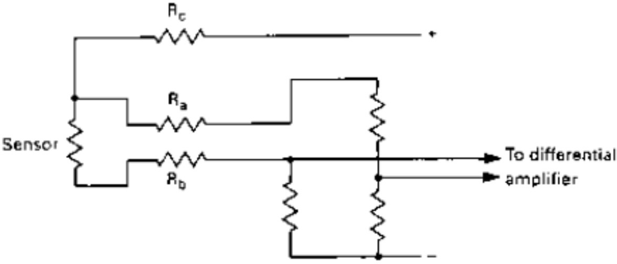
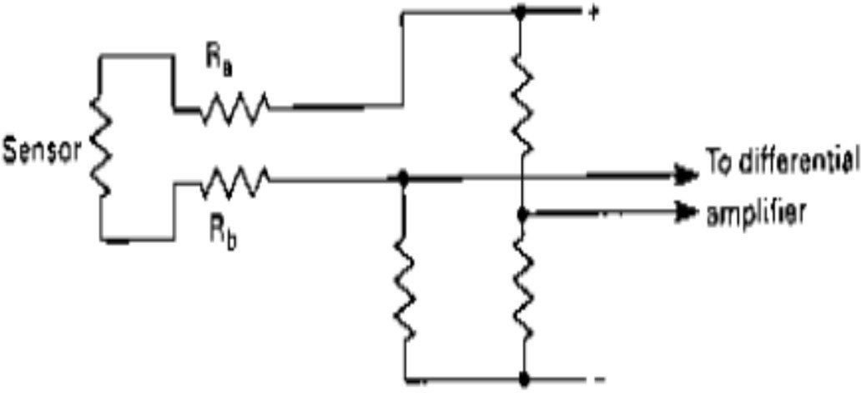
Lead Resistance Compensation (2-wire vs. 3-wire)
Introduction
Problem: In 2-wire systems, the resistance of the connecting cables adds to the sensor's resistance, causing measurement errors.
3-Wire System: Uses two leads to carry current and a third lead to sense the voltage.
Errors caused by cable resistance are balanced out if the leads are of equal length and material.

Slide 32
Lead Resistance Compensation (4-wire)
Introduction
Precision: Used for the highest accuracy laboratory applications.
Mechanism: Two wires supply a regulated constant current, while two separate wires measure the voltage drop directly across the sensor.
Benefit: Cable resistance and connection contact resistance are completely eliminated from the calculation.

Slide 33
Critical Factor: Self-Heating
Introduction
Definition: The current flowing through the sensor generates internal heat (I²R), which can raise the sensor's temperature above that of the medium.
Mitigation: Measuring current must be kept as low as possible to minimize errors.
Balance: Designers must compromise between high signal sensitivity (higher current) and high accuracy (lower current).

Slide 34
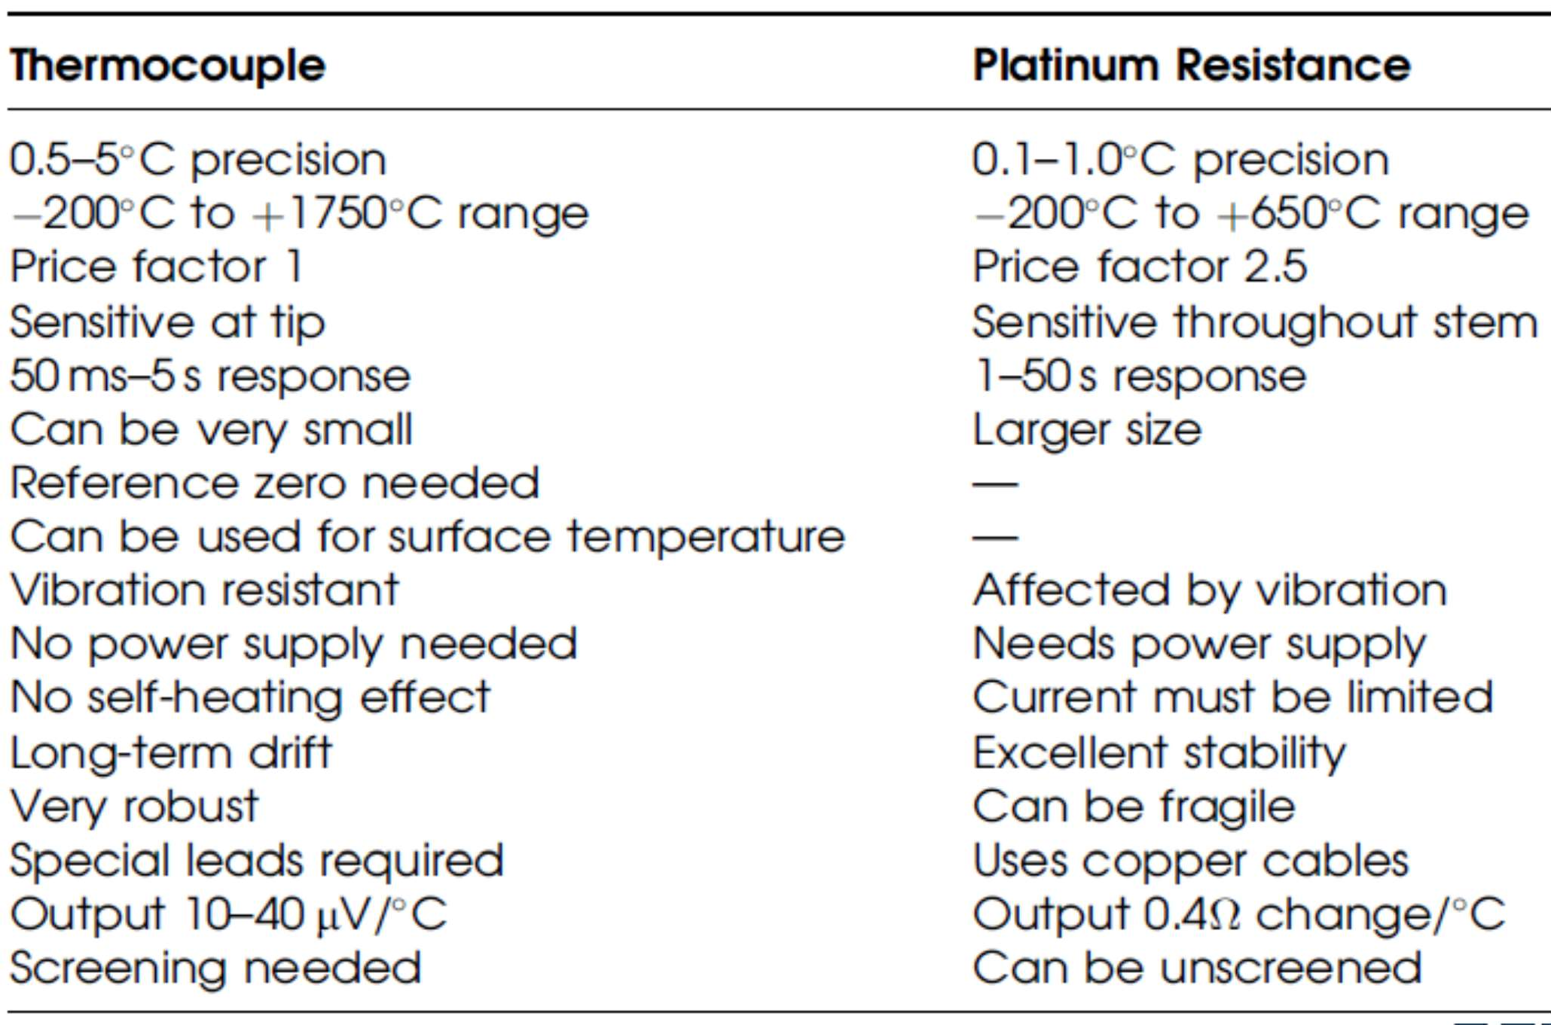
Comparison Table (Thermocouple vs RTD)
Introduction

Slide 35
Introduction to Thermistors
Introduction
Etymology: Derived from "Thermal" and "Resistor".
Composition: Formed from mixtures of metallic oxides (manganese, nickel, cobalt, etc.) pressed into beads, disks, or rods.
Resolution: Unlike RTDs, thermistors exhibit massive resistance changes for small temperature variations, allowing for high sensitivity.

Slide 36
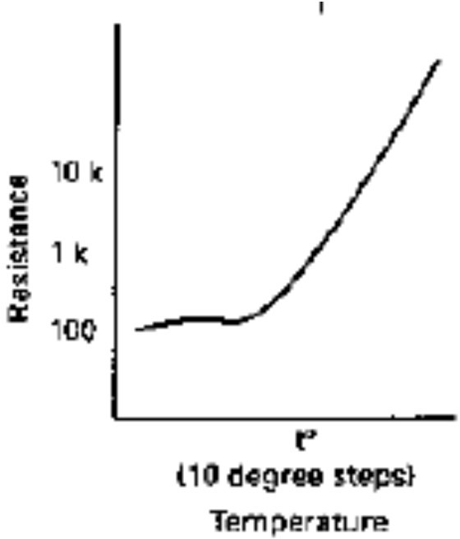
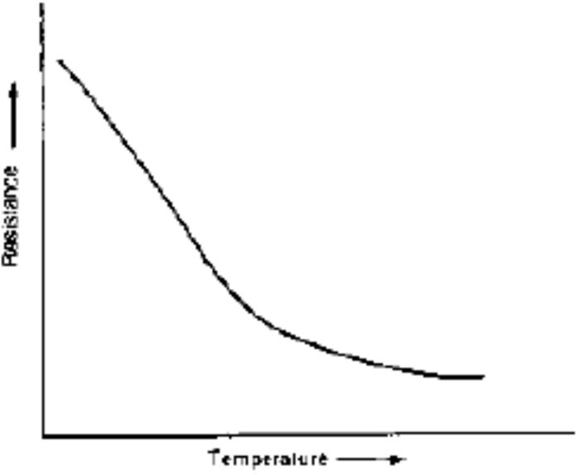
Thermistor Types
Introduction
NTC (Negative Temperature Coefficient): Resistance decreases as temperature rises. The most common type used for temperature sensing.
PTC (Positive Temperature Coefficient): Resistance
increases with temperature, often used for overcurrent protection.
Resistance vs Temperature characteristics
overheat and
for PTC thermistor
for NTC thermistor

Slide 37
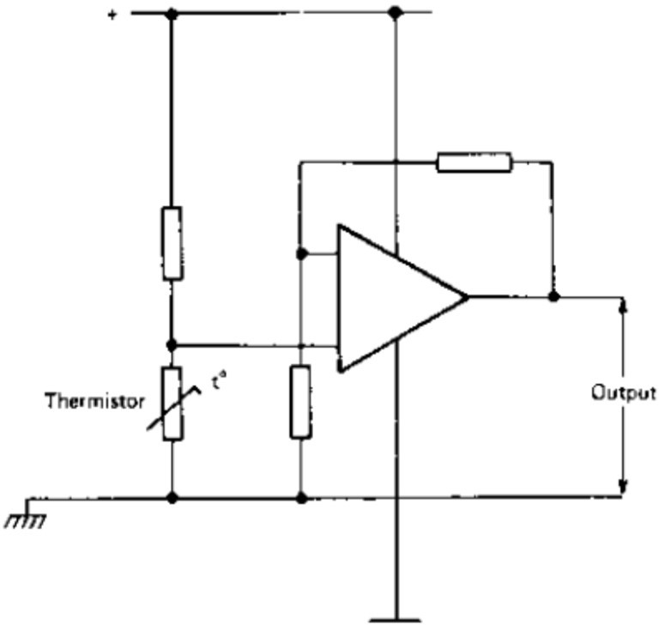
Working Principle of NTC Thermistors
Introduction
Mechanism: In these semiconductor materials, rising temperatures release more charge carriers (electrons), significantly lowering electrical resistance.
Non-Linearity: The relationship is exponential rather than linear, requiring complex calculations or linearization circuits.
An NTC thermistor temperature sensing circuit that makes use of an operational amplifier is shown here.
The sensitivity can be adjusted by altering the feedback ratio.

Slide 38
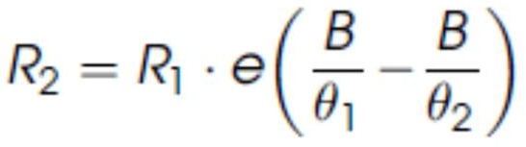
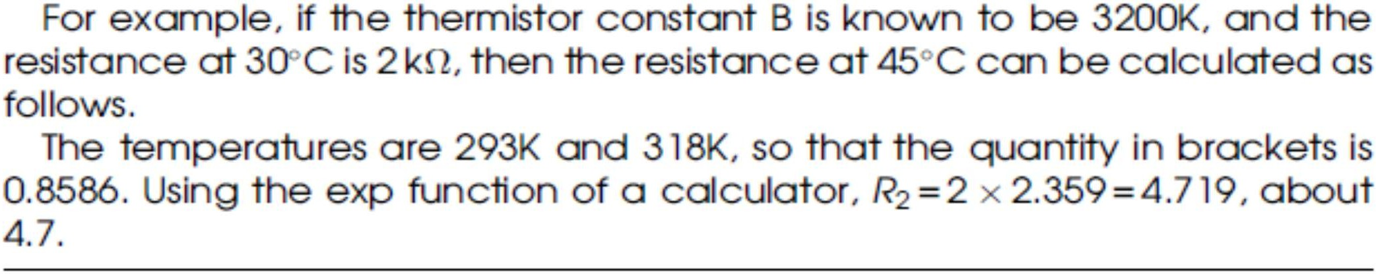
NTC Mathematical Modeling
Introduction
The B-Constant Equation: The resistance R₂ at temperature (θ₂ in Kelvins) is calculated by:
where B is a constant related to the material's properties.
Calibration: Manufacturers provide the "B-value" or specific resistance-temperature tables for each device.

Slide 39
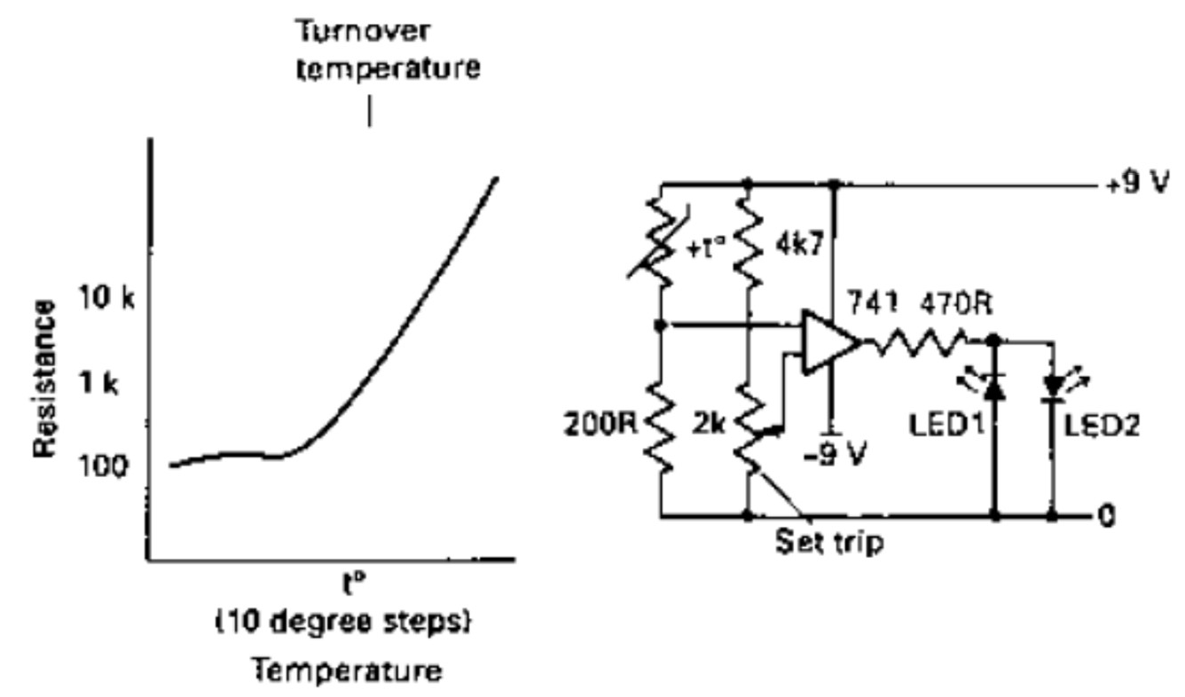
PTC Thermistors — Principle for overheat protection
Introduction
Trip Temperature (T_{r}): PTC thermistors exhibit a sharp increase in resistance once a specific threshold is reached.
Self-Regulation: This behavior is used to "switch off" or limit current when a device overheats.
PTC thermistor used for sensing excess temperature

Slide 40
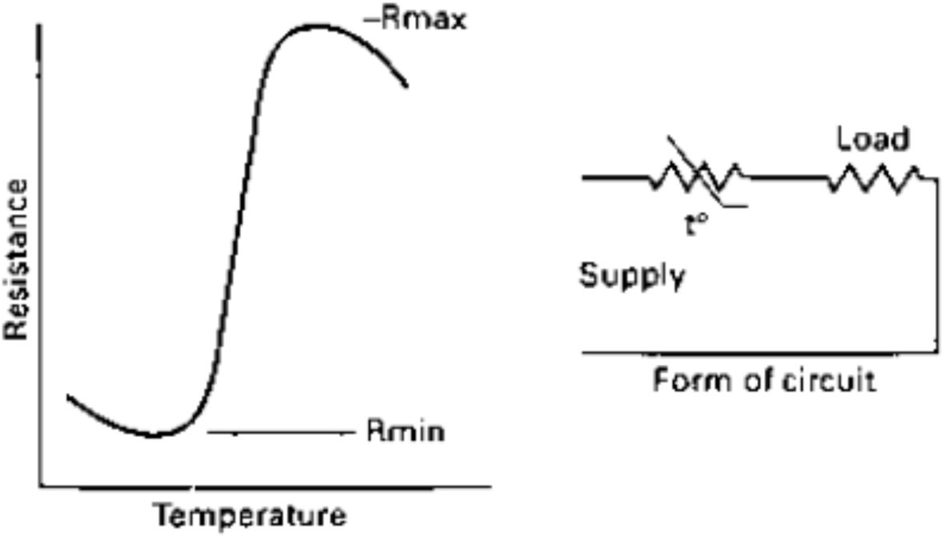
PTC Thermistors — Principle for overcurrent protection
Introduction
In the PTC region, the change resistance can be as large as 100% for each °C change in temperature.
The load is protected against excess current when it is connected in series with the thermistor.
S-shaped Characteristics and PTC thermistor used for sensing excess current

Slide 41
Industrial Applications of Thermistors
Introduction
Materials used for PTC thermistors are compounds of barium, lead and strontium titanates (ceramic materials).
NTC Applications:
Precise thermostats for deep-freezers and ovens.
Medical devices for patient temperature monitoring.
PTC Applications:
Over-temperature protection for motor windings and transformers.
Self-resetting fuses for over-current protection in electronic circuits.

Slide 42
Comparison Table (RTD vs. Thermistor)
Introduction
RTD (Platinum)
Highest (up to 0.1°C)
Excellent (Linear) Wide (-200 to
+660°C)
Very High
High (Platinum material)
Thermistor (NTC)
High (within 0.1- 0.2°C)
Poor (Exponential) Narrow (-50 to
+250°C)
Moderate to High
Low (Mass- produced oxides)
Feature
Accuracy
Linearity
Range
Stability
Cost

Slide 43
Introduction to Pyroelectric Materials
Introduction
that (IR)
Definition: Pyroelectric films are dielectric materials
develop a surface charge when exposed to infrared radiation.
Common Materials:
Plastic films: Historically used in earlier designs.
Lithium Tantalate: The preferred material for modern passive infrared (PIR) systems.
Core Function: They act as transducers converting thermal energy (IR) into electrical signals.

Slide 44
Principle of Operation
Introduction
Charge Separation: charge separation, also material.
Incident infrared radiation causes known as polarization, within the
Voltage Generation: This separation alters the charge and the resulting voltage across the plates of the detector.
Dynamic Sensing: Because the detector functions as a capacitor, it has no DC response; it cannot sense a stationary infrared emitter.
Motion Detection: The detector only responds when the amount of incident infrared radiation is altered, typically by movement.

Slide 45
Construction and Internal Circuitry
Introduction
Capacitor Structure: The detector is constructed as a capacitor with one metal plate and one plate made of pyroelectric material with a conducting surface.
High Impedance: The pyroelectric capacitor has a very high impedance.
Integrated MOSFET: To manage this impedance, practical detectors are built as a single unit containing both the capacitor and a MOSFET.
Connections: External connections are provided for the source (S) and drain (D) of the MOSFET.

Slide 46
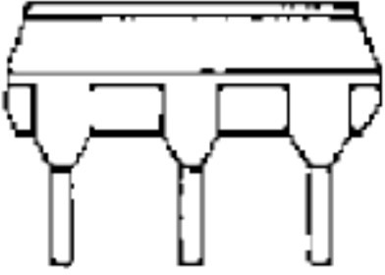
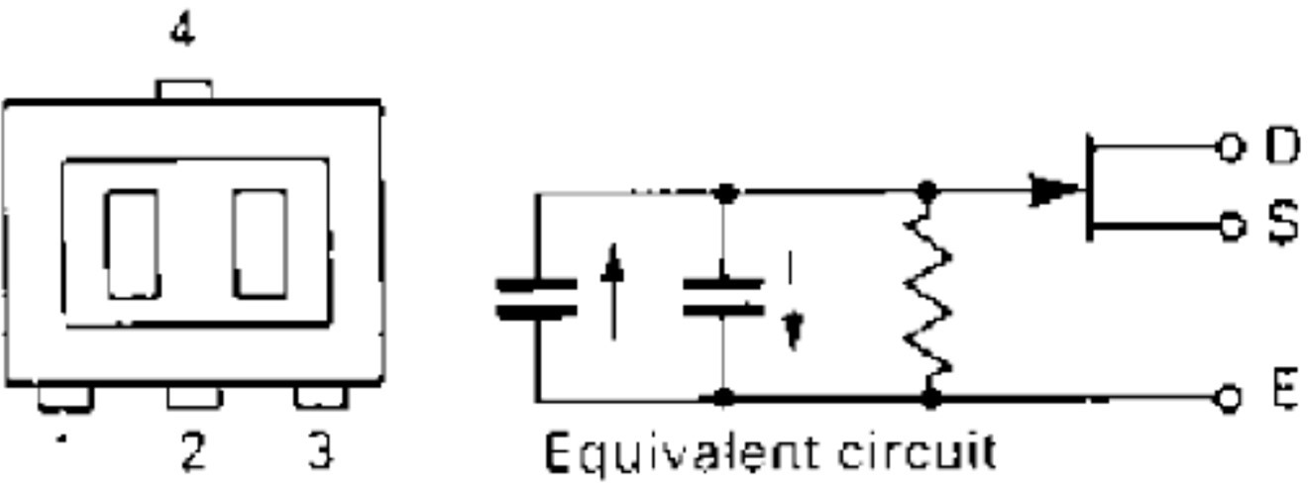
Construction and Internal Circuitry
Introduction
A typical pyroelectric passive infrared (PIR) unit and its internal circuit

Slide 47
Key Performance Parameters
Introduction
Noise-Equivalent Power (NEP): Expresses the lower limit of usefulness; signals below this are lost in noise. Lithium tantalate typically has an NEP of 10⁻⁹ W at 10 Hz.
Responsivity: Measured as voltage or current output per unit of radiant energy (V/W or A/W). A typical voltage responsivity is 3200 V/W.
Frequency Response: Refers to how responsivity changes with modulation frequencies, acting as a low-pass filter with a peak below 1 Hz.

Slide 48
Optical Components (The Fresnel Lens)
Introduction
Function: A faceted Fresnel lens is an essential part of the detector unit.
Focusing: It focuses infrared from an object onto the pyroelectric surfaces.
Sweeping Action: As an object moves, the lens causes infrared beams to sweep across the detector, triggering a response.
Field of View: The construction of the lens determines the detection angle of the system.

Slide 49
Response Characteristics
Introduction
Time Constant: These detectors feature a large time constant.
Response Rate: The typical response rate to IR alterations ranges from 0.2 to 1 Hz.
Frequency Sensitivity: Maximum relative response occurs at 0.2 Hz.
Response falls to 50% at 0.055 Hz and 0.7 Hz.
Ideally suited for detecting the movement of humans and animals.

Slide 50
Practical Application Circuitry
Introduction
Supply Voltage: Units typically operate within a range of 3- 15 V.
Source-Follower: The internal MOSFET is usually wired into a source-follower circuit with a load resistor (typically 100 to 200 kΩ).
Amplification: The small signal is often amplified by operational amplifiers; a common setup uses two stages to achieve an overall voltage gain of approximately 3200.

Slide 51
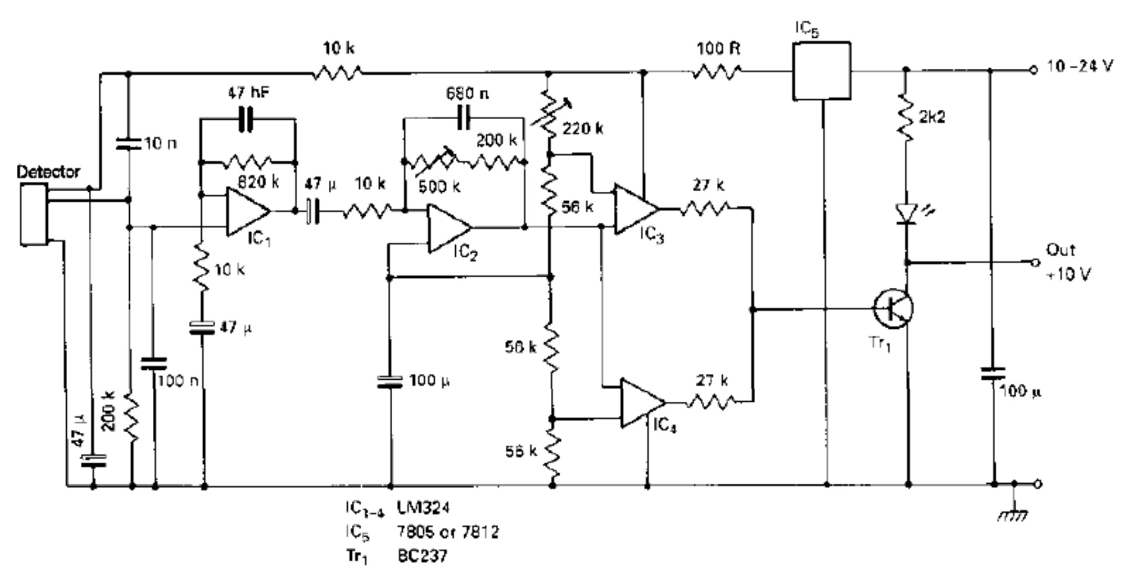
Practical Application Circuitry
Introduction
A suggested circuit for a pyroelectric detector unit

Slide 52
Major Use Cases
Introduction
Security Systems: Primary use in burglar alarms to detect unauthorized movement.
Automation:
Automatic light-switching based on room occupancy.
Automatic door-opening equipment.
Positioning: Utilized in various positioning systems.
Monitoring: Often includes an LED display to indicate the unit is functioning correctly even when the alarm is disengaged.

Slide 53
Conclusion and Summary
Introduction
Bimetallic strip serves as a fundamental and versatile thermal sensor that leverages the differential linear expansivity of bonded metals to provide reliable temperature-dependent switching, ranging from sensitive spiral- shaped thermostats to rapid-acting safety discs for overheating protection..
Thermocouples are among the most essential temperature sensors and are used extensively in industrial applications due to their small size and quick response time.
RTDs are the gold standard for high-accuracy, wide-range industrial processes requiring long-term stability.
Thermistors provide superior sensitivity and low-cost solutions for consumer electronics and medical applications where a narrow range is sufficient.
Pyroelectric detectors are "passive" because they do not emit radiation; they only sense it.

Slide 54
Test your understanding
Identify two specific components where bimetallic discs are used for overheating protection.
What is the primary advantage of arranging a bimetallic strip into a spiral shape?
Explain the working principle of a bimetallic strip.
Discuss the role and operation of an "accelerator" in a bimetallic thermostat.
Provide a comprehensive analysis of bimetallic sensors, covering their construction, material selection, and physical variations.
Evaluate the limitations of bimetallic thermostats and the methods used to overcome them.
State two primary advantages of using thermocouples as sensors.
Define the Seebeck Effect.

Slide 55
Test your understanding
Why is DC amplification usually necessary for thermocouple outputs?
Explain the construction and basic working of a thermocouple with a diagram.
Discuss the characteristic curve of a thermocouple and the significance of the "Transition Point."
Provide a comprehensive analysis of thermocouple theory, including mathematical models and practical circuitry requirements.
Evaluate the practical application and selection criteria for thermocouples in industrial environments.
What is the purpose of a ‘three-wire system’ in RTD circuitry?
State the primary advantage of using platinum thermometers.
Distinguish between NTC and PTC thermistors.
in resistance

Slide 56
Test your understanding
Compare and contrast the merits of Thermocouples and Platinum Resistance Thermometers.
Describe the working principle and typical applications of NTC thermistors.
Why a stationary (non-moving) infrared emitter cannot be detected by a
PIR sensor?
Describe the internal construction and equivalent circuit of a typical PIR unit.
Analyze the role of a faceted (Fresnel) lens in a pyroelectric detection
system.
Provide a comprehensive explanation of the working principle, key
performance parameters, and practical circuit implementation of a pyroelectric detector.

Slide 57
Textbook
Ian R Sinclair, Sensors and Transducers, Third Edition, 2001 (Units I & II).
Ramon PallásAreny, John G. Webster, Sensors and Signal conditioning, John Wiley and Sons, Second Edition, 2000.

