Slide 1
THEORY OF COMPUTATION

Slide 2
COURSE DESCRIPTION
Finite automata;
Nondeterministic finite automata;
Regular expressions;
Applications of the pumping lemma;
Context-free grammars;
Normal forms for context-free grammars;
Pushdown automata;
Chomsky hierarchy of languages;
Turing machines.
Undecidable Problem

Slide 3
UNIT I:
INTRODUCTION TO FINITE AUTOMATA
Introduction to formal proof, Deductive proof.
Additional forms of proofs
Inductive proofs
Induction on Integers,
Central Concepts of Automata Theory

Slide 4
Formal Proof
Formal proof can be using deductive proof and
inductive proof
Dedutive proof
It consists of sequence of statements given with logical reasoning in order to prove the first or initial statement. The initial statement is called hypothesis.

Slide 5
Additional forms of proof
Proof about sets
Proof by Contradicition
Proof byContrapositive
Proof by Couter Example
Inductive Proofs

Slide 6
Proof about sets
Set- collection of elements or items
By giving proofs about sets-try to prove certain properties of sets
Eg. Two expressions A and B
To prove: Both the expressions are equivalent
Proof: Set represented by expression A is same as the set represented by expression B.
PυQ=QυP => mapping expression A with PυQ and expression B with QυP to prove A=B.
The proof is of kind “ if and only if”, an element ‘x’ is in A if and only if it is in B.

Slide 7
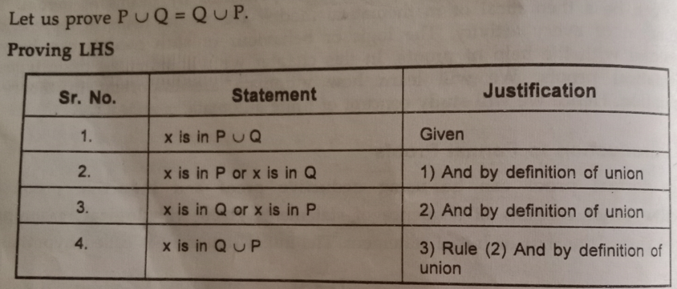
To prove the equivalence make use of sequence of statements along with logical justfication.

Slide 8
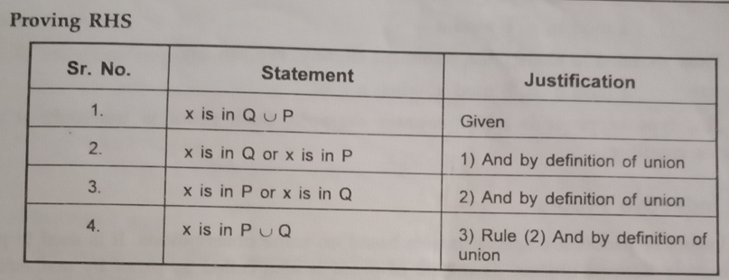
Hence PυQ=QυP. Thus, A=B is true as element x is in B if and only if x is in A.

Slide 9
Proof by Contradicition
The proof is of kind “if Athen B”.
Start with statement A is not true, and thus by assuming false A try to get conclusion of statement B.
When it is impossible to reach to statement B contradict our self and accept that A is true.
Ex. PυQ=QυP
1. Assume the statement is not true.
2. Consider ‘x’ is in P or Q, we can say that ‘x’ is in PυQ
3. This also implies that ‘x’ is in QυP (definition of union)
4. Hence assumption made initially is false. PυQ=QυP hence proved.

Slide 10

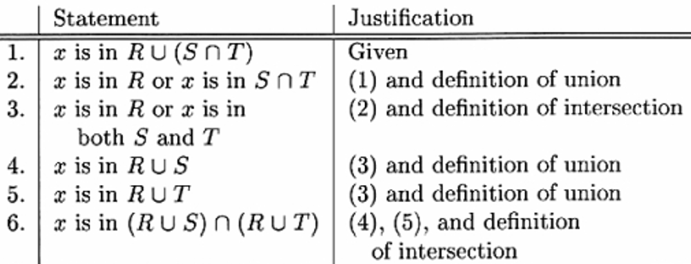

Proof by Contrapositive
The contrapositive of the statement “if H then C” is “if not C then not H”.
A statement and its contrapositive are either both true or both false, we ca prove either toprove the other.

Slide 11

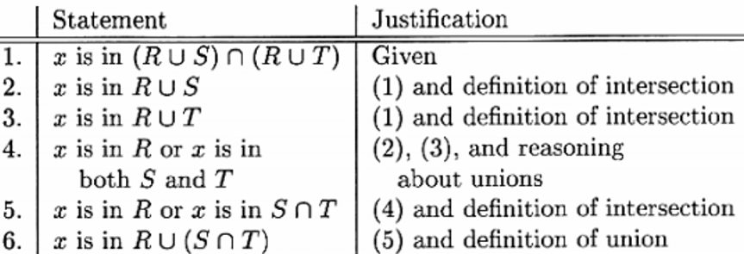
There are four cases to consider, H and C both true, H true and C false, C true and H false, H and C both false.

Slide 12
Proof by Couter Example
To prove certain statements, need to see all possible combinations in which the statements remains true.
There are some situations, the statement cannot be true.
Ex. There is no such pair of integers,
a mod b = b mod a
Proof: a=2, b=3
2 mod 3 ≠ 3 mod 2
The given pair is true for any pair of integers but if a=b then a mod b = b mod a
Proof is true only at some specific condition.

Slide 13
Inductive Proofs
It is a recursive kind of proof which consists of sequence of parameterized statements that use the statement itself with lower values of its parameter.
special prooofs based on observations.
used to prove resursively defined objects.
This proof is also called as proof by mathematical induction.
Steps carried out in the proof of mathematical induction are
* Basis
* Induction Hypothesis
* Inductive Step

Slide 14
Basis- assume the lowest possible value, initial step in the proof of mathematical induction.
Ex. prove that the result is true for n=1 or n=0.
Induction Hypothesis- assign the value of n to some other value k, and check whether the result is true for n=k or not.
Inductive Step- if n=k is true, check whether the result is true for n=k+1 or not.
- if we get the same result at n=k+1 then state that given proof it true by priciple of mathematical induction.

Slide 15
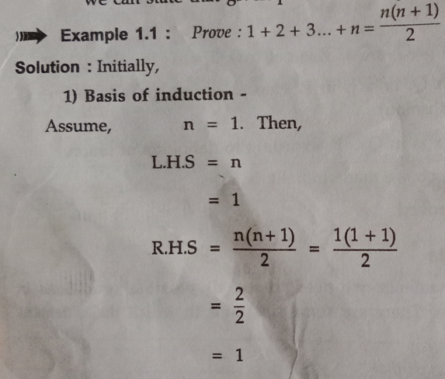

Slide 16
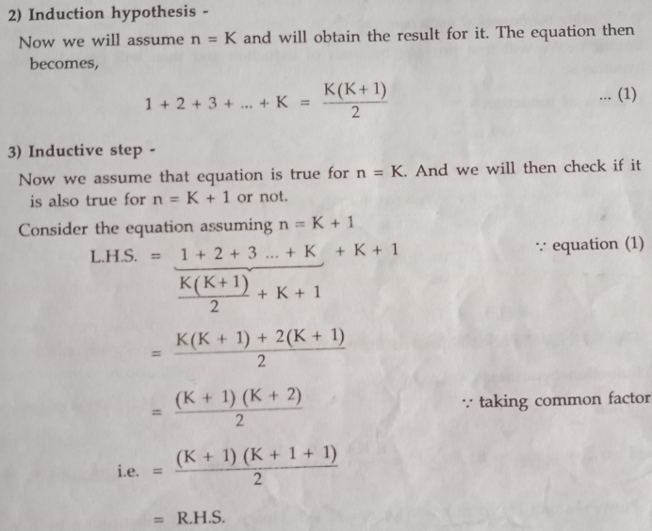

Slide 17
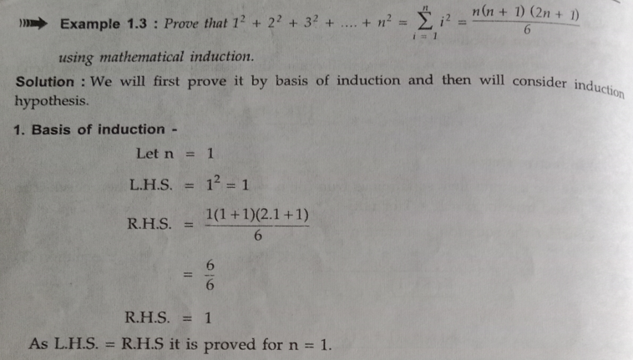

Slide 18
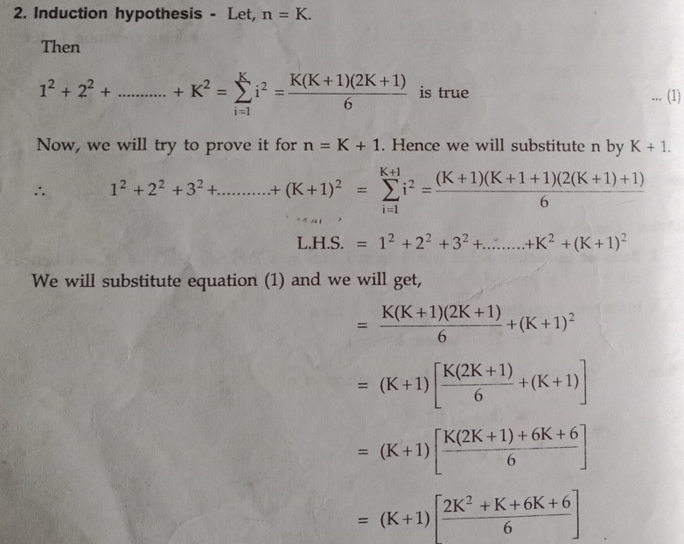

Slide 19
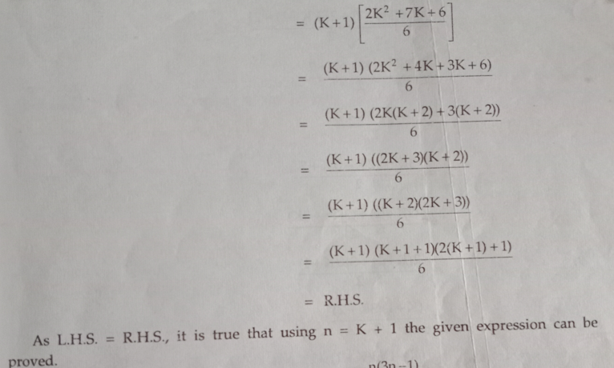

Slide 20
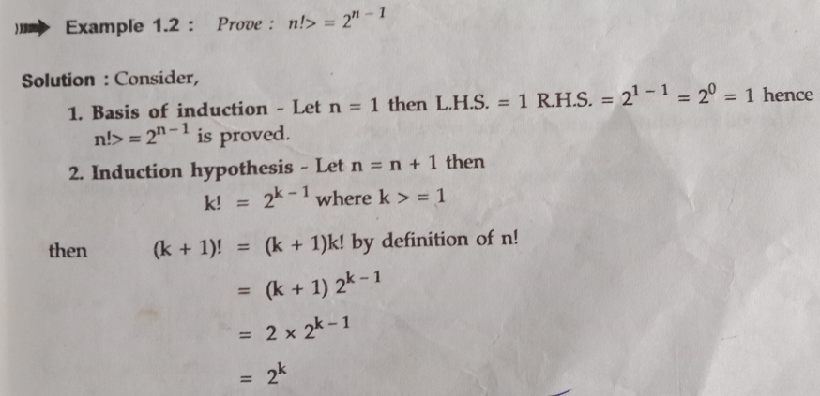

Slide 21
Central Concepts of Automata Theory
Theory of automata is a theoretical branch of computer science and mathematical.
It is the study of abstract machines and the computation problems that can be solved using these machines.
The abstract machine is called the automata.
An automaton with a finite number of states is called a Finite automaton.

Slide 22
State and transitions
The main motivation behind developing the automata theory was to develop methods to describe and analyse the dynamic behaviour of discrete systems.
This automation consists of states and transitions.
The State is represented by circles, and the Transitions is represented by arrows.
Automata is the kind of machine which takes some string as input and this input goes through a finite number of states and may enter in the final state.

Slide 23
basic terminologies
Symbols:
  Symbols are an entity or individual objects, which can be any letter, alphabet or any picture.
  Example:
      1, a, b, #
Alphabets:
  Alphabets are a finite set of symbols. It is denoted by ∑.
  Examples:
    ∑ = {a, b}
    ∑ = {A, B, C, D}
    ∑ = {0, 1, 2}
    ∑ = {0, 1, ....., 5]
    ∑ = {#, β, Δ}

Slide 24
basic terminologies
String:
  It is a finite collection of symbols from the alphabet. The string is denoted by w.
  Example 1:
    If ∑ = {a, b}, various string that can be generated from ∑ are {ab, aa, aaa, bb, bbb, ba, aba.....}.
    A string with zero occurrences of symbols is known as an empty string. It is represented by ε.
    The number of symbols in a string w is called the length of a string. It is denoted by |w|.
  Example 2:
    w = 010
    Number of Sting |w| = 3

Slide 25
basic terminologies
Language:
  A language is a collection of appropriate string. A language which is formed over Σ can be Finite or Infinite.
  Example: 1
    L1 = {Set of string of length 2} = {aa, bb, ba, bb} Finite Language
  Example: 2
    L2 = {Set of all strings starts with 'a'} = {a, aa, aaa, abb, abbb, ababb} Infinite Language

Slide 26
Finite Automata
Finite automata are used to recognize patterns.
It takes the string of symbol as input and changes its state accordingly.
  When the desired symbol is found, then the transition occurs.
At the time of transition, the automata can either move to the next state or stay in the same state.
Finite automata have two states, Accept state or Reject state.
  When the input string is processed successfully, and the automata reached its final state, then it will accept.

Slide 27
Formal Definition of FA
A finite automaton is a collection of 5-tuple (Q, ∑, δ, q0, F), where:
  Q: finite set of states
  ∑: finite set of the input symbol
  q0: initial state
  F: final state
  δ: Transition function

Slide 28
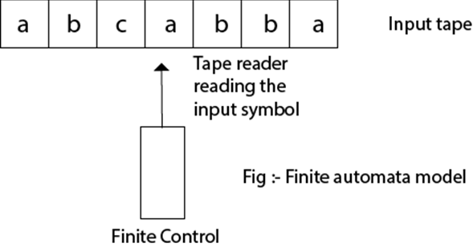
Finite Automata Model
Finite automata can be represented by input tape and finite control.
  Input tape: It is a linear tape having some number of cells. Each input symbol is placed in each cell.
  Finite control: The finite control decides the next state on receiving particular input from input tape. The tape reader reads the cells one by one from left to right, and at a time only one input symbol is read.

Slide 29
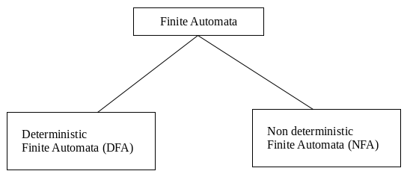
Types of Automata
There are two types of finite automata:
  DFA(deterministic finite automata)
  NFA(non-deterministic finite automata)

Slide 30
Types of Automata
DFA
  DFA refers to deterministic finite automata.
  Deterministic refers to the uniqueness of the computation.
  In the DFA, the machine goes to one state only for a particular input character.
  DFA does not accept the null move.
NFA
  NFA stands for non-deterministic finite automata.
  It is used to transmit any number of states for a particular input.
  It can accept the null move.

Slide 31
Some important points about DFA and NFA
Every DFA is NFA, but NFA is not DFA.
There can be multiple final states in both NFA and DFA.
DFA is used in Lexical Analysis in Compiler.
NFA is more of a theoretical concept.
Lexical Analysis is the first phase of the compiler also known as a scanner.
It converts the High level input program into a sequence of Tokens.
Lexical Analysis can be implemented with the Deterministic finite Automata.

Slide 32
Transition Diagram
A transition diagram or state transition diagram is a directed graph which can be constructed as follows:
  There is a node for each state in Q, which is represented by the circle.
  There is a directed edge from node q to node p labeled a if δ(q, a) = p.
  In the start state, there is an arrow with no source.
  Accepting states or final states are indicating by a double circle.

Slide 33
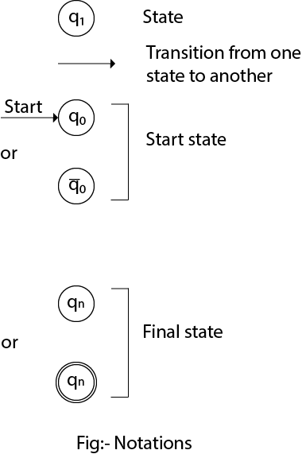
transition diagram Notations

Slide 34
how a DFA operates
In DFA, the input to the automata can be any string.
Now, put a pointer to the start state q and read the input string w from left to right and move the pointer according to the transition function, δ.
We can read one symbol at a time.
If the next symbol of string w is ‘a’ and the pointer is on state p, move the pointer to δ(p, a).
When the end of the input string w is encountered, then the pointer is on some state F.

Slide 35
how a DFA operates
The string w is said to be accepted by the DFA if r ∈ F that means the input string w is processed successfully and the automata reached its final state.
The string is said to be rejected by DFA if r ∉ F.

Slide 36
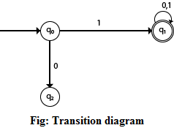
Example 1
DFA with ∑ = {0, 1} accepts all strings starting with 1.
  Solution:
    The finite automata can be represented using a transition graph.
    In the above diagram, the machine initially is in start state q0 then on receiving input 1 the machine changes its state to q1.
    From q0 on receiving 0, the machine changes its state to q2, which is the dead state.
    From q1 on receiving input 0, 1 the machine changes its state to q1, which is the final state.
    The possible input strings that can be generated are 10, 11, 110, 101, 111......., that means all string starts with 1.

Slide 37

Example 2
NFA with ∑ = {0, 1} accepts all strings starting with 1.
  Solution:
The NFA can be represented using a transition graph.
In the above diagram, the machine initially is in start state q0 then on receiving input 1 the machine changes its state to q1.
From q1 on receiving input 0, 1 the machine changes its state to q1.
The possible input string that can be generated is 10, 11, 110, 101, 111......, that means all string starts with 1.

Slide 38
Transition Table
The transition table is basically a tabular representation of the transition function.
It takes two arguments (a state and a symbol) and returns a state (the "next state").
  A transition table is represented by the following things:
  Columns correspond to input symbols.
  Rows correspond to states.
  Entries correspond to the next state.
  The start state is denoted by an arrow with no source.
  The accept state is denoted by a star.

Slide 39
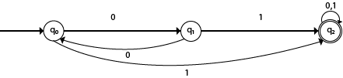
Example 1
Solution: Transition table of given DFA is as follows:
Present State | Next state for Input 0 | Next State of Input 1
→q0 | q1 | q2
q1 | q0 | q2
*q2 | q2 | q2
Explanation:
  In the above table, the first column indicates all the current states. Under column 0 and 1, the next states are shown.
  The first row of the transition table can be read as, when the current state is q0, on input 0 the next state will be q1 and on input 1 the next state will be q2.
  In the second row, when the current state is q1, on input 0, the next state will be q0, and on 1 input the next state will be q2.
  In the third row, when the current state is q2 on input 0, the next state will be q2, and on 1 input the next state will be q2.
  The arrow marked to q0 indicates that it is a start state and circle marked to q2 indicates that it is a final state.

Slide 40

Example 2
Present State | Next state for Input 0 | Next State of Input 1
→q0 | q0 | q1
q1 | q1, q2 | q2
q2 | q1 | q3
*q3 | q2 | q2
Solution: Transition table of given DFA is as follows:
Explanation:
  The first row of the transition table can be read as, when the current state is q0, on input 0 the next state will be q0 and on input 1 the next state will be q1.
  In the second row, when the current state is q1, on input 0 the next state will be either q1 or q2, and on 1 input the next state will be q2.
  In the third row, when the current state is q2 on input 0, the next state will be q1, and on 1 input the next state will be q3.
  In the fourth row, when the current state is q3 on input 0, the next state will be q2, and on 1 input the next state will be q2.

Slide 41
DFA (Deterministic finite automata)
DFA refers to deterministic finite automata.
  Deterministic refers to the uniqueness of the computation.
  The finite automata are called deterministic finite automata if the machine is read an input string one symbol at a time.
In DFA, there is only one path for specific input from the current state to the next state.
DFA does not accept the null move,
  i.e., the DFA cannot change state without any input character.
DFA can contain multiple final states.
  It is used in Lexical Analysis in Compiler.

Slide 42
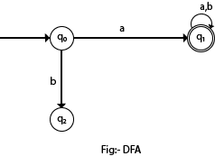
Example
In the following diagram, we can see that from state q0 for input a, there is only one path which is going to q1.
Similarly, from q0, there is only one path for input b going to q2.

Slide 43
Formal Definition of DFA
A DFA is a collection of 5-tuples same as we described in the definition of FA.
  Q: finite set of states
  ∑: finite set of the input symbol
  q0: initial state
  F: final state
  δ: Transition function
Transition function can be defined as:
  δ: Q x ∑→Q

Slide 44
Graphical Representation of DFA
A DFA can be represented by digraphs called state diagram. In which:
  The state is represented by vertices.
  The arc labeled with an input character show the transitions.
  The initial state is marked with an arrow.
  The final state is denoted by a double circle.

Slide 45

Example 1
Q = {q0, q1, q2}
∑ = {0, 1}
q0 = {q0}
F = {q2}
Solution: Transition Diagram:
Transition Table
Present State | Next state for Input 0 | Next State of Input 1
→q0 | q0 | q1
q1 | q2 | q1
*q2 | q2 | q2

Slide 46
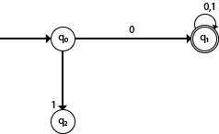
Example 2
DFA with ∑ = {0, 1} accepts all starting with 0.
Solution: Transition Diagram:
Explanation:
In the above diagram, we can see that on given 0 as input to DFA in state q0 the DFA changes state to q1 and always go to final state q1 on starting input 0.
It can accept 00, 01, 000, 001....etc. It can't accept any string which starts with 1, because it will never go to final state on a string starting with 1.

Slide 47

Example 3
DFA with ∑ = {0, 1} accepts all ending with 0.
Solution: Transition Diagram:
Explanation:
In the above diagram, we can see that on given 0 as input to DFA in state q0, the DFA changes state to q1.
It can accept any string which ends with 0 like 00, 10, 110, 100....etc.
It can't accept any string which ends with 1, because it will never go to the final state q1 on 1 input, so the string ending with 1, will not be accepted or will be rejected.

Slide 48

Example (1) of DFA
Design a FA with ∑ = {0, 1} accepts those string which starts with 1 and ends with 0.
Solution:
The FA will have a start state q0 from which only the edge with input 1 will go to the next state.
Explanation:
In state q1, if we read 1, we will be in state q1, but if we read 0 at state q1, we will reach to state q2 which is the final state.
In state q2, if we read either 0 or 1, we will go to q2 state or q1 state respectively. Note that if the input ends with 0, it will be in the final state.

Slide 49

Example (2) of DFA
Design a FA with ∑ = {0, 1} accepts the only input 101.
Solution:
In the given solution, we can see that only input 101 will be accepted. Hence, for input 101, there is no other path shown for other input.

Slide 50
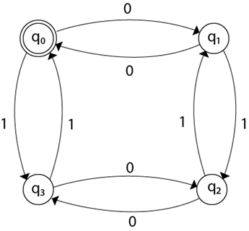
Example (3) of DFA
Design FA with ∑ = {0, 1} accepts even number of 0's and even number of 1's.
Solution:
This FA will consider four different stages for input 0 and input 1. The stages could be:
Explanation:
Here q0 is a start state and the final state also. Note carefully that a symmetry of 0's and 1's is maintained. We can associate meanings to each state as:
q0: state of even number of 0's and even number of 1's.
q1: state of odd number of 0's and even number of 1's.
q2: state of odd number of 0's and odd number of 1's.
q3: state of even number of 0's and odd number of 1's.

Slide 51

Example (4) of DFA
Design FA with ∑ = {0, 1} accepts the set of all strings with three consecutive 0's.
Solution:
The strings that will be generated for this particular languages are 000, 0001, 1000, 10001, .... in which 0 always appears in a clump of 3. The transition graph is as follows:
Note that the sequence of triple zeros is maintained to reach the final state.

Slide 52
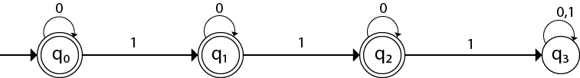
Example (5) of DFA
Design a DFA L(M) = {w | w ε {0, 1}*} and W is a string that does not contain consecutive 1's.
Solution:
When three consecutive 1's occur the DFA will be:
Here two consecutive 1's or single 1 is acceptable, hence
The stages q0, q1, q2 are the final states. The DFA will generate the strings that do not contain consecutive 1's like 10, 110, 101,..... etc.

Slide 53
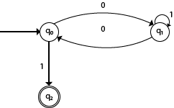
Example (6) of DFA
Design a FA with ∑ = {0, 1} accepts the strings with an even number of 0's followed by single 1.
Solution:
The DFA can be shown by a transition diagram as:

Slide 54
Conversion from NFA to DFA
Let, M = (Q, ∑, δ, q0, F) is an NFA which accepts the language L(M). There should be equivalent DFA denoted by M' = (Q', ∑', q0', δ', F') such that L(M) = L(M').
Steps for converting NFA to DFA:
  Step 1: Initially Q' = ϕ
  Step 2: Add q0 of NFA to Q'. Then find the transitions from this start state.
  Step 3: In Q', find the possible set of states for each input symbol. If this set of states is not in Q', then add it to Q'.
  Step 4: In DFA, the final state will be all the states which contain F(final states of NFA)

Slide 55
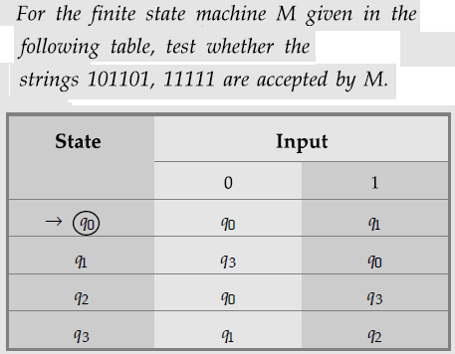
Example - 1

Slide 56
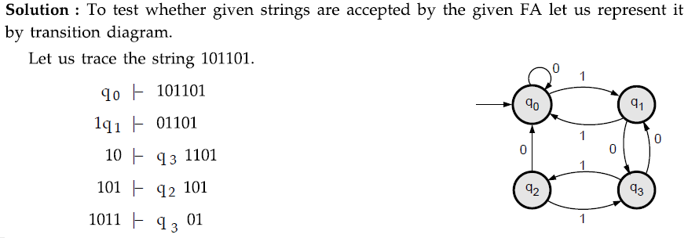
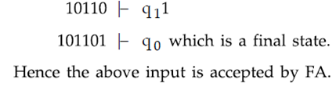
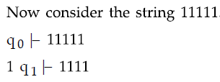
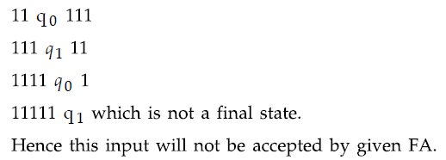

Slide 57
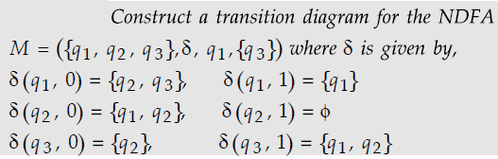
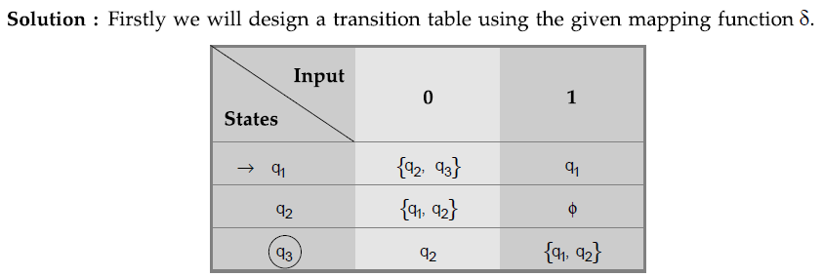
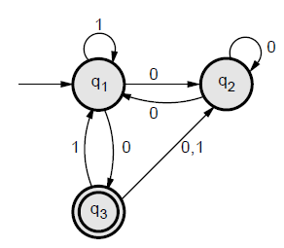

Example - 2

Slide 58
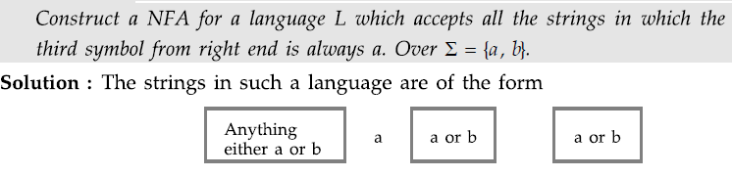
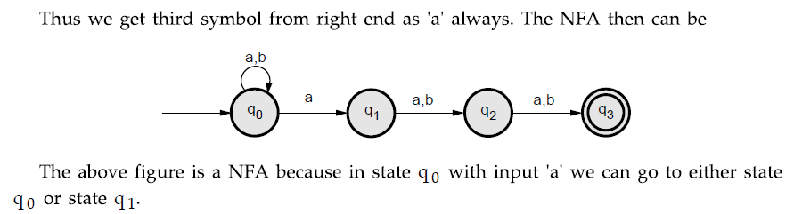
Example - 3

Slide 59
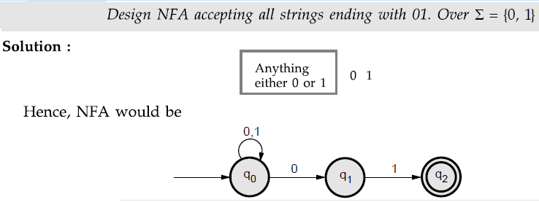
Example - 4

Slide 60
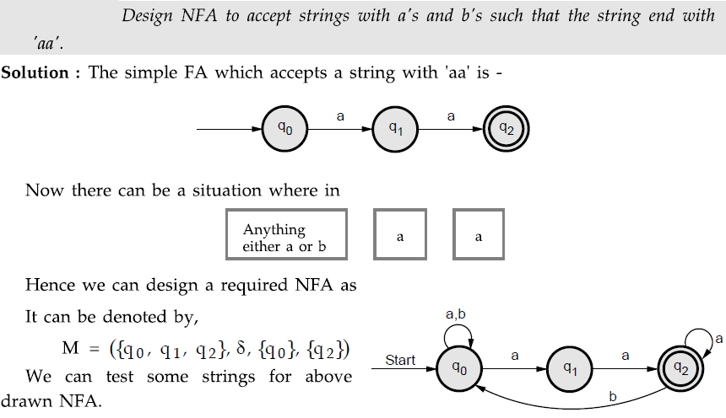
Example - 5

Slide 61
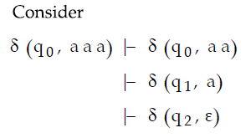
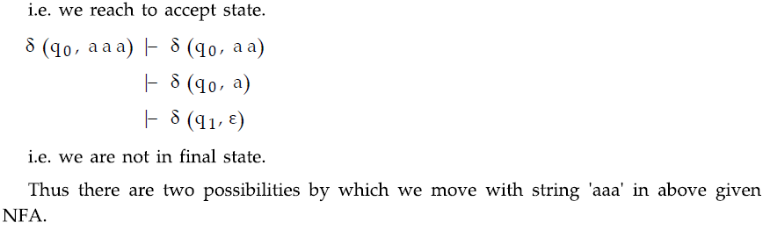

Slide 62
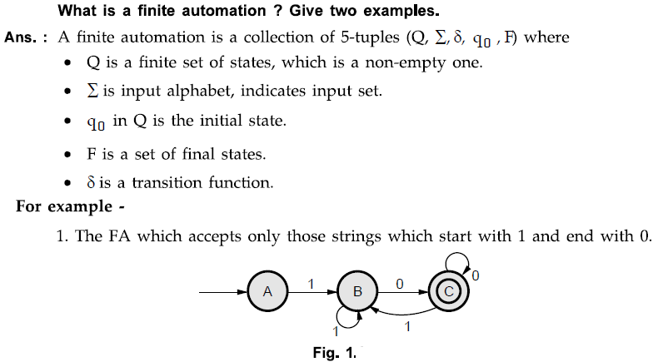
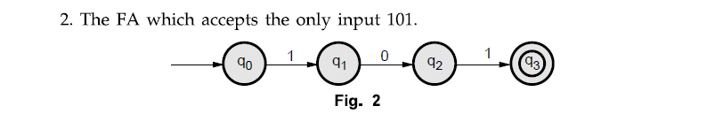

Slide 63
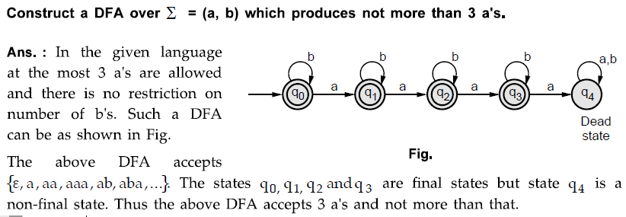

Slide 64
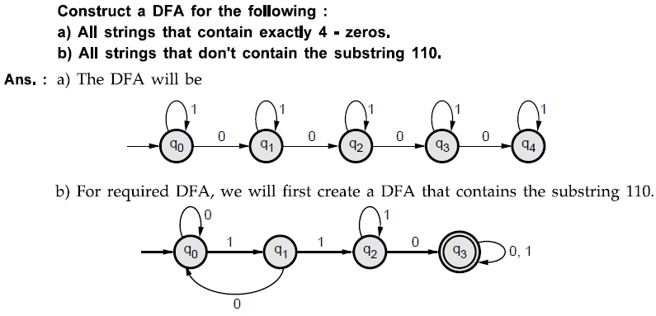
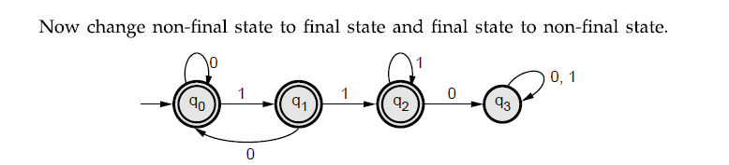

Slide 65
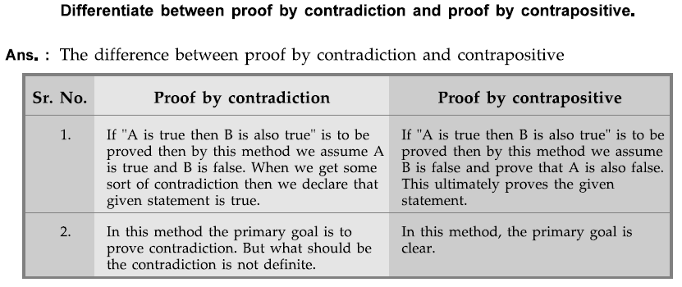

Slide 66
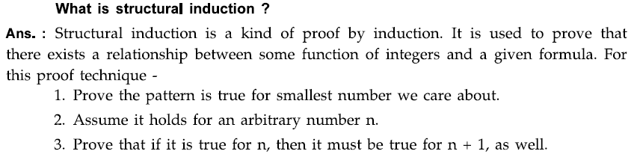
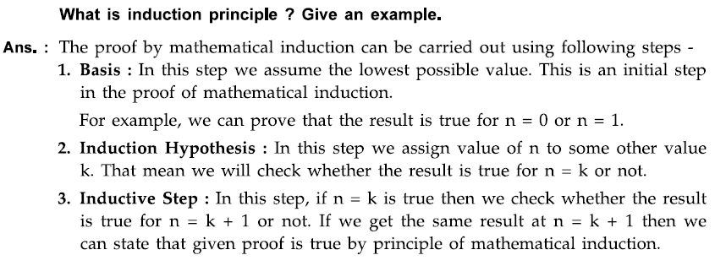

Slide 67
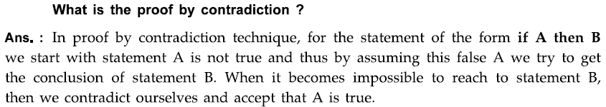
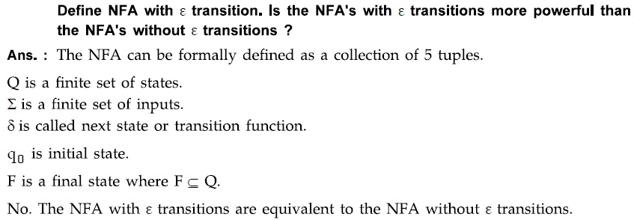

Slide 68
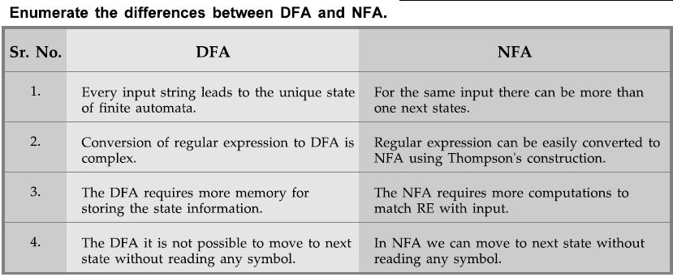

Slide 69
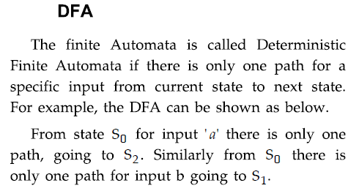
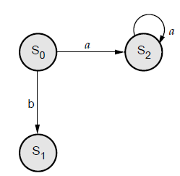
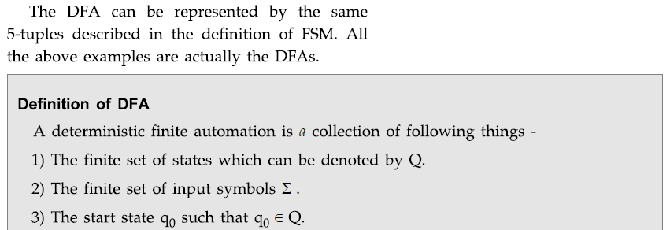

Slide 70
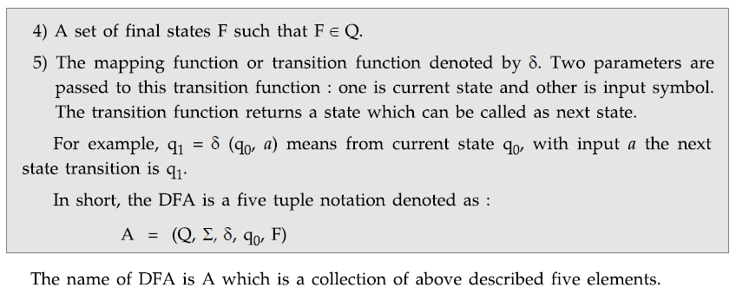

Slide 71
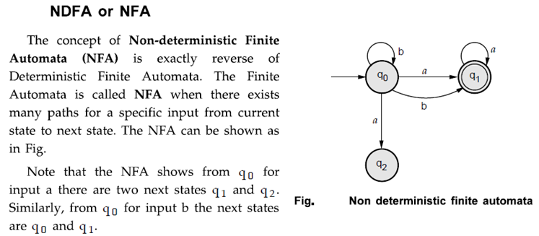


Slide 72


Slide 73


Slide 74

Theorem: NFA to DFA conversion

Slide 75


Slide 76

Alternate method

Slide 77

Theorem: NFA with ε to DFA directly

Slide 78

Theorem: NFA-ε to NFA without ε
If L is accepted by an NFA with ε-transition then show that L is accepted by NFA without ε -transition.

Slide 79


Slide 80


NFA to DFA

Slide 81



Slide 82


NFA with € to DFA

Slide 83


Slide 84



Slide 85



NFA with € to NFA without €

Slide 86



Slide 87



Slide 88



