Slide 1
THEORY OF COMPUTATION

Slide 2
UNIT II:
REGULAR EXPRESSIONS AND LANGUAGES
Regular expressions, Identity rules,
Finite automata and Regular expressions, Applications of regular expressions,
Closure properties of regular languages,
Pumping lemma for regular languages, Applications of the pumping lemma,
Equivalence of two regular expressions, Equivalence of two finite automata and minimization of automata..

Slide 3
Regular Expression
The language accepted by finite automata can be easily described by simple expressions called Regular Expressions. It is the most effective way to represent any language.
The languages accepted by some regular expression are referred to as Regular languages.
A regular expression can also be described as a sequence of pattern that defines a string.
Regular expressions are used to match character combinations in strings. String searching algorithm used this pattern to find the operations on a string.
For instance:
  In a regular expression, x* means zero or more occurrence of x. It can generate {ε, x, xx, xxx, xxxx, .....}
  In a regular expression, x⁺ means one or more occurrence of x. It can generate {x, xx, xxx, xxxx, .....}

Slide 4
Operations on Regular Language
The various operations on regular language are:
Union: If L and M are two regular languages then their union L U M is also a union.
  L U M = {s | s is in L or s is in M}
Intersection: If L and M are two regular languages then their intersection is also an intersection.
  L ⋂ M = {st | s is in L and t is in M}
Kleen closure: If L is a regular language then its Kleen closure L1* will also be a regular language.
  L* = Zero or more occurrence of language L.

Slide 5
Example 1:
Write the regular expression for the language accepting all combinations of a's, over the set ∑ = {a}
Solution:
All combinations of a's means a may be zero, single, double and so on. If a is appearing zero times, that means a null string.
That is we expect the set of {ε, a, aa, aaa, ....}. So we give a regular expression for this as:
R = a*
That is Kleen closure of a.
Example 2:
Write the regular expression for the language accepting all combinations of a's except the null string, over the set ∑ = {a}
Solution:
The regular expression has to be built for the language
L = {a, aa, aaa, ....}
This set indicates that there is no null string.
So we can denote regular expression as:
R = a⁺

Slide 6
Example 3:
Write the regular expression for the language accepting all the string containing any number of a's and b's.
Solution:
The regular expression will be:
r.e. = (a + b)*
This will give the set as L = {ε, a, aa, b, bb, ab, ba, aba, bab, .....}, any combination of a and b.
The (a + b)* shows any combination with a and b even a null string.
Example 4:
Write the regular expression for the language accepting all the string which are starting with 1 and ending with 0, over ∑ = {0, 1}.
Solution:
In a regular expression, the first symbol should be 1, and the last symbol should be 0. The r.e. is as follows:
R = 1 (0+1)* 0

Slide 7
Example 5:
Write the regular expression for the language starting and ending with a and having any having any combination of b's in between.
Solution:
The regular expression will be:
R = a b* a
Example 6:
Write the regular expression for the language starting with a but not having consecutive b's.
Solution:
The regular expression has to be built for the language:
L = {a, aba, aab, aba, aaa, abab, .....}
The regular expression for the above language is:
R = {a + ab}*

Slide 8
Example 7:
Write the regular expression for the language accepting all the string in which any number of a's is followed by any number of b's is followed by any number of c's.
Solution:
As we know, any number of a's means a* any number of b's means b*, any number of c's means c*. Since as given in problem statement, b's appear after a's and c's appear after b's.
So the regular expression could be:
R = a* b* c*
Example 8:
Write the regular expression for the language over ∑ = {0} having even length of the string.
Solution:
The regular expression has to be built for the language:
L = {ε, 00, 0000, 000000, ......}
The regular expression for the above language is:
R = (00)*

Slide 9
Example 9:
Write the regular expression for the language having a string which should have atleast one 0 and alteast one 1.
Solution:
The regular expression will be:
R = [(0 + 1)* 0 (0 + 1)* 1 (0 + 1)*] + [(0 + 1)* 1 (0 + 1)* 0 (0 + 1)*]
Example 10:
Describe the language denoted by following regular expression
r.e. = (b* (aaa)* b*)*
Solution:
The language can be predicted from the regular expression by finding the meaning of it. We will first split the regular expression as:
r.e. = (any combination of b's) (aaa)* (any combination of b's)
L = {The language consists of the string in which a's appear triples, there is no restriction on the number of b's}

Slide 10
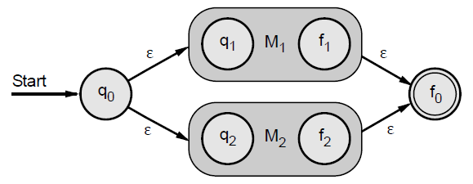
Regular expression to ∈-NFA
Union case
  a+b, a x b, a-b, or a/b
Concatenation case
  ab
Closure case
  a*

Slide 11
Regular Expression to nfa
Let r be a regular expression, then there exists a NFA eith ε transitions that accepts L (r).

Slide 12
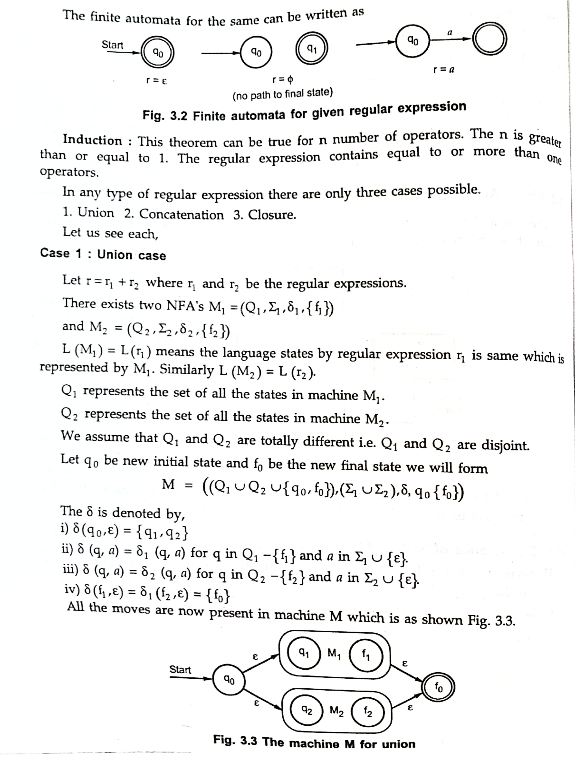

Slide 13
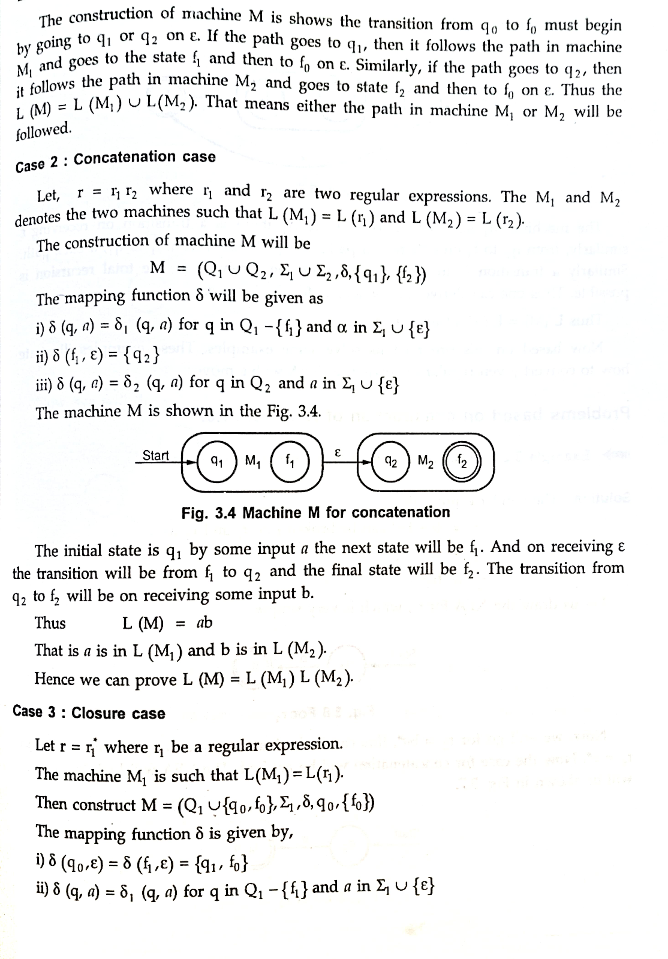

Slide 14
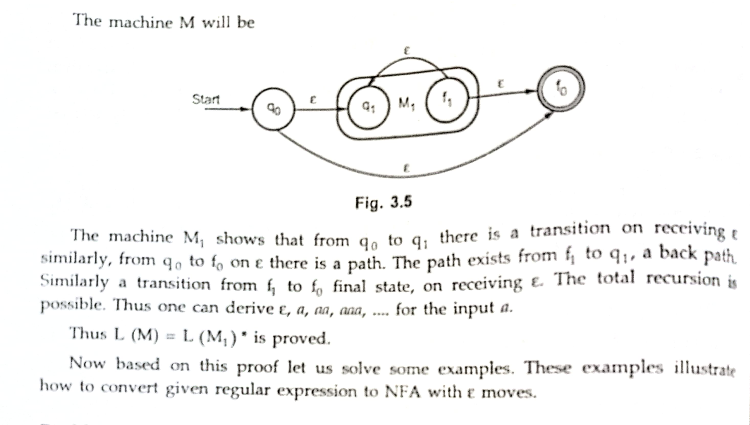

Slide 15
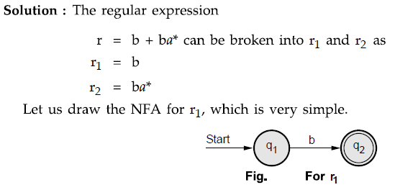



Slide 16
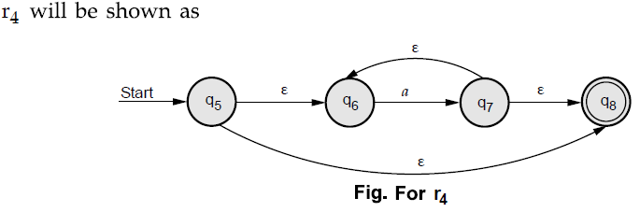
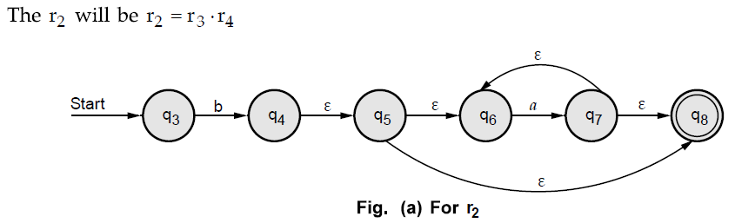

Slide 17
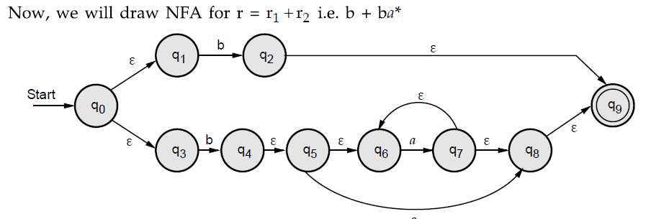

Slide 18
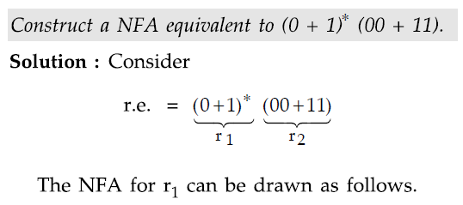
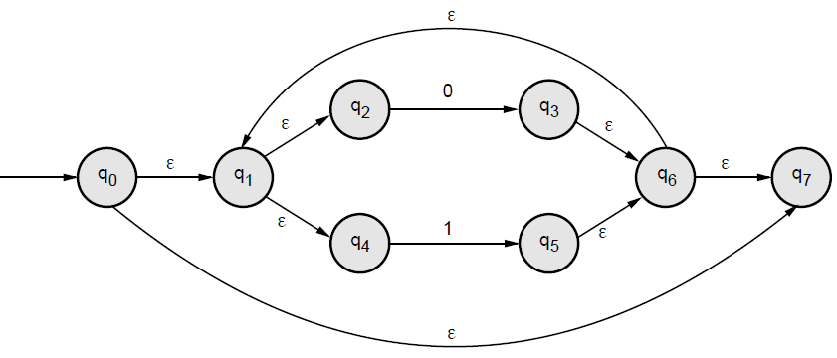
Example - 2

Slide 19
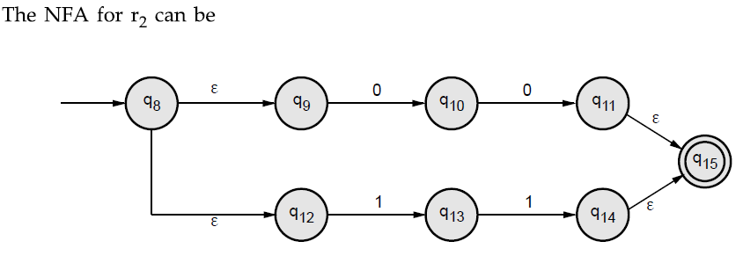
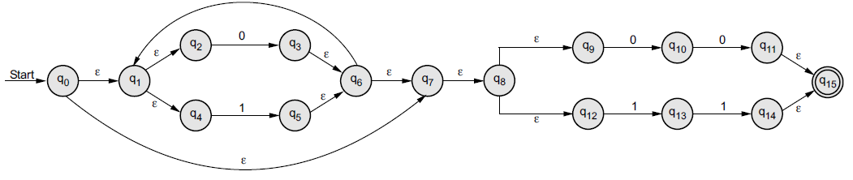

Slide 20
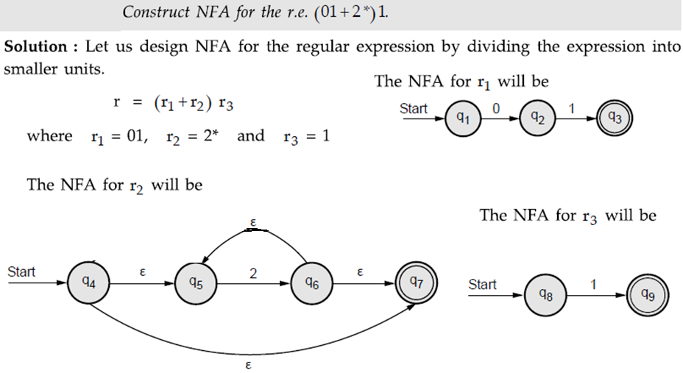
Example - 3

Slide 21
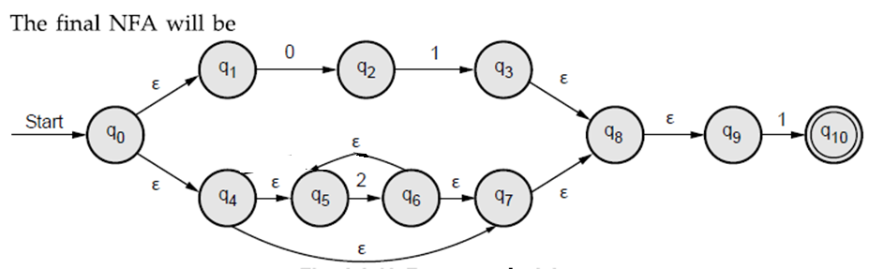

Slide 22

Unsolved Questions for Practice
Example - 4
Example - 5
Example - 6

Slide 23
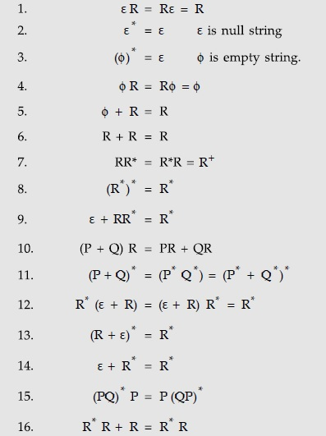
Identity rules
The two regular expressions P and Q are equivalent (denoted as P=Q) if and only if P represents the same set of strings as Q does. For showing this equivalence of regular expressions we need to show some identities of regular expressions.
Let P, Q and R are some regular expressions and the identity rules are given as

Slide 24
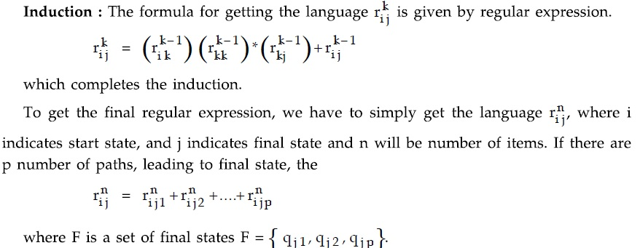
Generating regular expression from Finite Automata

Slide 25

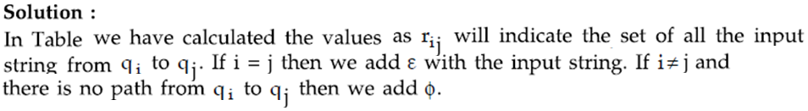
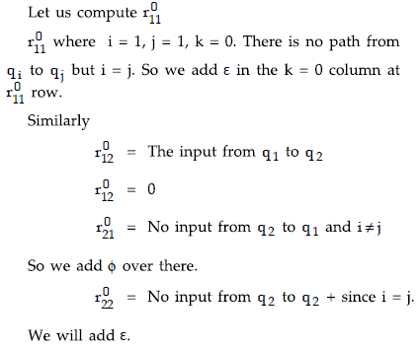
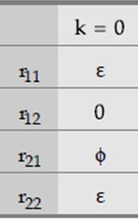
Example - 1

Slide 26
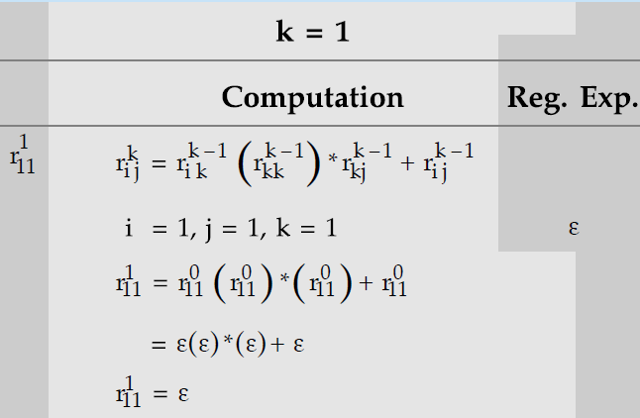
Apply rule →1

Slide 27
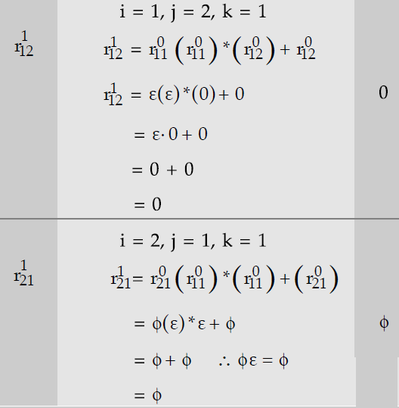

Slide 28
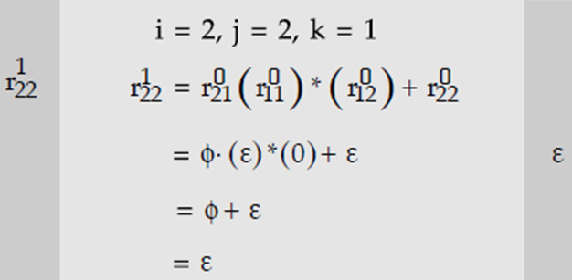
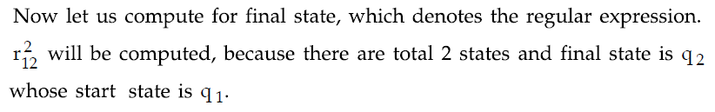



Slide 29
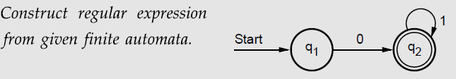
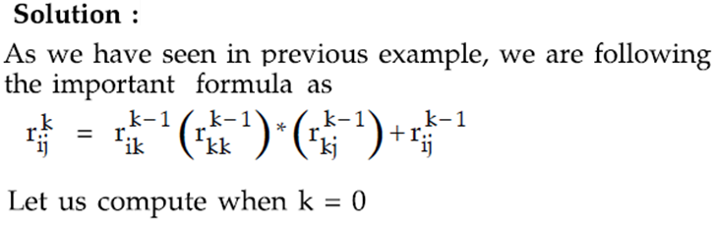
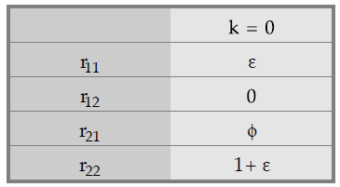
Example - 2

Slide 30
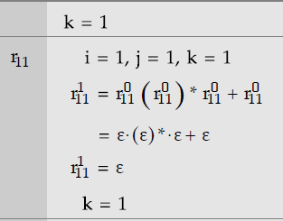
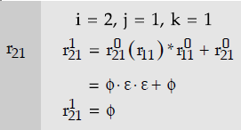
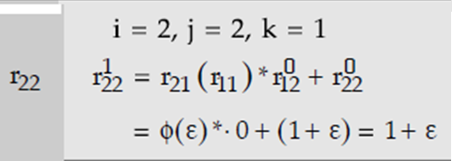
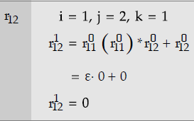

Slide 31
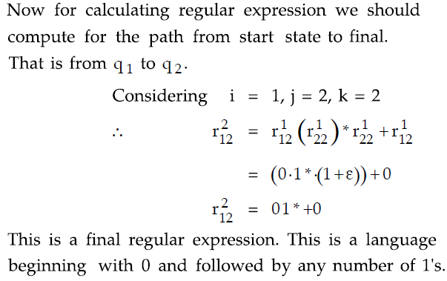
Apply rule →12

Slide 32
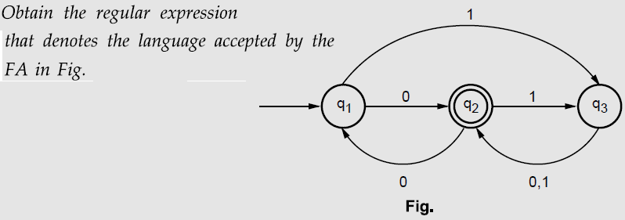
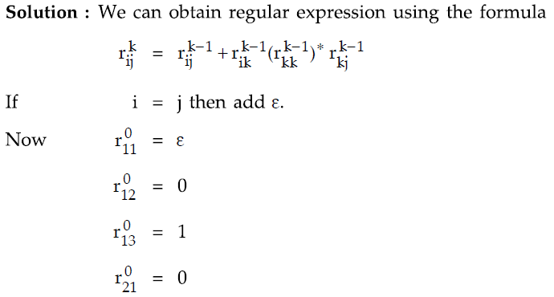
Example - 3

Slide 33
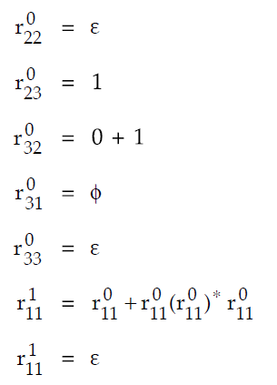

Slide 34
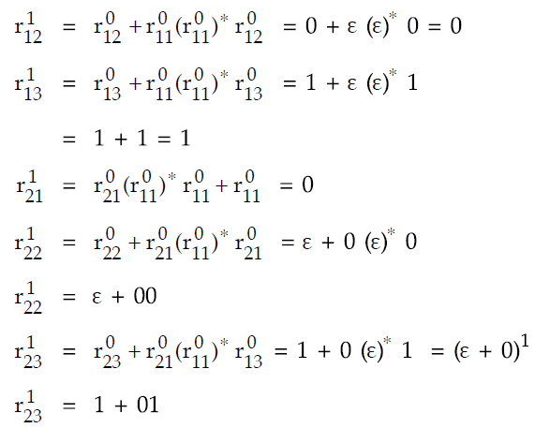

Slide 35
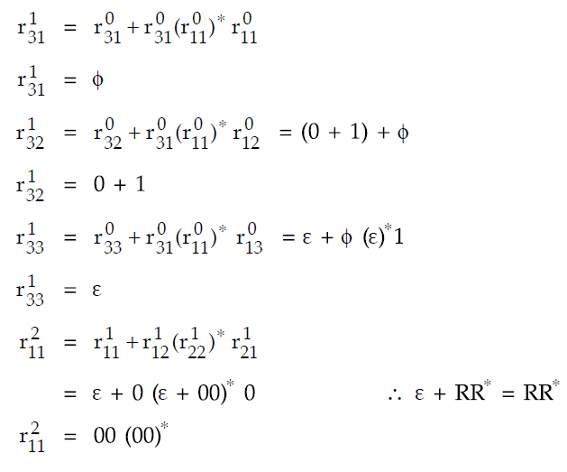

Slide 36
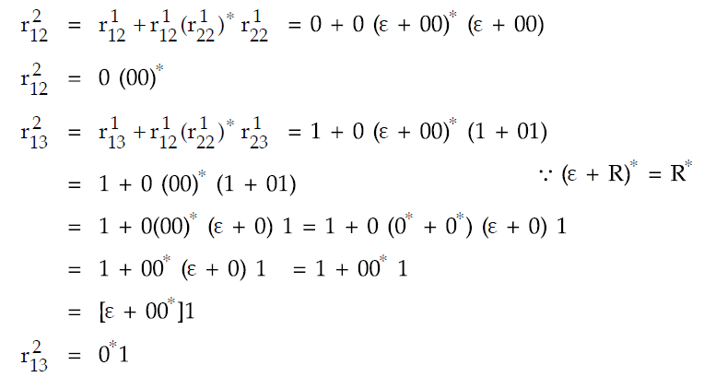
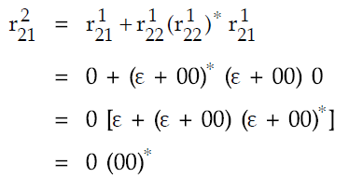

Slide 37
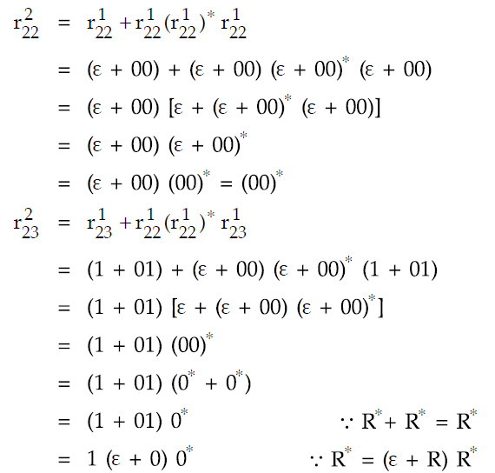

Slide 38
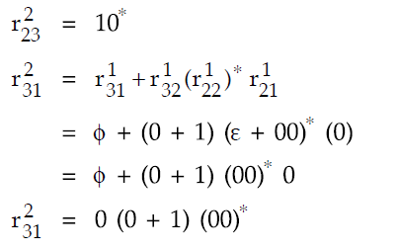
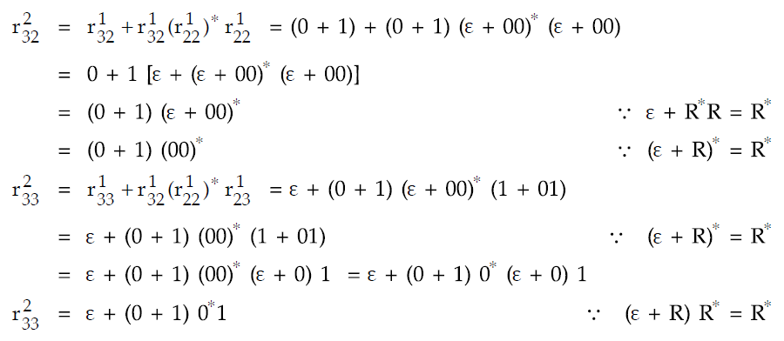

Slide 39
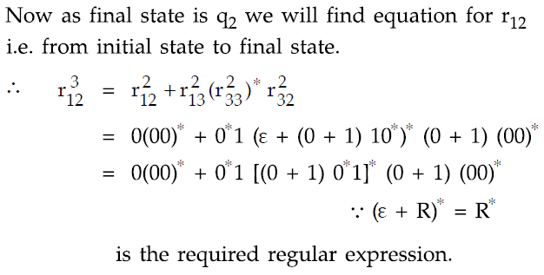

Slide 40
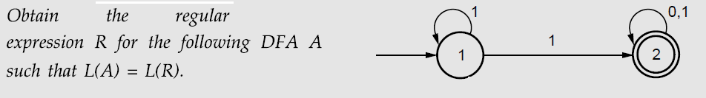
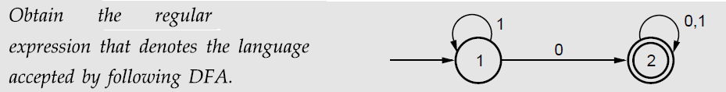
Example -4 : Self Study /Assignment
Example -5 : Self Study /Assignment

Slide 41
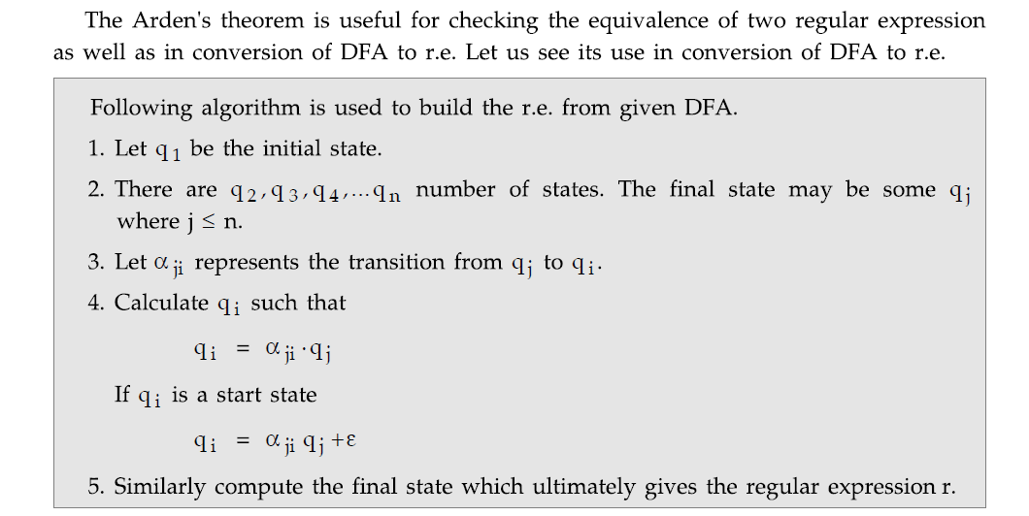
Arden’s Method for converting dfa to re

Slide 42
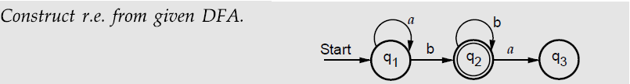

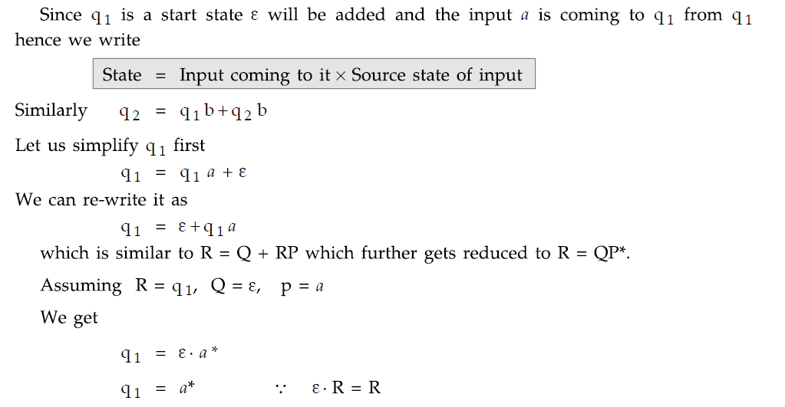

Slide 43
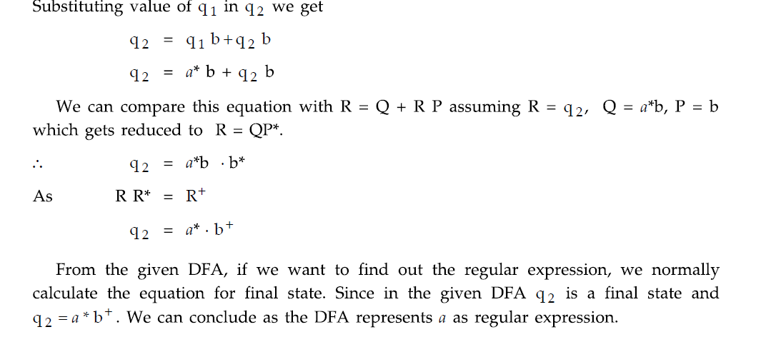

Slide 44
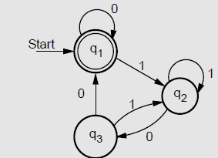
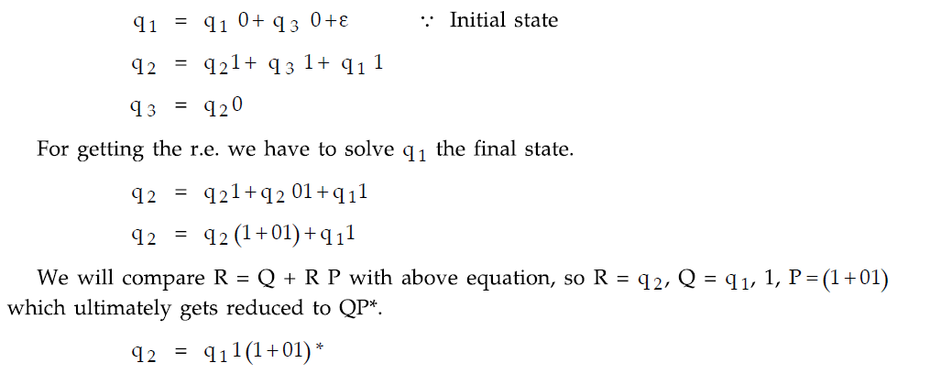
Example 2
Find out the regular expression from given dfa

Slide 45


Slide 46

Closure Properties of Regular Languages

Slide 47


Slide 48


Slide 49


Slide 50



Slide 51


Slide 52


Slide 53


Slide 54


Slide 55


Slide 56
Minimization of DFA

Slide 57
Minimization of DFA
The minimization of FSM means reducing the number of states from the given FA. Thus we get the FSM with redundant states after minimising the FSM.
While minimising the FSM we first find out which two states are equivalent we can represent those two states by one representative state.
The two state q1 and q2 are equivalent, if both δ (q1, x) and δ(q2, x) are final states or both of them are non final states for all x ∈ ∑* (∑* indicate any string of any length) we can minimize the given FSM by finding equivalent states.

Slide 58

Method for construction of minimum state automata

Slide 59

Example - 1
Solution:
We first construct the transition table for the given DFA.
Then we will start constructing equivalence classes.

Slide 60


Slide 61


Slide 62


Slide 63


Slide 64


Slide 65


Slide 66


Slide 67


Slide 68


Slide 69

Example -2 :

Slide 70


Slide 71


Slide 72


Slide 73


Slide 74


Slide 75


Slide 76


Slide 77


Slide 78


Slide 79


Slide 80
Minimization of dfa (alternate method)

Slide 81


Slide 82


Slide 83


Slide 84

Example -3 : Self Study /Assignment

Slide 85
PUMPING LEMMA FOR REGULAR SETS

Slide 86
Pumping lemma for regular sets
This is a basic and important theorem used for checking whether given string is accepted by regular expression or not.
Theorem:
Let L be the regular set. Then there is a constant n such that if Z is any word in L and |Z| ≥ n, we can write z= u v w such that |u v| ≤ n, |v|≥1 for all i≥0, u v^{i} w is in L. The n should be greater than number of states.

Slide 87


Slide 88


Example -1:

Slide 89


Slide 90


Slide 91

Example -2:

Slide 92

Example -3:

