Slide 1

UEC3942: Introduction to Sensors and Actuators
Unit II: Colour Temperature and Light Flux
Presentation by: Dr. C. Annadurai
Associate Professor/Dept. of ECE SSN College of Engineering

Slide 2
Overview
Learning Outcomes
At the end of the session, the students will be able to understand the relationship between Heat, Wavelength, and Visible Light.

Slide 3
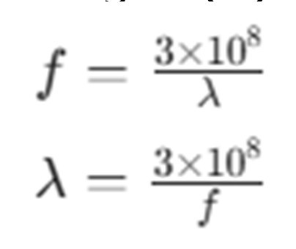
Physics of Light Waves
Introduction
The Constant Speed of Light: In a vacuum or air, light travels at approximately 3×10⁸ m/s.
Fundamental Equation: Speed (c) is the product of frequency (f) and wavelength (λ).
Media Impact: Light speed slows significantly when traveling through materials like glass.

Slide 4
Energy and the Quantum Nature of Light
Introduction
Amplitude and Energy: The total energy carried by a light radiation wave depends on the square of its amplitude.
Frequency and Unit Energy: The "unit energy" (quantum) of light is dependent on its frequency.
Scientific Milestone: The explanation of photoelectric emission—how light acts as quanta—won Albert Einstein his first Nobel Prize.

Slide 5
Defining Colour Temperature
Introduction
Thermal Radiation: Any object with a temperature above absolute zero (0 K) radiates energy.
The Concept: Colour temperature describes the spectrum of light in terms of the temperature a "black body" would need to reach to radiate in the same way.
Practical Calculation: To find Kelvin (absolute temperature), add 273 to the Celsius temperature.

Slide 6
Radiated Power and Temperature (Graph)
Introduction
Power Density: Plotted as watts per m² per micrometre (µm) band.
Correlation: Higher temperatures result in a higher peak of radiated power and a shift toward shorter wavelengths.

Slide 7
The Stefan-Boltzmann Relationship
Introduction
The Fourth Power Law: The amount of energy radiated is proportional to the fourth power of the absolute temperature.
Example:
An object at 1000K radiates 16 times more energy than an object at 500K.
Visual Change: As an object heats up, it radiates significantly more energy and the bandwidth of the spectrum increases.

Slide 8
The Shift from Infrared to Visible Light
Introduction
Low Temperatures: Radiation is predominantly in the far- infrared, which is invisible to the human eye.
The "Red-Hot" Threshold: Around 700K, the spectrum shifts enough for some radiation to enter the visible region.
Wien's Relationship: Doubling the absolute temperature halves the wavelength of the peak (predominant) radiation.

Slide 9
High Temperatures and "Cool" Light
Introduction
Shift to Blue: As temperature increases, the spectrum shifts toward higher frequencies (shorter wavelengths).
Sunlight Equivalence: Temperatures of approximately 3000K provide light that is predominantly blue, approaching the spectrum of natural sunlight.

Slide 10
Key Misconceptions
Introduction
Equivalent Temperature: Quoting a colour temperature of 3500K does not necessarily mean the light source itself is physically at that temperature.
Interaction with Matter: Interaction between radiation and material becomes critical when the wavelength is similar to the distance between atomic particles.

Slide 11
Introduction to Light Flux
Introduction
How is the sensitivity of photocells quantified, and the standards used for measurement?
Two Methods of Quoting Sensitivity:
Illumination: Measured in units of lux.
Irradiance: Measured as the power falling on a specific area (mW/cm²).

Slide 12
Understanding Illumination (Lux)
Introduction
Definition: Lux figures are obtained using photometers to measure light levels.
Common Benchmarks:
50 lux: Normal domestic lighting (sufficient for reading a newspaper).
1000 lux: Level required for close inspection work or reading fine print.
100,000 lux: Direct sunlight.

Slide 13
Understanding Irradiance
Introduction
Definition: Irradiance is the figure of power falling on a cell per cm² of sensitive area.
Electronic Perspective: This unit (mW/cm²) is often more comprehensible to those with an electronics background.
Conversion Challenge: There is no simple direct conversion between mW/cm² and lux unless quantities like spectral composition are held constant.

Slide 14
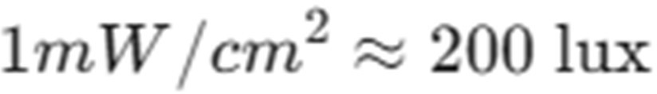
The Approximation Rule
Introduction
Standard Approximation: For the specific range of wavelengths used in photocells, a common estimate is used:
Context: This is an approximate figure used frequently in the field.

Slide 15
Wavelength and Peak Sensitivity
Introduction
Variable Response: Photocells vary in their wavelength at peak sensitivity.
Biasing:
Some sensors are biased toward the red or violet ends of the visible spectrum.
Others have peak responses in invisible radiation, such as infrared or ultraviolet.

Slide 16
Matching the Human Eye
Introduction
Silicon Photodiodes: Some specific devices are designed to have peak sensitivity matching the human eye.
Applications: These are ideal for automated processes that previously required human visual inspection.
Limitation: Even if peak sensitivities match, the response at other colors may differ significantly from the human eye.

Slide 17
Spectral Response Curves
Introduction
General Comparison: Most sensors are more sensitive than the human eye at the extremes of the light spectrum.
Standard Examples:
Selenium Cells: Distinct spectral response curves.
Photoresistive Cells: Differing response patterns compared to selenium.

Slide 18
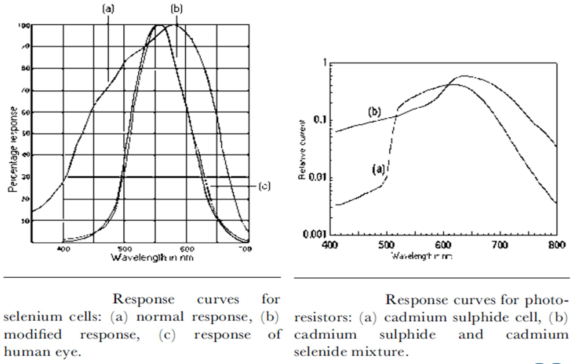
Spectral Response Curves
Introduction

Slide 19
Colour Matching and Filters
Introduction
Challenge: Because sensors and the eye perceive the spectrum differently, direct replacement for visual tasks is not always successful.
Solution: In applications like color matching, filters must be placed in the light path.
Goal: Filters help the response curve match the human eye more evenly across the entire spectrum.

Slide 20
Visual Matching
Introduction
While some devices, like silicon photodiodes, have peak sensitivity matching the human eye, they often fail to replicate human vision perfectly.
This is because the sensitivity at non-peak colors frequently follows a different pattern than the eye.
Sensors tend to be more sensitive to the red or violet extremes of the spectrum, necessitating the use of filters to achieve a balanced response curve.

Slide 21
Summary
Introduction
Proportionality:
temperature.
Wavelength vs.
Energy increases with the
₄th
power of
Temperature: Peak wavelength is inversely
proportional to absolute temperature.
Spectrum Profile: Colour temperature provides a compact way to describe the spectrum of any radiation.
Sensitivity measurement: Quoted in either lux (illumination) or mW/cm² (irradiance).
Environmental context: Light levels range from 50 lux (home) to 100,000 lux (sunlight).
Spectral limitations: Sensors often perceive colors at the spectrum's edge more intensely than humans, requiring filters for accuracy.

Slide 22
Test your understanding
Define Colour Temperature.
State the relationship between light flux and irradiance.
Explain the relationship between temperature, energy, and wavelength shift in thermal radiation.
Differentiate between radiant flux and luminous flux in the context of sensors.
Discuss the physics of light radiation and colour temperature including the roles of frequency, wavelength, and the quantum nature of light.
Define "Irradiance" as it relates to photocell sensitivity.
Why are filters sometimes required when using photosensors for color matching?
Discuss the different ways photocell sensitivity is quoted and the challenges of matching sensor response to human vision.

Slide 23
Textbook
Ian R Sinclair, Sensors and Transducers, Third Edition, 2001 (Units I & II).

