Slide 1

UEC3942: Introduction to Sensors and Actuators
Unit II: Liquid Crystal Display (LCD)
Presentation by: Dr. C. Annadurai
Associate Professor/Dept. of ECE SSN College of Engineering

Slide 2
Learning Outcomes
Overview
To understand the principles, operation, and advantages of LCD.

Slide 3
Introduction to Electronic Displays
Introduction
Electronic displays are essential for communicating data from sensors and transducers.
Two dominant technologies currently lead the market:
LED (Light Emitting Diode)
LCD (Liquid Crystal Display)
This presentation focuses on the shift toward LCD technology for modern portable devices.

Slide 4
The Problem with LEDs - Power Consumption
Introduction
LEDs consume significant power.
A single small 7-segment display requires 15–20 mA per segment.
Worst-case scenario: A four-digit display showing "8888" can consume at least 420 mA.

Slide 5
LED Power Limitations
Introduction
Current levels of 420 mA are acceptable for mains-powered equipment.
This consumption is "out of the question" for standard battery-operated circuits.
Exceptions include car displays using secondary cells, which typically turn off when the ignition is off.

Slide 6
Why LCDs for Portable Gear?
Introduction
LCDs are the preferred choice equipment.
Common applications:
Pocket calculators
Portable computers/laptops
Digital voltmeters
for battery-operated

Slide 7
What are "Liquid Crystals"?
Introduction
The name is a bit of a misnomer: they are not necessarily liquids and definitely not crystals.
The term refers to organic materials (chemicals found in living organisms) with a unique chemical structure.

Slide 8
Solid Crystals vs. Liquid Crystals
Introduction
Solid Crystals: Precise atomic order, hard, high melting point, and often polarize light.
Liquid Crystals: Units contain hundreds of thousands of atoms, but enough interaction exists to create a structure, especially in viscous liquids.

Slide 9
Molecular Structure
Introduction
Liquid crystal materials (like cholesterol) consist of long chains.
When these chains are arranged in a line, the material polarizes light very strongly.
In electronics, we use materials whose chains align in an
electrostatic field.

Slide 10
LCD Electrical Properties
Introduction
Liquid crystal materials are non-conductive.
Aligning the chains in an electric field causes no current to flow.
This lack of current flow is the secret to their incredibly low power consumption.

Slide 11
Basic LCD Cell Construction
Introduction
An LCD cell consists of:
Sets of electrodes.
Liquid crystal material covering the electrodes.
A transparent enclosing wall (front).
A reflective backplate.
Liquid Crystals: Organic compounds that exhibit both solid-like order and liquid-like fluidity, allowing them to twist and change orientation when electric voltage is applied to control light transmission.

Slide 12
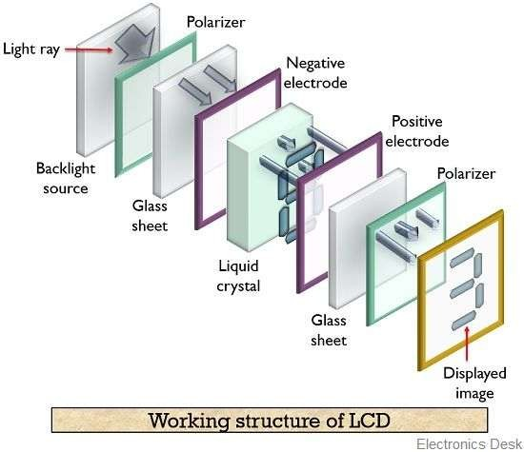
Basic LCD Cell Construction
Introduction

Slide 13
Basic LCD Cell Construction
Introduction
A liquid crystal display (LCD) has liquid crystal material sandwiched between two sheets of glass.
Without any voltage applied between transparent electrodes, liquid crystal molecules are aligned in parallel with the glass surface.
When voltage is applied, they change their direction and they turn vertical to the glass surface.
They vary in optical characteristics, depending on their orientation.

Slide 14
Basic LCD Cell Construction
Introduction
Therefore, the quantity controlled by combining
of light transmission can be the motion of liquid crystal
molecules and the direction of polarization of two polarizing plates attached to the both outer sides of the glass sheets.
LCDs utilize these characteristics to display images.

Slide 15
The Role of Polarization
Introduction
A sheet of polarizing material is placed over the transparent wall.
The cell relies on external light passing through this sheet.
Default state: Light passes through the material, reflects off the backplate, and returns to the viewer.

Slide 16
LCD Principle
Introduction
The liquid crystal display cell is used with a sheet of polarizing material over the transparent wall.
External light will pass through the polarizing sheet, and if the liquid crystal material is not aligned, will pass also through this and be reflected from the back-plate.
If a voltage is applied between two electrodes, however, the material between these electrodes will become polarizing, and the already polarized light will not pass and cannot be reflected.
This makes the affected area look dark, and the stronger the illumination of the cell the greater the contrast between this dark area and the brighter parts that have not been polarized.

Slide 17
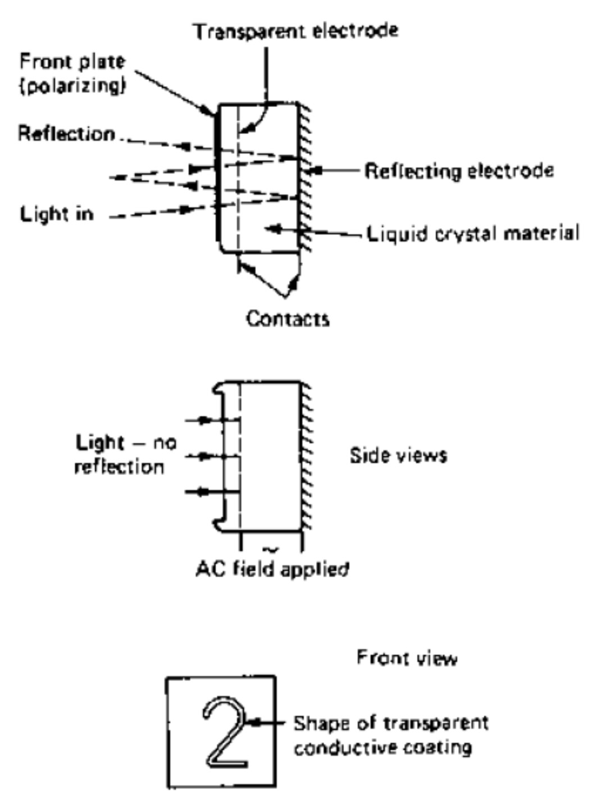
LCD Principle
Introduction
The shape that is to be displayed is deposited in the form of a transparent conductive coating on the front face, and the reflective rear face is the other electrode.
When power is applied, the material between these electrodes polarizes light, and the shape of the polarized zone accurately follows the shape of the electrode.
Where the material is light is reflected,
polarized, no
causing a dark
display.

Slide 18
LCD Principle
Introduction
Although some displays are made with a built-in backlight for viewing in the dark, LCDs generally are intended for use in well illuminated areas.
The use of DC on the electrodes causes irreversible changes to the liquid crystal material, so that the usual practice is to invert the DC supply to low- frequency (30–60 Hz) AC and use this as the supply to the electrodes.
The use of electronic conversion can ensure that no trace of DC is present, and since the power consumption is so low, relatively simple inverter circuits can be used.

Slide 19
How an LCD Creates an Image
Introduction
When a voltage is applied to the electrodes:
The material between them aligns/polarizes.
The already polarized light cannot pass through this zone and is not reflected.
Result: The affected area looks dark.

Slide 20
Contrast and Illumination
Introduction
LCDs work by contrast rather than emitting light.
The stronger the ambient illumination, the greater the contrast between dark and bright areas.
Most LCDs are intended for use in well-illuminated areas, though some use backlights for dark environments.

Slide 21
LCD Shape Formation
Introduction
The shape to be displayed (e.g., a number) is deposited as a transparent conductive coating on the front face.
The polarized zone accurately follows the shape of this electrode.

Slide 22
Power Requirements: DC vs. AC
Introduction
Problem: Using DC on electrodes causes "irreversible changes" to the liquid crystal material.
Solution: Invert the DC supply to low-frequency AC (30–60 Hz) for the electrodes.
Electronic conversion ensures no trace of DC is present.

Slide 23
Energy Efficiency Breakdown
Introduction
A four-digit LCD display operating at 32 kHz requires only about 8 µA.
Compare this to the 420,000 µA (420 mA) required by an equivalent LED display.
This makes them ideal for complex driving ICs powered by small batteries.

Slide 24
Packaging and Integrated Circuits
Introduction
Manufacturers rarely supply "bare" LCDs.
Most units are packaged with inverters and driving logic built-in.
Some incorporate counters and multiplexers so pulses can be input directly.

Slide 25
The Evolution: "Supertwist" LCDs
Introduction
"Supertwist" technology is a more recent advancement.
Benefits:
Much greater contrast.
Faster operation.
Widely used for modern portable computer screens.

Slide 26
TFT (Thin-Film Transistor) Screens
Introduction
The latest development in LCD technology.
A set of Thin-Film Transistors controls each individual LCD cell on the screen.
This technology allows for fast-acting colour displays found in modern laptops.

Slide 27
Alternative Display Technologies
Introduction
Filament Displays: 7-segment form, sometimes better brightness-to-consumption ratio than LEDs.
Gas Plasma Displays: Common before LEDs; used in older portable computers for low power and poor-light viewing.
Despite these, LED and LCD remain the dominant types.

Slide 28
Summary of Benefits
Introduction
Low Power: Micro-ampere consumption.
Reflective: Better visibility in bright light.
Scalable: From simple calculator digits to high-resolution TFT laptop screens.

Slide 29
Conclusion & Future Outlook
Introduction
LCD technology has revolutionized portable electronics.
Ongoing developments like TFT and Supertwist continue to improve speed and color fidelity.
LCD remains the gold standard for battery-efficient visual interfaces.

Slide 30
Test your understanding
Explain why LCDs are preferred over LEDs for battery-operated equipment.
Define the chemical nature of "liquid crystals" as described in the text.
Describe the physical construction and reflective principle of an LCD cell.
Compare the power consumption of a four-digit LED display versus a four-digit LCD display.
Briefly explain the evolution of LCD technology from standard displays to TFT screens.
Detailed Analysis of LCD Operation: From Molecular Alignment to Visual Output.
Discuss the role of auxiliary circuitry in electronic displays, including Multiplexers and Inverters.

Slide 31
Textbook
Ian R Sinclair, Sensors and Transducers, Third Edition, 2001 (Units I & II).

