Slide 1

UEC3942: Introduction to Sensors and Actuators
Unit II: Photoresistors and photoconductors
Presentation by: Dr. C. Annadurai
Associate Professor/Dept. of ECE SSN College of Engineering

Slide 2
Learning Outcomes
Overview
Focus on the principles, characteristics, and applications of light-sensing technology in photoresistors and photoconductors.

Slide 3
Introduction to Photoconductivity
Introduction
Definition: Materials whose electrical resistance changes when struck by light.
The Physics: These are semiconductors with few free charge carriers in their normal state.
Mechanism: Light energy separates electrons from "holes," allowing both to move and carry current through the material.

Slide 4
Terminology and Reliability
Introduction
Synonymous Terms: Often referred to interchangeably as photoresistors or photoconductive cells.
LDR: Commonly known as the Light-Dependent Resistor.
Durability: These devices are mechanically and electrically rugged with a strong record of reliability.

Slide 5
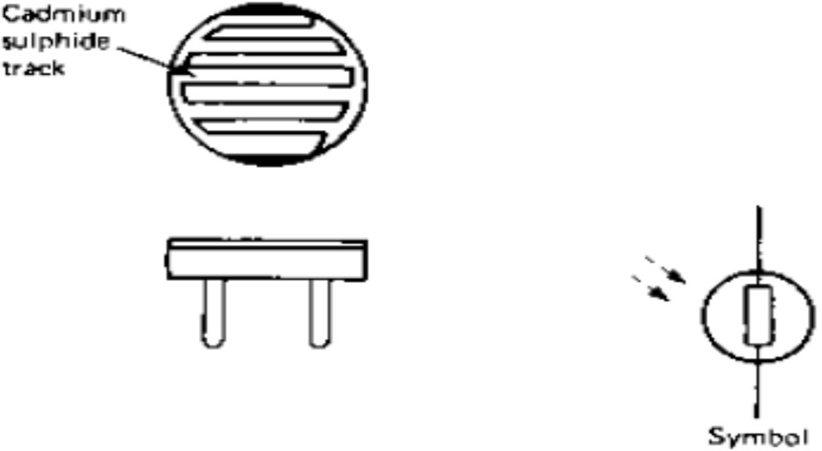
Photoconductive Cell
Introduction
Most Common Type: The cadmium sulphide (CdS) cell is the industry standard for general photosensing.
Construction: The CdS material is deposited as a thread pattern on an insulator.
Sensitivity: The zigzag shape of the track increases the length of the pattern, which enhances sensitivity.
Photoconductive cell

Slide 6
Physical Construction and Protection
Introduction
Encapsulation: Cells are encased in transparent resin or glass.
Purpose: This prevents contamination from the atmosphere while allowing light to reach the CdS track.
Operating Conditions: Capable of withstanding a wide range of temperatures during storage and operation.

Slide 7
Electrical Characteristics of LDRs
Introduction
Inherent Resistance: Resistance is high in the dark and drops significantly when illuminated.
Supply Voltage: LDRs can handle a considerable voltage range and are unique because they can be used with AC supplies.
Non-Linearity: The change in resistance relative to illumination is not linear, meaning sensitivity isn't a single fixed figure.

Slide 8
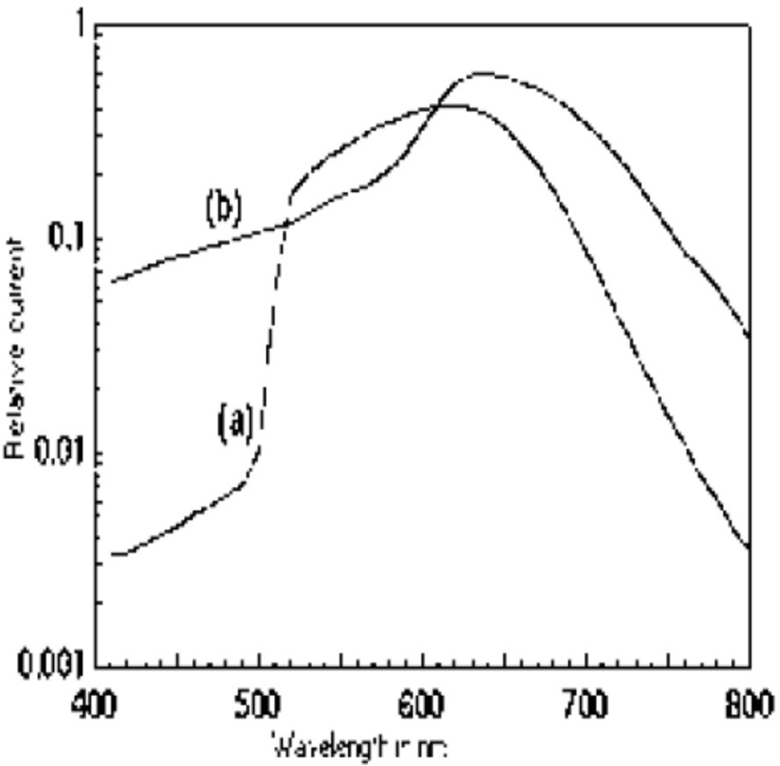
Case Study: The ORP12 Cell
Introduction
Typical Specifications:
Peak Spectral Response: 610 nm (Yellow-Orange region)
Dark Resistance: 10 MΩ
Resistance at 50 lux: 2400 Ω
Resistance at 1000 lux: 130 Ω
Max. Dissipation: 200 mW
(a) CdS and (b) Mixture of CdS and CdSe

Slide 9
Response Times of LDRs
Introduction
The "Fall Time": The time to reach final resistance value when illuminated (Typically 350 ms for ORP12).
The "Rise Time": The time for resistance to increase when light is cut off (Typically 75 ms for ORP12).
Limitation: Because of these relatively slow response times, LDRs cannot be used with modulated light beams.

Slide 10
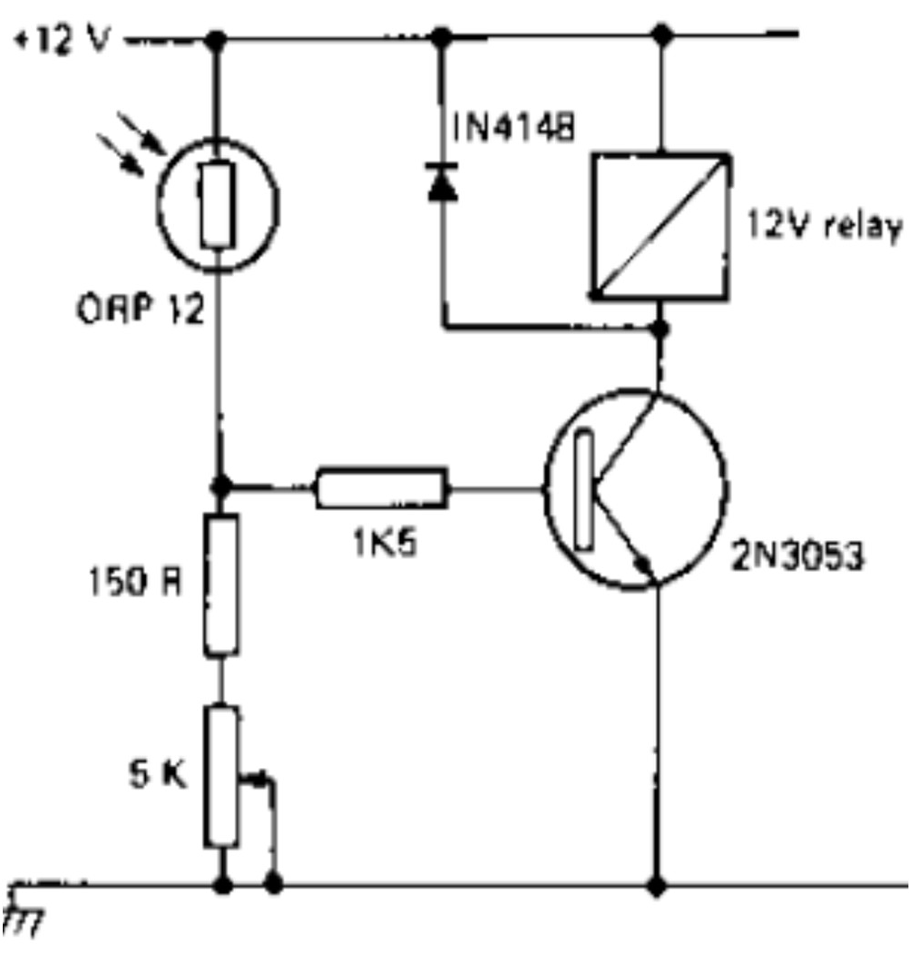
Industrial Applications
Introduction
Relay Operation:
response times are
Their well-
matched to the operating times of mechanical relays.
Flame Detection: Their peak response in the yellow-orange spectrum makes them ideal for detecting flames.
Boiler Safety: Used in oil-fired
boilers to cut off fuel if the flame is extinguished.
A typical ORP12 industrial application circuit

Slide 11
Summary and Comparison
Introduction
Photoresistors (LDRs)/Photoconductors:
Rugged, high voltage/AC capable, but long response times making it unsuitable for modulated light beams.
Photomultipliers:
Extremely sensitive, noiseless amplification, used for detection of very low light.

Slide 12
Test your understanding
Which material is most commonly used in industrial light- dependent resistors (LDRs)?
What is the main disadvantage of LDR?
What is the primary physical mechanism that allows a photoconductor to carry current when illuminated?
Explain why the cadmium sulphide track in an LDR is typically deposited in a zigzag pattern.
Mention any three electrical characteristics of LDRs.
Describe the operation and construction of an LDR.
Discuss any specific industrial application of LDR.

Slide 13
Textbook
Ian R Sinclair, Sensors and Transducers, Third Edition, 2001 (Units I & II).

