Slide 1

UEC3942: Introduction to Sensors and Actuators
Unit II: Photosensors: Photoemitters & Photomultipliers
Presentation by: Dr. C. Annadurai
Associate Professor/Dept. of ECE SSN College of Engineering

Slide 2
Learning Outcomes
Overview
Focus on the principles, characteristics, and applications of photosensors such as photoemissive cells, and photomultipliers.

Slide 3
Introduction to Photosensors
Introduction
Definition: Devices classed by the affected by light.
Main Classes:
Photoresistors (photoconductors).
Photovoltaic materials.
Photoemitters.
physical
quantity
Historical Note: Photoemitters were crucial for theoretical understanding, while photovoltaic materials like selenium were used early on.

Slide 4
Measuring Light Flux
Introduction
Sensitivity Units:
Illumination (Lux): Common for photometers; 50 lux (normal reading light), 1000 lux (fine print/inspection), 100,000 lux (direct sunlight).
Irradiance (mW/cm²): Power falling on the cell per unit area.
Conversion: No simple direct conversion exists unless spectral composition is constant, but approximately 1mW/cm² ≈ 200 lux.

Slide 5
Spectral Sensitivity
Introduction
Peak Sensitivity: Sensors often peak at specific wavelengths (red, violet, IR, or UV).
Human Eye Comparison: Few devices (e.g., some silicon photodiodes) match the eye’s peak sensitivity.
The Challenge: Even if peaks match, the response curve at other colors often differs.
Correction: Filters are often required to match the eye's response curve for applications like color matching.

Slide 6
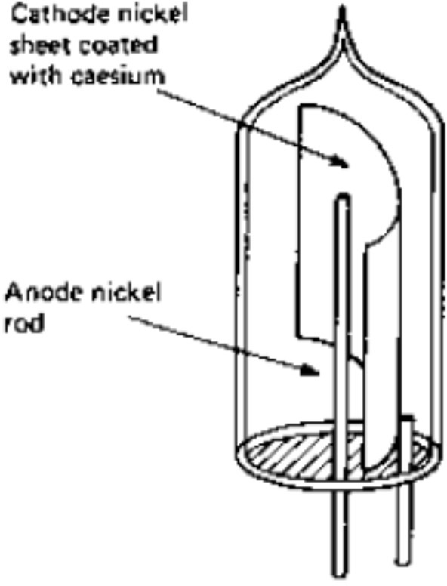
Photoemissive Cells – Basics
Introduction
Mechanism: The release of electrons into a vacuum when the material is struck by light.
Construction:
Vacuum Device: Required because photoemissive materials (like caesium) oxidize violently in air.
Components: A photocathode (emitting surface) and a positive anode (nickel rod/wire) to collect electrons.

Slide 7
The Threshold Frequency
Introduction
The Threshold Effect: Electrons are only emitted if the light frequency is above a specific threshold.
Quantum Theory: Based on Planck and Einstein's work- energy exists in units called "quanta".
Quantum Energy: E = frequency × Planck's constant.
Condition: If a single quantum carries less energy than needed to separate an electron, no emission occurs, regardless of light intensity.

Slide 8
Practical Limits of Photoemitters
Introduction
Wavelength Range: Easily sense UV (high frequency).
Difficult to sense Infrared (low frequency/energy).
Bias: Most cells are more sensitive to the blue/violet end than the orange/red end.
Materials:
(caesium,
Mixtures of antimony and potassium, sodium) provide the
alkali
most
metals stable
visible light output.

Slide 9
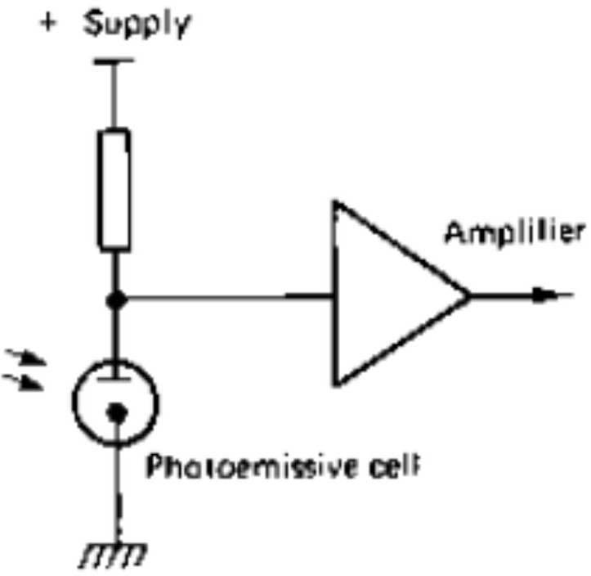
Photoemissive Circuitry
Introduction
Basic Circuit: Uses a voltage supply 100V) between anode and cathode.
Signal Conversion:
(typically 25V to
A load resistor in series converts the current to a voltage signal for an amplifier.
Commonly used for modulated light (e.g., cinema soundtracks).

Slide 10
Challenges in Photoemission Measurements
Introduction
Low Current: Typical output is in the microamp range, requiring high-gain amplification.
Noise & Response: Large load resistors create difficulties with frequency response and noise levels.
Calibration: High precision requires tedious calibration for every specific color of light used.

Slide 11
The Impact of Light Composition
Introduction
White Light Complexity: A mixture of all visible frequencies and some UV.
Sensitivity Issue: Small changes in light composition, invisible to the eye, can drastically change a photoemitter's output even if total energy is constant.
Artificial vs. Natural: Fluorescent tubes are more stable; filament lamps vary sharply with voltage (turning redder when undervoltage).

Slide 12
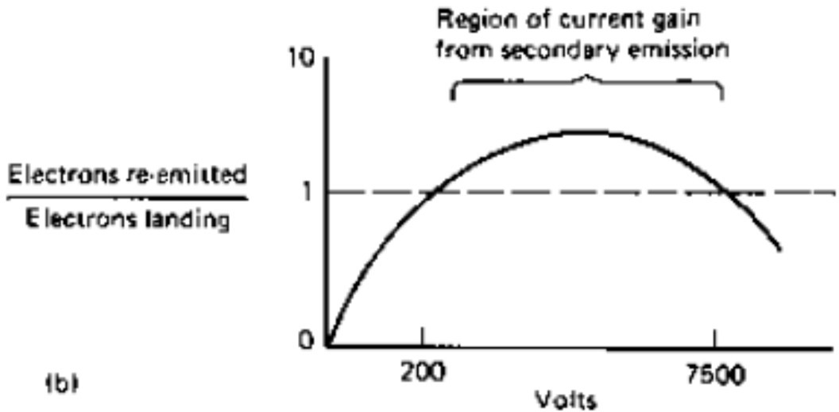
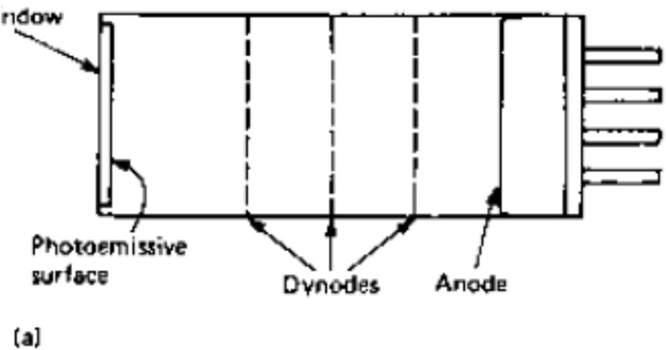
Introduction to Photomultipliers
Introduction
Purpose: To achieve much greater sensitivity with minimal noise or time delay.
Key Concept: Uses Secondary Emission.
Secondary Emission: When a material (like caesium) is struck by electrons, it releases more electrons than it received.

Slide 13
The Dynode Chain
Introduction
Dynodes: Secondary multiplying electrodes.
Multiplication Factor: Electrons accelerated by 30-200V can result in a multiplication factor of 3 to 7 per stage.
Cascading: By using multiple stages, the current is amplified exponentially.
Example: 5 stages with a factor of 5 = 5⁵ = 3125 times the original current.
Materials that are good photoemitters are usually good secondary emitters as well.

Slide 14
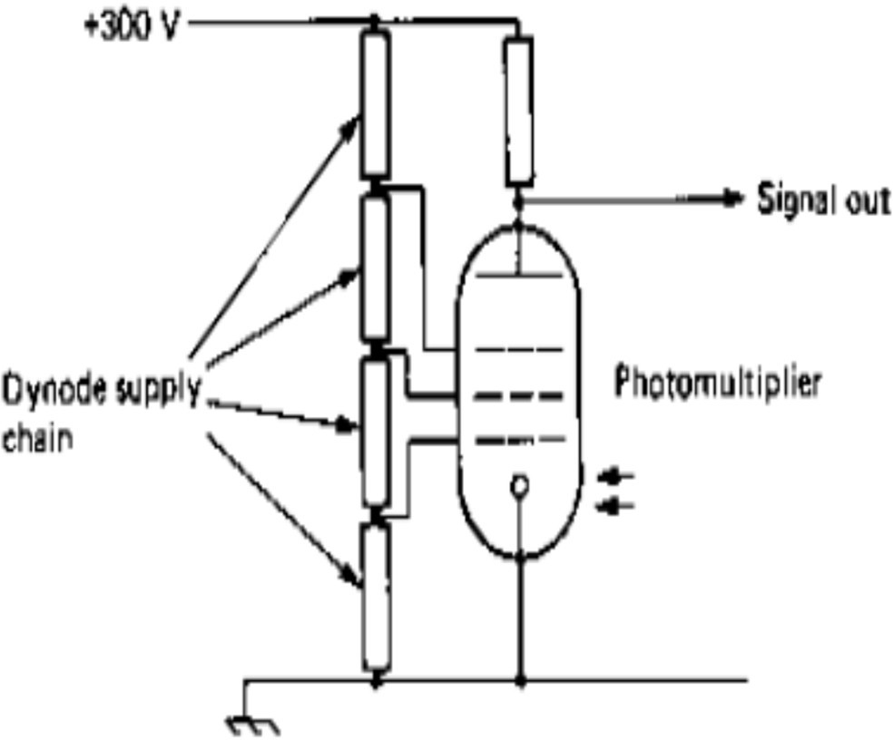
Photomultiplier Operation
Introduction
Voltage Arrangement: Each successive dynode must be run at a substantially higher voltage than the previous one.
Power Supply: Usually involves a resistor chain to divide a high-voltage DC supply (e.g., +300V).
Advantage: Virtually noiseless amplification, ideal for detecting very low light levels.

Slide 15
Secondary emission characteristics
Introduction
Due to the low work function of caesium, very little energy is enough to pull an electron away from a caesium atom.
This single high-speed primary enough "splash" energy to simultaneously.
electron can easily provide liberate many secondaries
In a photomultiplier, this physics is repeated across multiple dynodes.
Because the process is nearly instantaneous and involves only the movement of electrons in a vacuum (rather than through a semiconductor or wire), the amplification is extremely fast and introduces minimal noise, which is why it can detect a single photon of light.

Slide 16
Applications and Evolution
Introduction
Historical Dominance: Photoemissive cells were vital for cinema sound (optical soundtracks).
Vacuum vs. Solid-State: Vacuum devices are faster because electrons move faster in a vacuum than in solids.
However, vacuum cells are now mostly replaced by solid- state devices except in specialized instruments.

Slide 17
Conclusion
Introduction
Summary: Photosensors vary by their physical reaction to light (resistance, voltage, or emission).
Photoemission is governed by quantum thresholds.
Photomultipliers provide a high-sensitivity, low-noise solution for weak signals.

Slide 18
Test your understanding
Define photoelectric effect.
Define "threshold frequency" in the context of photoemissive sensors.
With a suitable circuit, explain the working of photoemissive cell.
Explain the principle and advantages of a photomultiplier.
Describe the operation and construction of a photomultiplier tube
Discuss the factors affecting the sensitivity and practical application of photoemissive cells.
Illustrate the secondary characteristics of photomultipliers.

Slide 19
Textbook
Ian R Sinclair, Sensors and Transducers, Third Edition, 2001 (Units I & II).

