Slide 1

UEC3942: Introduction to Sensors and Actuators
Unit I: Pressure Gauge Sensors
Presentation by: Dr. C. Annadurai
Associate Professor/Dept. of ECE SSN College of Engineering

Slide 2
Learning Outcomes
Overview
At the end understand
of the session, the students will be the working principle,
able to
characteristics, and
applications of pressure gauge sensors.

Slide 3
Definition of Pressure
Introduction
Working Principle: Pressure in a liquid or gas is defined as the force acting per unit area of a surface.
Solid Materials: For solids, this force/area quantity is termed "stress" rather than pressure.
Relationship: Stress is calculated from the force and cross-sectional area or derived from the measured strain.

Slide 4
Units of Measurement
Introduction
Standard Unit: The N/m² (newton per square metre) is the primary unit for stress and pressure.
Pascals: In liquids and gases, N/m² is also termed the Pascal (Pa).
Practical Scaling: Because the Pascal is small, kilo- pascals (kPa) are commonly used; for example, atmospheric pressure is 101.3 kPa.

Slide 5
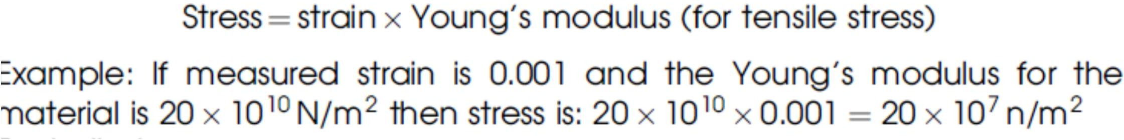
Stress and Strain Relationships
Introduction
Tensile Stress: Calculated as Strain × Young's modulus.
Bulk Stress: Calculated as Strain × Bulk modulus.
Significance: Since strain can be measured electronically, these constants allow for easy stress calculation.

Slide 6
Pressure Sensing Ranges
Introduction
High Pressure Range: Usually implies pressures greater than atmospheric pressure in both liquids and gases.
Low Pressure Range: Specific to gases, involving pressures significantly lower than atmospheric pressure (vacuum).
Specialization: Measurement of very low pressures requires specialized methods compared to high-pressure sensors.

Slide 7
Aneroid Barometer Principle
Introduction
Working Principle: Pressure causes the displacement of a diaphragm.
Mechanism: One side of the diaphragm is acted on by the pressure to be measured, while the other side maintains a constant (usually lower) pressure.
Mechanical Display: In domestic versions, a system of levers senses the diaphragm movement to move a pointer.

Slide 8
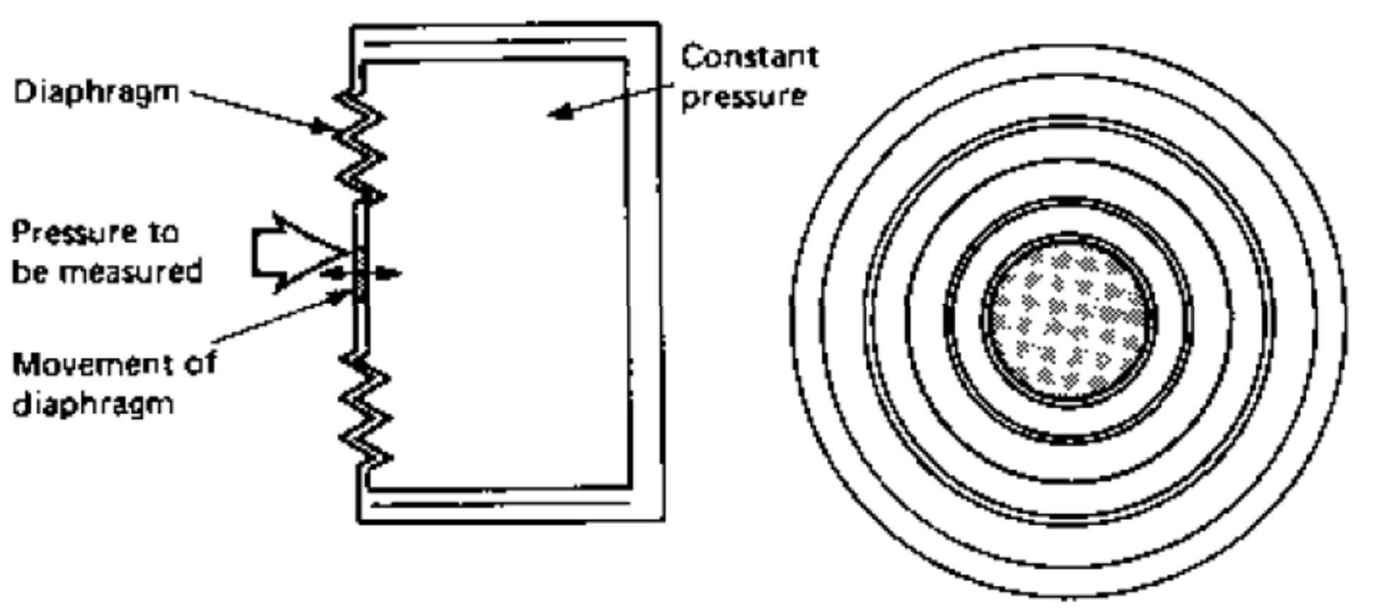
Aneroid Barometer Principle
Introduction

Slide 9
Capacitive Pressure Sensors
Introduction
Construction:
backplate.
Transduction:
The diaphragm is insulated from a fixed
As pressure moves the diaphragm, the
spacing (d) between it and the backplate changes, altering the capacitance (C).
Electronic Sensing: This capacitance forms part of an oscillator's resonant circuit; a change in spacing reduces the resonant frequency.

Slide 10
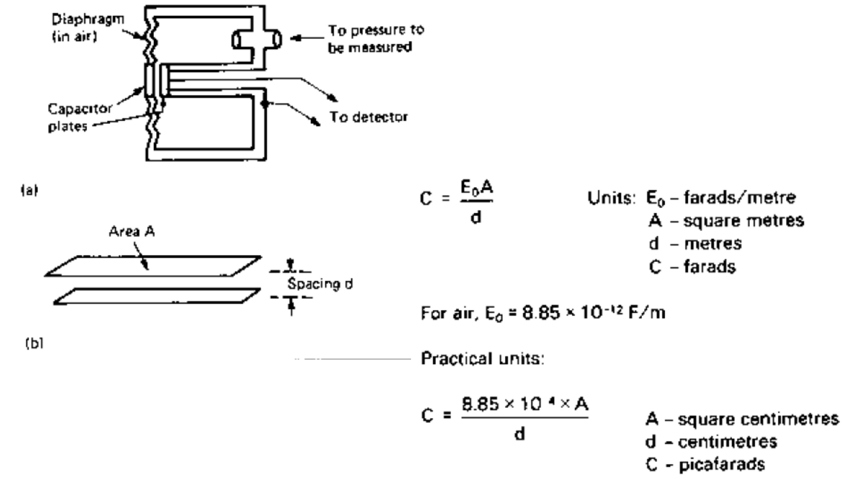
Capacitive Sensor & Formulas
Introduction

Slide 11
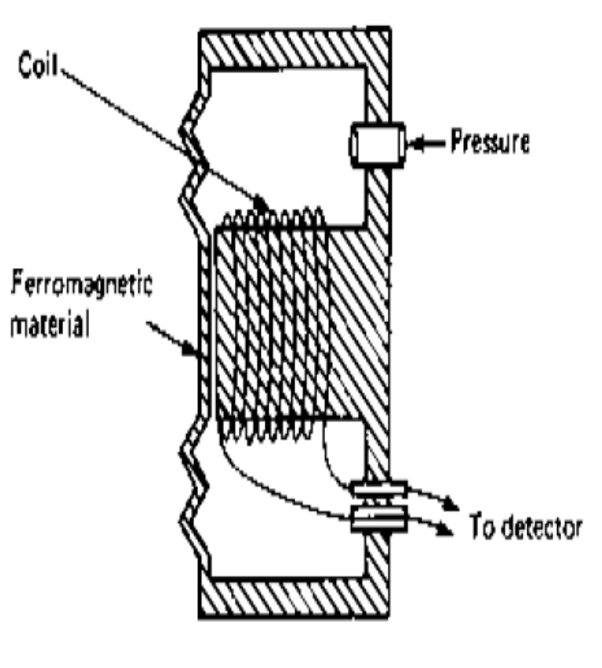
Variable Reluctance Sensors
Introduction
Requirement: Requires a ferromagnetic diaphragm.
Working Principle: Movement of the diaphragm causes changes in the reluctance of the magnetic path.
Electronic Output: The change in reluctance alters the
inductance which is detector.
of a nearby coil, then sensed by a

Slide 12
Characteristics of Variable Reluctance Gauges
Introduction
Pressure Range: Normally used for fairly large pressure differences.
Constraints: Cannot be used in environments where inert (non-magnetic) diaphragms are required.
Versatility: Suitable for both gases and liquids, across ranges higher or lower than atmospheric pressure.

Slide 13
Bourdon Tube (Flattened Tube) Sensors
Introduction
Construction: Uses a coiled, flattened tube.
Working Principle: Changes in pressure inside the tube cause it to coil or uncoil.
Electronic Conversion: The mechanical coiling is often coupled to a potentiometer to convert the movement into an electronic signal.
Range: Can be manufactured for various pressure ranges by changing tube material and thickness.

Slide 14
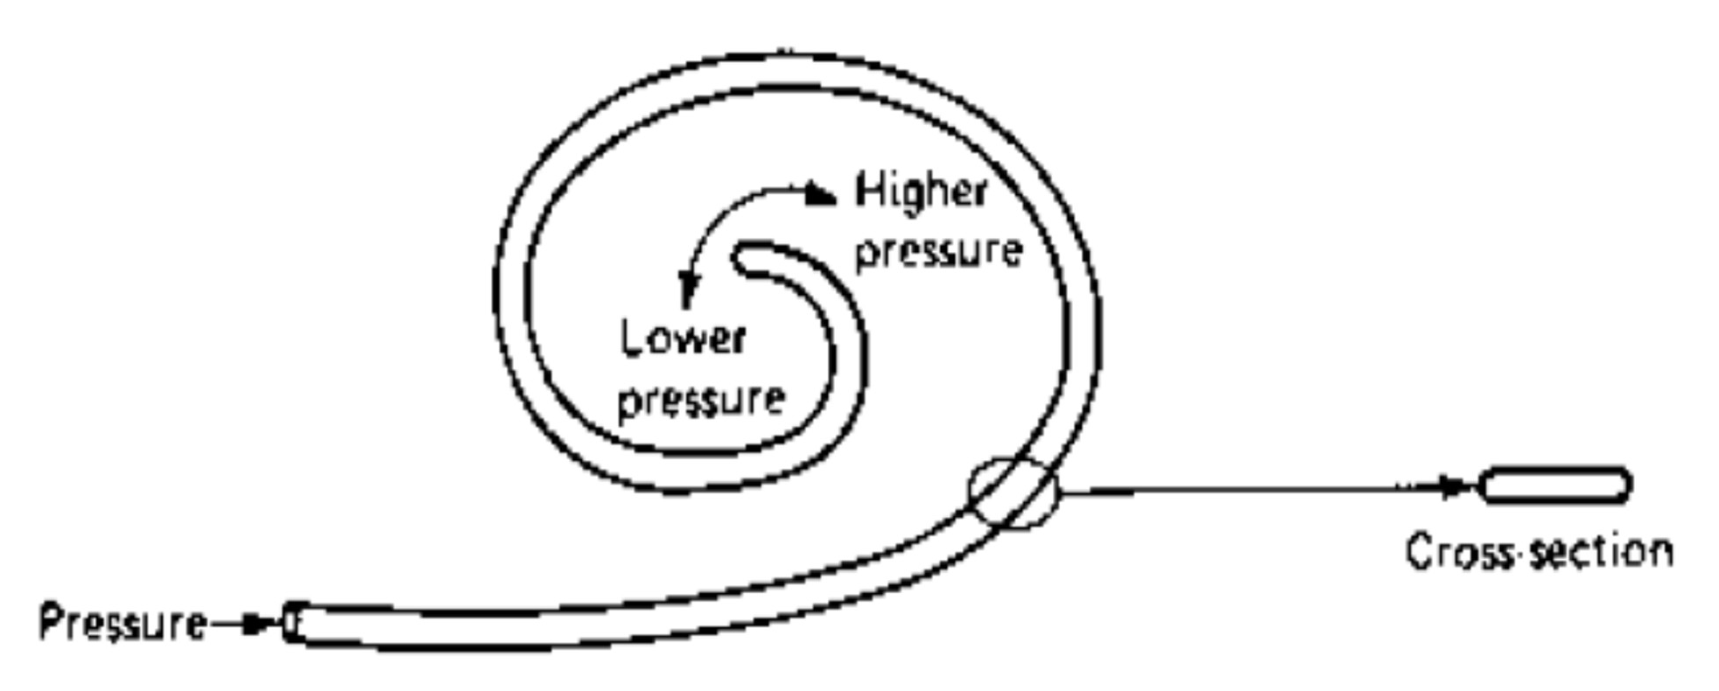
Bourdon Tube (Flattened Tube) Sensors
Introduction

Slide 15
Piezoelectric Pressure Sensors
Introduction
Working Principle: Uses a piezoelectric crystal (often barium titanate) to sense displacement.
Direct vs. Indirect: Some gases can be exposed to the crystal directly, but for liquids and corrosive gases, a diaphragm transmits pressure to the crystal.
Signal Type: More applicable to short-duration changes than steady-state pressure.

Slide 16
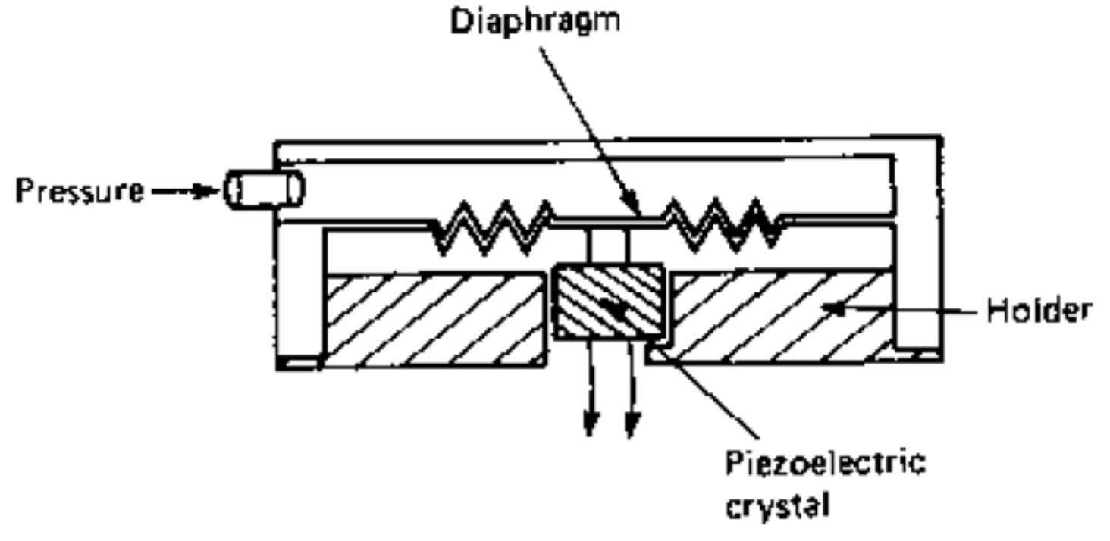
Advantages of Piezoelectric Sensors
Introduction
Passive Nature: These sensors are totally passive and do not require a power supply for the sensing element itself.
Simple Circuitry: Only requires a high-input impedance voltmeter or FET op-amp as an indicator.
Switching: The output can be applied directly to an op- amp for switching applications.

Slide 17
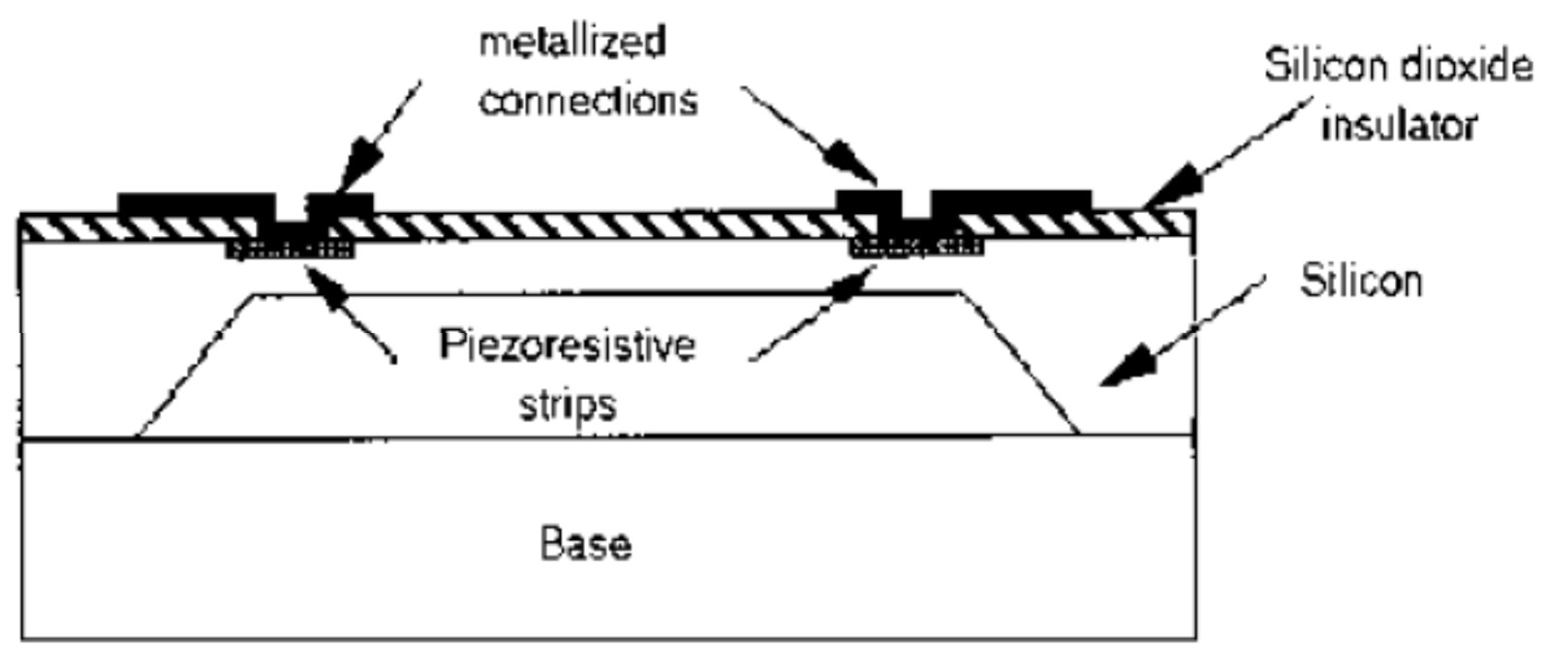
Semiconductor Pressure Gauges
Introduction
Integration: Piezoresistive, piezoelectric, and capacitive gauges can be fabricated using semiconductor techniques.
Construction: Built on a silicon base with a silicon dioxide insulator.
Piezoresistive Method: Piezoresistive strips and metallized connections are deposited onto the oxidized silicon.

Slide 18
Materials and Durability
Introduction
Standard Material: Stainless steel is suitable for most pressure-sensing diaphragms.
Corrosive Environments: Very corrosive substances require inert metals like platinum or palladium.
High Pressure Design: For extreme pressures, thick steel plates or small cross-section plugs are used to manage the absolute force.

Slide 19
Low Gas Pressure (Vacuum) Measurement
Introduction
Vacuum Definition: High-vacuum refers to pressures around 0.1 Pa (10⁻³ mm of mercury).
Conversion: 1 mm of mercury is equal to 133.3 Pa.
Methodology: Standard displacement methods become useless at very low pressures; vacuum gauges are used instead.

Slide 20
The Pirani Gauge
Introduction
Working Principle: Based on the fact that the thermal conductivity of gases decreases in proportion to pressure at low levels.
Construction: Uses a hot wire element and a sensor wire.
Measurement: The temperature (and thus resistance) of the sensor wire is measured to deduce pressure.
Range: Effective for pressures between 1 mm and 10⁻³ mm of mercury.

Slide 21
Ion Gauges and Recalibration
Introduction
Ion Gauge: Used for significantly lower pressures down to 10⁻⁹ mm of mercury 1.3 × 10⁻⁷ Pa.
Maintenance: A critical characteristic of all vacuum gauge heads is that they require recalibration whenever a head is replaced.
Summary: Pressure sensing spans a vast range of technologies, from mechanical tubes to molecular thermal conductivity.

Slide 22
Summary of Pressure Sensing Technologies
Introduction
Fundamental Principles: Pressure is the force acting per unit area (N/m² or Pascals), often measured through the mechanical displacement of diaphragms or tubes.
Transduction Methods:
Capacitive: Measures changes in plate spacing (d) to alter frequency.
Variable Reluctance: Uses ferromagnetic diaphragms to change magnetic path reluctance and coil inductance.
Piezoelectric/Piezoresistive: Converts mechanical stress directly into voltage or resistance changes, often integrated into
silicon bases.
Environmental Versatility: Devices range from domestic aneroid barometers to industrial high-pressure plugs and highly specialized vacuum gauges.

Slide 23
Conclusion and Key Takeaways
Introduction
Range Specificity: Sensor selection is strictly dictated by the pressure range; while diaphragms suit atmospheric levels, vacuum measurement (below 0.1 Pa) requires specialized thermal conductivity or ionization gauges.
Material Integrity: The choice of sensor material (e.g., stainless steel, platinum, or palladium) is vital to ensure durability against corrosive gases or liquids.
Electronic Integration: Modern sensors increasingly leverage semiconductor fabrication to create compact, passive, and highly sensitive piezoresistive or capacitive units.
Calibration Necessity: High-precision applications, particularly in vacuum technology, require rigorous recalibration whenever sensor heads are replaced to maintain accuracy.

Slide 24
Test your understanding
Explain how it is defined in liquids and gases compared to solids.
State the relationship between stress, strain, and Young's modulus for tensile stress.
Provide the value of 'normal' atmospheric pressure in kilo- pascals (kPa).
Under what specific condition can a variable-reluctance type pressure gauge be used?
Why is recalibration necessary for vacuum gauge heads?
Describe the construction of a capacitive pressure sensor using an aneroid capsule.

Slide 25
Test your understanding
Provide the mathematical formula relating capacitance to area and spacing in pressure gauge sensors.
Discuss the advantages of piezoelectric sensors, specifically their "passive" nature.
Explain the difference between direct pressure sensing and indirect sensing using a diaphragm for corrosive liquids.
Discuss the mechanical displacement principle (aneroid barometers/pistons) for high pressures.
Pressure sensors often rely on converting mechanical
displacement into electronic signals. Evaluate the methods: (i) Variable Reluctance (ii) Potentiometric Piezoresistive Semiconductors (iv) Capacitive.
four (iii)

Slide 26
Textbook
Ian R Sinclair, Sensors and Transducers, Third Edition, 2001 (Units I & II).
Ramon PallásAreny, John G. Webster, Sensors and Signal conditioning, John Wiley and Sons, Second Edition, 2000.

