Slide 1

UEC3942: Introduction to Sensors and Actuators
Unit I: Strain Gauge Sensors (Piezoresistive & Piezoelectric)
Presentation by: Dr. C. Annadurai
Associate Professor/Dept. of ECE SSN College of Engineering

Slide 2
Learning Outcomes
Overview
At the end of the session, the students will be understand the working principle,
able to
characteristics and
applications of strain gauge sensors.

Slide 3
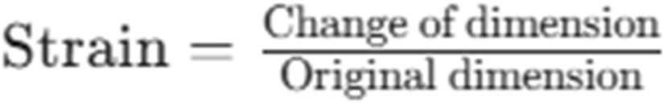
Introduction to Stress and Strain
Introduction
Confusion in Terms: Stress and strain are often confused in everyday language, but they have distinct definitions in physics/engineering.
Defining Strain: Strain is the result of stress.
Formula: It is defined as the fractional change in the dimensions of an object.

Slide 4
The Nature of Strain Measurements
Introduction
Dimensionless Quantity: Strain is a pure number with no physical dimensions.
Calculation: It represents one length divided by another (e.g., change in length / original length).
Significance: This measurement allows for the calculation of stress on an object if the elastic modulus is known.

Slide 5
Types of Strain
Introduction
Linear Strain: Change in length divided by original length.
Area Strain: Defined as the change of area divided by the original area.
Volume Strain: Defined as the change of volume divided by the original volume.
Applications: Common strain transducers typically focus on tensile mechanical strain.

Slide 6
Understanding Stress
Introduction
Definition: Stress is defined as force divided by an area.
Tensile Stress: For a wire/bar, it is the applied pulling force divided by the cross-sectional area.
Bulk Stress: For fluids (liquids/gases), bulk stress is force per unit area, identical to applied pressure.

Slide 7
Relationship Between Stress and Strain
Introduction
Elastic Modulus: Defined as the ratio of Stress to Strain.
Linearity: For small amounts of strain, strain is proportional to stress (linear region).
Common Moduli:
Young's Modulus: Linear stress/strain.
Shear Modulus: Twisting stress/strain.
Bulk Modulus: Pressure stress/strain.

Slide 8
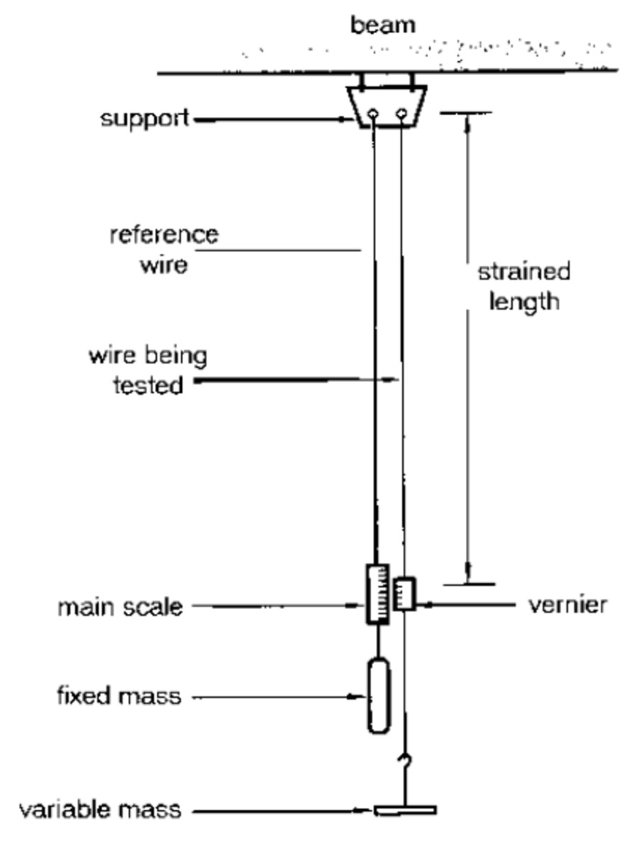
Classic Mechanical Measurement
Introduction
Method: The classic method involves a pair of long wires: one loaded (being tested) and one reference wire.
Instrumentation: Uses a vernier scale to measure the change in length.
Current Usage: Primarily used for school demonstrations to calculate Young's modulus.

Slide 9
Challenges in Sensing Strain
Introduction
Small Changes: Sensing tensile strain involves measuring very small changes in sample length.
Temperature Effects: Temperature changes (0–30°C) cause expansion or contraction comparable to changes caused by large stress.
Requirement: Sensors must be designed to compensate for temperature to ensure accuracy.

Slide 10
Main Sensing Principles
Introduction
Two Primary Methods: The principles used to sense linear or area strain are generally Piezoresistive or Piezoelectric.
Most Common: The most common form of strain measurement uses resistive strain gauges.

Slide 11
Piezoresistive Sensors
Introduction
Piezoresistive sensors are highly sensitive
pressure,
devices that force, and
measure physical quantities like
acceleration by detecting changes in electrical resistance when a material is mechanically deformed.
They are among the most widely used sensors in modern industry due to their simple design, reliability, and ability to measure both static and dynamic pressures.

Slide 12
How they work?
Introduction
The sensor operates based on the piezoresistive effect, where mechanical stress alters the electrical resistivity of a material— typically a semiconductor like silicon.
Mechanical Interaction: Pressure is applied to a thin diaphragm (often silicon or metal) containing integrated resistors.
Deformation: The diaphragm flexes, causing mechanical strain in the resistors.
Resistance Change: This strain changes the atomic or electronic band structure of the material, leading to a measurable change in resistance.
Signal Conversion: A Wheatstone bridge circuit typically converts this tiny resistance change into a voltage signal proportional to the applied pressure.

Slide 13
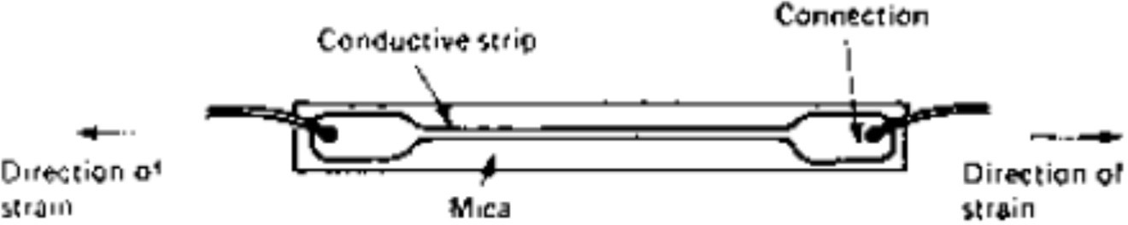
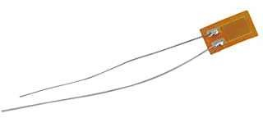
Resistive Strain Gauges - Construction
Introduction
Material: Consists of a conducting material (thin wire or strip).
Attachment: Attached firmly to the strained material (e.g., bridge part, turbine blade) using epoxy resins like 'Araldite'.
Insulation: Resins serve as electrical insulators while being extremely strong.

Slide 14
Piezoresistive Principle
Introduction
Concept: The change in resistance is due to the deformation of the structure of the sensing material.
Operation: As the material undergoes strain, its electrical resistance changes proportionally.
Connection: The strip is connected as part of a resistance bridge circuit.

Slide 15
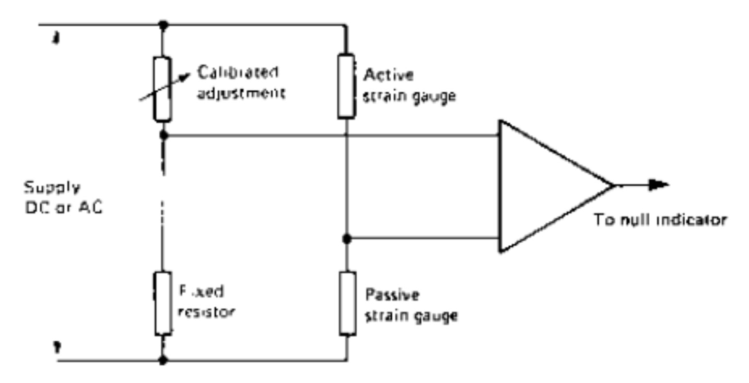
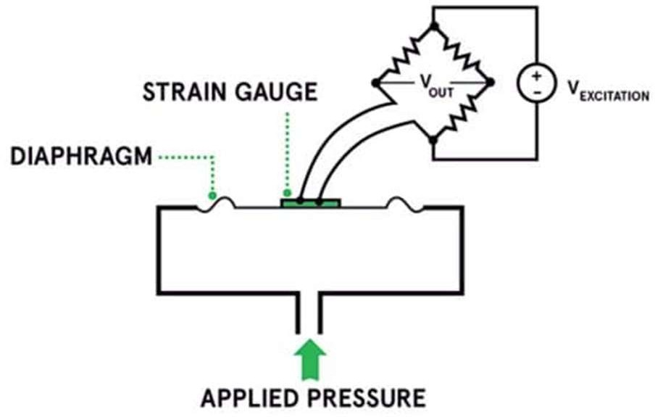
Circuitry: The Wheatstone Bridge
Introduction
Bridge Circuit: Used to convert small resistance changes into measurable voltage.
Configuration: Typically involves an "Active" (strained) gauge and a "Passive" (unstrained) gauge.

Slide 16
Temperature Compensation
Introduction
Problem: Resistance changes due to temperature variations in the wire and the material itself.
Solution: Use an identical unstrained passive gauge in the bridge circuit.
Mechanism: If both gauges are affected identically by temperature, the effects balance out, leaving only the strain signal.

Slide 17
Sensitivity: The Gauge Factor
Introduction
Definition: Gauge Factor is the fractional change of resistance divided by the change of strain.
Metal Wire Gauges: Typical Gauge Factor is about 2.
Semiconductor Gauges: Typical Gauge Factor is about 100.
Significance: Higher gauge factor implies higher sensitivity.

Slide 18
Metal Wire Strain Gauges
Introduction
Material: Typically, thin Nichrome wire.
Characteristics: Resistance is proportional to length.
Limitations:
Resistance change is very small (often < 0.1% change needed to be detected).
Low base resistance (< 1 ohm) makes connection resistance significant, leading to measurement uncertainty.

Slide 19
Semiconductor Strain Gauges
Introduction
Advantages:
Higher resistance than metal wires, making measurement easier.
Significantly larger resistance changes for the same strain.
Preference: Preferred for most applications unless high temperatures are involved (e.g., gas-turbine blades).

Slide 20
Semiconductor Passivation
Introduction
Protection: Semiconductor material must passivated (protected by an oxidation layer).
Risk: If the oxide layer is removed by the chemical factors will affect the readings.
be surface
atmosphere,
Result: Without passivation, measurements become unreliable due to atmospheric contamination.

Slide 21
Key Types of Materials
Introduction
Silicon (Doped): The most common material used in MEMS (Micro-Electro-Mechanical Systems) because of its extreme sensitivity and fast response times.
Metal Strain Gauges: Often used for their robustness and ability to handle higher temperatures (up to 200°C) than standard silicon sensors.
Advanced Materials (2025 Trends): Recent innovations include MXenes, carbon nanotubes (CNTs), and graphene to create flexible, wearable "electronic skin" (e-skin) for health monitoring.

Slide 22
Major Applications
Introduction
Piezoresistive sensors find applications across various fields:
Automotive: Used in tire pressure monitoring systems (TPMS), fuel injection, and airbag deployment.
Medical: Found in blood pressure monitors, ventilators, and respiratory devices.
Industrial: Essential for monitoring hydraulic systems, pipelines, and pneumatic controls.
Consumer Electronics: Integrated as barometers in smartphones and wearables for altitude and activity tracking.

Slide 23
Piezoelectric Sensors
Introduction
A piezoelectric sensor is a device that uses the piezoelectric effect to convert mechanical energy (such as force, pressure, or vibration) into a measurable electrical charge, and vice versa.
They are known for their high sensitivity, wide frequency range, and robust construction, making them suitable for a variety of dynamic measurement applications

Slide 24
How they work?
Introduction
The operation of a piezoelectric sensor is based on the inherent property of certain materials (like quartz or PZT ceramics) to generate an electric charge when subjected to mechanical stress.
Mechanical Stress Applied: When a physical force (compression, tension, etc.) is applied to the piezoelectric crystal, its internal electric charges become unbalanced.
Charge Generation: This charge imbalance causes net positive and negative
charges to appear on opposite faces of the crystal.
Voltage Output: The metal plates on either side of the crystal collect these charges, producing an analog voltage output that is proportional to the applied force or stress.
Signal Processing: The generated electrical charge is often small and
requires specialized electronics, such as a charge amplifier, to be converted into a usable signal for processing and interpretation.
Piezoelectric sensors are ideal for measuring dynamic changes but are
generally not suitable for measuring static pressure or force due to charge leakage over time.

Slide 25
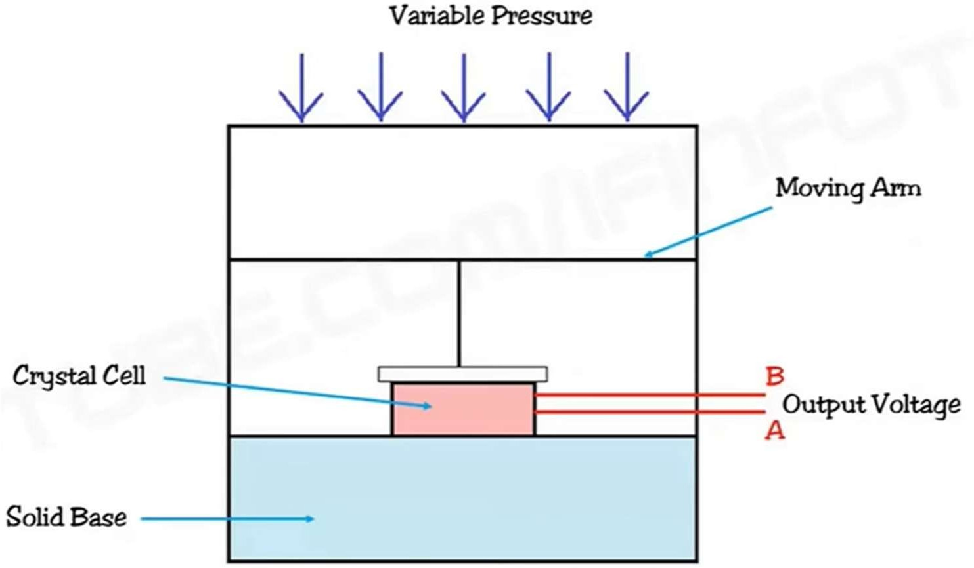
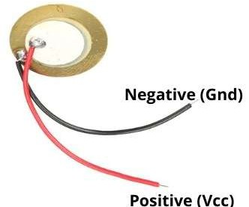
Piezoelectric Strain Gauge - Working Principle
Introduction
Material: Uses a piezoelectric crystal.
Mechanism: Ions in the crystal move asymmetrically when strained, generating an Electromotive Force (EMF) between faces.
Orientation: Maximum electric effect occurs across faces at right angles to the applied force.

Slide 26
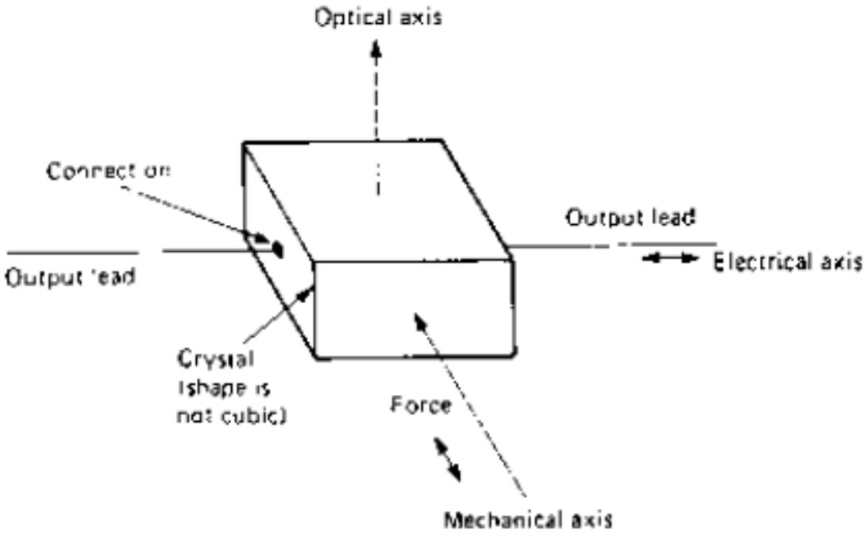
Piezoelectric Characteristics
Introduction
Output: Can generate very large EMF (several kV) for heavily strained crystals.
Impedance: High output impedance, usually capacitive.

Slide 27
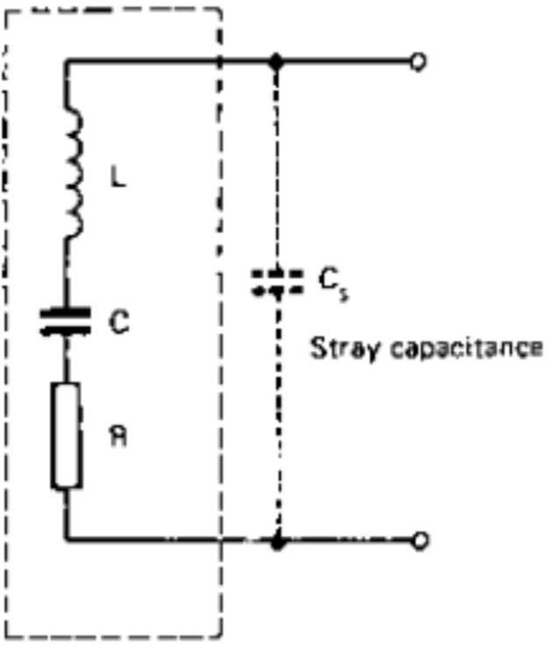
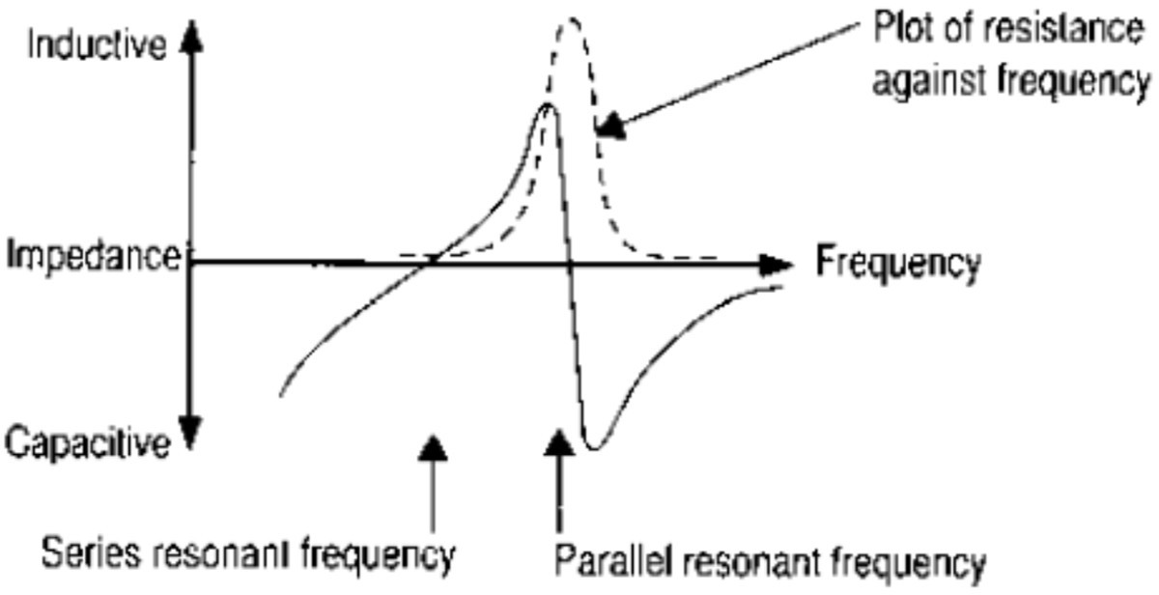
Electrical Model of Piezoelectric Gauges
Introduction
Equivalent Circuit: Corresponds to a series resonant circuit.
Components: Very high inductance (L), low capacitance (C), and negligible resistance (R).

Slide 28
Limitations of Piezoelectric Gauges
Introduction
DC Response: The output is not DC; therefore, it cannot detect slow or static changes.
Ideal Application: Useful where strain is of short duration or rapidly changing.
Primary Use Case: Main application is in acceleration sensing rather than static strain.

Slide 29
Common Types
Introduction
Piezoelectric sensors come in various forms designed for specific measurement tasks.
Piezoelectric Accelerometers: These sensors detect acceleration, shock, and vibration by using a seismic mass attached to the crystal, which applies force during motion. They are common in machinery health monitoring and aerospace systems.
Piezoelectric Force Sensors: Designed to quantify force, tension, and compression in industrial equipment, robotic systems, and medical devices.
Piezoelectric Pressure Sensors: These measure dynamic pressure changes in liquids or gases, often in applications like engine combustion and hydraulic systems.
Piezoelectric Vibration Sensors: Utilized for monitoring vibrations in machines and structures, providing early warnings of potential issues.

Slide 30
Key Applications
Introduction
The self-generating nature (no external power needed) and high-frequency response of piezoelectric sensors make them useful across numerous industries. Automotive: Used in engine knock sensors, airbag sensors, and for general vibration analysis.
Medical: Found in ultrasound imaging equipment, stethoscopes, and pacemakers for heart rate and activity monitoring.
Consumer Electronics: Integrated into microphones, touchscreens for impact detection, and buzzers/speakers.
Industrial: Employed in non-destructive testing, force monitoring in robotic systems, and high-speed shock wave analysis.
Aerospace & Defense: Used for monitoring jet engine vibrations, structural health monitoring in aircraft, and sonar equipment

Slide 31
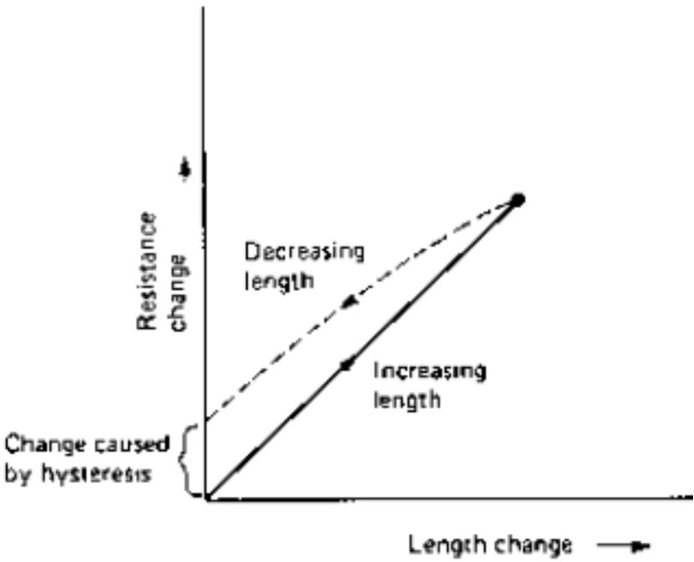
Sensor Errors: Hysteresis
Introduction
Definition: The graph of resistance change change follows a different path when stress
vs. length decreases
compared to when it increases.
Consequence: Upon overstretching, the gauge may show a permanently changed resistance when strain is removed.
Magnitude: Should be small (~0.025%) unless the gauge is over- stretched.

Slide 32
Sensor Errors: Creep
Introduction
Definition: A gradual change in the length of the gauge element that does not correspond to a change in strain in the measured material.
Magnitude: Like hysteresis, this should be very small (~0.025%).
Temperature dependency: Both creep and hysteresis increase as operating temperature rises.
Proper choice of material: Both hysteresis and creep are non-linear effects which can never be eliminated but can be reduced by careful choice of the strain gauge element material.

Slide 33
Application: Load Cells
Introduction
Function: A force transducer used in electronic weighing systems.
Construction: Uses a set of strain gauges, typically four, connected in a Wheatstone bridge circuit.
Output: Generates a voltage proportional to the force/weight applied.
Processing: Output can be processed directly or digitized.

Slide 34
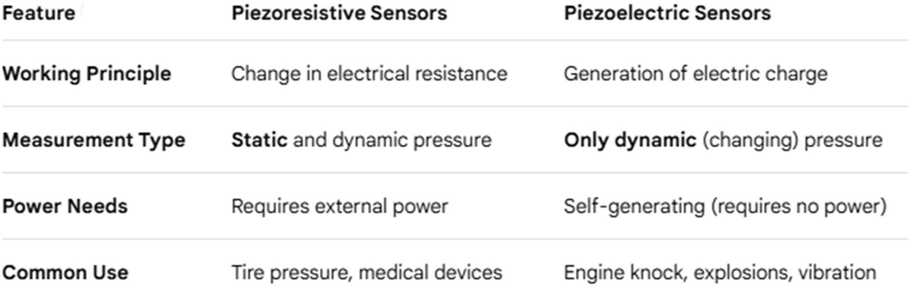
Comparison: Piezoresistive vs. Piezoelectric
Introduction

Slide 35
Future & Advanced Methods
Introduction
Laser Interferometry: A method presenting considerable advantages in sensitivity.
History: Principles are ancient, but practical use required modern lasers and electronics.
Summary: From simple wires to piezo crystals and laser optics, strain measurement is critical for monitoring structural health and forces.

Slide 36
Summary
The students should have gained knowledge on the working principle, characteristics and applications of strain gauge sensors.

Slide 37
Test your understanding
Differentiate between Stress and Strain.
What is the 'Gauge Factor' and what are typical values for metal and semiconductor gauges?
Why is temperature compensation necessary in strain measurement?
Define Hysteresis in the context of strain gauges.
What is a Load Cell?
Explain the working principle of a resistive strain gauge and how it is constructed.
Describe the principle and electrical characteristics of Piezoelectric Strain Gauges.
Explain the concept of temperature compensation using a
Wheatstone bridge circuit.
Discuss the construction, operation, and advantages of Semiconductor Strain Gauges compared to Metal Wire Gauges.
Detailed the common sources of error in strain gauges (Hysteresis and Creep) and explain the operation of Load Cells.

Slide 38
Textbook
Ian R Sinclair, Sensors and Transducers, Third Edition, 2001 (Units I & II).
Ramon PallásAreny, John G. Webster, Sensors and Signal conditioning, John Wiley and Sons, Second Edition, 2000.

