Slide 1
Greibach Normal Form

Slide 2

Problem - 1
Convert the grammar
$$S→AB$$
$$A→BS|a$$
$$B→SA|b$$
Into GNF.
Solution:
Replace
$S by A_{1};$
$$A by A_{2};$$
$$B by A_{3}$$
T. M. Rajalaxmi | 2 | Mathematics

Slide 3

Solution
$$S→AB$$
$$A→BS|a$$
$$B→SA|b$$
becomes
$$A_{1}→A_{2}A_{3}$$
$$A_{2}→A_{3}A_{1}|a$$
$$A_{3}→A_{1}A_{2}|b$$
since productions must starts with terminals or with higher numbered variable,
correct form
$$A_{1}→A_{2}A_{3}$$
$$A_{2}→A_{3}A_{1}|a$$
$$A_{3}→b$$
convert $A_{3}→A_{1}A_{2}$ into a required form.
T. M. Rajalaxmi | 3 | Mathematics

Slide 4
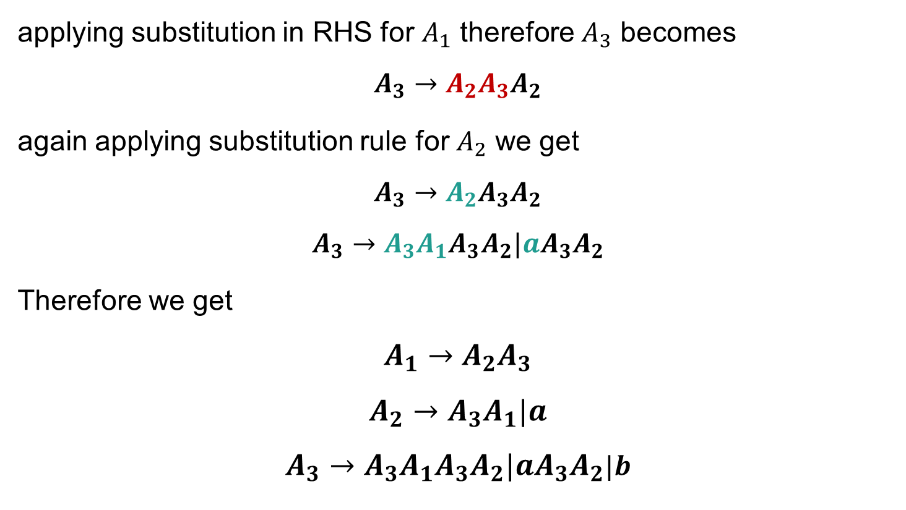
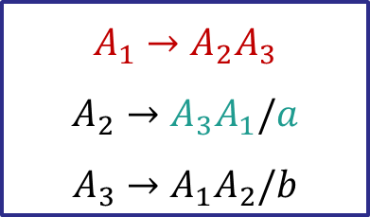
Solution cont’d..
applying substitution in RHS for $A_{1}$ therefore $A_{3}$ becomes
$$A_{3}→A_{2}A_{3}A_{2}$$
again applying substitution rule for $A_{2}$ we get
$$A_{3}→A_{2}A_{3}A_{2}$$
$$A_{3}→A_{3}A_{1}A_{3}A_{2}|aA_{3}A_{2}$$
Therefore we get
$$A_{1}→A_{2}A_{3}$$
$$A_{2}→A_{3}A_{1}|a$$
$$A_{3}→A_{3}A_{1}A_{3}A_{2}|aA_{3}A_{2}|b$$
$$A_{1}→A_{2}A_{3}$$
$$A_{2}→A_{3}A_{1}/a$$
$$A_{3}→A_{1}A_{2}/b$$
T. M. Rajalaxmi | 4 | Mathematics

Slide 5


Solution cont’d..
Eliminating the left recursion in $A_{3},$we get
$$A_{3}→A_{3}A_{1}A_{3}A_{2}|aA_{3}A_{2}|b$$
$$A_{3}→aA_{3}A_{2}B_{3}|bB_{3}|aA_{3}A_{2}|b$$
$$B_{3}→A_{1}A_{3}A_{2}B_{3}|A_{1}A_{3}A_{2}$$
Left Recursion
$$A→Aα|β$$
by
$$A→βA′/β$$
$$A′→αA′/α$$
T. M. Rajalaxmi | 5 | Mathematics

Slide 6
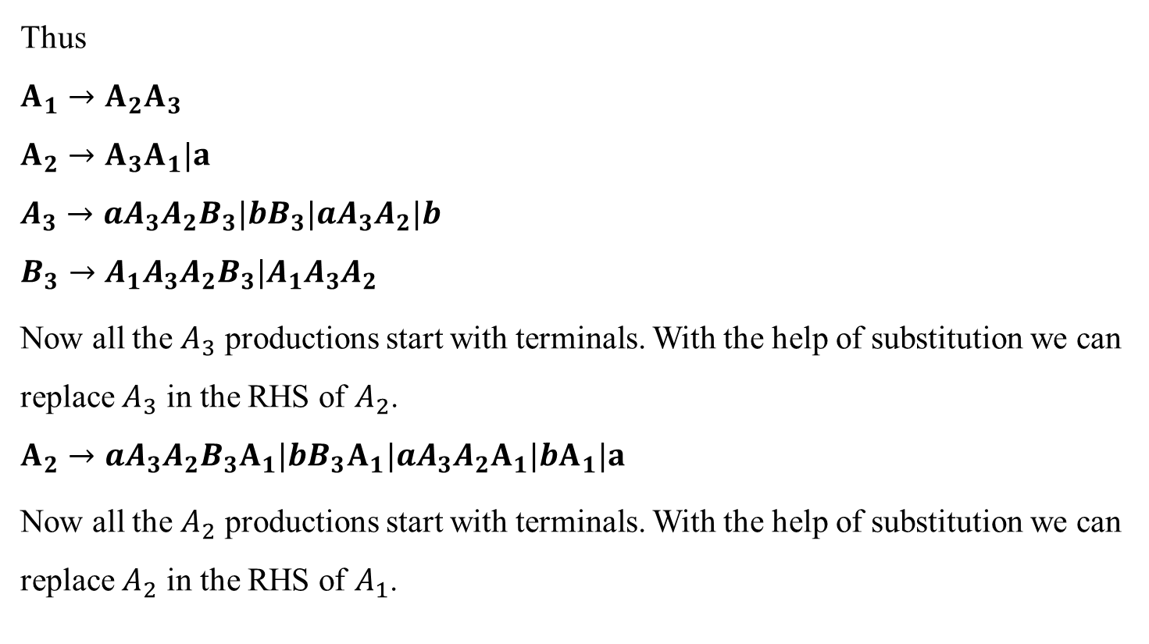
Solution cont’d..
Thus
$$A_{1}→A_{2}A_{3}$$
$$A_{2}→A_{3}A_{1}|a$$
$$A_{3}→aA_{3}A_{2}B_{3}|bB_{3}|aA_{3}A_{2}|b$$
$$B_{3}→A_{1}A_{3}A_{2}B_{3}|A_{1}A_{3}A_{2}$$
Now all the $A_{3}$ productions start with terminals. With the help of substitution we can replace $A_{3}$ in the RHS of $A_{2}$.
$$A_{2}→aA_{3}A_{2}B_{3}A_{1}|bB_{3}A_{1}|aA_{3}A_{2}A_{1}|bA_{1}|a$$
Now all the $A_{2}$ productions start with terminals. With the help of substitution we can replace $A_{2}$ in the RHS of $A_{1}$.
T. M. Rajalaxmi | 6 | Mathematics

Slide 7
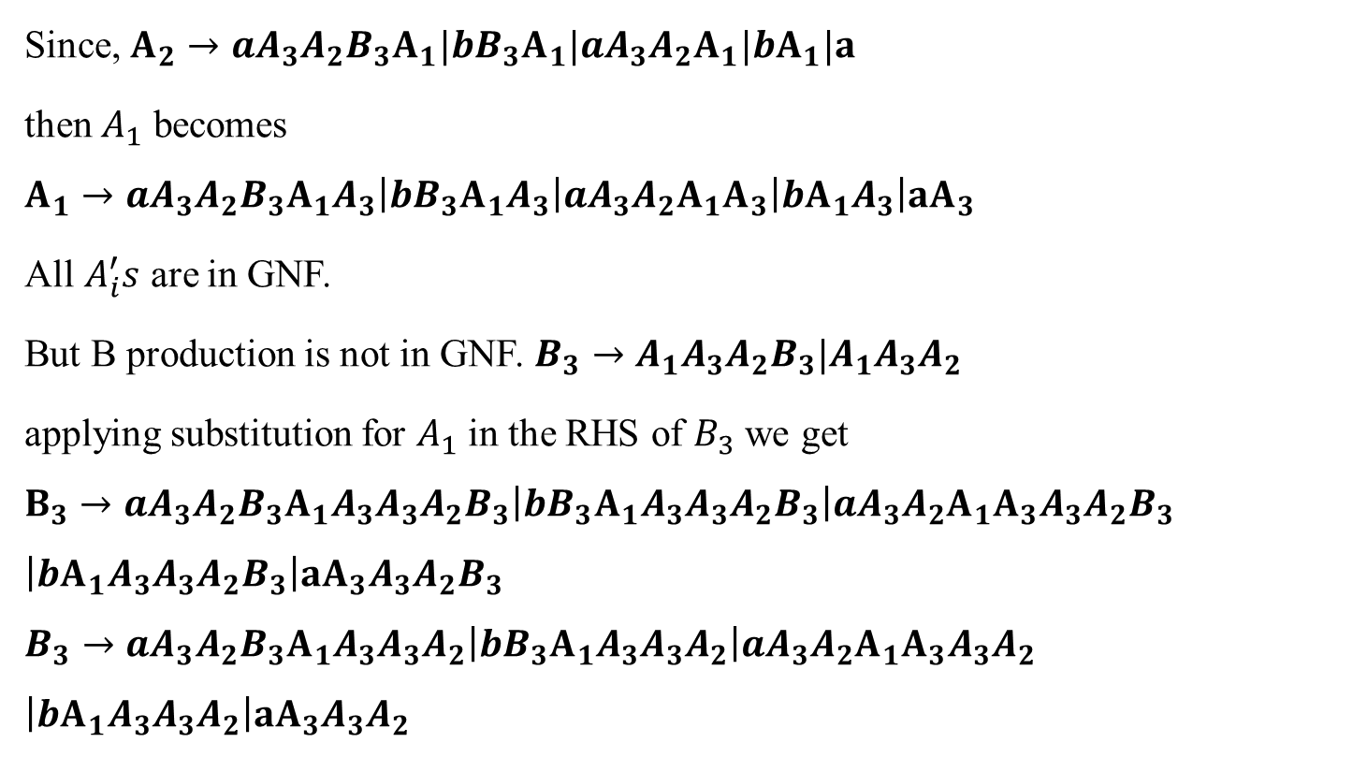
Solution cont’d..
Since, $A_{2}→aA_{3}A_{2}B_{3}A_{1}|bB_{3}A_{1}|aA_{3}A_{2}A_{1}|bA_{1}|a$
then $A_{1}$ becomes
$$A_{1}→aA_{3}A_{2}B_{3}A_{1}A_{3}\left|bB_{3}A_{1}A_{3}\right|aA_{3}A_{2}A_{1}A_{3}\left|bA_{1}A_{3}\right|aA_{3}$$
All $A_{i}^{′}s$ are in GNF.
But B production is not in GNF. $B_{3}→A_{1}A_{3}A_{2}B_{3}|A_{1}A_{3}A_{2}$
applying substitution for $A_{1}$ in the RHS of $B_{3}$ we get
$$B_{3}→aA_{3}A_{2}B_{3}A_{1}A_{3}A_{3}A_{2}B_{3}\left|bB_{3}A_{1}A_{3}A_{3}A_{2}B_{3}\right|aA_{3}A_{2}A_{1}A_{3}A_{3}A_{2}B_{3}$$
$$\left|bA_{1}A_{3}A_{3}A_{2}B_{3}\right|aA_{3}A_{3}A_{2}B_{3}$$
$$B_{3}→aA_{3}A_{2}B_{3}A_{1}A_{3}A_{3}A_{2}\left|bB_{3}A_{1}A_{3}A_{3}A_{2}\right|aA_{3}A_{2}A_{1}A_{3}A_{3}A_{2}$$
$$\left|bA_{1}A_{3}A_{3}A_{2}\right|aA_{3}A_{3}A_{2}$$
T. M. Rajalaxmi | 7 | Mathematics

Slide 8
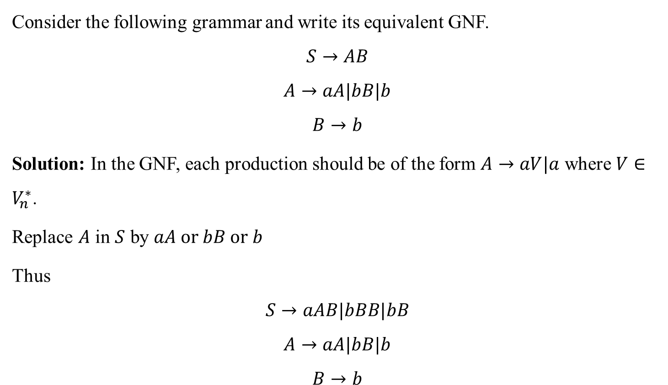
Problem - 2
Consider the following grammar and write its equivalent GNF.
$$S→AB$$
$$A→aA|bB|b$$
$$B→b$$
Solution: In the GNF, each production should be of the form $A→aV|a$ where $V∈V_{n}^{∗}$.
Replace $A$ in $S$ by $aA or bB or b$
Thus
$$S→aAB|bBB|bB$$
$$A→aA|bB|b$$
$$B→b$$
T. M. Rajalaxmi | 8 | Mathematics

