Slide 1
DISCRETE MATHEMATICS
Department of Mathematics
SSN College of Engineering (Autonomous)

Slide 2
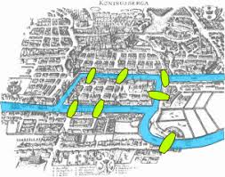
Euler and Seven Bridges of Konigsberg
Wikipedia: The city of Konigsberg in Prussia (now Kaliningrad, Russia) was set on both sides of the Pregel River, and included two large islands which were connected to each other and the mainland by seven bridges. The problem was to find a walk through the city that would cross each bridge once and only once.
Konigsberg in 1652.

Slide 3
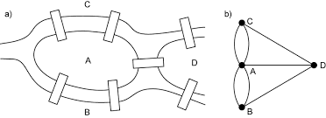
Euler and Seven Bridges of Konigsberg
In 1736 the Swiss mathematician Leonhard Euler presented a solution to this problem, concluding that such a walk was impossible, if an odd number of bridges are connected to more than two land masses. In demonstrating that the answer is no, he laid the foundation for graph theory - the first theorem in graph theory. W.W.Rouse Ball (in 1892) seems to have been the first to use the graph in the following figure to solve the problem.
The seven bridges of Konigsberg, as drawn by Leonhard Euler

Slide 4
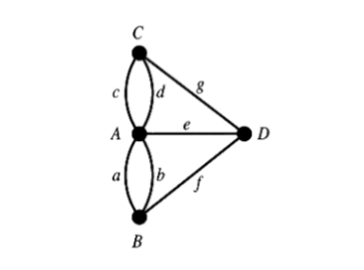
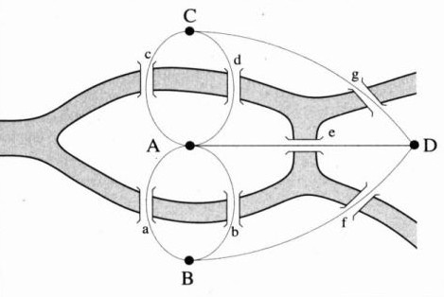
Graph Model
The word "graph" was first used in this sense by English Mathematician James Joseph Sylvester in 1878.
Notes:
Each path is traversed once – simple path
Each edge is traversed once – Euler path
In the above graph, an Euler path is possible only when odd degree vertex is either 0 or 2. In the case of Konigsberg all the 4 vertices are odd degree. So add one bridge – two vertices are even degree and 2 are odd degree. Hence solution is possible.

Slide 5
What is Graph?....
A graph is an ordered pair G = (V,E) where V is a set of vertices and E is a set of edges.
are also called as points or nodes.
Edges are called as lines or arcs.
Graph G with 6 vertices and 9 edges
Notes:
A graph G(V,E) is a non-empty set V of vertices and a set E of edges with incidence relationship

Slide 6
Graph Terminologies
Adjacent vertices
Adjacent edges
Parallel edges/ multiple edges
Loop
Simple graph
Multi graph
Pseudo graph
Degree of a graph
First Theorem of Graph
In a graph G, the sum of the degrees of the vertices is equal to twice the number of edges.
Notes:
Let G be a simple graph with n-vertices. Consider any vertex v of G. Since the graph is simple (i.e., without self loops and parallel edges), the vertex v can be adjacent to atmost remaining (n – 1) vertices. Hence the maximum degree of any vertex in a simple graph with n vertices is (n – 1).

Slide 7
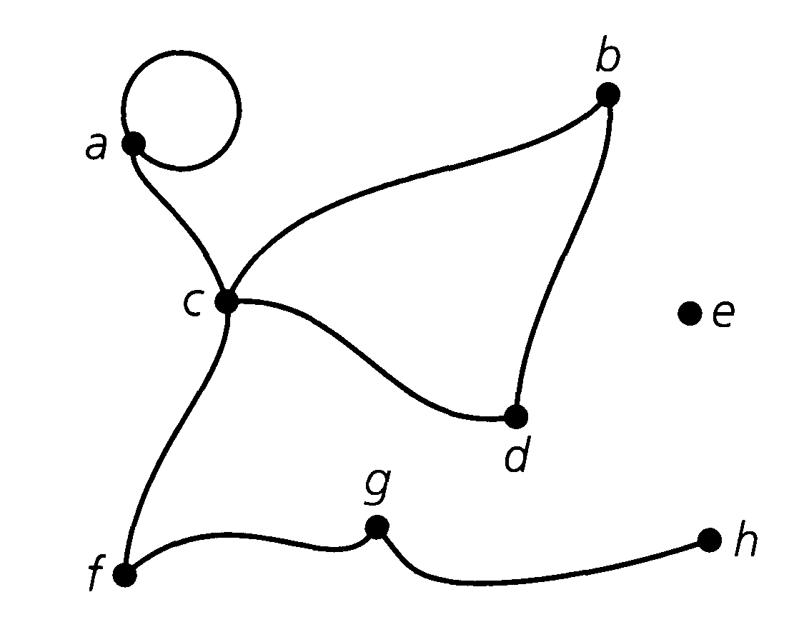
Example for the degree of a graph
For the graph in Figure, deg(b) = deg(d) = deg(f) = deg(g) = 2, deg(c) = 4, deg(e) = 0, and deg(h)=1. For vertex a we have deg(a) = 3 because we count a loop twice. Since h has degree 1, it is called a pendant vertex. Since vertex e has degree 0, it is called an isolated vertex.

Slide 8
Graph Terminologies-Contd.
Regular graph
2-regular graph and 3-regular graph
Complete graph
Complete graphs K₁, K₂, K₃, K₄ and K₅

Slide 9
Graph Terminologies-Contd.
Bipartite graph
Let G be a graph. If the vertex set of G can be partitioned into two non-empty subsets X and Y (i.e., X U Y = V and X ∩ Y = Φ ) in such a way that each edge of G has one end in X and the other end in Y, then G is called bipartite.
A complete bipartite graph is a simple bipartite graph G, with bipartition V = X U Y, in which every vertex in X is joined to every vertex in Y.
If X has m vertices and Y has n vertices, then the complete bipartite graph is denoted by Km,n.
Complete bipartite graphs K_{1,8} and K_{3,3}

Slide 10
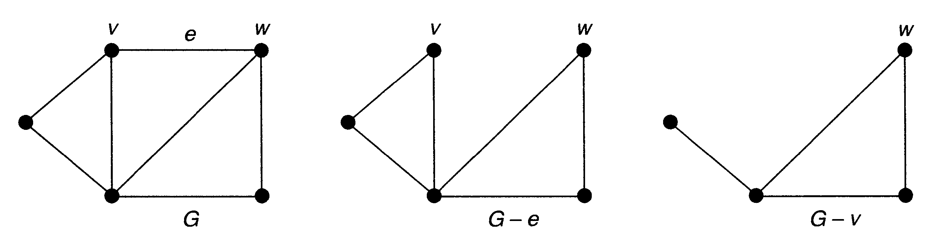
Examples - Subgraphs

Slide 11
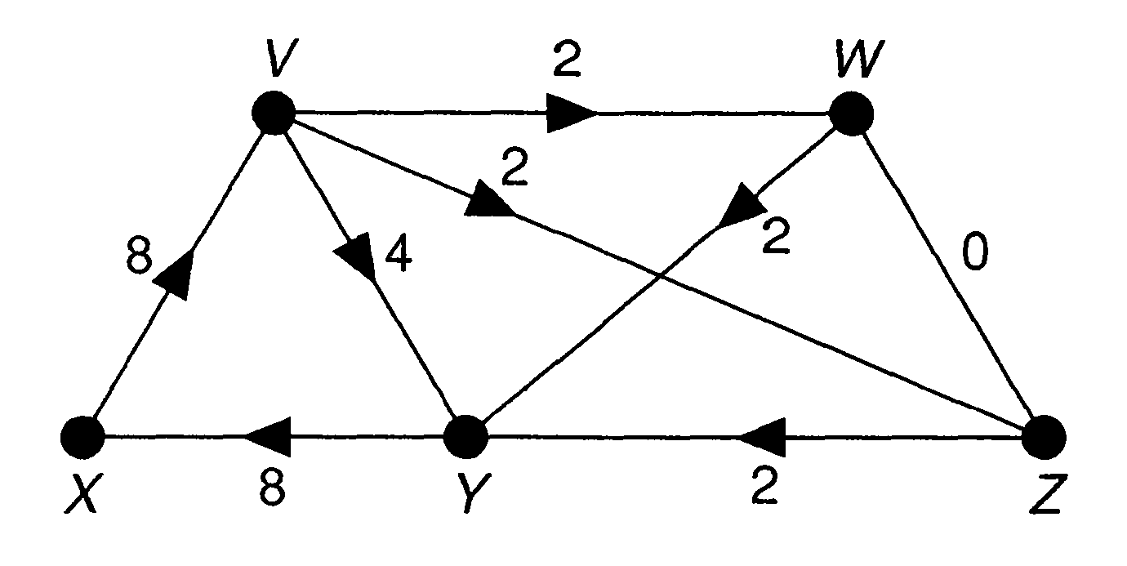
Directed weighted Graph

Slide 12
Graph Terminologies-Contd.
Path - A path is a sequence of vertices such that each vertex is adjacent to the next. In a path, each edge can be traveled only once. The length of a path is the number of edges in that path.
Cycle - A cycle or a circuit is a path that starts and ends at the same vertex.
Connected graph - A graph is connected if any two vertices can be joined by a path. Otherwise the graph is disconnected.
Connected graph Disconnected graph

Slide 13
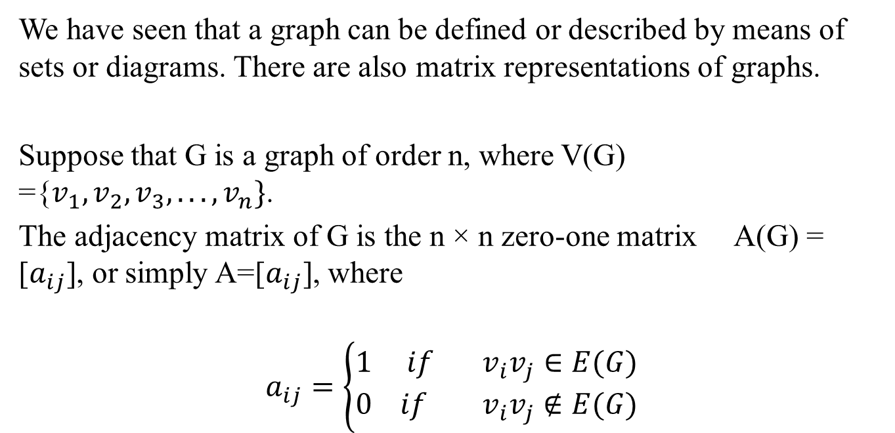
The Adjacency Matrix of a Graph
We have seen that a graph can be defined or described by means of sets or diagrams. There are also matrix representations of graphs.
Suppose that G is a graph of order n, where V(G) ={$v_{1}, v_{2}, v_{3}, . . . , v_{n}\}$.
The adjacency matrix of G is the n × n zero-one matrix A(G) = [$a_{ij}$], or simply A=[$a_{ij}$], where
$$a_{ij}=\left\{\begin{aligned}1 if v_{i}v_{j}∈E(G) \\ 0 if { v}_{i}v_{j}∉E(G)\end{aligned}\right.$$

Slide 14
Example 1
Figure shows the adjacency matrix of a graph G.

Slide 15
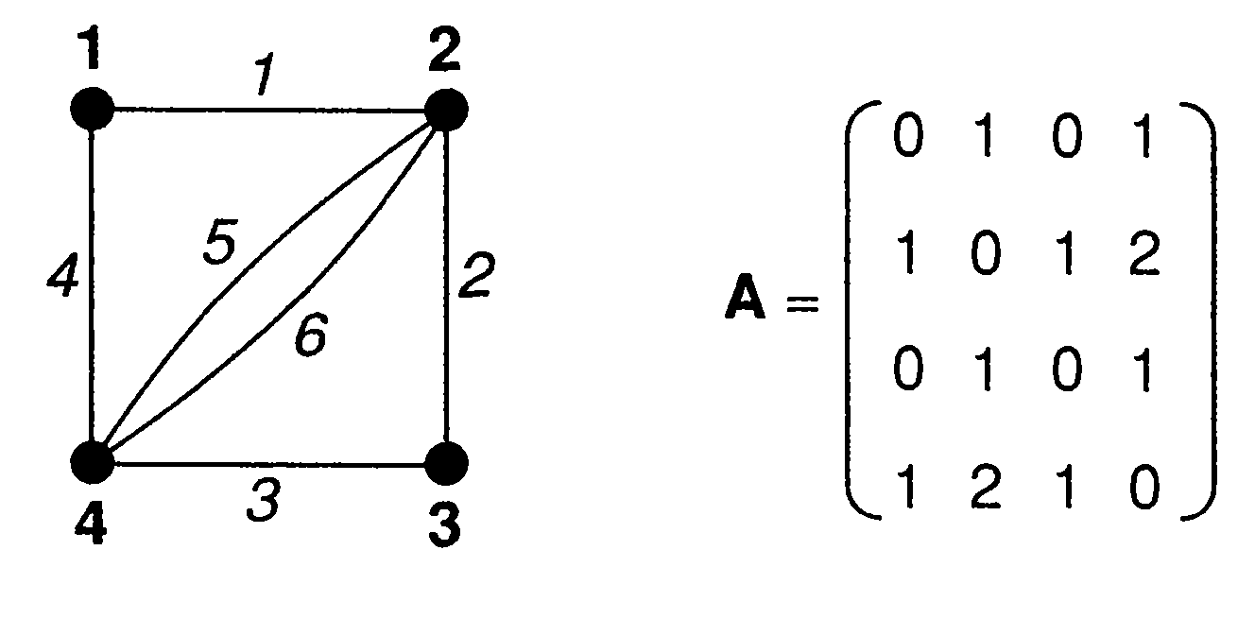
Example 2

Slide 16
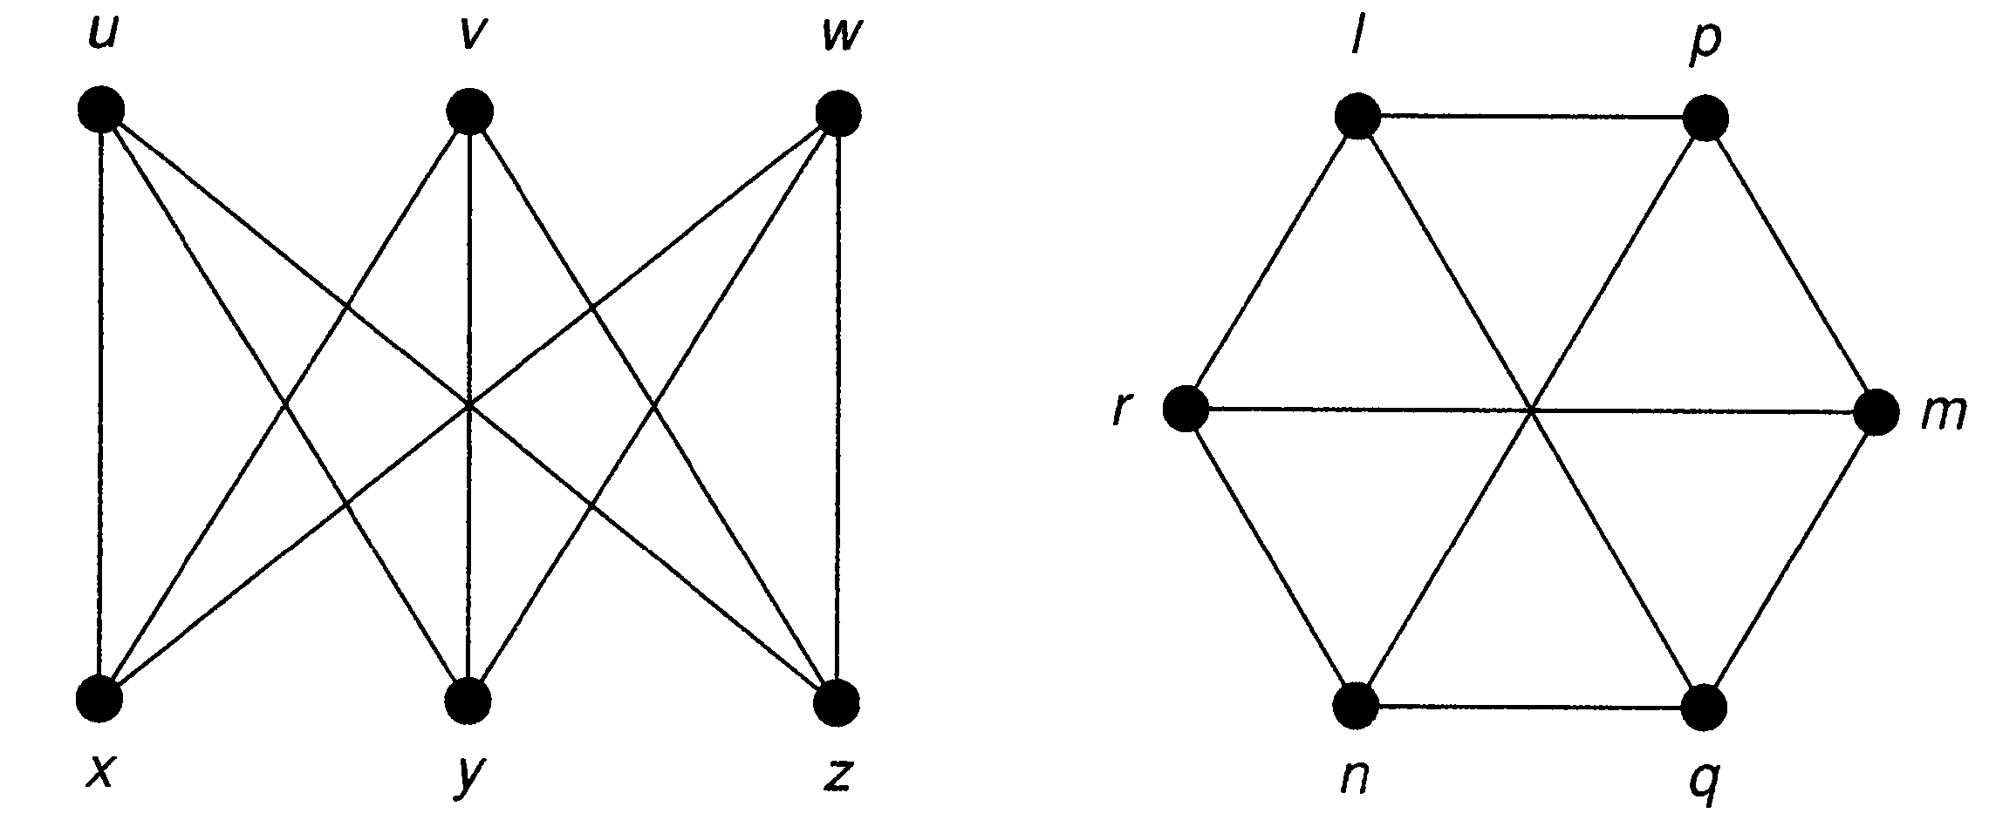

Isomorphism
Two graphs $G_{1}$ and $G_{2}$ are isomorphic if there is a one-one correspondence between the vertices of $G_{1}$ and those of $G_{2}$ such that the number of edges joining any two vertices of $G_{1}$ is equal to the number of edges joining the corresponding vertices of $G_{2}$.

Slide 17
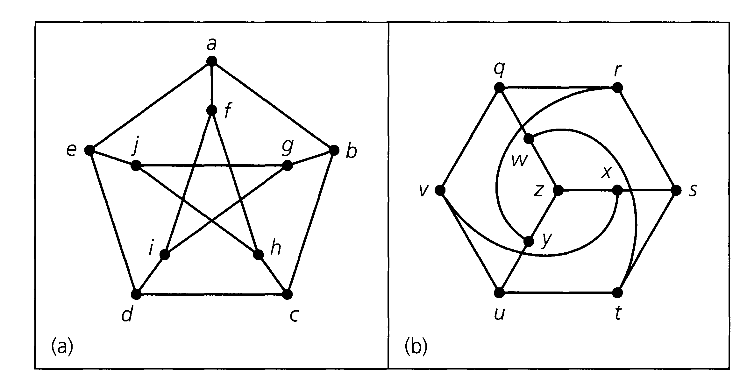
We have two graphs, each on ten vertices. It is not immediately apparent whether or not these graphs are isomorphic.

Slide 18
Euler Paths and Circuits
An Euler path, in a graph, is a walk through the graph which uses every edge exactly once.
An Euler circuit is an Euler path which starts and stops at the same vertex. Our goal is to find a quick way to check whether a graph has an Euler path or circuit.

Slide 19
Euler path & Euler Circuit
If we start at a vertex and trace along edges to get to other vertices, we create a walk through the graph. More precisely, a walk in a graph is a sequence of vertices such that every vertex in the sequence is adjacent to the vertices before and after it in the sequence. If the walk travels along every edge exactly once, then the walk is called an Euler path (or Euler walk).
If, in addition, the starting and ending vertices are the same (so you trace along every edge exactly once and end up where you started), then the walk is called an Euler circuit (or Euler tour). Of course if a graph is not connected, there is no hope of finding such a path or circuit.

Slide 20

Examples
The graph $G_{1}$ of Figure contains an Eulerian trail while $G_{2}$ contains an Eulerian circuit.
Figure : Graphs with Eulerian trails and Eulerian circuits

Slide 21
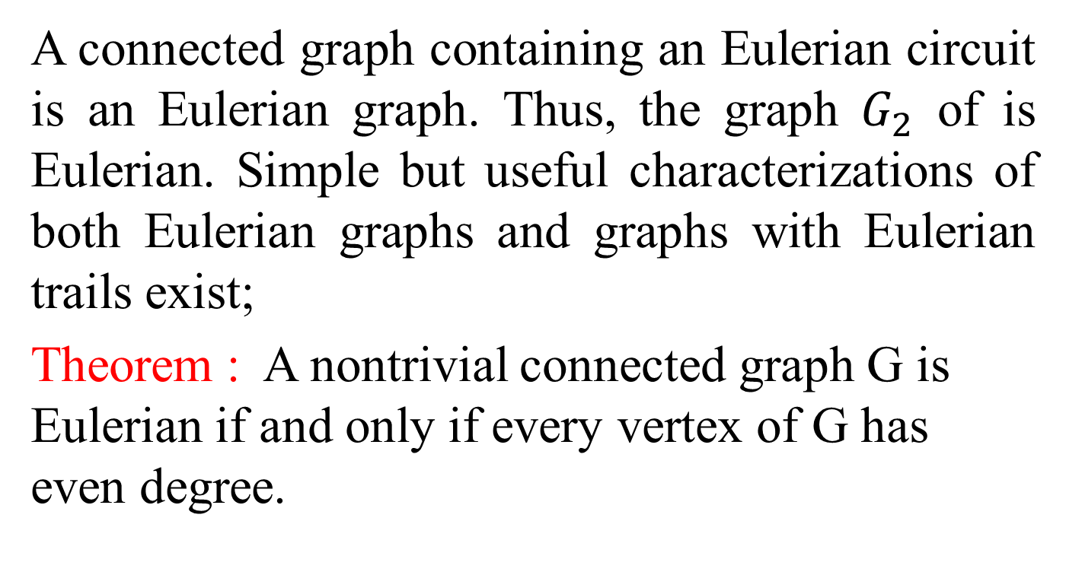
Euler’s Theorem
A connected graph containing an Eulerian circuit is an Eulerian graph. Thus, the graph $G_{2}$ of is Eulerian. Simple but useful characterizations of both Eulerian graphs and graphs with Eulerian trails exist;
Theorem : A nontrivial connected graph G is Eulerian if and only if every vertex of G has even degree.

Slide 22
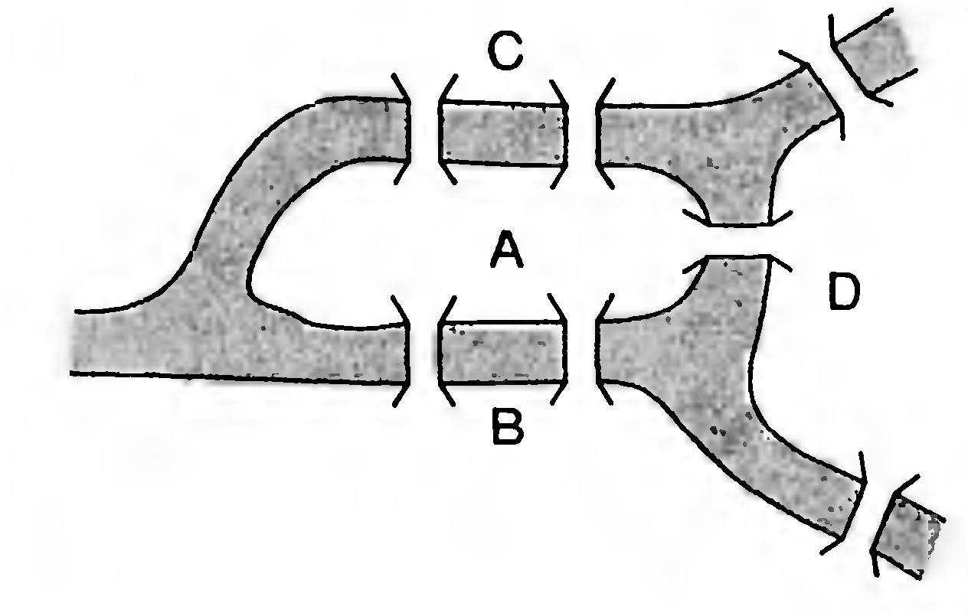
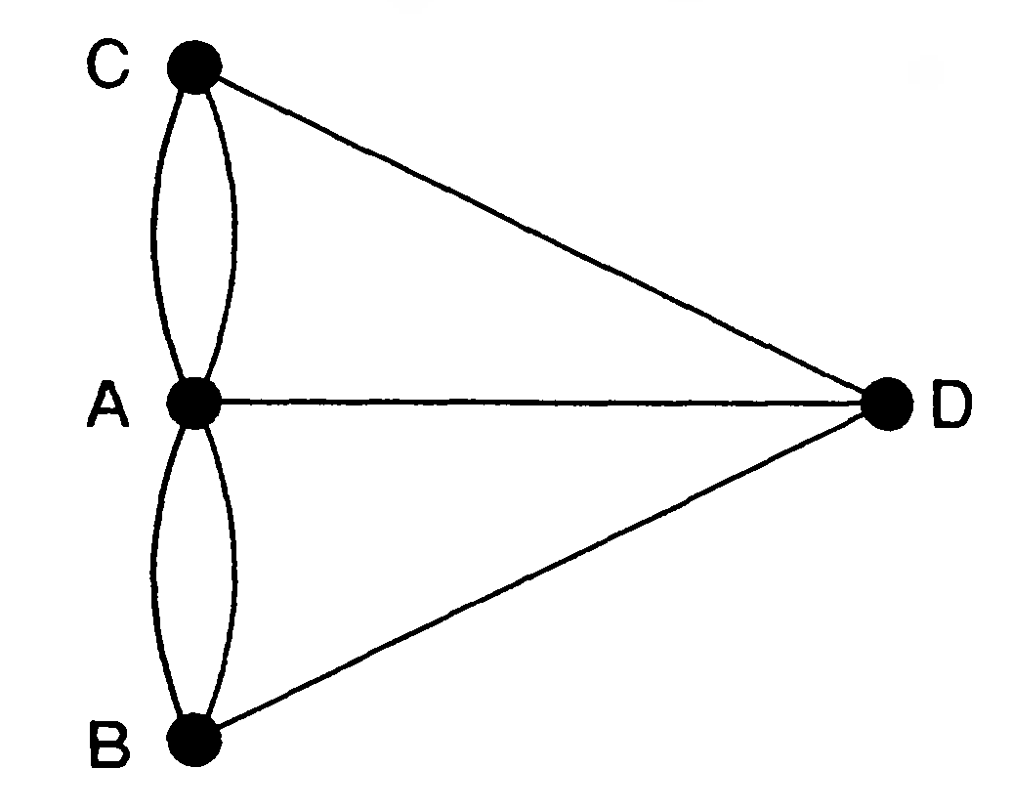

The K$\ddot{o}$nigsberg Bridge problem

Slide 23
Hamiltonian graph
Let G be a graph. A path in G that contains every vertex of G is called a Hamiltonian path of G, while a cycle in G that contains every vertex of G is called a Hamiltonian cycle of G.
A graph that contains a Hamiltonian cycle is itself called Hamiltonian.

Slide 24

Examples
The graph $G_{1}$ of Figure is Hamiltonian and therefore contains both a Hamiltonian cycle and a Hamiltonian path. The graph $G_{2}$ contains a Hamiltonian path but is not Hamiltonian; while $G_{3}$ contains neither a Hamiltonian cycle nor a Hamiltonian path.

Slide 25
Remark
Certainly, the order of every Hamiltonian graph is at least 3 and every Hamiltonian graph contains a Hamiltonian path.
On the other hand, a graph with a Hamiltonian path need not be Hamiltonian.

Slide 26
Remark
Hamiltonian does not involve the degrees of the vertices of G but, rather, involves the cardinality of sets of pairwise nonadjacent vertices of a graph and its connectivity.

Slide 27
Online resources
For further details click : Graph Theory - Interactive
https://d3gt.com/

