Slide 1
Properties of Algebraic Structures
by
Dr. T. M. Rajalaxmi
Assistant Professor
Department of Mathematics

Slide 2
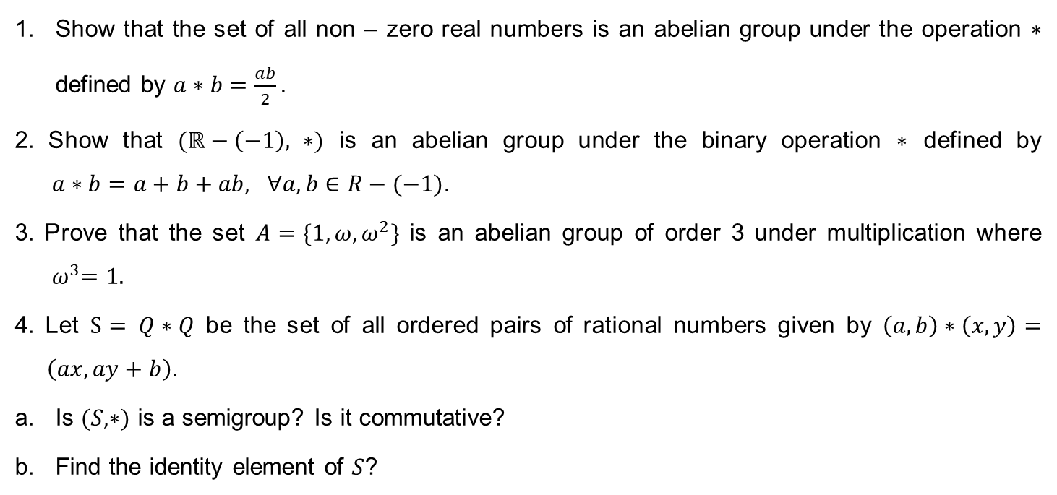
Problems
Show that the set of all non – zero real numbers is an abelian group under the operation $∗$ defined by $a∗b=\frac{ab}{2}.$
2. Show that $(ℝ−\left(−1\right), ∗)$ is an abelian group under the binary operation $∗$ defined by $a∗b=a+b+ab, ∀a,b∈R−(−1)$.
3. Prove that the set $A=\{1, ω, ω^{2}\}$ is an abelian group of order 3 under multiplication where ${ ω}^{3}=1.$
4. Let $S= Q∗Q$ be the set of all ordered pairs of rational numbers given by $\left(a,b\right)∗\left(x,y\right)= \left(ax, ay+b\right).$
Is $(S,∗)$ is a semigroup? Is it commutative?
Find the identity element of $S$?

Slide 3
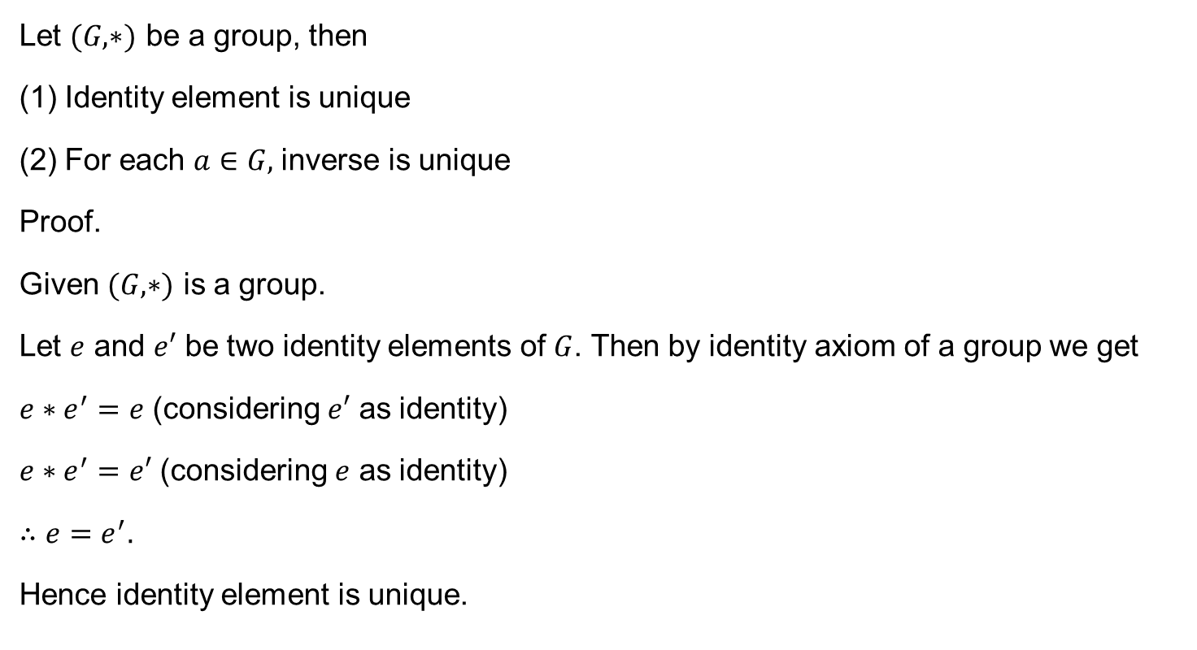
Theorem 1
Let $(G,∗)$ be a group, then
Identity element is unique
For each $a∈G,$inverse is unique
Proof.
Given $(G,∗)$ is a group.
Let $e$ and $e′$ be two identity elements of $G$. Then by identity axiom of a group we get
$e∗e^{′}=e$ (considering $e′$ as identity)
$e∗e^{′}=e′$ (considering $e$ as identity)
$∴$ $e=e^{′}.$
Hence identity element is unique.

Slide 4
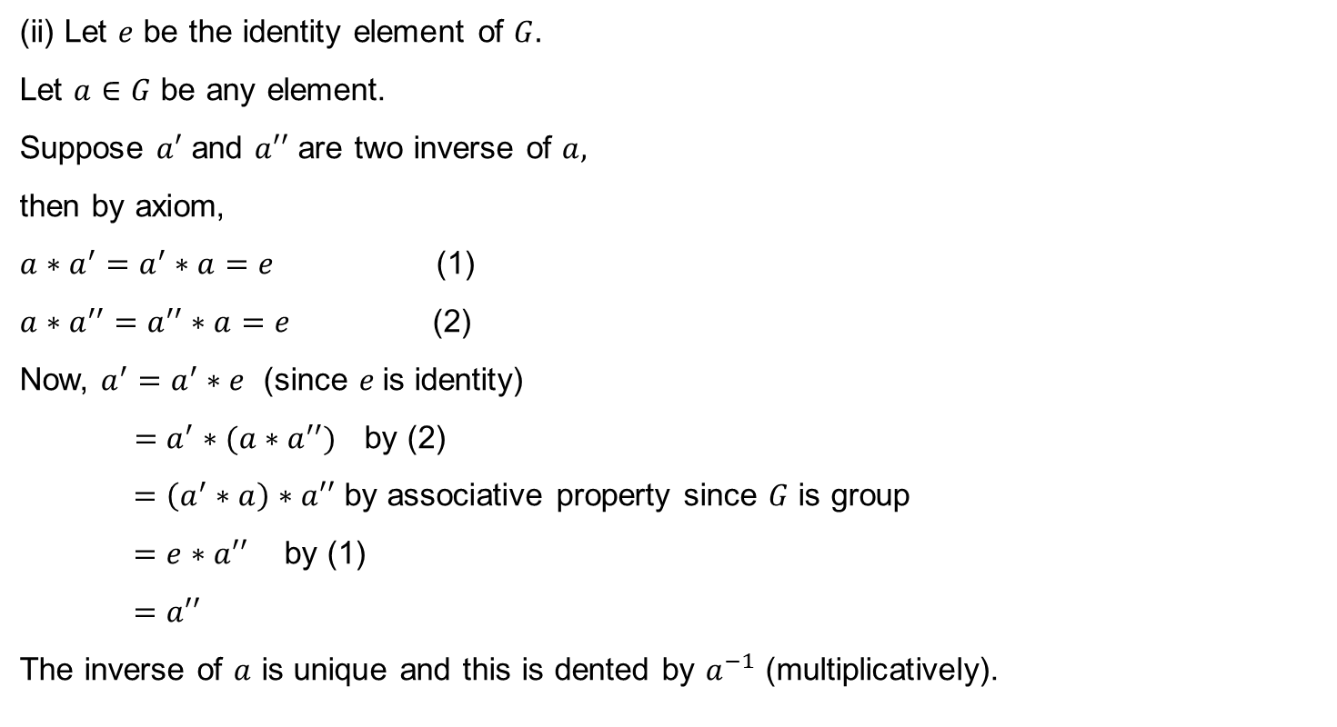
Theorem 1 ctd..
(ii) Let $e$ be the identity element of $G.$
Let $a∈G$ be any element.
Suppose $a′$ and $a′′$ are two inverse of $a,$
then by axiom,
$a∗a^{′}=a^{′}∗a=e$ (1)
$a∗a^{′′}=a^{′′}∗a=e$ (2)
Now, $a^{′}=a^{′}∗e$ (since $e$is identity)
$=a^{′}∗(a∗a^{′′})$ by (2)
$=\left(a^{′}∗a\right)∗a′′$ by associative property since $G$ is group
$=e∗a′′$ by (1)
$=a′′$
The inverse of $a$ is unique and this is dented by $a^{−1}$ (multiplicatively).

Slide 5

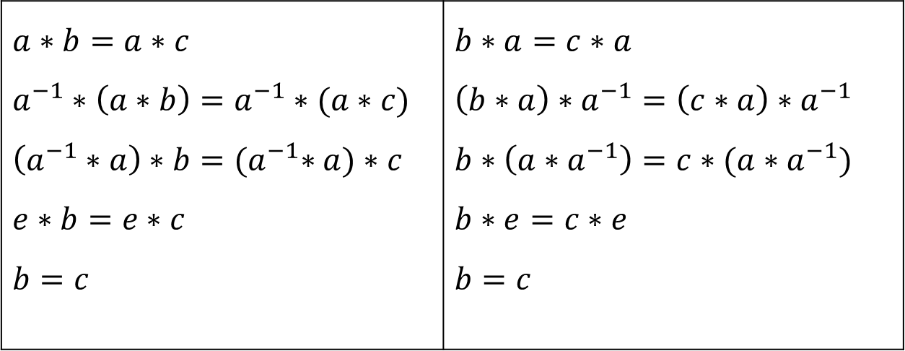
Theorem 2
In a group $(G,∗)$ the cancellation laws hold $∀a,b,c∈G.$
$a∗b=a∗c$ $⟹$ $b=c$ (left cancellation law)
$b∗a=c∗a$ $⟹$ $b=c$ (right cancellation law)
Proof:
$$a∗b=a∗c$$ $$a^{−1}∗\left(a∗b\right)=a^{−1}∗(a∗c)$$ $$\left(a^{−1}∗a\right)∗b={(a}^{−1}∗a)∗c$$ $$e∗b=e∗c$$ $$b=c$$ | $$b∗a=c∗a$$ $$\left(b∗a\right)∗a^{−1}=\left(c∗a\right)∗a^{−1}$$ $$b∗\left(a∗a^{−1}\right)=c∗(a∗a^{−1})$$ $$b∗e=c∗e$$ $$b=c$$

Slide 6

Theorem 3
Let $(G,∗)$ be a group, then for each $a∈G,$ ${\left(a^{−1}\right)}^{−1}=a.$
Proof:
Let $a∈G,$then $a^{−1}$ is the inverse of $a$ and${\left(a^{−1}\right)}^{−1}$ is the inverse of $a^{−1}$.
$∴a∗a^{−1}=a^{−1}∗a=e$
And $a^{−1}∗{\left(a^{−1}\right)}^{−1}={\left(a^{−1}\right)}^{−1}∗a^{−1}=e$
$$∴ a^{−1}∗a=a^{−1}∗{\left(a^{−1}\right)}^{−1}$$
By left cancellation law
$a={\left(a^{−1}\right)}^{−1}$.

Slide 7

Problem
Show that $\left\{1, 3, 7, 9\right\}$ is an abelian group under multiplication modulo 10 ${(x}_{10})$.

Slide 8
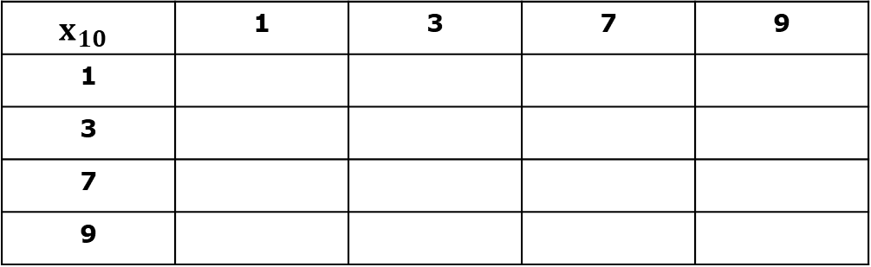
Problem
Show that $\left\{1, 3, 7, 9\right\}$ is an abelian group under multiplication modulo 10 ${(x}_{10})$.
$$x_{10}$$ | 1 | 3 | 7 | 9
1
3
7
9

Slide 9
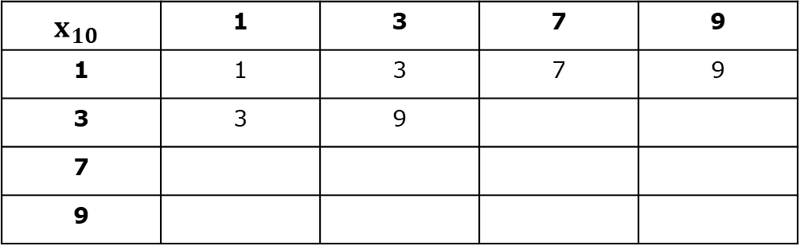
Problem
Show that $\left\{1, 3, 7, 9\right\}$ is an abelian group under multiplication modulo 10 ${(x}_{10})$.
$$x_{10}$$ | 1 | 3 | 7 | 9
1 | 1 | 3 | 7 | 9
3 | 3 | 9
7
9

Slide 10

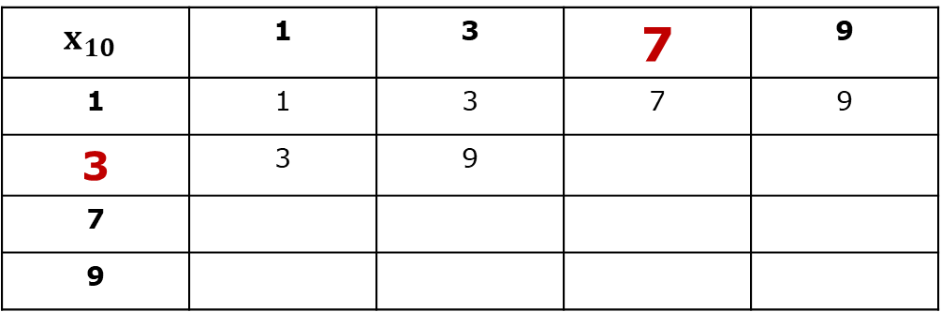
Problem
Show that $\left\{1, 3, 7, 9\right\}$ is an abelian group under multiplication modulo 10 ${(x}_{10})$.
$$3 x 7=21≡1(mod 10)$$
$$x_{10}$$ | 1 | 3 | 7 | 9
1 | 1 | 3 | 7 | 9
3 | 3 | 9
7
9

Slide 11
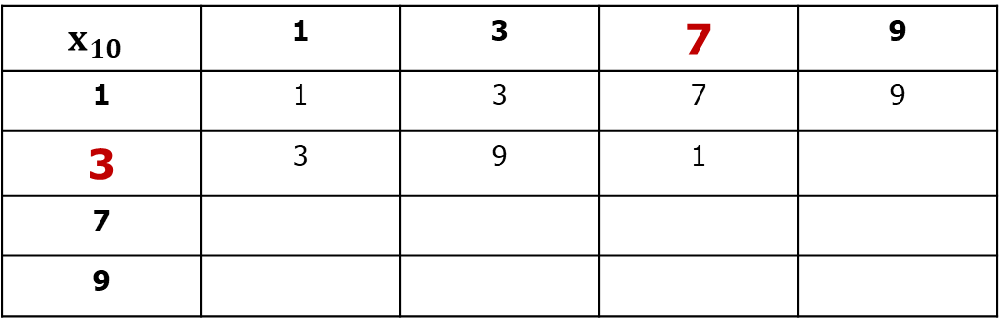
Problem
Show that $\left\{1, 3, 7, 9\right\}$ is an abelian group under multiplication modulo 10 ${(x}_{10})$.
$$3 x 7=21≡1(mod 10)$$
$$x_{10}$$ | 1 | 3 | 7 | 9
1 | 1 | 3 | 7 | 9
3 | 3 | 9 | 1
7
9

Slide 12
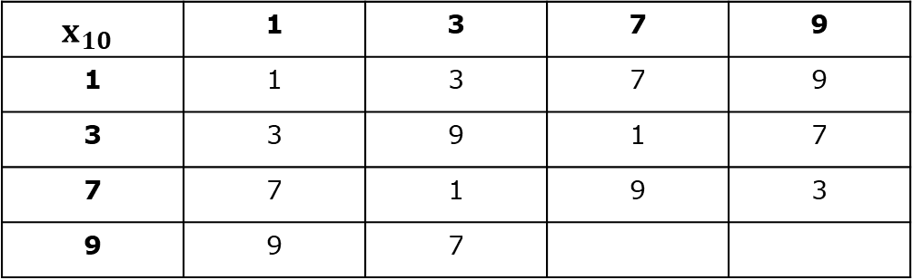
Problem
Show that $\left\{1, 3, 7, 9\right\}$ is an abelian group under multiplication modulo 10 ${(x}_{10})$.
$$x_{10}$$ | 1 | 3 | 7 | 9
1 | 1 | 3 | 7 | 9
3 | 3 | 9 | 1 | 7
7 | 7 | 1 | 9 | 3
9 | 9 | 7

Slide 13

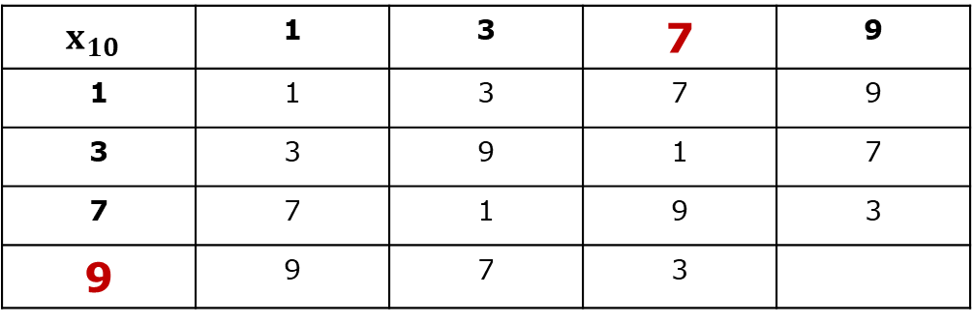
Problem
Show that $\left\{1, 3, 7, 9\right\}$ is an abelian group under multiplication modulo 10 ${(x}_{10})$.
$$9 x 7=63≡3 (mod 10)$$
$$x_{10}$$ | 1 | 3 | 7 | 9
1 | 1 | 3 | 7 | 9
3 | 3 | 9 | 1 | 7
7 | 7 | 1 | 9 | 3
9 | 9 | 7 | 3

Slide 14

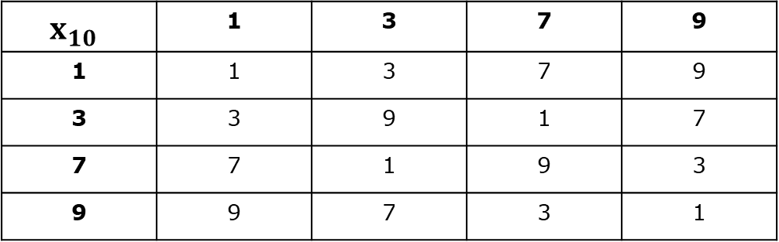
Problem
Show that $\left\{1, 3, 7, 9\right\}$ is an abelian group under multiplication modulo 10 ${(x}_{10})$.
Closure: Elements of the table is same as elements of the given set.
Associative: $\left(3 x_{10} 7\right){ x}_{10} 9=1x_{10}9=9$; $3 x_{10}\left(7 x_{10} 9\right)=3 x_{10} 3=9$
Identity: 1
$$x_{10}$$ | 1 | 3 | 7 | 9
1 | 1 | 3 | 7 | 9
3 | 3 | 9 | 1 | 7
7 | 7 | 1 | 9 | 3
9 | 9 | 7 | 3 | 1

Slide 15

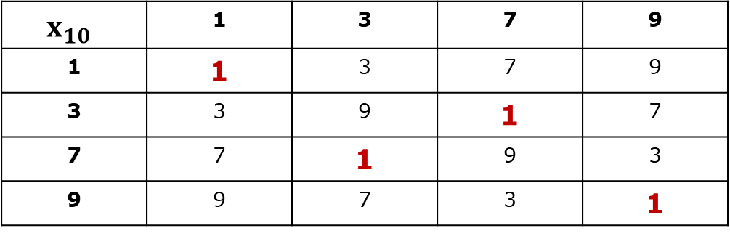
Problem
Show that $\left\{1, 3, 7, 9\right\}$ is an abelian group under multiplication modulo 10 ${(x}_{10})$.
Inverse of 1: 1
Inverse of 3: 7 Since Symmetric, $∴$ commutative.
Inverse of 7: 3 Hence given set is an abelian group.
Inverse of 9: 9
$$x_{10}$$ | 1 | 3 | 7 | 9
1 | 1 | 3 | 7 | 9
3 | 3 | 9 | 1 | 7
7 | 7 | 1 | 9 | 3
9 | 9 | 7 | 3 | 1

Slide 16

Theorem 4
Let $(G,∗)$ be a group, then for $∀ a, b∈G, {\left(a∗b\right)}^{−1}=b^{−1}∗a^{−1}.$ (Inverse reversal law)
Proof: We must prove that inverse of $\left(a∗b\right)$ is $b^{−1}∗a^{−1}$
Consider
$$\left(a∗b\right)∗\left(b^{−1}∗a^{−1}\right)=a∗\left(b∗b^{−1}\right)∗a^{−1}$$
$=a∗(e)∗a^{−1}$
$=a∗a^{−1}$
$$=e$$
$∴$ inverse of $\left(a∗b\right)$ is $b^{−1}∗a^{−1}$
i.e., ${\left(a∗b\right)}^{−1}=b^{−1}∗a^{−1}$

Slide 17
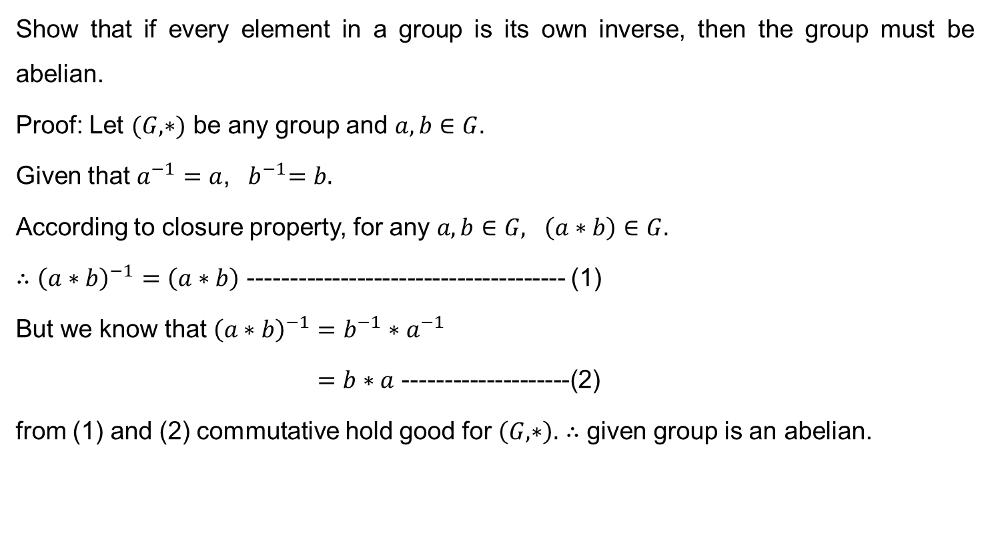
Property
Show that if every element in a group is its own inverse, then the group must be abelian.
Proof: Let $(G,∗)$ be any group and $a, b∈G.$
Given that $a^{−1}=a$, ${ b}^{−1}=b.$
According to closure property, for any $a, b∈G, \left(a∗b\right)∈G.$
$∴{\left(a∗b\right)}^{−1}=\left(a∗b\right)$ -------------------------------------- (1)
But we know that ${\left(a∗b\right)}^{−1}=b^{−1}∗a^{−1}$
$=b∗a$ --------------------(2)
from (1) and (2) commutative hold good for $\left(G,∗\right).$ $∴$ given group is an abelian.

Slide 18
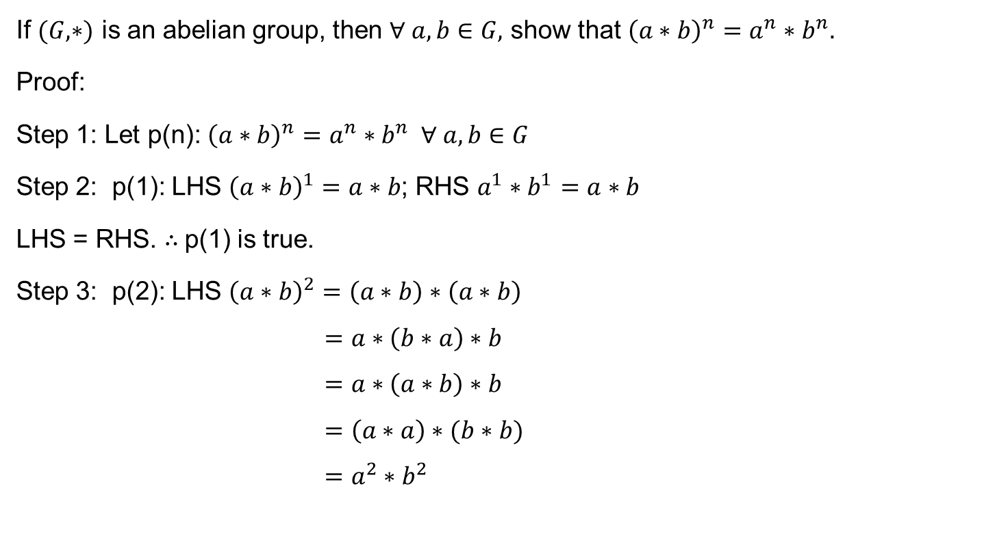
Property
If $(G,∗)$ is an abelian group, then $∀ a, b∈G,$ show that ${\left(a∗b\right)}^{n}=a^{n}∗b^{n}.$
Proof:
Step 1: Let p(n): ${\left(a∗b\right)}^{n}=a^{n}∗b^{n} ∀ a, b∈G$
Step 2: p(1): LHS ${\left(a∗b\right)}^{1}=a∗b$; RHS $a^{1}∗b^{1}=a∗b$
LHS = RHS. $∴$p(1) is true.
Step 3: p(2): LHS ${\left(a∗b\right)}^{2}=\left(a∗b\right)∗\left(a∗b\right)$
$$=a∗\left(b∗a\right)∗b$$
$$=a∗\left(a∗b\right)∗b$$
$$=\left(a∗a\right)∗(b∗b)$$
$$=a^{2}∗b^{2}$$

Slide 19

Property
Step 4: p(n): LHS ${\left(a∗b\right)}^{n}=\left(a^{n−1}∗b^{n−1}\right)∗\left(a∗b\right)$
$$=a^{n−1}∗\left(b^{n−1}∗a\right)∗b$$
$$=a^{n−1}∗\left(a∗b^{n−1}\right)∗b$$
$$=\left(a^{n−1}∗a\right)∗(b^{n−1}∗b)$$
$$=a^{n}∗b^{n}$$
Thus p(n) is true for all $a,b∈G.$

Slide 20

Property
If $a$ is the inverse of $b,$ $b$ is the inverse of $c$, then prove that $a=c.$
Proof:
Let $a$ is the inverse of $b,$ $∴$ $a∗b=b∗a=e$.
$b$ is the inverse of $c$, $∴$ $b∗c=c∗b=e$
$⟹$ $b∗a=b∗c$
$⟹$ $a=c$ (by left cancellation law).

Slide 21

Property
In a group $G$, if $a^{2}=e ∀a∈G$, then $G$ is abelian.
Proof:
Given $a^{2}=e$
premultiply by $a^{−1}$ on both sides
$$a^{−1}∗a^{2}=a^{−1}∗e$$
$$a^{−1}∗a∗a=a^{−1}∗e$$
$${(a}^{−1}∗a)∗a=a^{−1}∗e$$
$$e∗a=a^{−1}∗e$$
$⟹a=a^{−1}$ $∀a∈G$
i.e., every element is its own inverse. Hence $G$ is an abelian group.

Slide 22

Property
Show that only idempotent element $(b^{2}=b)$ in $(G,∗)$ is identity.
proof:
Given $a=a^{2}$
$$a=(a∗a)$$
post multiply by $a^{−1}$
$$a∗a^{−1}=\left(a∗a\right)∗a^{−1}$$
$$e=a∗(a∗a^{−1})$$
$$e=a∗e$$
$$e=a$$
$∴$ only idempotent element in $(G,∗)$ is the identity element.

Slide 23
Thank You

