Slide 1
Subgroup
by
Dr. T. M. Rajalaxmi
Assistant Professor
Department of Mathematics

Slide 2
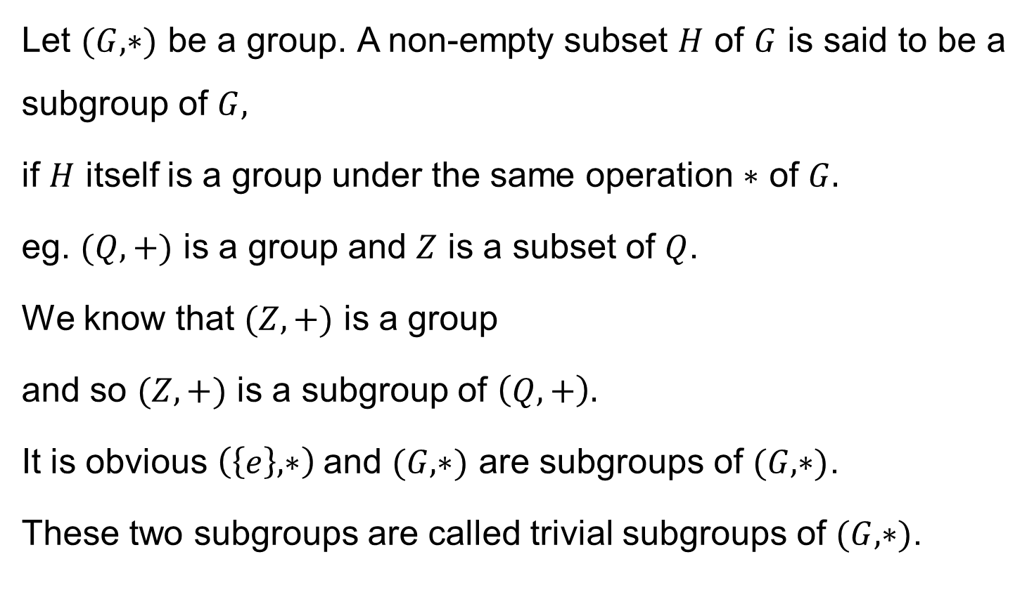
Definition
Let $(G,∗)$ be a group. A non-empty subset $H$ of $G$ is said to be a subgroup of $G,$
if $H$ itself is a group under the same operation $∗$ of $G.$
eg. $(Q,+)$ is a group and $Z$ is a subset of $Q$.
We know that $(Z,+)$ is a group
and so $(Z,+)$ is a subgroup of $\left(Q,+\right).$
It is obvious $\left(\left\{e\right\},∗\right)$and $(G,∗)$ are subgroups of $(G,∗)$.
These two subgroups are called trivial subgroups of $(G,∗)$.

Slide 3
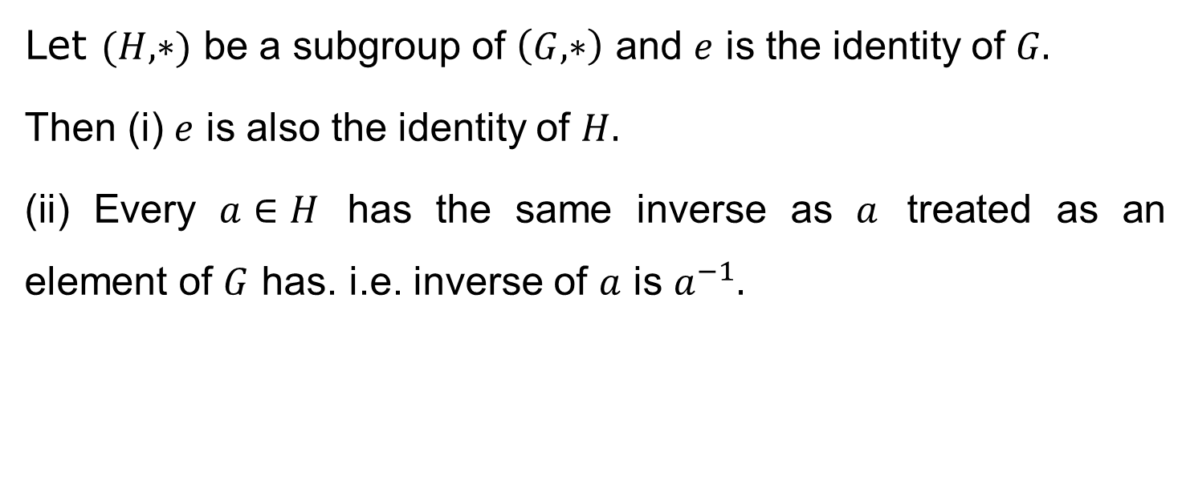
Theorem
Let $(H, ∗)$ be a subgroup of $\left(G, ∗\right)$ and $e$ is the identity of $G.$
Then (i) $e$ is also the identity of $H.$
(ii) Every $a∈H$ has the same inverse as $a$ treated as an element of $G$ has. i.e. inverse of $a$ is $a^{−1}.$

Slide 4
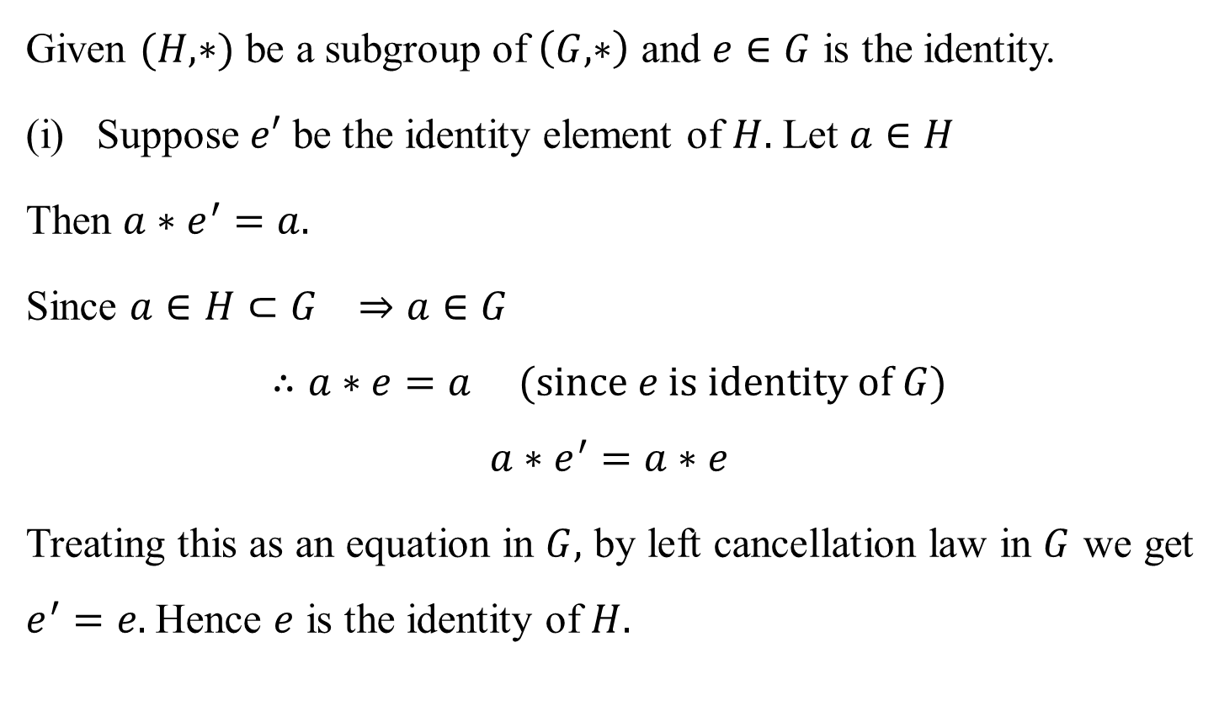
Proof:
Given $(H, ∗)$ be a subgroup of $\left(G, ∗\right)$ and $e∈G$ is the identity.
Suppose $e′$ be the identity element of $H.$ Let $a∈H$
Then $a∗e^{′}=a.$
Since $a∈H⊂G ⇒a∈G$
$$∴a∗e=a (since e is identity of G)$$
$$a∗e^{′}=a∗e$$
Treating this as an equation in $G,$ by left cancellation law in $G$ we get $e^{′}=e.$Hence $e$ is the identity of $H.$

Slide 5
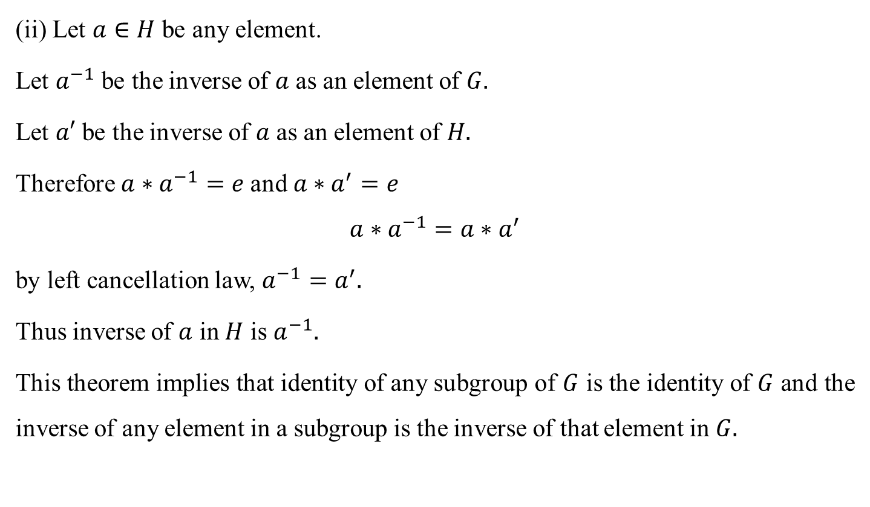
Proof:
(ii) Let $a∈H$ be any element.
Let $a^{−1}$ be the inverse of $a$ as an element of $G.$
Let $a′$ be the inverse of $a$ as an element of $H.$
Therefore $a∗a^{−1}=e$and $a∗a^{′}=e$
$$a∗a^{−1}=a∗a^{′}$$
by left cancellation law, $a^{−1}=a^{′}.$
Thus inverse of $a$ in $H$ is $a^{−1}.$
This theorem implies that identity of any subgroup of $G$ is the identity of $G$ and the inverse of any element in a subgroup is the inverse of that element in $G.$

Slide 6
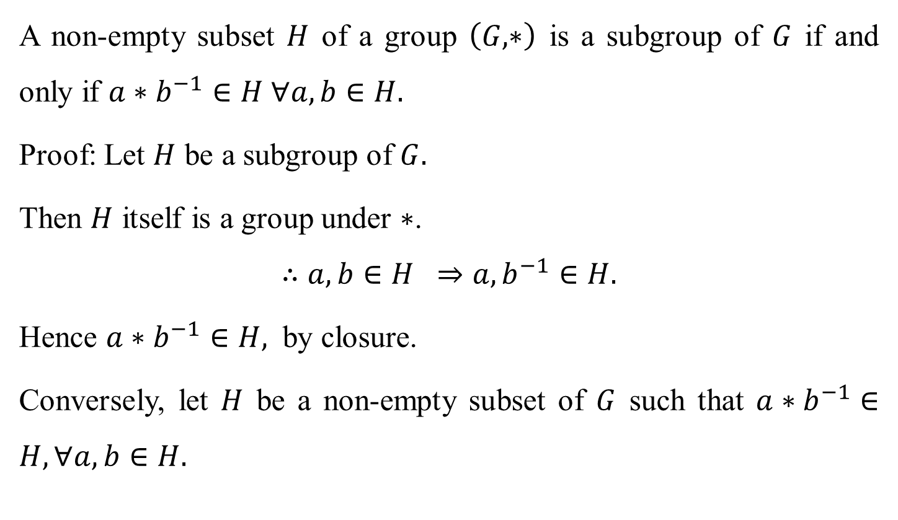
Theorem
A non-empty subset $H$ of a group $\left(G, ∗\right)$ is a subgroup of $G$ if and only if $a∗b^{−1}∈H ∀a,b∈H.$
Proof: Let $H$ be a subgroup of $G.$
Then $H$ itself is a group under $∗$.
$$∴a,b∈H ⇒a,b^{−1}∈H.$$
Hence $a∗b^{−1}∈H,$ by closure.
Conversely, let $H$ be a non-empty subset of $G$ such that $a∗b^{−1}∈H, ∀a,b∈H.$

Slide 7
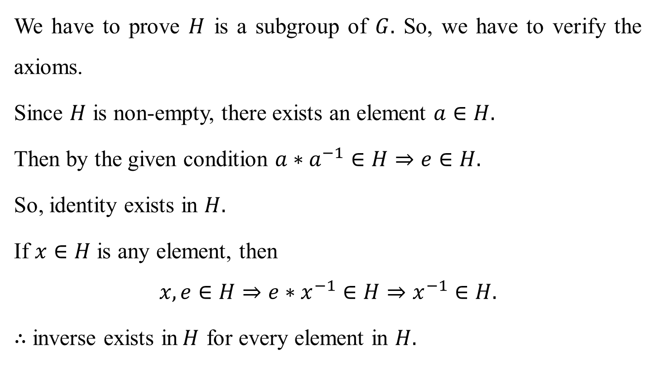
Theorem
We have to prove $H$ is a subgroup of $G.$ So, we have to verify the axioms.
Since $H$ is non-empty, there exists an element $a∈H.$
Then by the given condition $a∗a^{−1}∈H⇒e∈H.$
So, identity exists in $H.$
If $x∈H$ is any element, then
$$x,e∈H⇒e∗x^{−1}∈H⇒x^{−1}∈H.$$
$∴$ inverse exists in$H$ for every element in $H.$

Slide 8
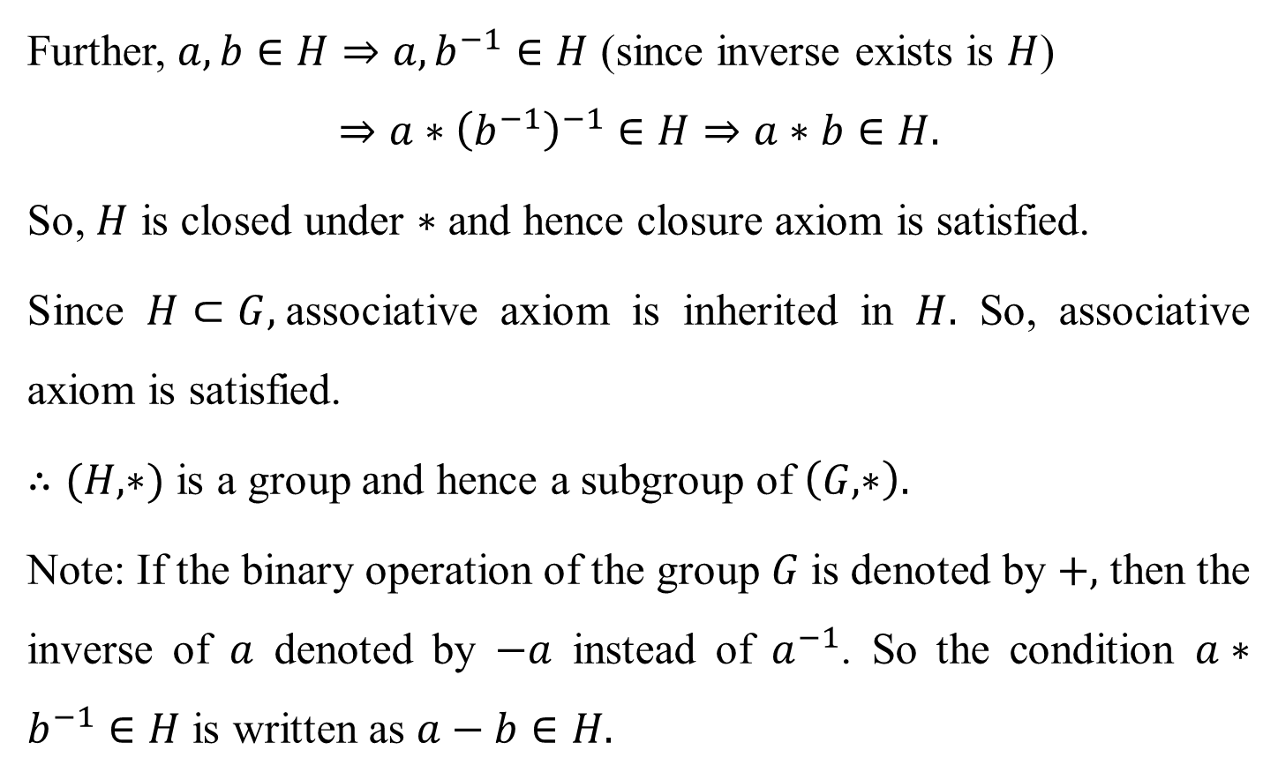
Theorem
Further, $a,b∈H⇒a,b^{−1}∈H$ (since inverse exists is $H$)
$$⇒a∗{\left(b^{−1}\right)}^{−1}∈H⇒a∗b∈H.$$
So, $H$ is closed under $∗$ and hence closure axiom is satisfied.
Since $H⊂G,$associative axiom is inherited in $H.$ So, associative axiom is satisfied.
$∴(H,∗)$ is a group and hence a subgroup of $\left(G,∗\right).$
Note: If the binary operation of the group $G$is denoted by $+,$ then the inverse of $a$ denoted by $−a$ instead of $a^{−1}$. So the condition $a∗b^{−1}∈H$ is written as $a−b∈H.$

Slide 9
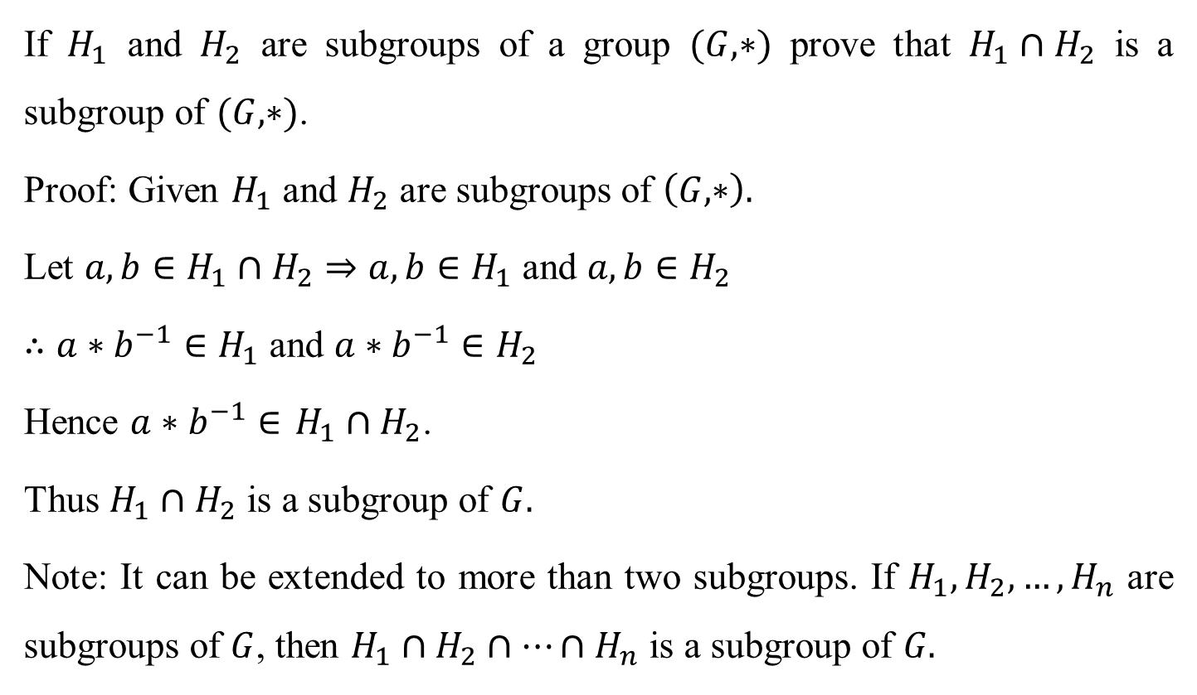
Theorem
If $H_{1}$ and $H_{2}$ are subgroups of a group $(G,∗)$ prove that $H_{1}∩H_{2}$ is a subgroup of $(G,∗)$.
Proof: Given $H_{1}$ and $H_{2}$ are subgroups of $\left(G,∗\right).$
Let $a,b∈H_{1}∩H_{2}⇒a,b∈H_{1}$ and $a,b∈H_{2}$
$∴a∗b^{−1}∈H_{1}$ and $a∗b^{−1}∈H_{2}$
Hence $a∗b^{−1}∈$ $H_{1}∩H_{2}$.
Thus $H_{1}∩H_{2}$ is a subgroup of $G.$
Note: It can be extended to more than two subgroups. If $H_{1},H_{2},…,H_{n}$ are subgroups of $G$, then $H_{1}∩H_{2}∩⋯∩H_{n}$ is a subgroup of $G.$

Slide 10
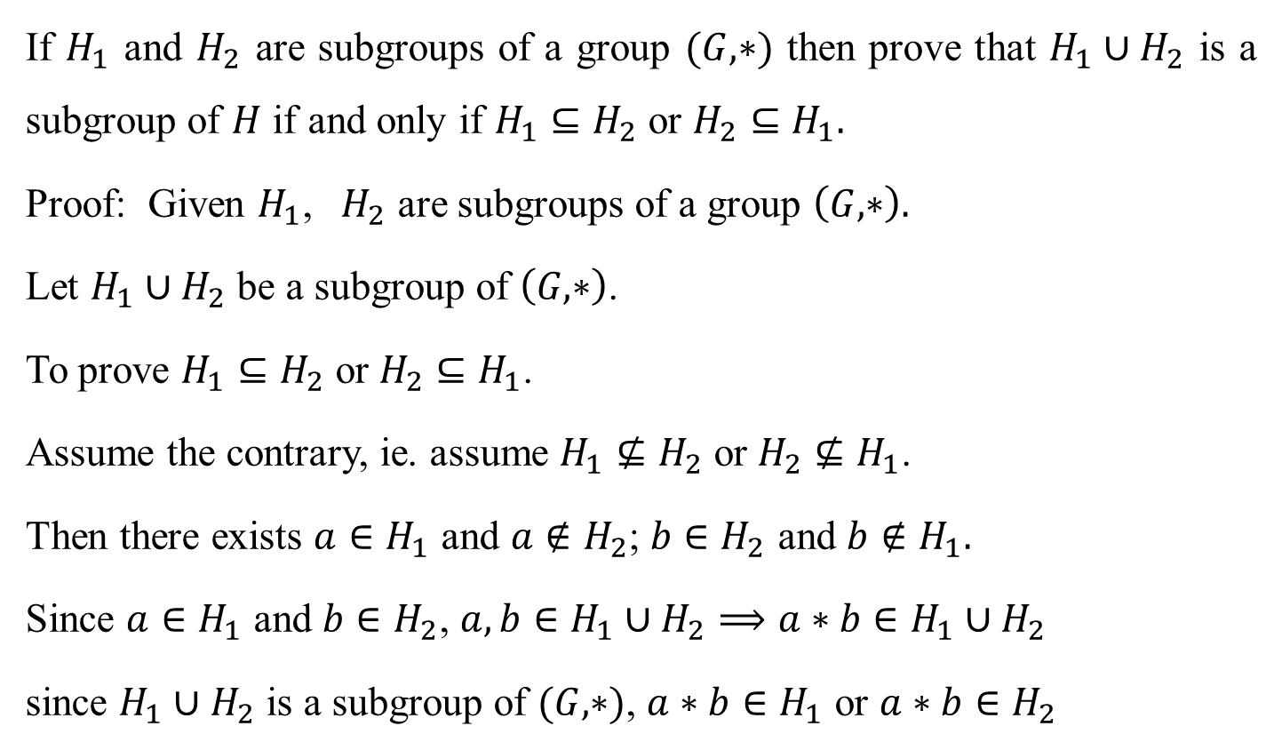
Theorem
If $H_{1}$ and $H_{2}$ are subgroups of a group $(G,∗)$ then prove that $H_{1}∪H_{2}$ is a subgroup of $H$ if and only if $H_{1}⊆H_{2}$ or $H_{2}⊆H_{1}.$
Proof: Given $H_{1}$, $H_{2}$ are subgroups of a group $\left(G,∗\right).$
Let $H_{1}∪H_{2}$ be a subgroup of $\left(G,∗\right)$.
To prove $H_{1}⊆H_{2}$ or $H_{2}⊆H_{1}$.
Assume the contrary, ie. assume $H_{1}{⊈H}_{2}$ or $H_{2}⊈H_{1}$.
Then there exists $a∈H_{1}$ and $a∉H_{2}$; $b∈H_{2}$ and $b∉H_{1}.$
Since $a∈H_{1}$ and $b∈H_{2}$, $a,b∈H_{1}∪H_{2}⟹a∗b∈H_{1}∪H_{2}$
since $H_{1}∪H_{2}$ is a subgroup of $(G,∗)$, $a∗b∈H_{1}$ or $a∗b∈H_{2}$

Slide 11

Theorem
Case (i): Let $a∗b∈H_{1},$
since $a∈H_{1}, a^{−1}∈H_{1}$
$∴a^{−1}∗\left(a∗b\right)∈H_{1},$as $H_{1}$ is a subgroup.
$$⟹\left(a^{−1}∗a\right)∗b∈H_{1}$$
$$⇒e∗b∈H_{1}$$
$⇒b∈H_{1}$, which contradicts the assumption $b∉H_{1}.$

Slide 12
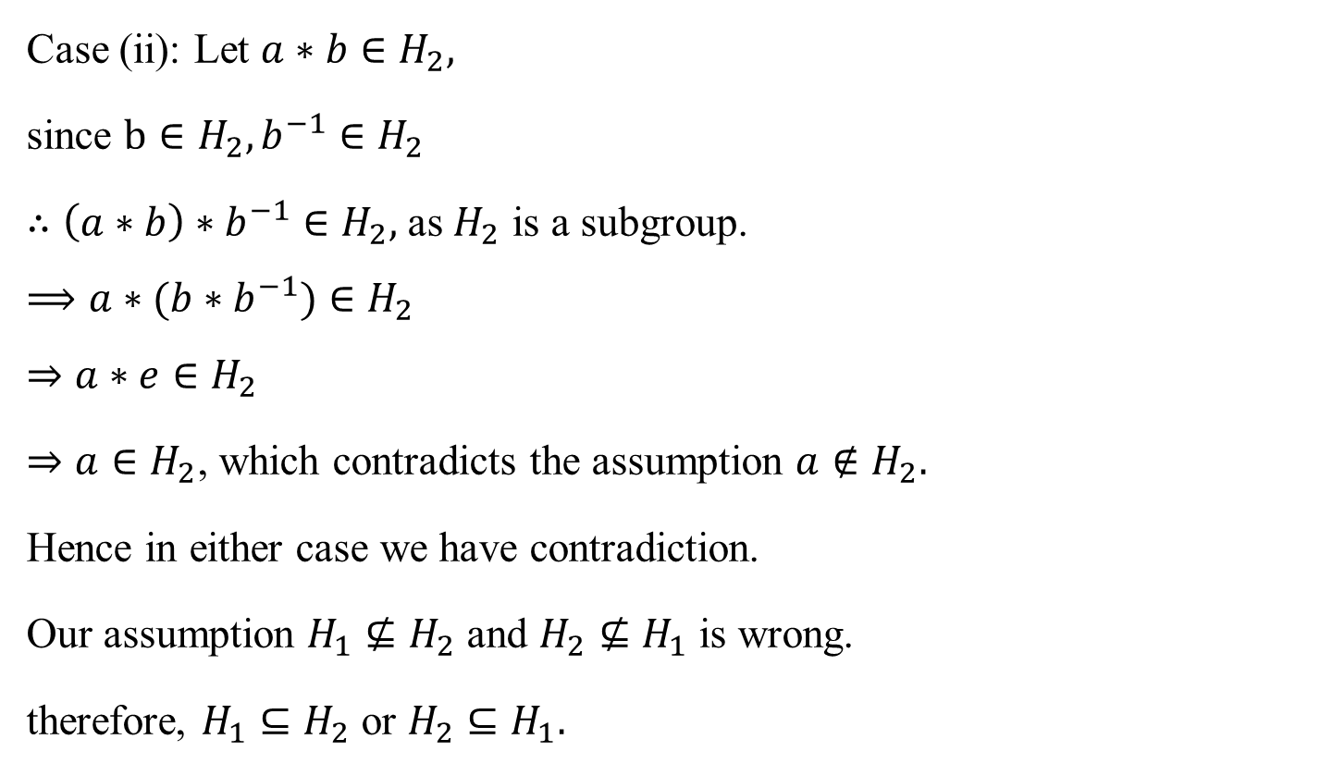
Theorem
Case (ii): Let $a∗b∈H_{2},$
since $b∈H_{2}, b^{−1}∈H_{2}$
$∴\left(a∗b\right)∗b^{−1}∈H_{2},$as $H_{2}$ is a subgroup.
$$⟹a∗(b∗b^{−1})∈H_{2}$$
$$⇒a∗e∈H_{2}$$
$⇒a∈H_{2}$, which contradicts the assumption $a∉H_{2}.$
Hence in either case we have contradiction.
Our assumption $H_{1}{⊈H}_{2}$ and $H_{2}⊈H_{1}$ is wrong.
therefore, $H_{1}⊆H_{2}$ or $H_{2}⊆H_{1}.$

Slide 13

Theorem
Conversely, let $H_{1}⊆H_{2}$ or $H_{2}⊆H_{1}$
To prove $H_{1}⋃H_{2}$ is a subgroup.
If $H_{1}⊆H_{2}$ then $H_{1}⋃H_{2}=H_{2}$
$∴H_{1}⋃H_{2}$ is a subgroup.
If $H_{2}⊆H_{1}$ then $H_{1}⋃H_{2}=H_{1}$
$∴H_{1}⋃H_{2}$ is a subgroup.
Thus $H_{1}⋃H_{2}$ is a subgroup of $\left(G,∗\right).$

Slide 14
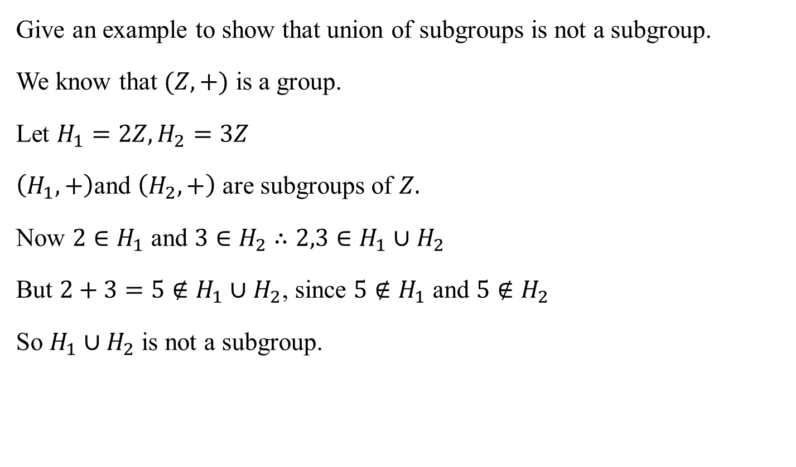
Example
Give an example to show that union of subgroups is not a subgroup.
We know that $(Z,+)$ is a group.
Let $H_{1}=2Z, H_{2}=3Z$
$\left(H_{1},+\right)$and $\left(H_{2},+\right)$ are subgroups of $Z.$
Now $2∈H_{1}$ and $3∈H_{2}$ $∴2,3∈H_{1}∪H_{2}$
But $2+3=5∉H_{1}∪H_{2}$, since $5∉H_{1}$ and $5∉H_{2}$
So $H_{1}∪H_{2}$ is not a subgroup.

Slide 15
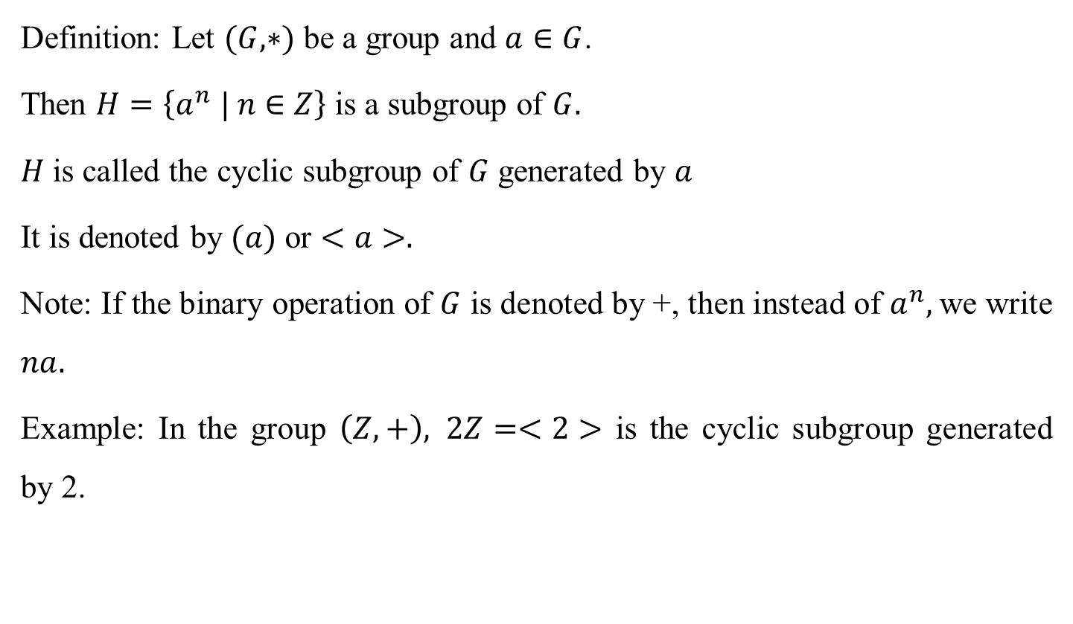
Cyclic subgroup
Definition: Let $(G,∗)$ be a group and $a∈G$.
Then $H=\left\{a^{n} | n∈Z\right\}$ is a subgroup of $G.$
$H$is called the cyclic subgroup of $G$ generated by $a$
It is denoted by $(a)$ or $<a>.$
Note: If the binary operation of $G$ is denoted by +, then instead of $a^{n},$we write $na.$
Example: In the group $\left(Z,+\right), 2Z=<2>$ is the cyclic subgroup generated by 2.

Slide 16
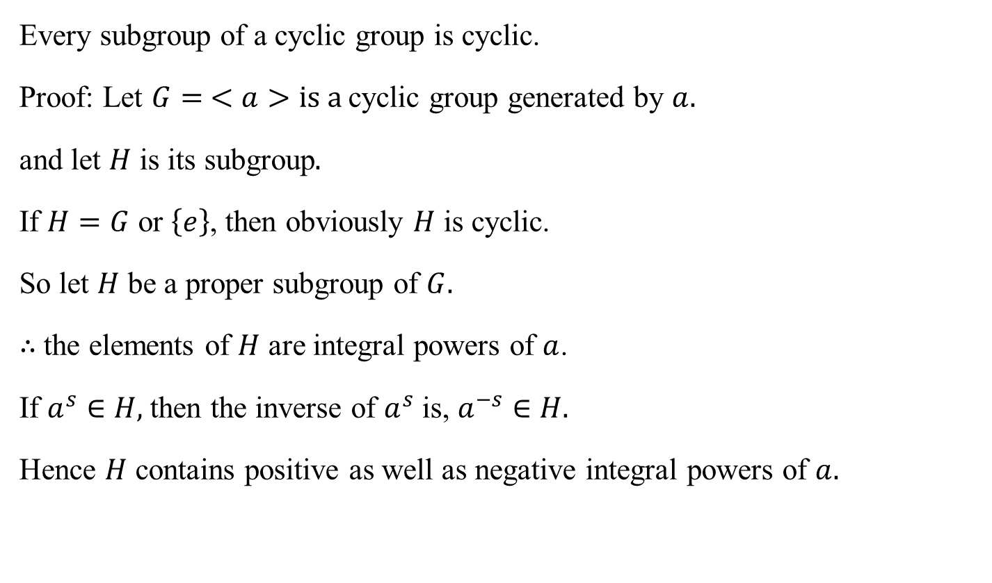
Theorem
Every subgroup of a cyclic group is cyclic.
Proof: Let $G= <a>is a$cyclic group generated by $a.$
and let $H$ is its subgroup$.$
If $H=G$ or $\left\{e\right\}$, then obviously $H$ is cyclic.
So let $H$ be a proper subgroup of $G.$
$∴$the elements of $H$ are integral powers of $a$.
If $a^{s}∈H,$then the inverse of $a^{s}$ is, $a^{−s}∈H.$
Hence $H$ contains positive as well as negative integral powers of $a.$

Slide 17
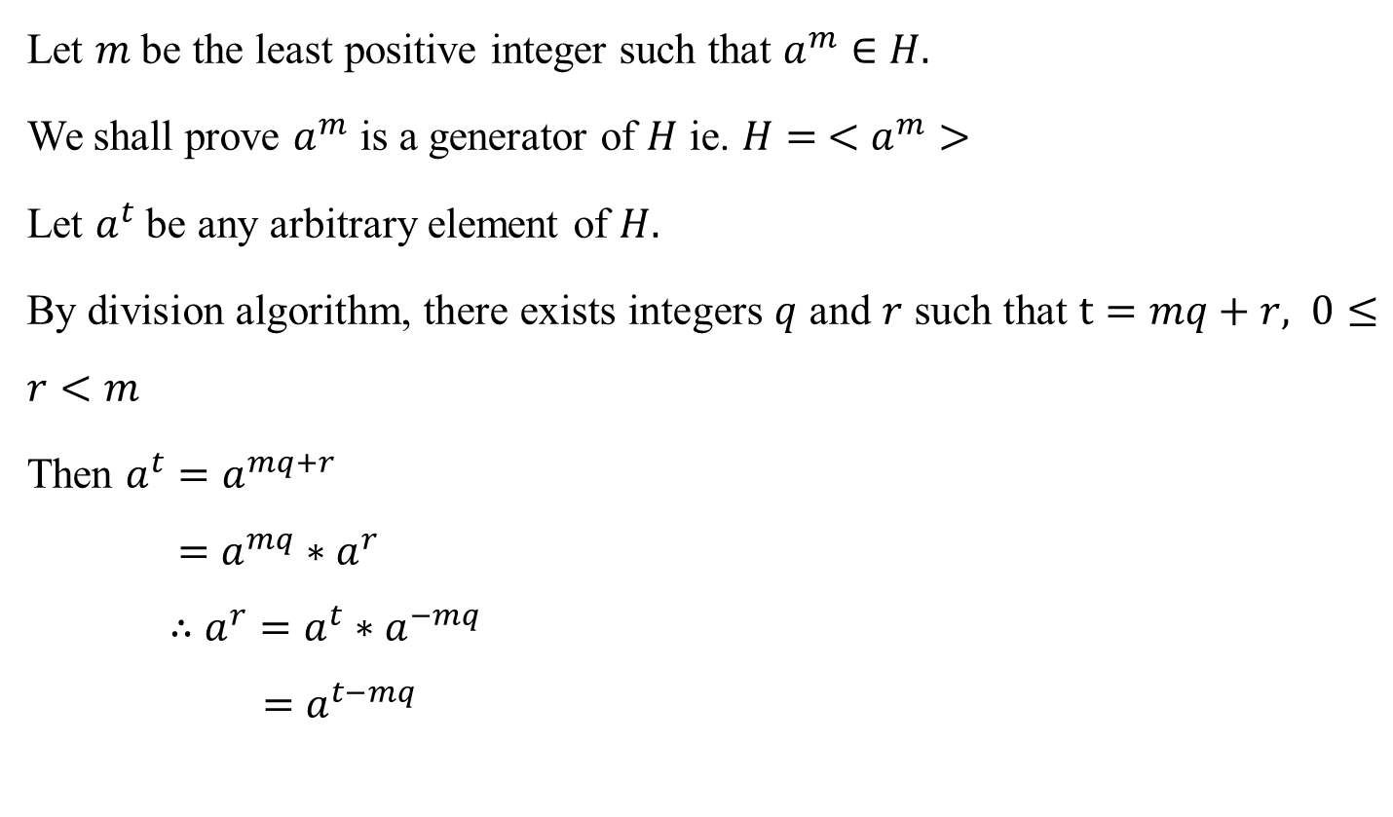
Theorem
Let $m$ be the least positive integer such that $a^{m}∈H.$
We shall prove $a^{m}$ is a generator of $H$ ie. $H= <a^{m}>$
Let $a^{t}$ be any arbitrary element of $H.$
By division algorithm, there exists integers $q$ and $r$ such that $t=mq+r, 0≤r<m$
Then $a^{t}=a^{mq+r}$
$$=a^{mq}∗a^{r}$$
$$∴a^{r}=a^{t}∗a^{−mq}$$
$$=a^{t−mq}$$

Slide 18
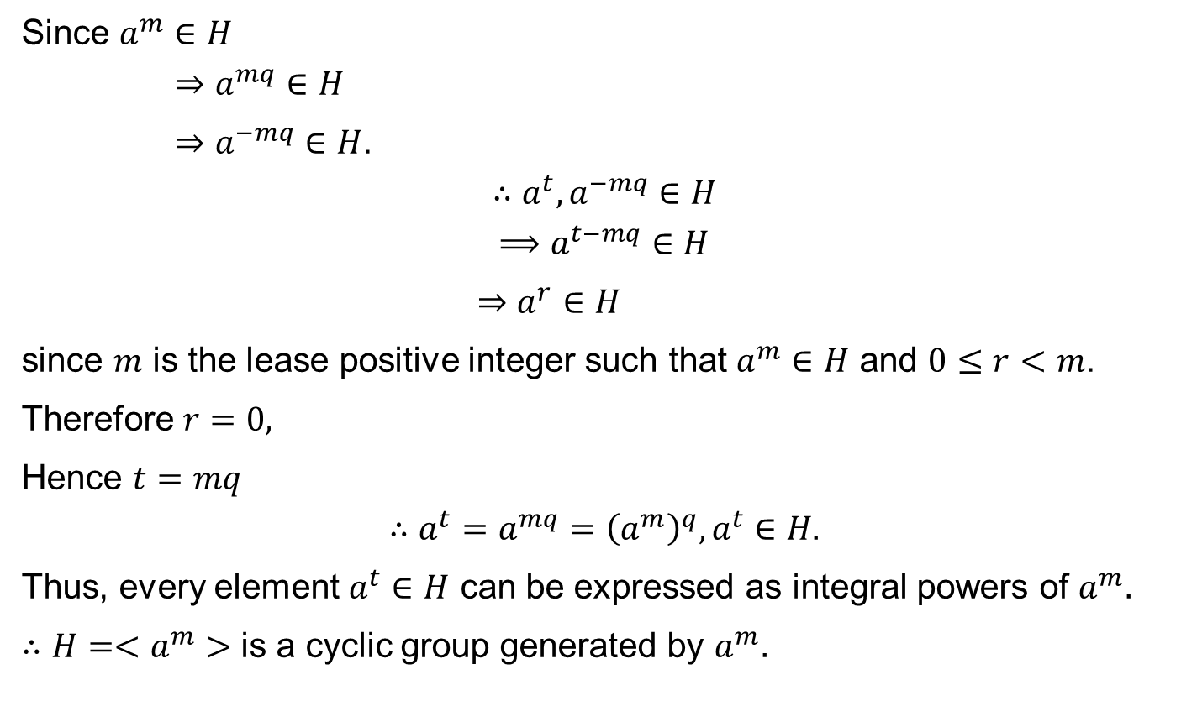
Theorem
Since $a^{m}∈H$
$$⇒a^{mq}∈H$$
$⇒a^{−mq}∈H$.
$$∴a^{t},a^{−mq}∈H$$
$$⟹a^{t−mq}∈H$$
$⇒a^{r}∈H$
since $m$ is the lease positive integer such that $a^{m}∈H$ and $0≤r<m$.
Therefore $r=0,$
Hence $t=mq$
$$∴a^{t}=a^{mq}={\left(a^{m}\right)}^{q}, a^{t}∈H.$$
Thus, every element $a^{t}∈H$ can be expressed as integral powers of $a^{m}.$
$∴H=<a^{m}>$ is a cyclic group generated by $a^{m}.$

Slide 19
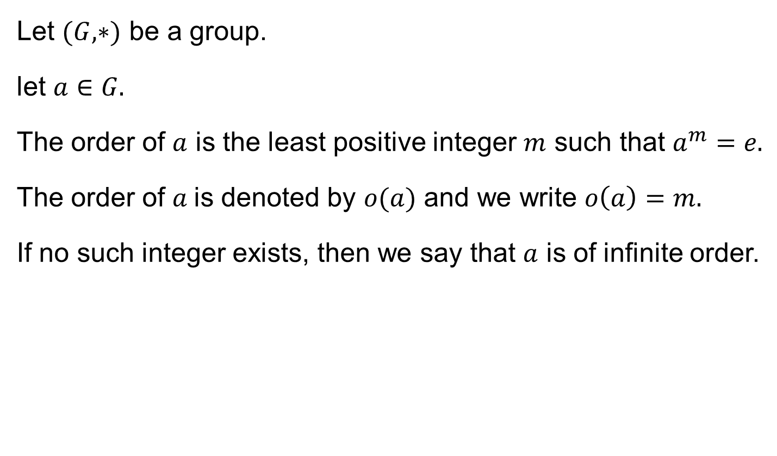
Order of an element
Let $(G,∗)$ be a group.
let $a∈G.$
The order of $a$ is the least positive integer $m$ such that $a^{m}=e.$
The order of $a$is denoted by $o(a)$ and we write $o\left(a\right)=m.$
If no such integer exists, then we say that $a$ is of infinite order.

Slide 20
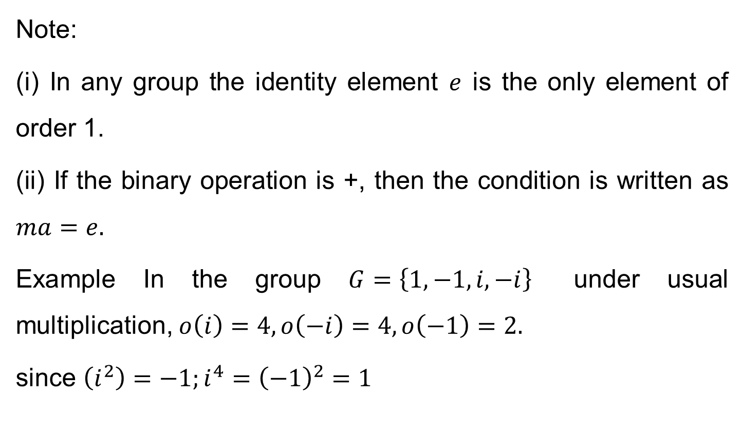
Order of an element
Note:
(i) In any group the identity element $e$ is the only element of order 1.
(ii) If the binary operation is +, then the condition is written as $ma=e.$
Example In the group $G=\left\{1, −1, i, −i\right\}$ under usual multiplication, $o\left(i\right)=4,o\left(−i\right)=4, o\left(−1\right)=2.$
since $\left(i^{2}\right)=−1;i^{4}={\left(−1\right)}^{2}=1$

Slide 21
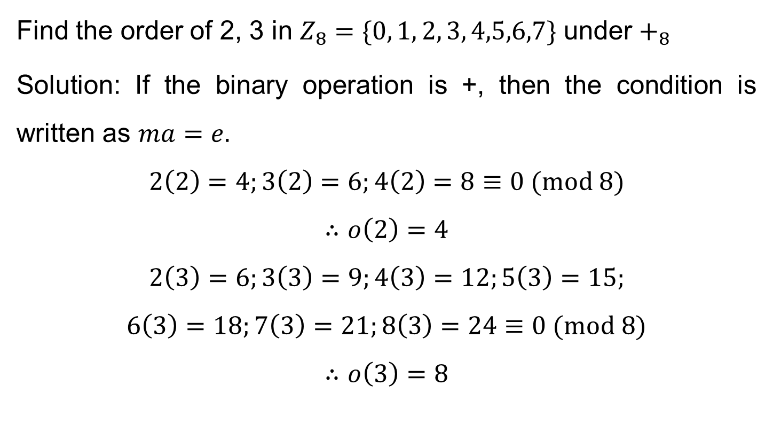
Order of an element
Find the order of 2, 3 in $Z_{8}=\{0, 1, 2, 3, 4,5,6,7\}$ under $+_{8}$
Solution: If the binary operation is +, then the condition is written as $ma=e.$
$$2\left(2\right)=4;3\left(2\right)=6;4\left(2\right)=8≡0 (mod 8)$$
$$∴o\left(2\right)=4$$
$$2\left(3\right)=6;3\left(3\right)=9;4\left(3\right)=12;5\left(3\right)=15;$$
$$6\left(3\right)=18;7\left(3\right)=21;8\left(3\right)=24≡0 (mod 8)$$
$$∴o\left(3\right)=8$$

