Slide 1
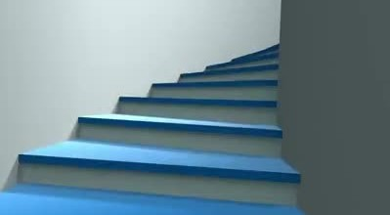


STAIR CHAIR
- Live Without Limits
Mentors :
Mr. B. Satya Krishna,
Asst. Professor,
Dept. of Mechanical Engg.
Mrs. P. Lavanya,
Asst. Professor,
Dept. of Civil Engg.
Team Members :
K.B.S.S.S. Koulini (ECE)
G. L. Sowjanya (EEE)
G. Sai Navya (ECE)
Y. Ravali (CSE)

Slide 2
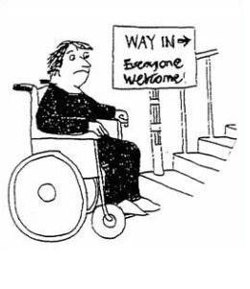
Motivation
Objectives
At present, wheelchairs moving on plain roads are more prevalent. But it fails in case of staircase climbing. Hence, an enhanced version “STAIR CHAIR” could help to overcome such cases.
To modify the conventional wheel chair by replacing the regular wheels with tri-star wheels
To design it to operate in two different modes :
Plain Path
Stair cases and irregular surfaces

Slide 3
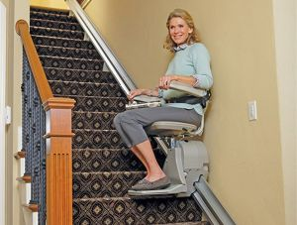
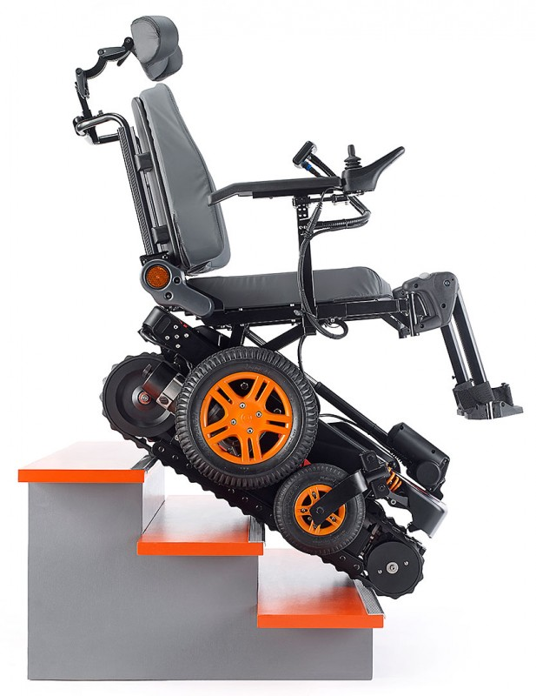
Market Study
Model : Chair Lift
Cost : Between $2500-$4000
Model : Top Chair S-52
Cost : 19,500 €

Slide 4

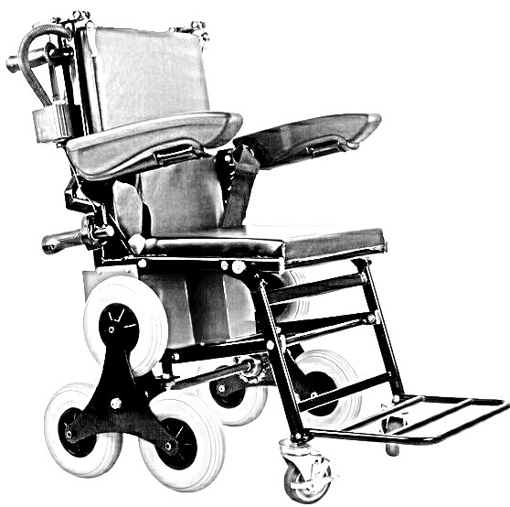
Problem Identification
Proposed Solution
High technology involved
Needs separate railing & not available in public places
Requires a person’s assistance
Highly expensive

Slide 5
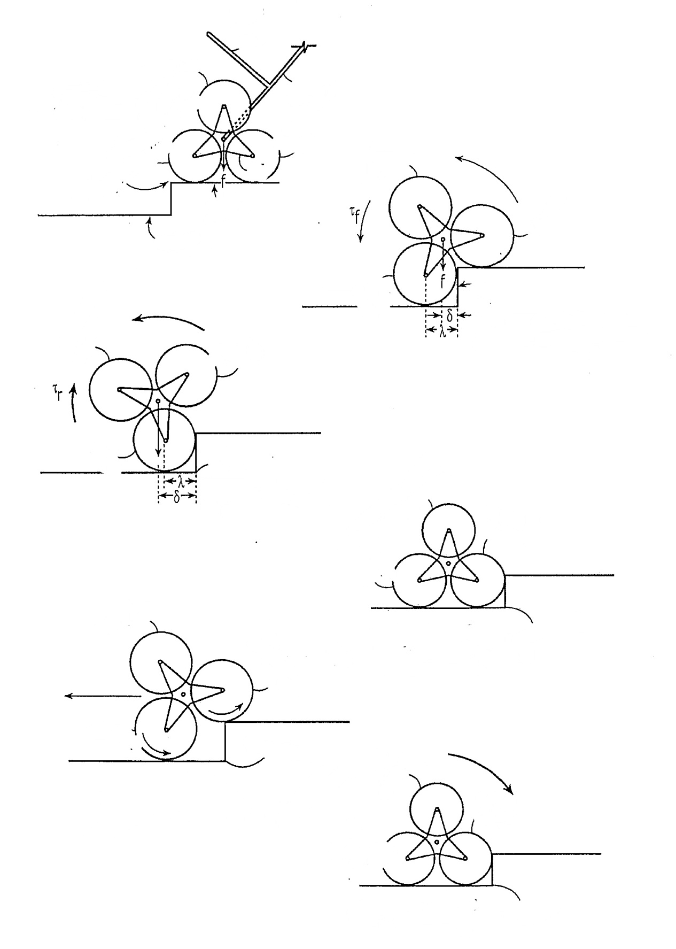
W
O
R
K
I
N
G

