Slide 1
DATA SCIENCE PROJECT / FINAL PRESENTATION
DEEP LEARNING-BASED
IMAGE CLASSIFICATION ON CIFAR-10
A comparative study of Baseline CNN, Mixup, and CutMix augmentation
Student: [Your Name]
Course: Data Science Project
Institution: [Your Institution]
Best test accuracy
81.48% with Mixup
October 2026
Notes:
Title slide. Replace all bracketed text. Use the full project title, list every team member with registration number, and name your guide. Insert the institution logo in the dashed box.

Slide 2



01 / CONTEXT
Introduction & Problem Statement
Background
Problem
Motivation
Image classification is a core computer-vision task. CIFAR-10 provides a compact benchmark for testing how CNNs learn visual patterns from small RGB images.
CNNs can overfit training data. The project tests whether research-backed augmentation can improve generalization without changing the model architecture.
A fair comparison helps identify which technique gives the best balance of accuracy, loss, training cost, and practical usefulness.
- Research question: Do Mixup and CutMix improve test performance over a standard CNN?
- Success criterion: compare all models on the same held-out CIFAR-10 test set.
- Practical outcome: expose individual test predictions through an interactive local website.
CIFAR-10 CNN COMPARATIVE STUDY
02
Notes:
State the domain, the exact problem and why it matters. Keep it to about 2 minutes. Add one real-world statistic if you can, with a citation.

Slide 3


02 / GOALS
Objectives & Scope
Build
Augment
Implement a baseline CNN for 10-class CIFAR-10 classification.
Implement Mixup and CutMix as on-the-fly training transformations.
Evaluate
Explain
Compare accuracy, loss, precision, recall, F1-score, and training time.
Analyze class-level errors and expose predictions in a browser demo.
Scope: one CNN architecture, 50 epochs, fixed seed 42, one alpha value per augmentation.
CIFAR-10 CNN COMPARATIVE STUDY
03
Notes:
Objectives should be measurable and start with action verbs. The scope slide tells the panel what you did and did not attempt.

Slide 4

03 / PRIOR WORK
Literature Survey & Research Gap
S.No | Author(s) & Year | Method / Technique | Key Findings | Limitation / Gap
1 | [Author, Year] | [Method used] | [Main result] | [Gap or limitation]
2 | [Author, Year] | [Method used] | [Main result] | [Gap or limitation]
3 | [Author, Year] | [Method used] | [Main result] | [Gap or limitation]
4 | [Author, Year] | [Method used] | [Main result] | [Gap or limitation]
Mixup / Zhang et al. (2017)
CutMix / Yun et al. (2019)
Research Gap
Creates virtual samples by interpolating two images and their labels. It encourages smoother decision boundaries and acts as a regularizer.
Pastes a patch from one image into another and mixes labels according to the visible area. It encourages local feature reasoning.
The techniques can behave differently on small 32x32 images and simple CNNs. This project measures their effect under a controlled local experiment.
Contribution: an end-to-end, reproducible comparison plus an interactive test-set prediction explorer.
CIFAR-10 CNN COMPARATIVE STUDY
04
Notes:
Summarise four to six relevant papers or existing systems. End with the research gap, because that gap justifies your project.

Slide 5





04 / PIPELINE
Proposed System & Methodology
1
Define
2
Prepare
3
Build
4
Augment
5
Evaluate
Question, scope, metrics
Load and normalize CIFAR-10
Shared CNN architecture
Mixup and CutMix batches
Test metrics and demo
Key novelty
Outputs
The comparison keeps the architecture and core training conditions consistent, isolating the effect of augmentation.
Saved .h5 models, JSON metrics, training plots, confusion matrices, and a local prediction website.
CIFAR-10 CNN COMPARATIVE STUDY
05
Notes:
Walk through the five steps left to right. Rename the steps to match your project (for example, Requirement Analysis, Design, Coding, Testing, Deployment). End with your novelty.

Slide 6
05 / MODEL
System Architecture
32x32x3
RGB image
Conv blocks
32 -> 64 -> 128
Flatten +
Dense 512
Softmax
10 classes
Regularization
Training
Output
Dropout 0.25 after each convolutional block and Dropout 0.5 before the output layer.
Adam optimizer, categorical cross-entropy, batch size 64, 50 epochs, 1,341,226 parameters.
A probability distribution over airplane, automobile, bird, cat, deer, dog, frog, horse, ship, and truck.
CIFAR-10 CNN COMPARATIVE STUDY
06
Notes:
Insert a clear block diagram: input, processing, storage, output. Number each block and explain them on the right. Redraw the figure yourself rather than copying it.

Slide 7


06 / ENVIRONMENT
Hardware & Software Requirements
Hardware
Software
Tools & Deployment
CPU training environment
Intel Core i9-14900HX
32 GB RAM
NVIDIA RTX 4070 available but not used for TensorFlow training on Windows
Training time: about 16-17 minutes per model
Windows environment
Python 3.14 environment
TensorFlow 2.22.0-rc0
Keras API
NumPy 2.5.4
scikit-learn 1.9.1
Matplotlib and Seaborn for plots
Jupyter for exploration
Saved H5 models and JSON metrics
Local Python web server at 127.0.0.1:8000
CIFAR-10 CNN COMPARATIVE STUDY
07
Notes:
List only what you actually used, with versions. For a pure software project, shorten the hardware list and add cloud or deployment resources.

Slide 8
07 / DATA
Dataset & Data Understanding
60,000
50,000
10,000
10
RGB images
training images
test images
target classes
Classes
Data quality
Airplane, automobile, bird, cat, deer, dog, frog, horse, ship, truck. Each test class contributes 1,000 images.
Balanced class distribution, no missing values, 32x32 pixel RGB format, and normalized values in the [0, 1] range.
The test set remained untouched during training and was used for final comparison.
CIFAR-10 CNN COMPARATIVE STUDY
08
Notes:
Explain where the data came from and what it contains. Show a screenshot of the first rows or the info summary. For non-data projects, replace this slide with “Requirement Analysis” or “Input Specification”.

Slide 9
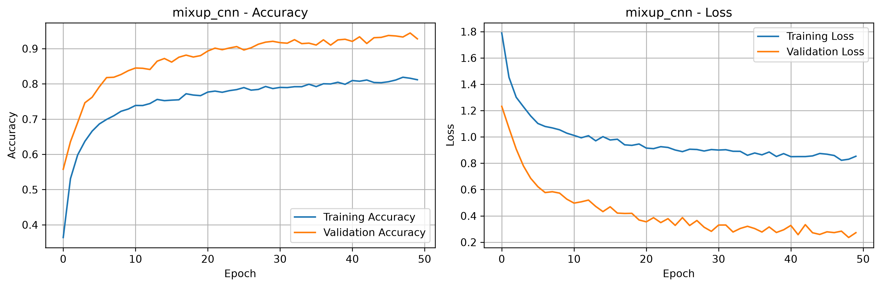



08 / PREPROCESSING
Data Preprocessing & Exploratory Analysis
Loading
CIFAR-10 batch files are read from the extracted dataset and reshaped from channel-first storage to 32x32x3 images.
Normalization
Each pixel is divided by 255 so model inputs lie between 0 and 1.
Labels
Integer class labels are converted to one-hot vectors for categorical cross-entropy.
CIFAR-10 CNN COMPARATIVE STUDY
09
Notes:
Show two or three plots that tell a story: distributions, correlations, outliers. Explain what each plot told you and what you did about it.

Slide 10
09 / IMPLEMENTATION
Module-wise Description
Data utilities
Baseline CNN
Mixup CNN
Load, normalize, encode labels, and create the shared CNN.
Train the reference model without synthetic augmentation.
Mix image and label pairs on every training batch.
CutMix CNN
Evaluation + web app
Replace image patches and adjust labels by area.
Save metrics, plots, models, and serve random test predictions.
CIFAR-10 CNN COMPARATIVE STUDY
10
Notes:
Divide the project into three to five modules. For each, state its purpose, inputs, outputs and who built it. Duplicate a card if you have more modules.

Slide 11

10 / TECHNIQUES
Algorithms & Technologies Used
CNN classifier
Mixup
CutMix
Chosen because convolutions learn local edges, textures, and object patterns directly from images.
Key setting: 3 convolutional blocks with increasing filter counts.
Chosen to regularize the model through smooth interpolation.
Key setting: alpha = 0.2, applied per training batch.
Chosen to test localized feature learning by hiding and replacing image regions.
Key setting: alpha = 1.0, area-adjusted labels.
Selection criterion: maximize held-out test accuracy while keeping the architecture and evaluation protocol consistent.
CIFAR-10 CNN COMPARATIVE STUDY
11
Notes:
Name each model, algorithm or technology, say why you chose it, and list the key settings. Then explain how you picked the final one.

Slide 12
11 / TRAINING
Implementation & Model Building
Pipeline
Mixup equation
CutMix equation
1. Load 50,000 training and 10,000 test images
2. Normalize pixels
3. One-hot encode labels
4. Shuffle training batches
5. Apply augmentation
6. Train with Adam
7. Evaluate on held-out test set
x_mix = lambda*x_i + (1-lambda)*x_j
y_mix = lambda*y_i + (1-lambda)*y_j
lambda sampled from Beta(alpha, alpha), alpha = 0.2
A patch from image j replaces part of image i.
y_mix = lambda*y_i + (1-lambda)*y_j
lambda is corrected using the actual retained image area.
CIFAR-10 CNN COMPARATIVE STUDY
12
Notes:
Describe the build in the order you did it. Paste only the most important code or pseudocode, not entire files. For hardware projects, show the circuit or wiring summary instead.

Slide 13
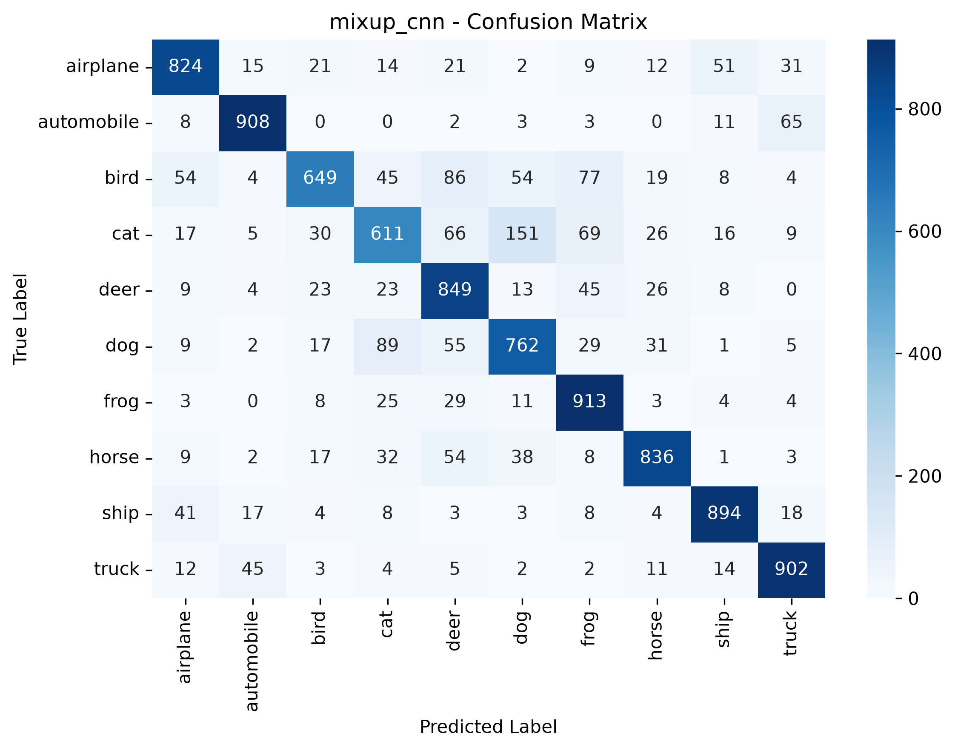
12 / DEMO
Working Prototype & Output Screens
Interactive explorer
How to launch
The local website randomly selects one of 10,000 test images and displays:
- true label
- predicted label
- correct / incorrect status
- confidence
- top three predictions
python web_app.py
Open:
http://127.0.0.1:8000
Images appear pixelated when enlarged because CIFAR-10 images are only 32x32 pixels.
CIFAR-10 CNN COMPARATIVE STUDY
13
Notes:
Show real screenshots, photos of the hardware or a short demo video link. Caption each one with what the viewer should notice.

Slide 14
13 / RESULTS
Results & Performance Comparison
Metric | Model A | Model B | Model C
Accuracy | 0.00 | 0.00 | 0.00
Precision | 0.00 | 0.00 | 0.00
Recall | 0.00 | 0.00 | 0.00
F1-score | 0.00 | 0.00 | 0.00
ROC-AUC | 0.00 | 0.00 | 0.00
Model | Test acc. | Test loss | Time | Val acc.
Baseline | 79.24% | 0.6993 | 1015 s | 81.10%
Mixup | 81.48% | 0.5780 | 963 s | 92.78%
CutMix | 80.30% | 0.5952 | 1031 s | 89.20%
Best result: Mixup reached 81.48% test accuracy and reduced test loss to 0.5780.
CIFAR-10 CNN COMPARATIVE STUDY
14
Notes:
Right-click the chart and choose Edit Data to enter your real numbers. Replace the metrics with the ones that fit your project (accuracy, latency, power, throughput, user rating). State clearly which option performed best.

Slide 15
14 / INTERPRETATION
Analysis & Key Findings
Mixup wins
CutMix helps
+2.24 percentage points over baseline. Lowest test loss and highest validation accuracy.
+1.06 percentage points over baseline, but trails Mixup.
Hard classes
Cats, dogs, and birds remain challenging because their visual patterns overlap at 32x32 resolution.
Strong classes
Automobiles, ships, trucks, and frogs produced the strongest F1-scores across models.
CIFAR-10 CNN COMPARATIVE STUDY
15
Notes:
Explain what the numbers mean. Use a confusion matrix, ROC curve, feature-importance chart or output comparison. Be honest about weak results; panels value that.

Slide 16

15 / VERIFICATION
Testing & Validation
Test ID | Test Description | Expected Result | Actual Result | Status
TC-01 | [What is tested] | [Expected output] | [Observed output] | [Pass / Fail]
TC-02 | [What is tested] | [Expected output] | [Observed output] | [Pass / Fail]
TC-03 | [What is tested] | [Expected output] | [Observed output] | [Pass / Fail]
TC-04 | [What is tested] | [Expected output] | [Observed output] | [Pass / Fail]
Installation test
Model evaluation
Interactive validation
test_installation.py verified TensorFlow, NumPy, Matplotlib, scikit-learn, Seaborn, and all local modules.
Result: 3/3 tests passed.
evaluate_mixup.py loaded the saved model and evaluated all 10,000 test images.
Observed Mixup accuracy: 81.48%.
web_app.py loads the same saved model, selects a random test sample, encodes it for the browser, and returns prediction details.
Validation principle: use real held-out data and real model outputs, not mocked predictions.
CIFAR-10 CNN COMPARATIVE STUDY
16
Notes:
List representative test cases with expected and actual outcomes. Name the validation methods you used. Delete rows you do not need.

Slide 17


16 / REFLECTION
Challenges & Limitations
Challenges faced
How addressed
Limitations
Small 32x32 images make fine-grained recognition difficult.
Windows TensorFlow did not use the available NVIDIA GPU.
A hardcoded path in the installation test initially broke local imports.
Normalized data consistently.
Kept architecture and core settings aligned.
Replaced hardcoded paths with workspace-relative paths.
Added a direct evaluation script and web demo.
Only one alpha value per method.
No early stopping or learning-rate schedule.
Simple CNN without batch normalization or residual blocks.
One main seed and training configuration.
CIFAR-10 CNN COMPARATIVE STUDY
17
Notes:
Be candid. Pair every challenge with how you solved it, and list limitations that the panel would otherwise spot themselves.

Slide 18

17 / OUTCOME
Conclusion
81.48%
- The baseline CNN achieved 79.24% test accuracy.
- Mixup achieved the best result at 81.48%, improving the baseline by 2.24 points.
- CutMix achieved 80.30%, improving the baseline by 1.06 points.
- The project met its goals: implementation, fair comparison, evaluation, and an interactive prediction demo.
- Augmentation improved generalization without changing the CNN architecture.
Best test accuracy: Mixup
Main takeaway: Mixup was the strongest method in this experiment.
CIFAR-10 CNN COMPARATIVE STUDY
18
Notes:
Revisit each objective and say whether you met it. Quote your headline result with numbers. Do not introduce new material here.

Slide 19



18 / NEXT STEPS
Future Scope & Applications
Improve performance
Expand analysis
Applications
Tune alpha values, add learning-rate schedules, batch normalization, early stopping, and stronger CNN backbones such as ResNet or WideResNet.
Run multiple seeds, report mean and standard deviation, evaluate CIFAR-10-C corruptions, and add saliency or Grad-CAM explanations.
Educational model inspection, classroom demonstrations, augmentation research, and a foundation for a larger computer-vision dashboard or API.
CIFAR-10 CNN COMPARATIVE STUDY
19
Notes:
Give concrete next steps, ideally tied to the limitations. Then name two or three real-world uses.

Slide 20
19 / CONTRIBUTIONS
Team Contribution
Replace the placeholders below with your actual team members and registration numbers.
Reg. No. | Name | Contribution / Modules Handled
[Reg. No.] | [Member 1] | [Modules, tasks and report sections]
[Reg. No.] | [Member 2] | [Modules, tasks and report sections]
[Reg. No.] | [Member 3] | [Modules, tasks and report sections]
[Reg. No.] | [Member 4] | [Modules, tasks and report sections]
Member | Contribution
[Name / Reg. No.] | Dataset preparation, baseline CNN, documentation
[Name / Reg. No.] | Mixup and CutMix implementation, training
[Name / Reg. No.] | Evaluation, visualizations, and interactive website
CIFAR-10 CNN COMPARATIVE STUDY
20
Notes:
Show that work was planned and shared. Every member should be able to explain their own module.

Slide 21

20 / SOURCES
References & Project Links
- 1. Zhang et al. (2017), “mixup: Beyond Empirical Risk Minimization,” arXiv:1710.09412.
- 2. Yun et al. (2019), “CutMix: Regularization Strategy to Train Strong Classifiers with Localizable Features,” ICCV.
- 3. Krizhevsky & Hinton (2009), “Learning Multiple Layers of Features from Tiny Images.”
- 4. Abadi et al. (2016), “TensorFlow: A System for Large-Scale Machine Learning.”
Dataset
Project artifacts
CIFAR-10: https://www.cs.toronto.edu/~kriz/cifar.html
Source code, saved models, metrics, plots, and web demo are included in the project workspace.
CIFAR-10 CNN COMPARATIVE STUDY
21
Notes:
Use IEEE style, numbered in order of first citation in the deck. Include datasets, documentation and code repositories.

Slide 22
DEEP LEARNING-BASED IMAGE CLASSIFICATION ON CIFAR-10
THANK YOU
Questions & Discussion
Baseline: 79.24% | Mixup: 81.48% | CutMix: 80.30%
Student: [Your Name] | Guide: [Guide Name] | [Institution]
Notes:
Leave this slide up during questions. Make sure every team member can answer questions about their own module.

