Slide 1
Deep Learning-Based Image Classification on CIFAR-10
[Institution / department logo]
Final Project Review - CSE – KLH UNIVERSITY BACHUPALLY
TEAM MEMBERS
2420030096 – D. Sanjay Ram Reddy
2420030345 – Ch. Sri Krishna Vardhan
2420030392 – Yashwanth
Guide: N. Sunanda | Academic Year: 2026–2027
Notes:
Title slide. Replace all bracketed text. Use the full project title, list every team member with registration number, and name your guide. Insert the institution logo in the dashed box.

Slide 2



Introduction & Problem Statement
Background
CIFAR-10 is a standard computer-vision dataset containing 60,000 small RGB images from 10 object classes.
Problem Statement
CNNs can perform well on training data but may overfit and generalize poorly to unseen images.
Motivation / Need
This project investigates whether Mixup and CutMix augmentation can improve CNN generalization without changing the model architecture.
Notes:
State the domain, the exact problem and why it matters. Keep it to about 2 minutes. Add one real-world statistic if you can, with a citation.

Slide 3


Objectives & Scope
Objectives
Scope
The project focuses on CIFAR-10 classification using TensorFlow/Keras and a common CNN architecture.
1
Objective 1 – Build a baseline CNN for CIFAR-10 classification.
2
Objective 2 –Implement Mixup and CutMix data augmentation.
3
Objective 3 - Compare accuracy, loss, F1-score, and training time.
4
Objective 4 - Build an interactive website to inspect individual predictions.
Notes:
Objectives should be measurable and start with action verbs. The scope slide tells the panel what you did and did not attempt.

Slide 4

Literature Survey
S.No | Author(s) & Year | Method / Technique | Key Findings | Limitation / Gap
1 | Yun et al., 2019 | CutMix augmentation | Replacing image regions and mixing labels improves local feature learning and classification. | Performance depends on patch size, patch location, alpha value, and image resolution.
2 | Zhang et al., 2017 | Mixup augmentation | Interpolating images and labels improves generalization and reduces overfitting. | May produce visually unrealistic blended images and may weaken local spatial structure.
3 | He et al., 2016 | ResNet / residual learning | Skip connections allow deeper CNNs to train more effectively. | Requires a more complex architecture and higher computational cost.
4 | Krizhevsky & Hinton, 2009 | CIFAR-10 image dataset | Introduced a benchmark for evaluating image-classification models on 32 × 32 RGB images. | Low image resolution makes fine-grained classification difficult.
Research Gap
Existing studies demonstrate that Mixup and CutMix can improve image-classification performance, but their results depend on the dataset, image resolution, CNN architecture, and hyperparameters.
This project provides a controlled comparison of Baseline CNN, Mixup, and CutMix on CIFAR-10 using the same CNN architecture, training conditions, and held-out test set. The project also connects aggregate performance metrics with individual predictions through an interactive test-set visualization website.
Notes:
Summarise four to six relevant papers or existing systems. End with the research gap, because that gap justifies your project.

Slide 5





Proposed System & Methodology
STEP 1
STEP 2
STEP 3
STEP 4
STEP 5
Define Problem
Collect Data
Design
Implement
Test & Evaluate
Identify the need, scope and success criteria.
[Source, size and format of data or requirements]
[Architecture, algorithms and tools chosen]
[Modules built, code and integration]
[Metrics, test cases and validation]
Dataset
Preprocessing
CNN
Augmentation
Training
Evaluation
Web Demo
Key Novelty / Contribution
[In one or two sentences, explain what is new or better about your approach compared with existing work.]
Notes:
Walk through the five steps left to right. Rename the steps to match your project (for example, Requirement Analysis, Design, Coding, Testing, Deployment). End with your novelty.

Slide 6


Hardware & Software Requirements
Hardware
Software & Tools
Deployment
Intel Core i9-14900HX processor
32 GB RAM
NVIDIA RTX 4070 available
Training performed on CPU because of Windows TensorFlow limitations
Python
TensorFlow/Keras
NumPy
scikit-learn
Matplotlib
Seaborn
Jupyter Notebook
Local Python web server
Notes:
List only what you actually used, with versions. For a pure software project, shorten the hardware list and add cloud or deployment resources.

Slide 7
System Architecture
[Insert system architecture / block diagram
(Input → Processing → Output)]
Components
1
CIFAR-10 Image
Normalization
2
3
CNN Convolutional Blocks
4
Flatten + Dense Layer
5
Softmax Classifier
6
Predicted CIFAR-10 Class
Notes:
Insert a clear block diagram: input, processing, storage, output. Number each block and explain them on the right. Redraw the figure yourself rather than copying it.

Slide 8
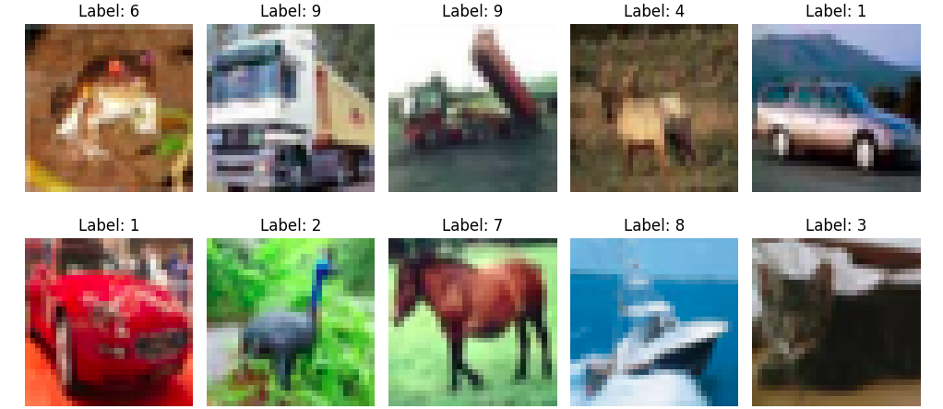
Dataset : CIFAR-10
60,000
50,000
images
Training images
10,000
10
Test images
Classes
Sample images from the CIFAR-10 dataset. Each image is a 32 × 32 RGB image belonging to one of 10 balanced classes
32 x 32
RGB images
1,000 test images per class
Balanced dataset
No missing values
Notes:
Explain where the data came from and what it contains. Show a screenshot of the first rows or the info summary. For non-data projects, replace this slide with “Requirement Analysis” or “Input Specification”.

Slide 9
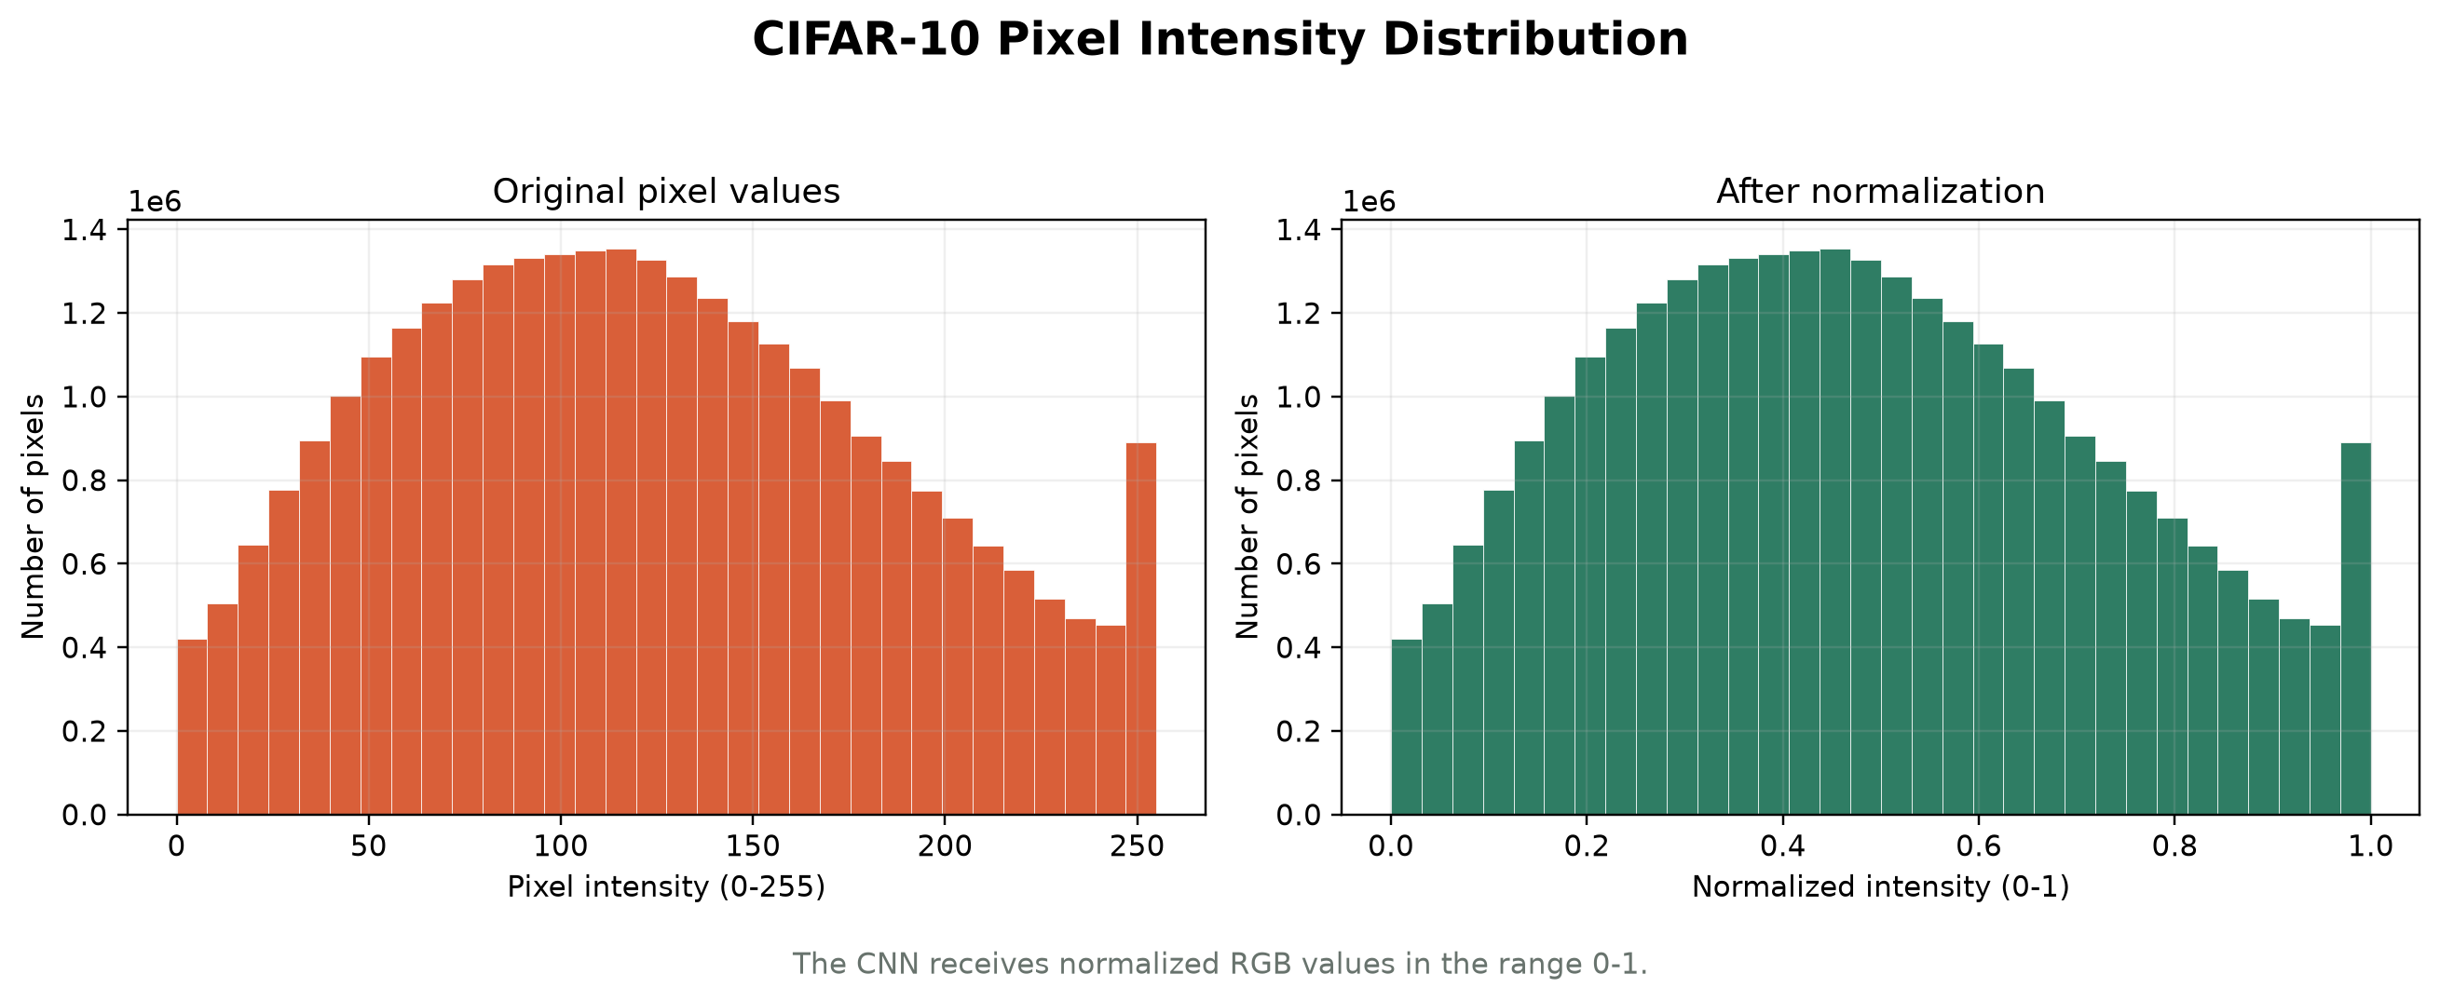
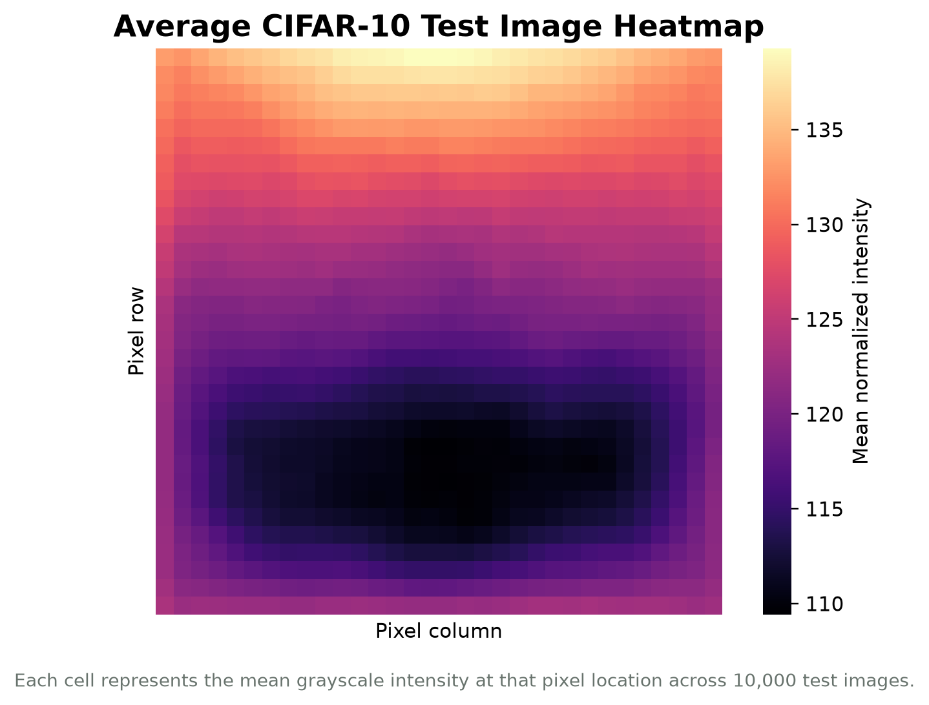



Data Preprocessing & Exploratory Analysis
[Insert feature distribution / histogram]
[Insert correlation heatmap / outlier box-plot]
Cleaning
Transformation
Feature Selection
The dataset contained no missing values or duplicate records.
Images were loaded from the CIFAR-10 batch files and checked for the expected 32 × 32 × 3 shape.
Images were reshaped to 32 × 32 × 3 and normalized from pixel values 0–255 to the range 0–1. Labels were converted to one-hot encoded vectors.
No manual feature selection was performed. The CNN automatically learned visual features from all RGB pixel values using convolutional filters.
Notes:
Show two or three plots that tell a story: distributions, correlations, outliers. Explain what each plot told you and what you did about it.

Slide 10
Module-wise Description
1
Data utilities
2
Baseline CNN:
Purpose: Loads, reshapes, normalizes, and encodes CIFAR-10 data
Developed by: Yashwanth
Purpose: Trains the standard CNN without augmentation.
Developed by: Ch. Sri Krishna Vardhan
3
Mixup CNN:
4
CutMix CNN:
Purpose: Combines images and label pairs during training
Developed by: D. Sanjay Ram Reddy
Purpose: Replaces images patches and adjusts labels based on area
Developed by: Ch. Sri Krishna Vardhan
Notes:
Divide the project into three to five modules. For each, state its purpose, inputs, outputs and who built it. Duplicate a card if you have more modules.

Slide 11
Module-wise Description
1
Evaluation and web app:
Purpose: Calculates metrics and displays random test-set prediction
Developed by: D. Sanjay Ram Reddy
Notes:
Divide the project into three to five modules. For each, state its purpose, inputs, outputs and who built it. Duplicate a card if you have more modules.

Slide 12

Algorithms & Technologies Used
CNN
Mixup
CutMix
Why chosen:
Learns edges, textures, shapes, and object patterns through convolutional filters.
Key parameters
Accuracy : 79.24%
Test Loss : 0.6993
Training Time(s) : 1,015.36
Why chosen
Uses alpha = 0.2 and creates interpolated images and labels
Key parameters
Accuracy : 81.48%
Test Loss : 0.5780
Training Time(s) : 962.97
Why chosen
Uses alpha = 1.0 and replaces rectangular image patches
Key parameters
Accuracy : 80.30%
Test Loss : 0.5952
Training Time(s) : 1,031.16
Selection criteria: Highest held-out test accuracy with comparable training conditions.
Notes:
Name each model, algorithm or technology, say why you chose it, and list the key settings. Then explain how you picked the final one.

Slide 13
Implementation / Model Building
Feature Selection
Preprocessing Pipeline
No manual feature selection was performed.
The CNN receives the complete 32 × 32 × 3 RGB image and learns visual features automatically through convolutional filters.
1. Load CIFAR-10 images from batch files
2. Reshape images to 32 × 32 × 3
3. Normalize pixel values from 0–255 to 0–1
4. Convert labels to one-hot encoded vectors
5. Shuffle training data before each epoch
6. Apply Mixup or CutMix during training
Data Splitting
Configuration
Training set: 50,000 images
Validation set: 10% of the training data
Test set: 10,000 images
The test set was kept separate and used only for final evaluation.
Epochs: 50
Batch size: 64
Optimizer: Adam
Loss: Categorical cross-entropy
Random seed: 42
Mixup alpha: 0.2
CutMix alpha: 1.0
Output classes: 10
Notes:
Describe the build in the order you did it. Paste only the most important code or pseudocode, not entire files. For hardware projects, show the circuit or wiring summary instead.

Slide 14
Implementation / Model Building
Code snippet / pseudocode
(x_train, y_train), (x_test, y_test) = \
load_and_preprocess_cifar10()
model = create_baseline_cnn()
x_mixed, y_mixed, lam = \
mixup_data(x_batch, y_batch, alpha=0.2)
model.train_on_batch(x_mixed, y_mixed)
test_loss, test_accuracy = \
model.evaluate(x_test, y_test)
Notes:
Describe the build in the order you did it. Paste only the most important code or pseudocode, not entire files. For hardware projects, show the circuit or wiring summary instead.

Slide 15
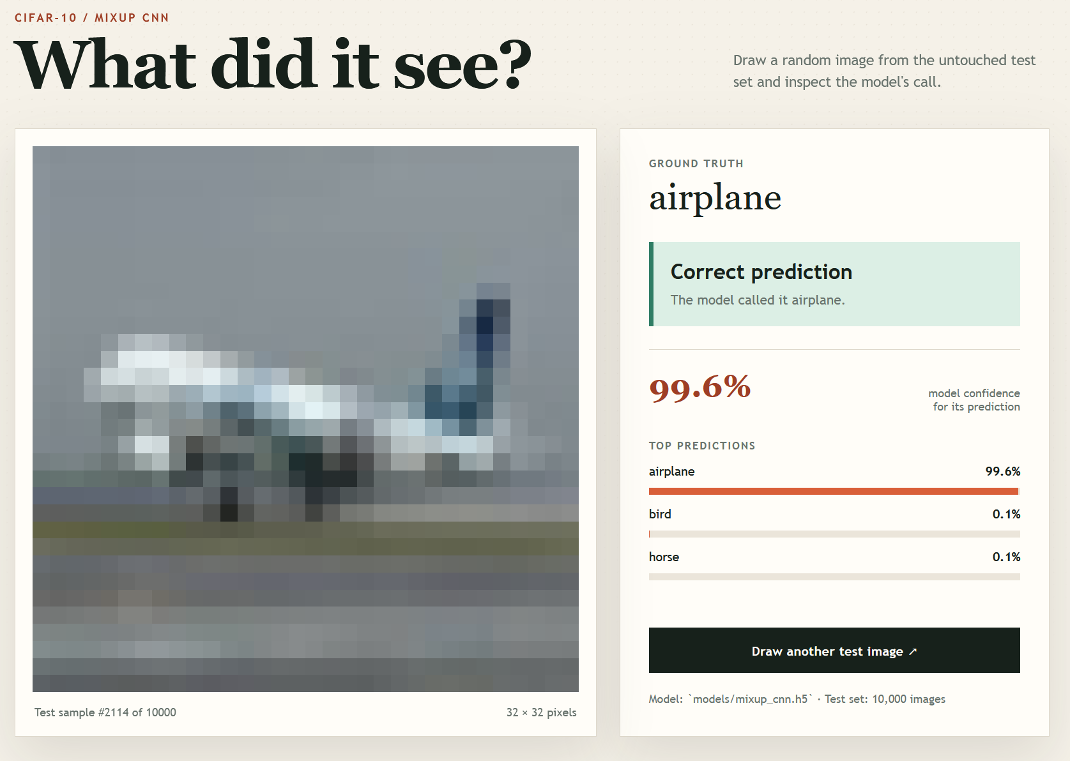
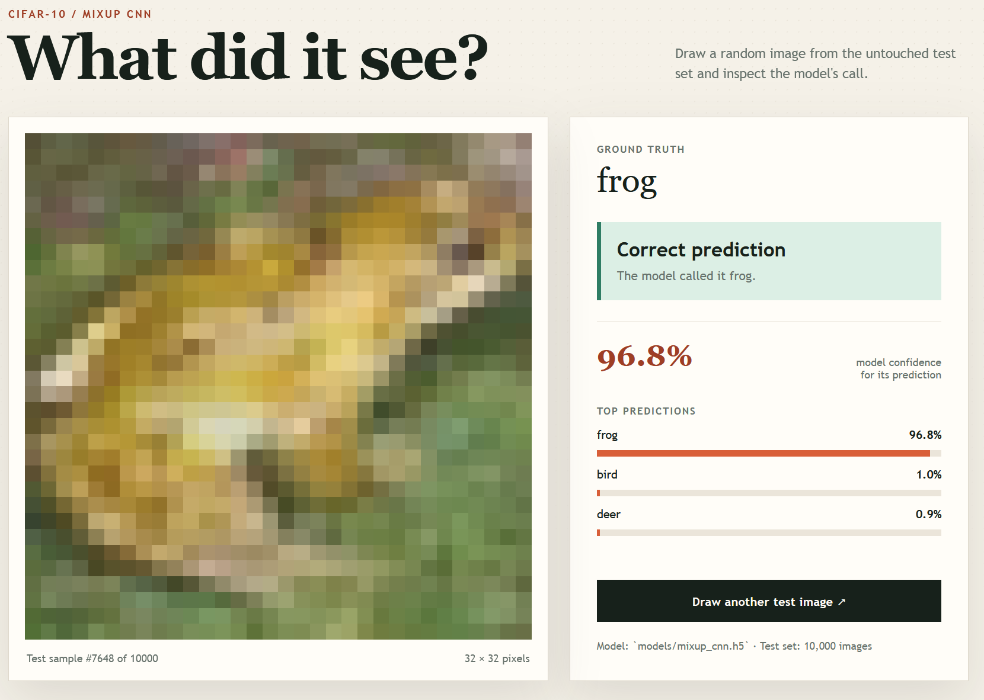
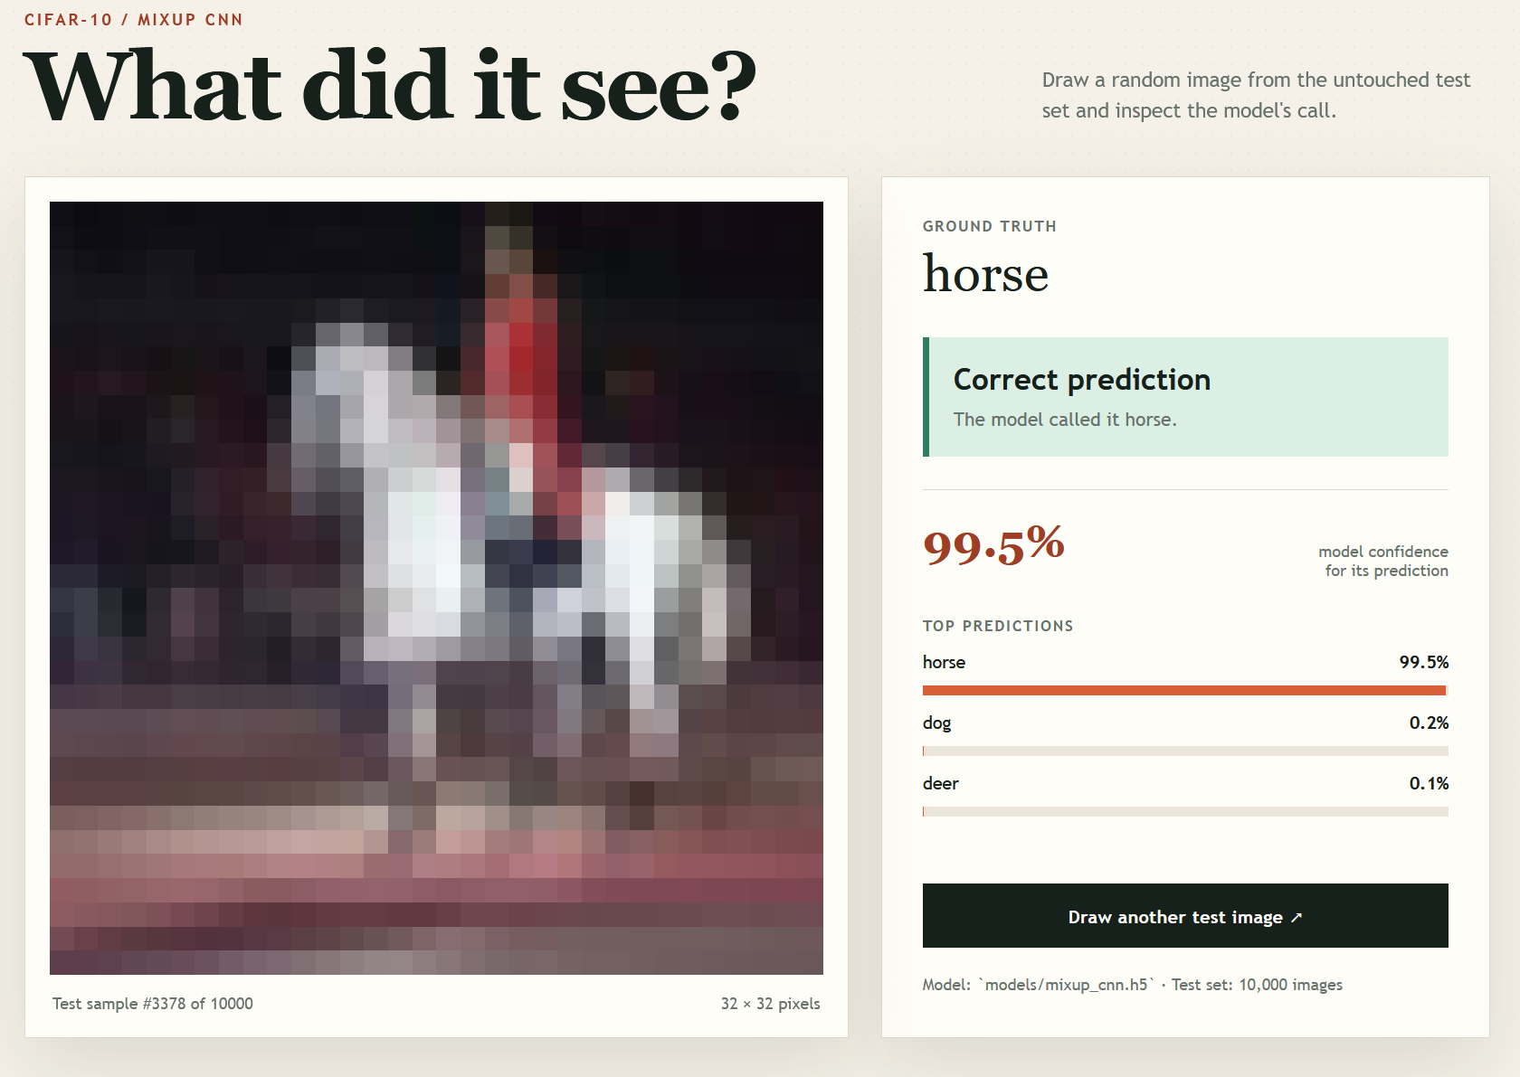
Working Prototype / Output Screens
[Screenshot / photo 1]
[Screenshot / photo 2]
[Screenshot / photo 3]
Testing of a random image from the dataset
Class: Aeroplane
Testing of a random image from the dataset
Class: Frog
Testing of a random image from the dataset
Class: Horse
Notes:
Show real screenshots, photos of the hardware or a short demo video link. Caption each one with what the viewer should notice.

Slide 16
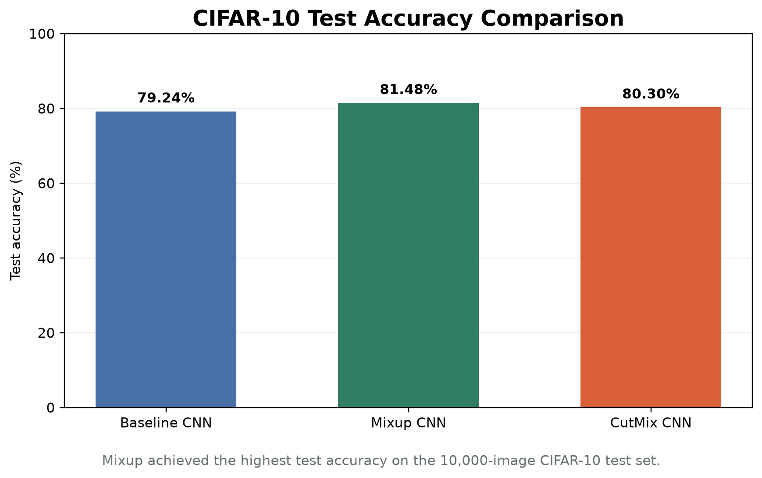
Results & Performance Comparison
Metric | Baseline CNN | Mixup CNN | CutMix CNN
Accuracy | 79.24% | 81.48% | 80.30%
Test Loss | 0.6993 | 0.5780 | 0.5952
Macro precision | 79.96% | 81.62% | 80.49%
Macro Recall | 79.24% | 81.48% | 80.30%
Macro F1 - score | 79.24% | 81.28% | 80.13%
Best: Mixup CNN - Test Accuracy = 81.48%
Notes:
Right-click the chart and choose Edit Data to enter your real numbers. Replace the metrics with the ones that fit your project (accuracy, latency, power, throughput, user rating). State clearly which option performed best.

Slide 17
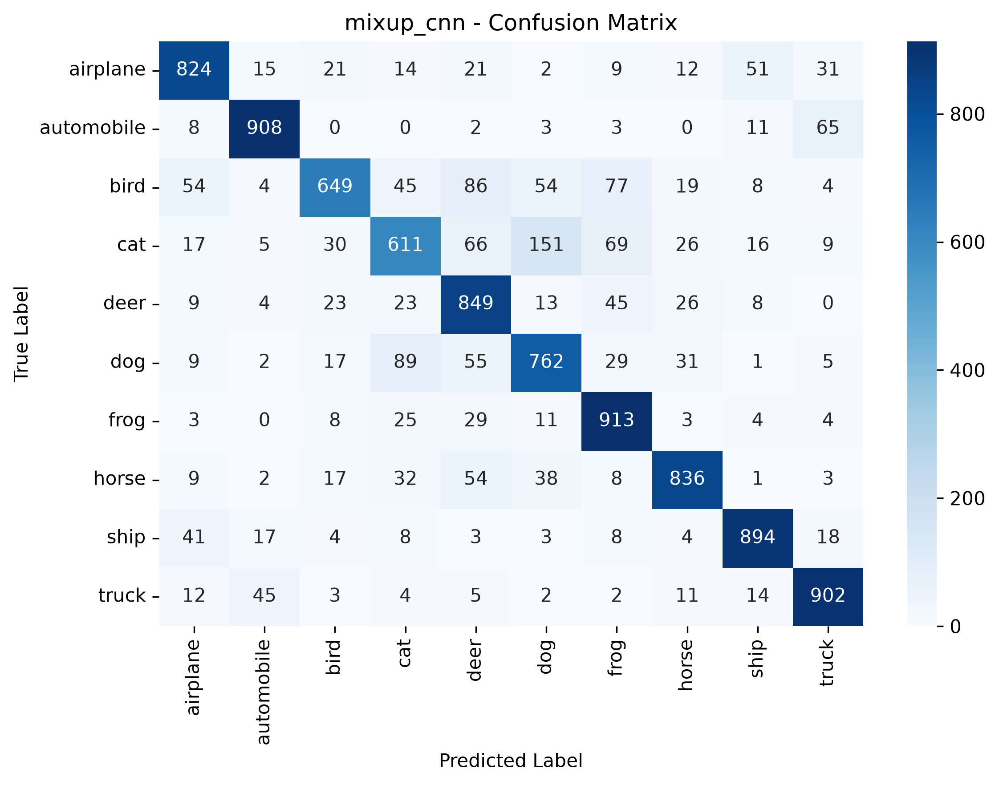
Analysis & Key Findings
[Insert confusion matrix / feature importance /
ROC curve / output comparison]
[81.48%]
Best test accuracy achieved by Mixup CNN
Interpretation: Mixup achieved the highest test accuracy and lowest test loss. It improved the baseline by 2.24 percentage points.
Error analysis: Cat, dog, and bird were the most difficult classes because their visual patterns are similar at 32 x 32 resolution.
Key drivers: The main factors were CNN feature extraction, data normalization, dropout regularization, and Mixup interpolation.
Notes:
Explain what the numbers mean. Use a confusion matrix, ROC curve, feature-importance chart or output comparison. Be honest about weak results; panels value that.

Slide 18

Testing & Validation
Test ID | Test Description | Expected Result | Actual Result | Status
TC-01 | Verify required libraries | TensorFlow and required libraries import successfully | All required libraries imported successfully | Pass
TC-02 | Verify local modules | All CNN and utility modules import successfully | Baseline, Mixup, CutMix, training, and utility modules imported successfully | Pass
TC-03 | Evaluate saved Mixup model | Model loads and evaluates on 10,000 test images | Test accuracy: 81.48%, test loss: 0.5780 | Pass
TC-04 | Test random prediction website | Website displays image, actual label, prediction, and confidence | Random CIFAR-10 test prediction interface loads successfully | Pass
Functional Testing
Validation Method
Performance Testing
Verified dependency imports, local module imports, model loading, dataset loading, and prediction functionality.
Hold-out validation using the separate CIFAR-10 test set.Training data: 50,000 imagesTest data: 10,000 imagesRandom seed: 42
Baseline accuracy: 79.24%Mixup accuracy: 81.48%CutMix accuracy: 80.30%Training time per model: approximately 16–17 minutes.
Notes:
List representative test cases with expected and actual outcomes. Name the validation methods you used. Delete rows you do not need.

Slide 19


Challenges & Limitations
Challenges Faced
Limitations
Small 32 × 32 images made fine-grained classification difficult → used CNN feature extraction and augmentation.
TensorFlow GPU acceleration was unavailable on Windows → trained the models using the CPU.
The installation script used a hardcoded path → replaced it with a workspace-relative path.
Only one alpha value was tested for Mixup and CutMix.
The model used a simple CNN without batch normalization or residual connections.
Training used one main configuration and was not repeated across multiple random seeds.
Notes:
Be candid. Pair every challenge with how you solved it, and list limitations that the panel would otherwise spot themselves.

Slide 20

Conclusion
Implemented a complete CIFAR-10 image-classification system using TensorFlow/Keras, including a baseline CNN, Mixup CNN, CutMix CNN, evaluation scripts, and an interactive web demo.
1
Final Outcome
Mixup achieved the best test accuracy at 81.48%, compared with 79.24% for the baseline and 80.30% for CutMix.
[81.48%]
2
Best test accuracy achieved by Mixup CNN
Objectives achieved: 4 of 4
[How the The results show that data augmentation improved model generalization, with Mixup providing the strongest overall performance. meets the objectives and what value it adds]
3
Notes:
Revisit each objective and say whether you met it. Quote your headline result with numbers. Do not introduce new material here.

Slide 21



Future Scope & Applications
Improve Performance
Tune Mixup and CutMix alpha values, add batch normalization, learning-rate scheduling, and stronger architectures such as ResNet.
Applications
Educational demonstration of CNN classification and augmentation
Interactive analysis of individual model predictions
Prototype computer-vision classification dashboard
Useful for students, researchers, and machine-learning practitioners
Expand Data / Features
Evaluate additional datasets, corrupted CIFAR-10 images, and multiple random seeds for more reliable results.
Deploy & Build an Interface
Expand the local prediction explorer into a dashboard with confusion matrices, class filtering, image upload, and prediction history.
Scale & Secure
Deploy the model through an API or cloud service with monitoring, reliability checks, and secure access.
Notes:
Give concrete next steps, ideally tied to the limitations. Then name two or three real-world uses.

Slide 22
Team Contribution
Reg. No. | Name | Contribution / Modules Handled
2420030345 | Ch. Sri Krisna Vardhan | CNN architecture, CutMix , evaluation, report
2420030096 | D. Sanjay Ram Reddy | Mixup, training, evaluation, report, web application
2420030392 | Yashwanth | Dataset preparation
Notes:
Show that work was planned and shared. Every member should be able to explain their own module.

Slide 23

References
[1] H. Zhang, M. Cisse, Y. N. Dauphin, and D. Lopez-Paz,
“mixup: Beyond Empirical Risk Minimization,”
arXiv:1710.09412, 2017.
[2] S. Yun et al.,
“CutMix: Regularization Strategy to Train Strong Classifiers with Localizable Features,”
Proceedings of ICCV, 2019.
[3] A. Krizhevsky and G. Hinton,
“Learning Multiple Layers of Features from Tiny Images,”
University of Toronto Technical Report, 2009.
[4] M. Abadi et al.,
“TensorFlow: A System for Large-Scale Machine Learning,”
Proceedings of OSDI, 2016.
Project Links
GitHub: [URL]
Dataset: [URL]
Notes:
Use IEEE style, numbered in order of first citation in the deck. Include datasets, documentation and code repositories.

Slide 24
THANK YOU
Questions & Discussion
[Team email / contact details]
[Guide name and department]
Notes:
Leave this slide up during questions. Make sure every team member can answer questions about their own module.

