Slide 1
Idea Execution Document for
Making the Elevator Pitch
Entrepreneur’s Unique Registration Code: 69290A4E
Entrepreneur Name: Srikanth Sombhatla
Email id: srikanthsombhatla@gmail.com
Mobile number: 919885851504

Slide 2
Guidelines
  This is a sample format provided by The Power of Ideas for evaluation.
  Each idea/venture has its own Unique Selling Points (USP) and you should highlight the USP in the pitch. The Power of Ideas does not recommend use of one standard format for presentation for all ventures.
  We however believe that the key points mentioned in this template are crucial and should be detailed in the Pitch.
  The Pitch should be no more than 3 minutes in length and should get the listener interested in your business. The time limit will be adhered to strictly.
  This document when submitted should not exceed 5MB in size.
  You are required to submit a MS PowerPoint file in the same format for the Evaluating Panel’s reference.
  Remember to name the PowerPoint file with the Unique Registration Code (URC) given.
  Please note that the submission deadline of midnight, Sep 6 will be implemented strictly.

Slide 3
Define the company/business in a single declarative sentence
Simplifies local train travel by providing a service to buy tickets through
toll-free SMS.

Slide 4
Company Profile
Don't have a company yet !
But I dream of having the company as
  Decii – You dream, we do.

Slide 5
Need
Describe the needs your business idea is trying to fulfill. How are these needs met currently?
Need is to address local train ticketing and long queues during rush-hours.
Ticket counters, kiosks serve the purpose currently.
Who are your target customers?
Target customers are all local train travelers who have a mobile phone.
09/04/10
Notes:
Describe the needs you are trying to fulfill. How are these needs met currently?
Illustrate the customer inconvenience you are trying to remove, how are you making her life better? How is the customer solving these problems currently?
Who are your target customers? What is the market potential?
Identify various segments who would be using your product service, assess the market potential in terms of value/volume?

Slide 6
Market Potential
Millions of ridership across the country.
6.94 million daily ridership in Mumbai Suburban trains.
1.5 million daily ridership in Hyderabad MMTS.
76000 ridership in Chennai MRTS.
And welcome to millions of upcoming Metro travelers across multiple cities
Can address abroad markets too like Americas, Europe, China.
Can extend to local road transport also.

Slide 7
Value Proposition
Describe your offering.
Leverage mobile penetration to simplify ticketing.
Centralized server allowing ticket booking through a toll free SMS.
Billing done directly from user's phone balance, via operator support.
How does this offering solve the problem?
Commuters can comfortably book tickets via SMS as and when they arrive at terminal.
Each mobile is a personal ticket counter!
No sequence problem, no long queues.
Notes:
Describe your offering
Please provide description of your product or service
How does your offering solve the problem?
Explain your product/service, put in links to photos, demo videos etc if needed.

Slide 8
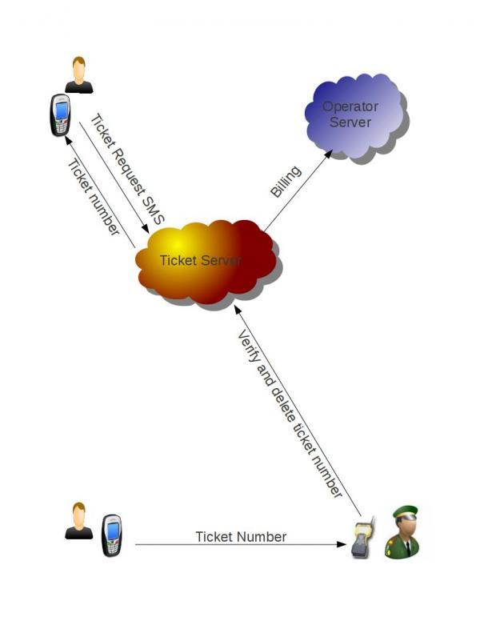
Big picture

Slide 9
Case study
Srikanth's office is 25 km, on the other end of city. So he relies on local trains. On his way to train station he sends a SMS to book a ticket from Secunderabad to Hitec City. When he reached station, he smartly escaped the long rush-hour ticketing queue and comfortably entered the train. With no extra charge for SMS and the standard train fare of Rs. 4 is deducted from his mobile balance. When ticket collector queries for ticket, he simply shows his ticket response SMS.
He also sees a text ad in ticket response SMS, that Style-Center mall(which is nearby his office) is offering 15% flat discount on DVD players. On his way home, he buys a DVD player for his wife!
Moreover, instead of retyping the SMS everyday, he resends the same SMS and enjoys the travel without ever looking at a ticket counter.

Slide 10
Competition
Competitors are traditional ticket queue and ticketing kiosks
They just don't solve the sequential problem and long queues.
How is this solution better than that of the competitor’s?
Commuter can book ticket with the comfort of his/her mobile phone.
Toll free SMS.
This doest requires commuters to stand in queue. So no sequential problem.
Same cost as print ticket. No extra charge!
Its green ! No paper and print cartridge wastage.
Notes:
List Competitors and their offerings
If you think you have no competition, you may not have researched well enough, or there might not be a market for your offering. So please think twice before saying there is no competition
Also try to identify potential competition- who else could enter the market and be a significant threat.

Slide 11
Business Model
How do you plan to make money?
Share revenue from money saved on print cost of each ticket.
Maintenance of ticket server.
Text ads with every ticket.
How will you price your product/service?
Same as traditional paper ticket. No extra charge. This price model makes it an equal alternative.
How will you reach out to your consumers/deliver your product to them?
Rigorous publicity in social media. Deep publicity push in railway premises.
What are your funding requirements?

