Slide 1
Creating an AI Agent
Stop Manually Updating Your Resume.
The Problem: Manual process of reading job descriptions, finding keywords, and editing a resume takes an average of 20 minutes per job, leading to a tedious and time-consuming experience.
The Solution:
The AI Agent reduces this process to just 5 seconds. Users simply paste the job description, and a tailored resume is instantly generated.

Slide 2
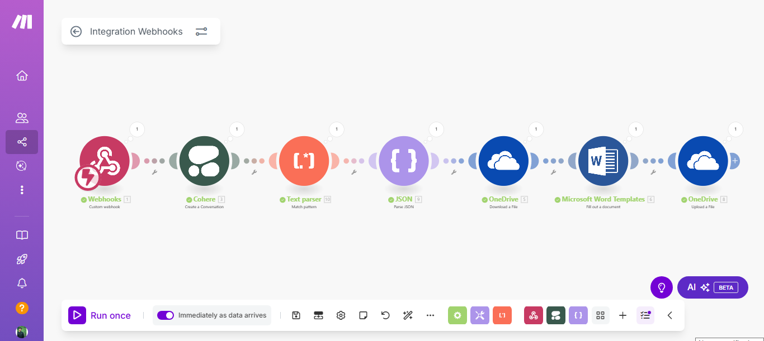
Built a fully automated tailored resumes with just few clicks.
Here's how it works.
1. The process starts with a Webhook as soon as a new job description is provided.
2. A Cohere AI model instantly reads the description to find all the important keywords.
3. The system uses JSON to neatly organize the information from the AI.
4. It takes that organized data and automatically fills in a Microsoft Word resume template.
5. Your finished, personalized resume is then saved and uploaded to OneDrive, ready to use.

Slide 3
How This AI Agent Works
All your professional data (education, experience, projects, skills) is saved in the agent.
The agent is pre-instructed to write a resume summary based on your profile and the job description.
You can set a pre-defined resume design.
The AI analyzes both the job description and your data to construct a ready-to-use resume, eliminating the need for re-editing.
Apply to any job in under a minute.

