Slide 1
Business Analysis Project
Predicting Customer Response for
“iFood Online Campaign”
Business Problem: "How can we predict which customers are most likely to respond to a marketing campaign to improve targeting and efficiency?"
Analysed by: SRIDHAR. K. S

Slide 2
Real-time example and how this project solve actual business problems:
Food Delivery Company: Targeted Promotions at Swiggy or Zomato
Scenario: A food delivery app wants to run a campaign to get users to order more frequently using discount coupons.
Problem: Giving a flat 20% off to everyone is costly.
Solution (acc to project):
Analyze user data: order frequency, average order value, favorite cuisines, app visits, response to past offers.
Build a model to predict the likelihood a user will use a coupon and increase their order frequency.
Target users who are likely to respond but aren't ordering frequently (to boost activity).
Company Name | Promotional/Marketing Cost (FY2024) | Marketing Cost as % of Revenue (FY2024)
Zomato | ~₹1,432 crore | ~17% (based on revenue of ₹8,080 crore)
Swiggy | ~₹1,850.79 crore | ~16.5% (based on revenue of ₹11,247 crore)
Blinkit | Not reported separately; included in Zomato's figures. | Not applicable
Zepto | ~₹304 crore | ~6.8% (based on revenue of ₹4,455 crore)

Slide 3
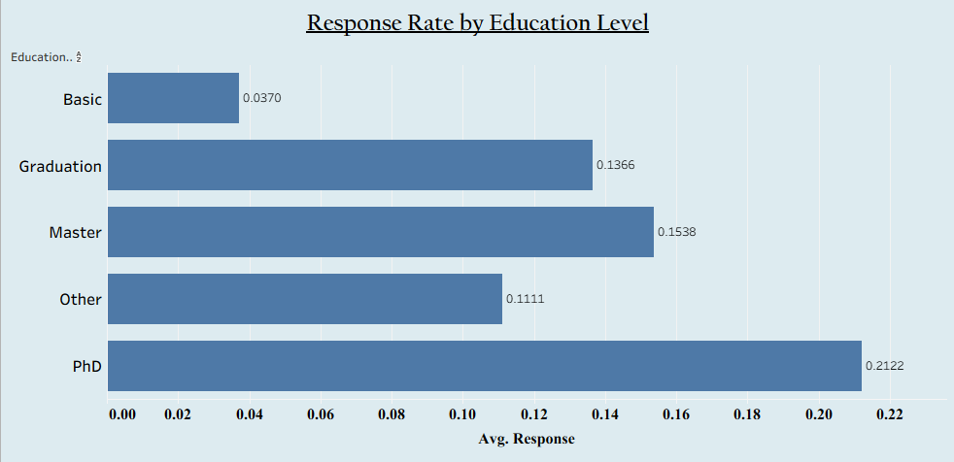
Data Set Link:
https://www.kaggle.com/datasets/jackdaoud/marketing-data
Includes:
Demographics (Age, Education, Family)
Purchase History (Spending, Channels)
Campaign Responses (AcceptedCmp1-5)
Target: Response to Latest Campaign
Our Process:
Clean & Prepare Data
Explore Data (EDA)
Engineer Features
Build Prediction Models (Logistic Regression)
Evaluate Model Performance

Slide 4
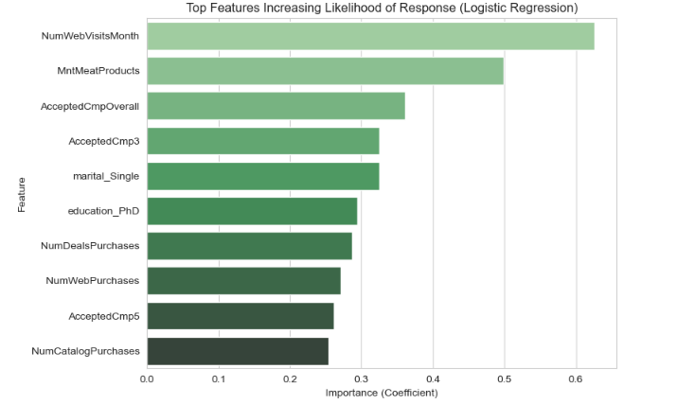
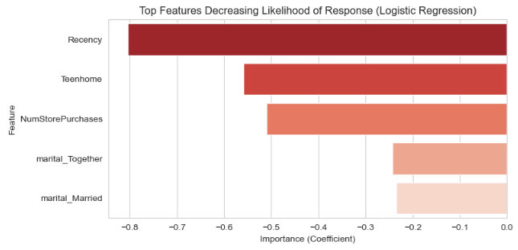
Model Performance
Accuracy: 0.8957 and AUC Score: 0.5000
Accuracy: 0.8957
Out of 100 predictions your model made, it got about 89.57 of them correct. In your case, it correctly predicted whether a customer would respond (or not respond) to the campaign about 90% of the time.
AUC Score: 0.5000 AUC measures how good your model is at ranking customers – putting the ones who will respond at the top of the list and those who won't at the bottom.

Slide 5
Turning Data into Smart Marketing Decisions
Who Should We Target?
Recent Shoppers(Recency),
2. Online Engagers(NumWebVisitsMonth),
3. Past Campaign Responders(AcceptedCmpOverall),
4. Highly Educated(education_PhD).
Who Might Not Respond As Well?
In-Store Shoppers(NumStorePurchases),
2. Families with Teenagers(Teenhome),
3. Low Web Activity
Why This Matters for the Company
Spend Money Wisely (Better ROI):
By targeting the customers most likely to respond, the company avoids wasting money on people who probably won't engage. This increases the return on investment for marketing campaigns.
Increase Conversions:
Focusing on the right audience means more people will respond, leading to more sales.
Improve Customer Experience: Sending relevant offers to the right people makes customers feel understood, rather than spammed.
Learn About Customers:
The analysis reveals clear patterns about who engages, helping the company understand its customer base better for future strategies.

Slide 6
Conclusion & Tools Used
What This Analysis Achieved
Built a Smart Predictor:
Successfully created a model that can predict whether a customer is likely to respond to a marketing campaign.
Found Key Patterns:
The analysis clearly showed which customer behaviors and characteristics are linked to a higher or lower chance of responding.
Provided Actionable Insights:
Gave specific advice on which customer groups to target and which to be cautious with for future campaigns.
The Building Blocks
1. Data Analysis & Programming:
Python
4. Data Visualization:
Matplotlib/Seaborn (Python tools for creating charts), Tableau (for creating the final dashboard)
2. Data Handling:
Pandas (a Python tool for cleaning and organizing data)
5. Model Evaluation:
Techniques to check how well our model performed (like looking at Accuracy and AUC).
3. Machine Learning:
Scikit-learn (a Python tool for building predictive models like Logistic Regression)

