Slide 1

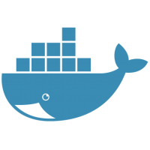
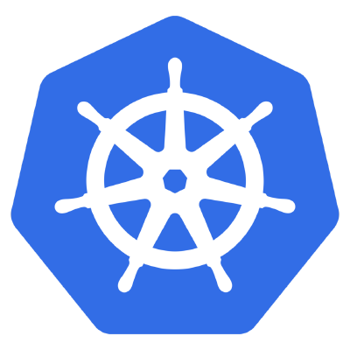
POD
App
(catalog-api)
Node
Docker Container
POD
Notes:
Talk about App, Node JS
Talk about Docker Container
Talk about POD, basic unit of deployment in K8s

Slide 2



etcd
etcd
kubernetes
kubeapi server
kubeapi server
controller
controller
scheduler
scheduler
master
master
kubelet
kubelet
kubelet
Pod
Pod
Pod
Pod
Pod
Pod
Pod
Pod
Pod
Pod
Pod
Pod
node
node
node
Notes:
Talk about Master-Node Architecture
Talk about Redundancy
Talk about ETCD, Controller and Scheduler
Talk about KubeCTL

Slide 3
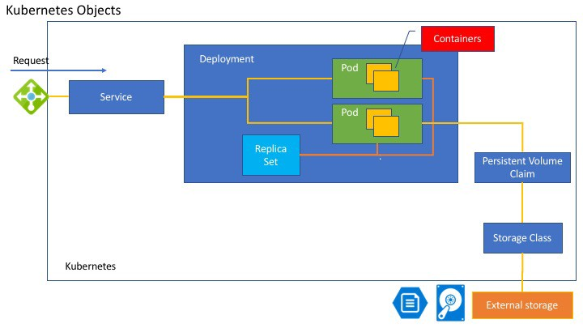
Storage

Slide 4
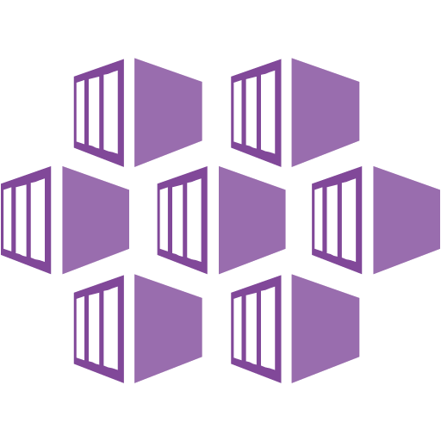



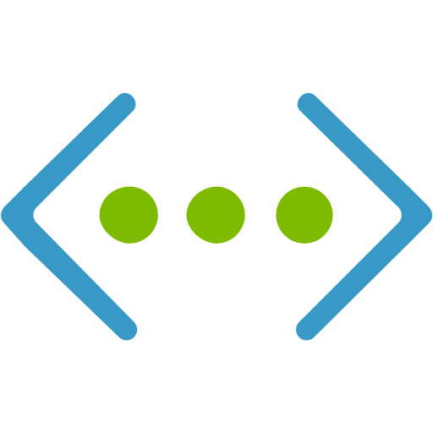

AKS
Managed Kubernetes Cluster
etcd
etcd
Managed Network
Hosted Control Plane
kubeapi server
kubeapi server
controller
controller
RBAC Enabled
Azure Monitor
scheduler
scheduler
Advanced Traffic
Routing
Azure Load Balancer
Azure Virtual Network
…
Pod
Pod
Pod
Pod
Pod
Pod
Pod
Node 100
Pod
Node 1

