Slide 1
Agenda
Basic Cluster Setup and App Deployment
ACR integration with AKS
Upgrading a cluster
Monitoring and Telemetry

Slide 2

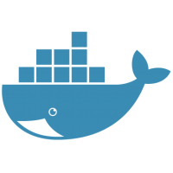
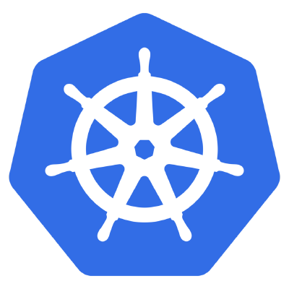
POD
App
(catalog-api)
Node
Docker Container
POD
Notes:
Talk about App, Node JS
Talk about Docker Container
Talk about POD, basic unit of deployment in K8s

Slide 3



etcd
etcd
kubernetes
kubeapi server
kubeapi server
controller
controller
scheduler
scheduler
master
master
kubelet
kubelet
kubelet
Kube
proxy
Kube
proxy
Kube
proxy
Pod
Pod
Pod
Pod
Pod
Pod
Pod
Pod
Pod
Pod
Pod
Pod
node
node
node
Notes:
Talk about Master-Node Architecture
Talk about Redundancy
Talk about ETCD, Controller and Scheduler
Talk about KubeCTL

Slide 4
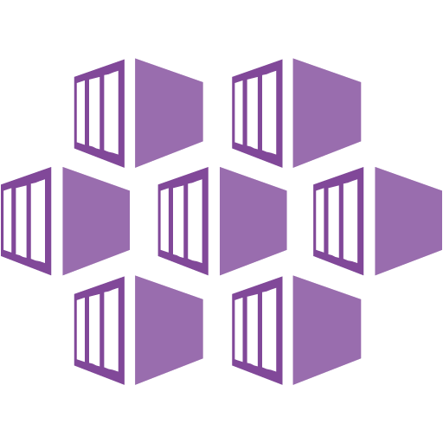
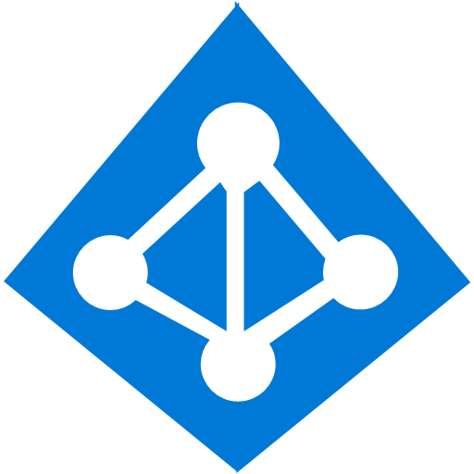




AKS
Managed Kubernetes Cluster
etcd
etcd
Managed Network
Hosted Control Plane
kubeapi server
kubeapi server
controller
controller
RBAC Enabled
Azure Monitor
scheduler
scheduler
Advanced Traffic
Routing
Azure Load Balancer
Azure Virtual Network
…
Pod
Pod
Pod
Pod
Pod
Pod
Pod
Node 100
Pod
Node 1

Slide 5
Cluster Components
AKS –Engine can be used for cluster customization like Hybrid Cluster (Linux + Windows), Runtime Change (from Moby) can be done using AKS-Engine -> https://github.com/Azure/aks-engine
AKS uses Node Pools to manage VM Pools
The following are the resources reserved on each Node for System Services
CPU - 60 ms
Memory - 20% up to 4 GiB
This is on top of the resources occupied by the Node
Choose VM Size with Premium disks for High-performance and availability
VNet, NSG, NIC, Subnets and few other networking resources are auto provisioned

Slide 6
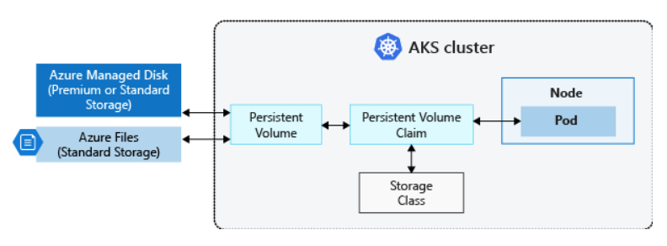
Storage
Volumes (per Pod LifeCycle)
emptyDir – storage for pod
Secret – stored at node level, per NS
Configmap – per NS
Persistent Volumes (beyond Pod lifetime)
Azure Disks
Azure Files (only standard storage available)
Initial StorageClasses
Default (Standard Storage, Managed Disk)
Managed Premium (Premium Storage)

Slide 7
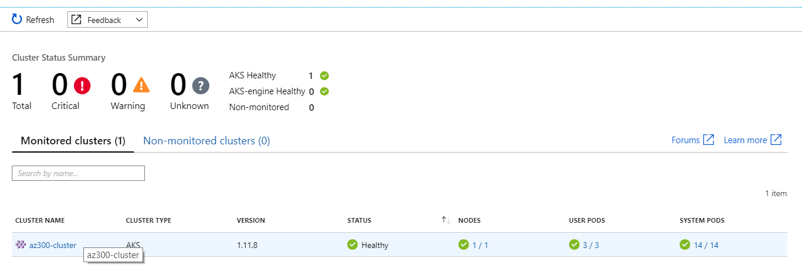
Monitoring & Telemetry
AKS Nodes, Containers can be monitored using Log Analytics.
If you have a custom monitor solution and you want to ensure this solution is deployed on every node, use Daemon Sets
You can turn on Master Diagnostic Logs as well
AzureDiagnostics
| where Category == "kube-apiserver"
| project log_s
Use Journelctl to view kubelet logs
Pod Level Logs (Live Metrics)

Slide 8
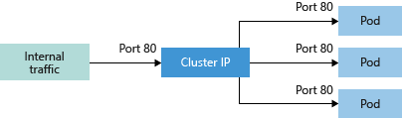
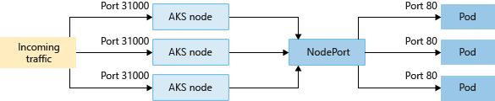
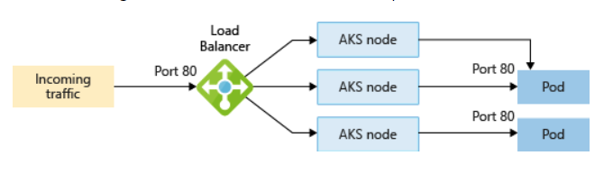
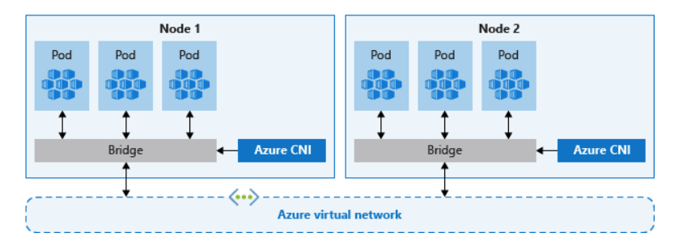
Networking
Nodes are part of VNET by default
Kube-proxy uses the K8s Networking abstraction to provide internal Ips
Pods are grouped as Services and can be accessed via. DNS or IP.
More complex routing can be achieved by using Ingress Controllers
Kubenet, Azure CNI Networking
Ingress Controllers

Slide 9
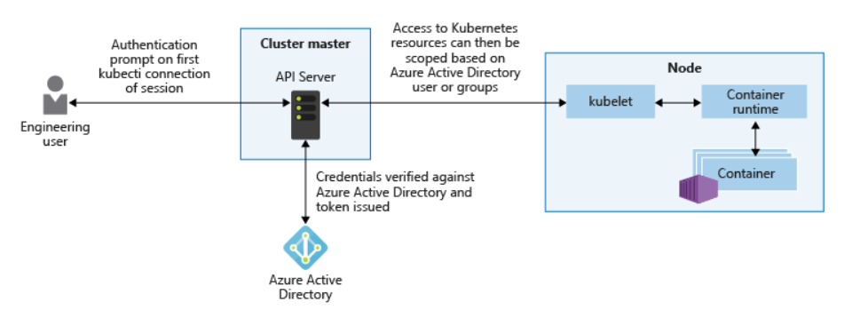
Identity & Access Management Recommendations
AKS Cluster can be logically divided into multiple namespaces to restrict access, for ex: Dev, Test, Prod.
Default Namespaces – default, kube-system, kube-dashboard
Integrate with AAD to login to AKS clusters, for fine grained used RBAC.
AKS uses RBAC to grant permissions, there is no deny.
RBAC roles are used to define permissions within namespace for cluster level use CluserRole
RoleBindings, ClusterBindings are used to bind Roles, ClusterRole to users/groups
Configure AKS for AAD Authentication https://docs.microsoft.com/en-in/azure/aks/aad-integration

Slide 10
Upgrading the Cluster
Stop Provision additional Pods
Move the Pods out of upgrading Node
A new node is created with latest K8s
Join the New Node to cluster
Delete old node
https://github.com/weaveworks/kured

Slide 11
Appendix (Exam Perspective)
https://docs.microsoft.com/en-in/azure/aks/container-service-quotas
https://docs.microsoft.com/en-us/azure/dev-spaces/?toc=%2Fen-in%2Fazure%2Faks%2FTOC.json&bc=%2Fen-in%2Fazure%2Fbread%2Ftoc.json
https://docs.microsoft.com/en-in/azure/aks/supported-kubernetes-versions
https://docs.microsoft.com/en-in/azure/aks/best-practices

