Slide 1
FEATURE SELECTION AND CLASSIFICATION METHODS FOR ATTACK DETECTION USING DEEP LEARNING IN VANET
GUIDE: P.SRILAKSHMI
Ms. G. MAHALAKSHMI 2019272037
MCA-SS(3rd year)

Slide 2
MOTIVATION & OBJECTIVE
Intrusions occurs frequently in the networks. So, in order to identify and detect these intrusion this project used.
In this way, we can detect the intrusion early and save our data
The main objective is to identify the attacks and then classify them into different categories.
It uses DNN to predict an incoming value as attack or not and classify them accordingly.

Slide 3
INTRODUCTION
Vehicular Ad hoc Networks (VANETs) are the core of Intelligent Transportation Systems (ITS), allowing vehicles to communicate between themselves and with other entities.
The presence of a large number of communicating vehicles greatly increases the number and types of possible anomalies in the network.
However, since there can be a multitude of anomalies possible in the network, there is a need for better anomaly detection frameworks that can address this unprecedented scenario.
In this project, we propose an anomaly detection framework for VANETs based on deep neural networks (DNNs) using PCA and DNN algorithms.
Our DNN model learns the abstract and high-dimensional feature representation of the IDS data by passing them into many hidden layers.

Slide 4
LITERATURE REVIEW
S.No. | Author name & Paper title | Concept in the paper (Algorithm, Advantages, Limitations, Future enhancement) | Paper details
1. | R. VINAYAKUMAR, MAMOUN ALAZAB, K. P. SOMAN , PRABAHARAN POORNACHANDRAN , AMEER AL-NEMRAT , AND SITALAKSHMI VENKATRAMAN Deep Learning Approach for Intelligent Intrusion Detection System | In this paper, a hybrid intrusion detection alert system is proposed which has the capability to analyze the network and host-level activities. It uses DNNs for handling and analyzing very large scale data in real-time. The proposed architecture is able to perform better than previously implemented classical machine learning classifiers in both HIDS and NIDS. The execution time of the proposed system can be enhanced by adding more nodes to the existing cluster. In addition, the proposed system does not give detailed information on the structure and characteristics of the malware. | IEEE Access ( Volume: 7) Digital Object Identifier 10.1109/ACCESS.2019.2895334
2. | Tejasvi Alladi,Bhavya Gera, Ayush Agrawal, Vinay Chamola and Fei Richard Yu DeepADV: A Deep Neural Network Framework for Anomaly Detection in VANETs. | A DNN-based anomaly detection framework for the identification of anomalous data pertaining to various possible anomalies in VANETs. Anomaly scenarios are considered for analyzing the performance of the proposed framework. Performance analysis of the framework using key evaluation metrics is presented by employing several DNN architectures. | IEEE TRANSACTIONS ON VEHICULAR TECHNOLOGY, VOL. 70, NO. 11, NOVEMBER 2021

Slide 5
LITERATURE REVIEW
S.No. | Author name & Paper title | Concept in the paper (Algorithm, Advantages, Limitations, Future enhancement) | Paper details
3. | Elvin Eziama , Kemal Tepe , Ali Balador , Kenneth Sorle Nwizege and Luz M. S. Jaimes-Malicious Node Detection in Vehicular Ad-Hoc Network Using Machine Learning and Deep Learning. | The paper proposes the Bayesian Neural Network (BNN) model framework for high performance prediction, classification accuracy and low detection latency, in trust computation in VANET. The idea of BNN framework is needed to overcome the challenges in NN. the future work aims at implementing the proposed framework in Veins simulator and providing simulation experiments. | 2018 IEEE Globecom Workshops (GC Wkshps)
4. | Tejasvi Alladi, Ayush Agrawal , Bhavya Gera, Vinay Chamola, Biplab Sikdar, Mohsen Guizani Deep Neural Networks for Securing IoT Enabled Vehicular Ad-Hoc Networks | In this paper,a deep neural network architecture for securing IoT-enabled VANETs is proposed. Deep learning models were trained on time sequences generated from normal vehicle data in the network. the paper tells about classify sequences into normal data and anomalies and perfectly classify most of the anomalous types. the proposed CNN & LSTM model is shown to give a higher performance compared to a stacked LSTM model. | CC 2021 - IEEE International Conference on Communications
5. | Yi Zeng, Meikang Qiu, Dan Zhu, Zhihao Xue, Jian Xiong, and Meiqin Liu- DeepVCM: a Deep Learning Based Intrusion Detection Method in VANET. | the DeepVCM procedure is consist of two common DL models, namely CNN and LSTM. This method does not require the heavy work of selecting features and private featured details. Moreover,it can attain a much more robust and accurate performance on intrusion detection than state-of-art methods with a less storage resource requirement | IEEE Intl Conference on Intelligent Data and Security (IDS)

Slide 6
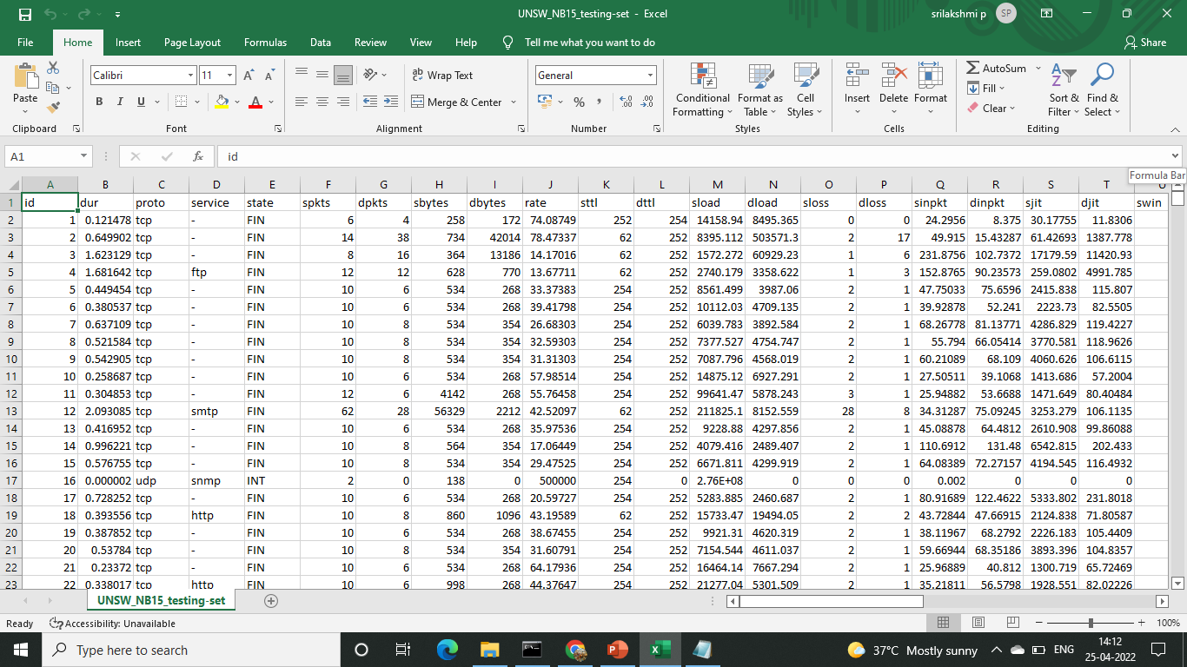
DATASET DETAILS
UNSW-NB15:
The raw network packets of the UNSW-NB 15 dataset was created by the IXIA PerfectStorm.
This dataset has nine types of attacks, namely, Fuzzers, Analysis, Backdoors, DoS, Exploits, Generic, Reconnaissance, Shellcode and Worms.
The Argus, Bro-IDS tools are used and twelve algorithms are developed to generate totally 49 features with the class label. These features are described in UNSW-NB15_features.csv file.
The number of records in the training set is 175,341 records and the testing set is 82,332 records from the different types, attack and normal.

Slide 7
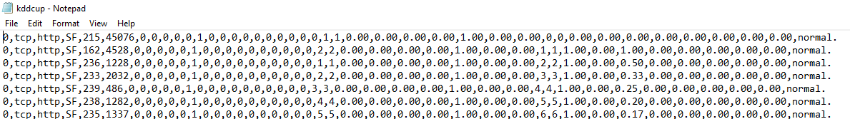
DATASET DETAILS
KDDCUP 99:
KDDCup 99 dataset was built by processing tcpdump data of the 1998 DARPA intrusion detection challenge dataset.
The network traffic data was captured and stored in tcpdump format for 10 weeks.
The data of first seven weeks was used as training dataset and rest used as testing dataset.
KDDCup 99 dataset is available in two forms. They are full dataset and 10% dataset. The dataset contains 41 features and 5 classes (’Normal’, ’DoS’, ’Probe’, ’R2L’, ’U2R’). These features are grouped into different categories.

Slide 8
IMPLEMENTATION PLATFORM / FRAMEWORK
Language used:
Python
Platform used:
Jupyter notebook

Slide 9
DETAILED DESIGN
Load datasets
Convert the categories to numbers
One hot encoding technique
Normalize encoded data using min-max technique
Train the dataset using classification model
Reduce the number of features using PCA
Calculate information gain
Test the dataset using classification model
Output

Slide 10
OVERALL ARCHITECTURE (with completed modules highlighted)
FEATURE SELECTION AGENT
FEATURE IMPORTANCE CALCULATION
FEATURE SELECTION USING PCA
PRE PROCESSING
ONE-HOT ENCODING
NORMALIZATION
DATA SET
Testing
Training
Not attack
CLASSIFICATION
STRATEGY
CLASSIFICATION
STRATEGY
DNN
DNN
Attack
Routing

Slide 11
LIST OF MODULES
PRE-PROCESSING:
Converting the data into numeric values and encoding it using one hot encoding technique.
Normalise the encoded dataset with the min-max techniques.
PRE PROCESSING
DATASET
NORMALIZED OUTPUT
ONE HOT ENCODING
MIN-MAX SCALAR NORMALIZATION

Slide 12
FEATURE SELECTION
Feature selection agent is the process of reducing the dimension of our dataset by selecting only the necessary features.
This is done using the feature importance calculations which calculates the information gain and entropy value. Then we perform the feature selection using the PCA (Principal Component Analysis) method.
FEATURE SELECTION AGENT
NORMALIZED DATASET
REDUCED OUTPUT
FEATURE IMPORTANCE CALCULATION
PCA(PRINCIPAL COMPONENT ANALYSIS)

Slide 13
TRAINING AND TESTING THE CLASSIFICATION ALGORITHM:
Training and Testing is necessary for us to know if the said model works.
The observations in the training set form the experience that the algorithm uses to learn.
The test set is a set of observations used to evaluate the performance of the model using some performance metric.
It is important that no observations from the training set are included in the test set.
In this DNN classification algorithm is used to train and test the dataset and check if the output we obtain is accurate. The accuracy can be tested using the accuracy formula.
CLASSIFICATION STRATEGY
REDUCED DATASET
OUTPUT
TRAINING THE MODEL
TESTING THE MODEL

Slide 14
ALGORITHM STEPS
Start
Algorithm:
Input: kddcup99,UNSW-NB15 dataset
Output: Normalized data
Start
Read dataset
If(Null values),then replace.
Else, (identify Unique feature category).
Convert data using encoding.
Perform min-max normalization.
Stop
Read Dataset
Null value?
yes
Remove/process value
no
Find unique feature category
Convert to numeric value
Convert to encoded value
Normalize using min-max
Normalized data

Slide 15
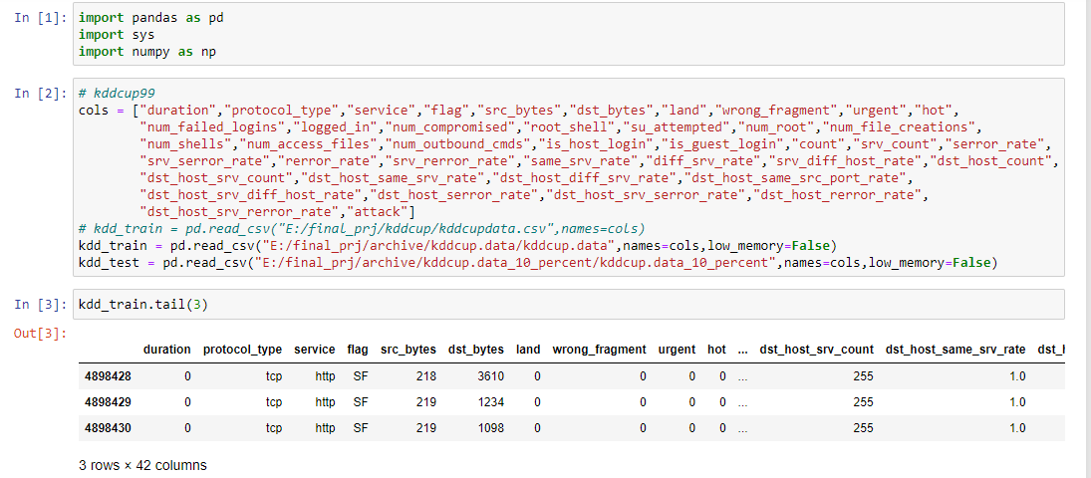
MODULE BASED OUTPUT SCREENSHOTS
READ DATASETS KDDCUP99

Slide 16
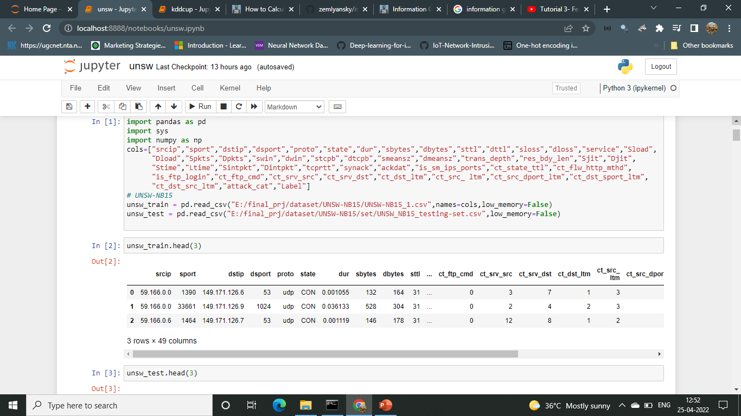
UNSW-NB15 DATASET

Slide 17
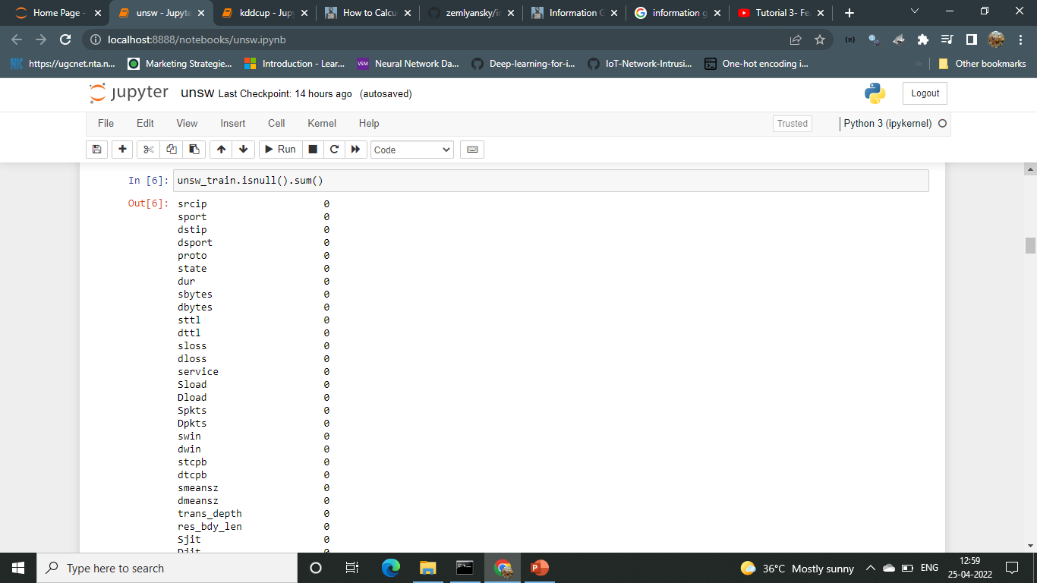
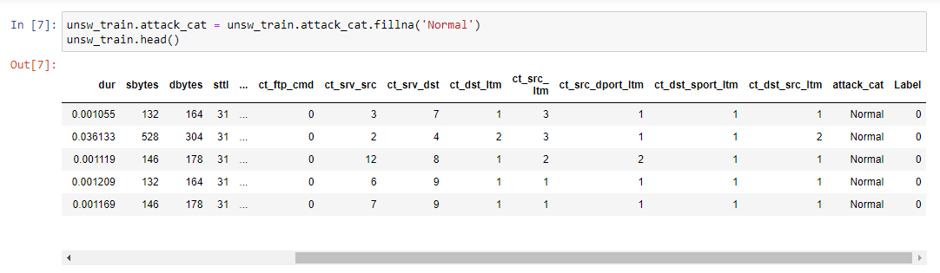
Checking for null values and replacing

Slide 18
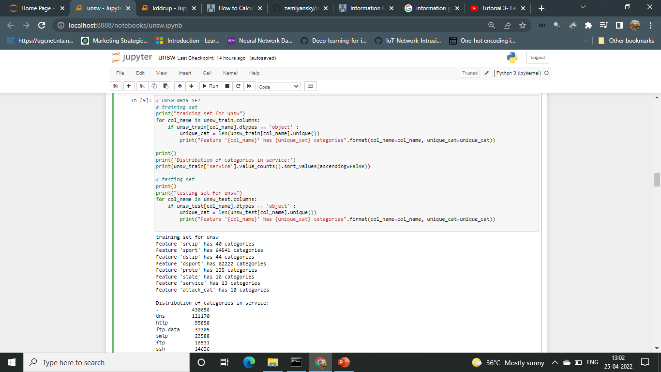
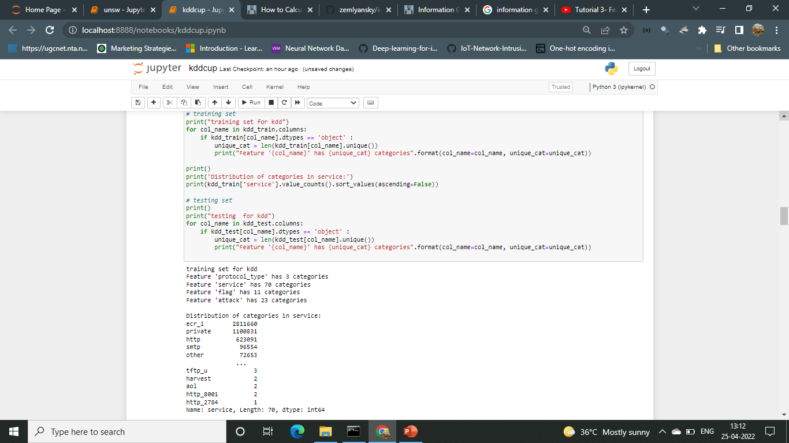
Identify Unique feature category
UNSW-NB15
KDDCUP 99

Slide 19
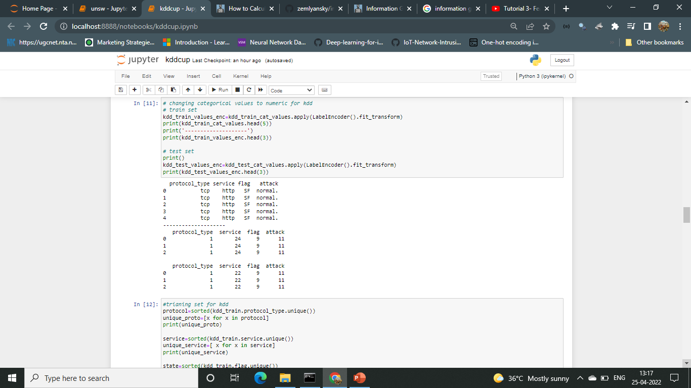
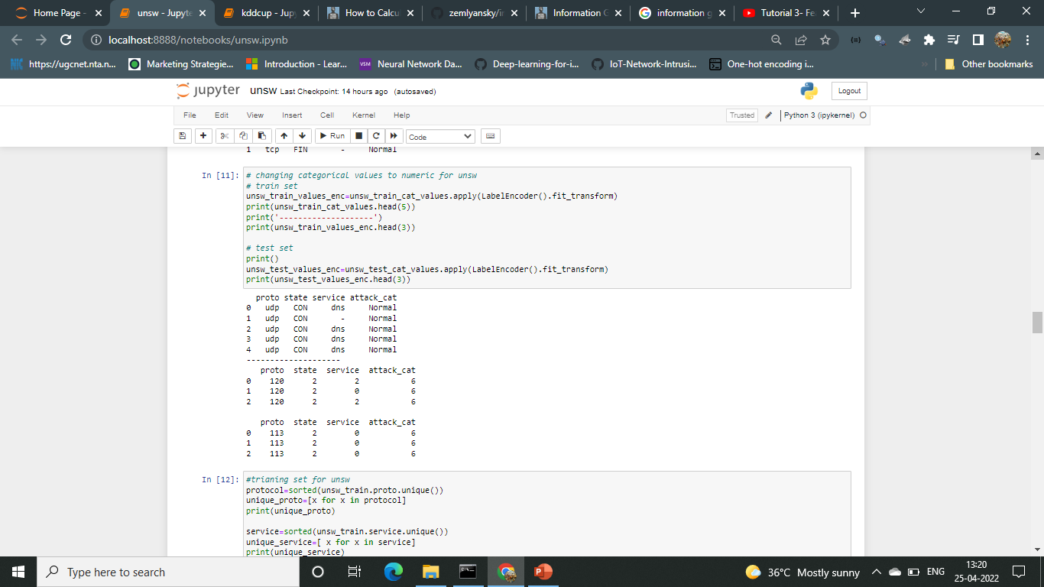
Convert to numeric values
KDDCUP 99
UNSW-NB15

Slide 20
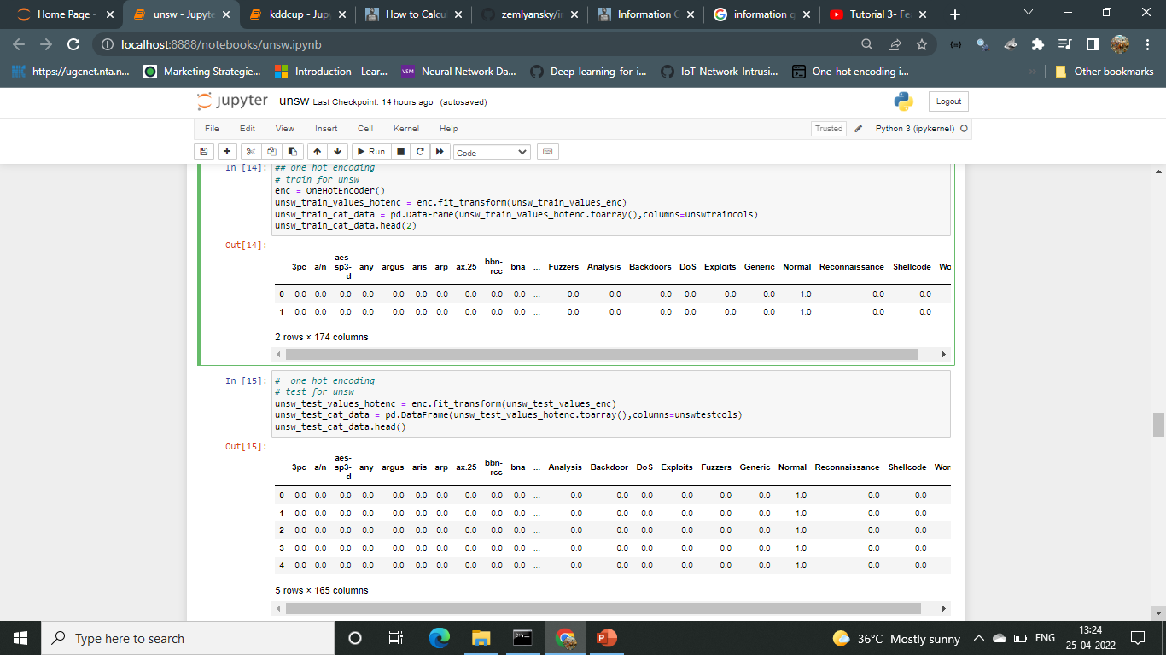
ONE HOT ENCODING
UNSW-NB15

Slide 21
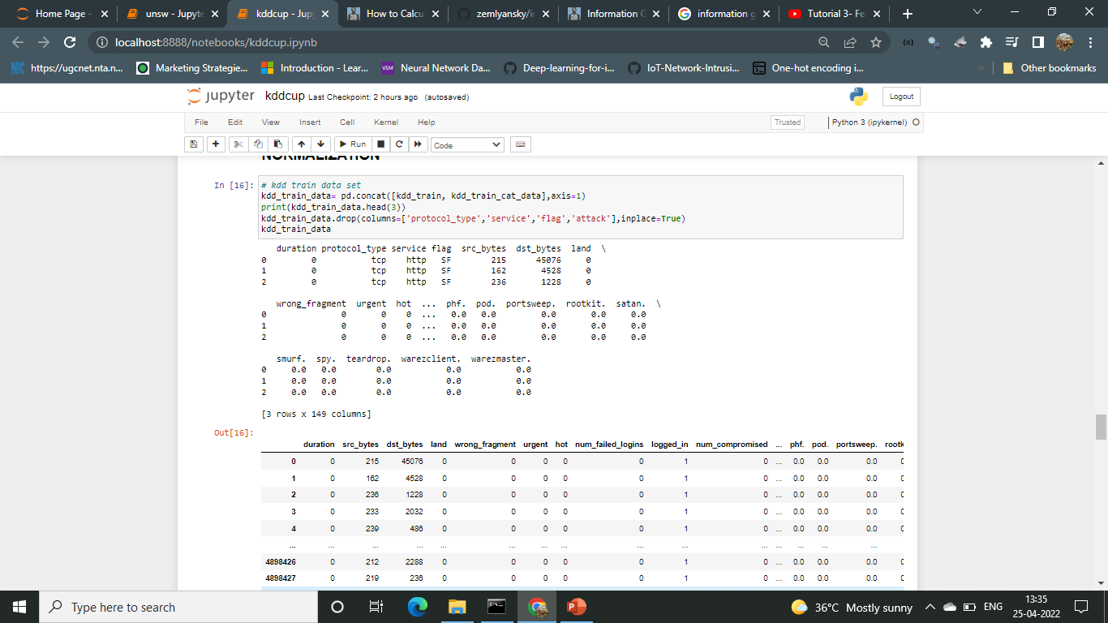
KDDCUP99 NORMLIZATION

Slide 22
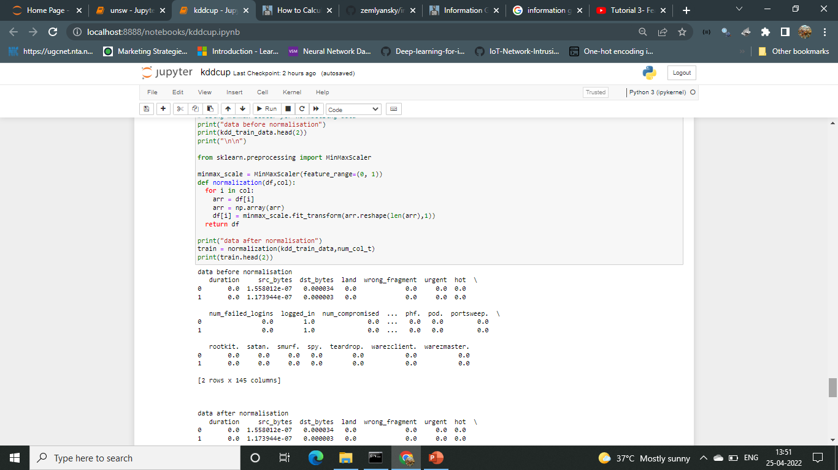
NORMALIZATION

Slide 23
REFERENCES
https://www.educative.io/edpresso/one-hot-encoding-in-python
https://machinelearningmastery.com/start-here/
https://github.com/alik604/cyber-security/blob/master/Intrusion-Detection/UNSW_NB15.ipynb
https://www.youtube.com/watch?v=Fw5iiyIHzew
https://github.com/Ahamasaleh/Deep-learning-for-intrusion-detection-using-RecurrentneuralnetworkRNN/blob/main/KDDTest%2BBinary_Classification.ipynb
https://github.com/abhinav-bhardwaj/IoT-Network-Intrusion-Detection-System-UNSW-NB15/blob/master/UNSW_Project.ipynb

Slide 24
THANK YOU

