Slide 1
Online Registration Form
Name : Sri Lakshmi R
Batch : 2022-7601
Enrollment No. : EBHEXL0722617596

Slide 2
Contents
Introduction
Frontend : Thymeleaf, HTML , CSS
Backend : Spring MVC, JAVA
Technologies used
Objective
Requirements
Screenshots
Page1 : Home
Page2 : Confirmation of Data Entry
Page3 : Updating the data in MySQL
Page4 : New page for new data-entry
Advantages
Conclusion

Slide 3
Introduction
With Online Registration Form we can fill in with our e-mail address, desired user name, password and password confirmation, in order to create a User Account.
The main aim of this software is to record the details entered by an user and store the same.
In order to retrieve the data as and when required
Processing a large amount of data effectively and efficiently.
To provide better service.
It basically contains the records of User name , Password, E-mail and Contact No. .

Slide 4
Frontend : Thyme leaf, HTML and CSS.
Thymeleaf : Thymeleaf is a server-side Java-based template engine for both web and standalone environments, capable of processing HTML, XML, JavaScript, CSS and even plain text. It is more powerful than JPS and responsible for dynamic content
It is a HTML5/XHTML/XML template engine. It is a server-side Java template engine for both web (servlet-based) and non-web (offline) environments.
It is perfect for modern day JVM development.
It is an engine based on XML attributes.
The engine evalutes values from attributes to build a DOM tree.

Slide 5
HTML : HTML is the standard markup language for creating Web pages.
In java, we can extract the HTML content and can parse the HTML Document.
HTML in this project is integrated using a JSP file.
<a> for link. <b> to make bold text. <strong> for bold text with emphasys. <body> main HTML part. <br> for break.
HTML is heavily used for creating pages that are displayed on the world wide web. Every page contains a set of HTML tags, including hyperlinks which are used for connecting to other pages. Every page that we witness on the world wide web is written using a version of HTML code.

Slide 6
CSS : Cascading Style Sheets is a style sheet language used for describing the presentation of a document written in a markup language such as HTML or XML.
There are three types of CSS 1)Inline 2)Internal or Embedded
3)External CSS
CSS is mainly used for styling a web content.
Bootstrap is the most popular CSS framework used to develop the most responsive and mobile-first websites.
With CSS, you can control the color, font, the size of text, the spacing between elements, how elements are positioned and laid out, what background images or background colors are to be used, different displays for different devices and screen sizes, and much more!

Slide 7
Backend : Spring Boot and JAVA
Spring Boot : It is an open source Java-based framework used to create a micro Service.
Spring Tool Suite is a java IDE tailored for developing Spring-based applications.
It is easier, faster, and more convenient. And most importantly it is based on Eclipse IDE. STS is free, open-source, and powered by VMware.
It provides a ready-to-use environment to implement, debug, run and deploy your applications.
It also includes integration for Pivotal TC Server, Pivotal Cloud Foundry, Git, Maven and AspectJ and many more.

Slide 8
Today's most popular Java backend frameworks is Spring Framework .
Along which an application programming interface , Java Database Connectivity (JDBC) is used for the programming language Java, which defines how a client may access a database.
It is a Java-based data access technology used for Java database connectivity.
Which mainly allows Java programs to access database management systems.
The JDBC API consists of a set of interfaces and classes written in the Java programming language.

Slide 9
Technologies Used
Spring Boot
Java
Thymeleaf
MySql
Bootstrap

Slide 10
Objectives
The main objective of online registration form is to manage the details of the user.
The Student registration form application will help in maintaining all the details at one stretch.
This makes institutions/schools to store the entered data correctly without any confusions and retrieving the same as when required.
Once uploaded the data wont be lost and we can also update our records if needed.
It mainly reduces the burden of manual entries that has to be stored in books and fear of losing data.

Slide 11
Requirements
Hardware:
Processor – i3
Hard Disk –8GB
Software:
Windows 11
MySql work bench
Eclipse 2022

Slide 12
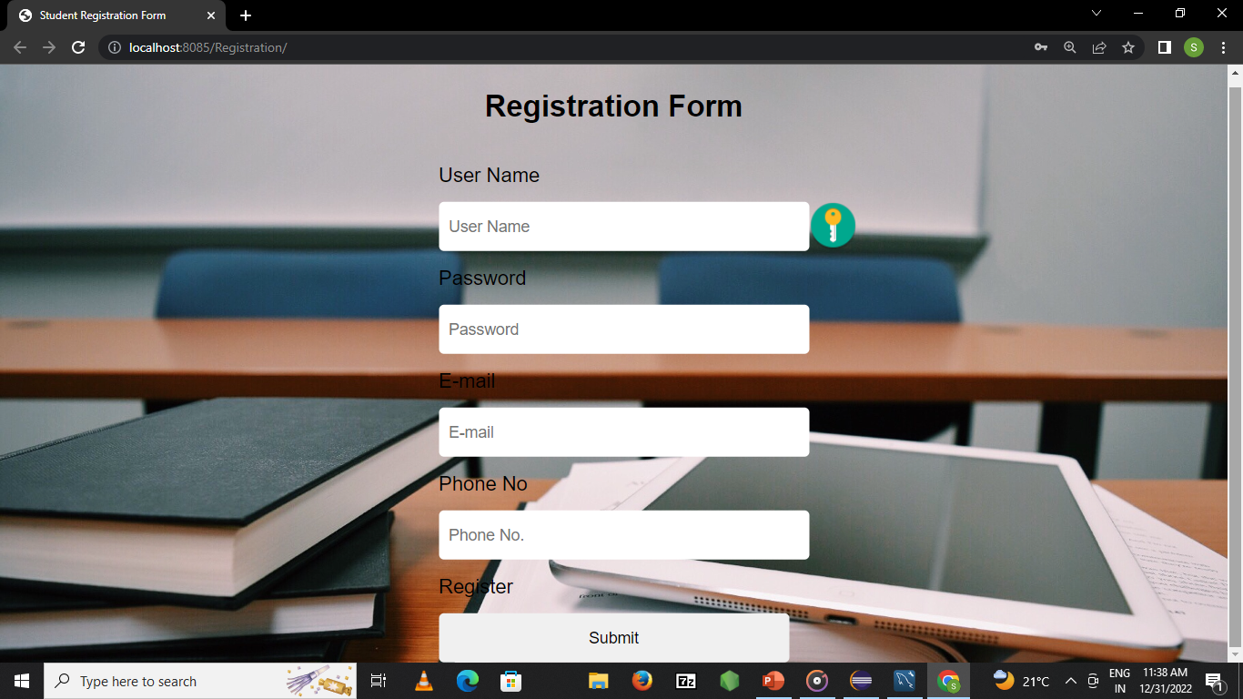
HOME PAGE

Slide 13
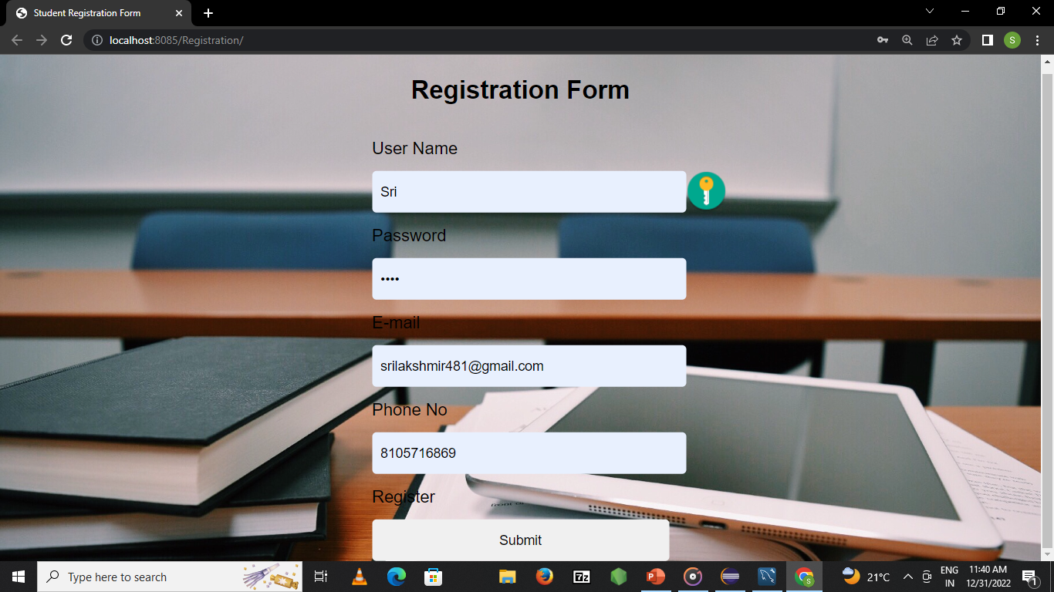

Slide 14
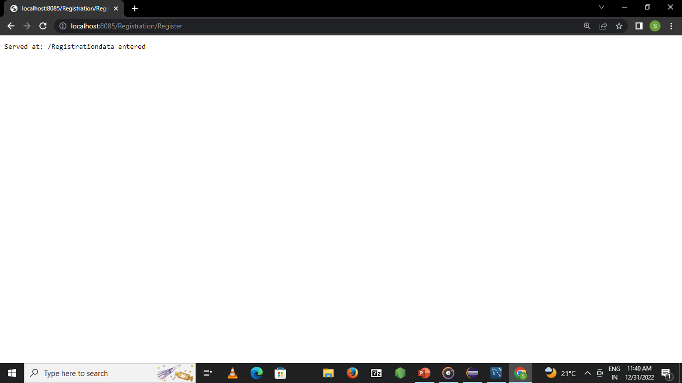
Data Confirmation

Slide 15
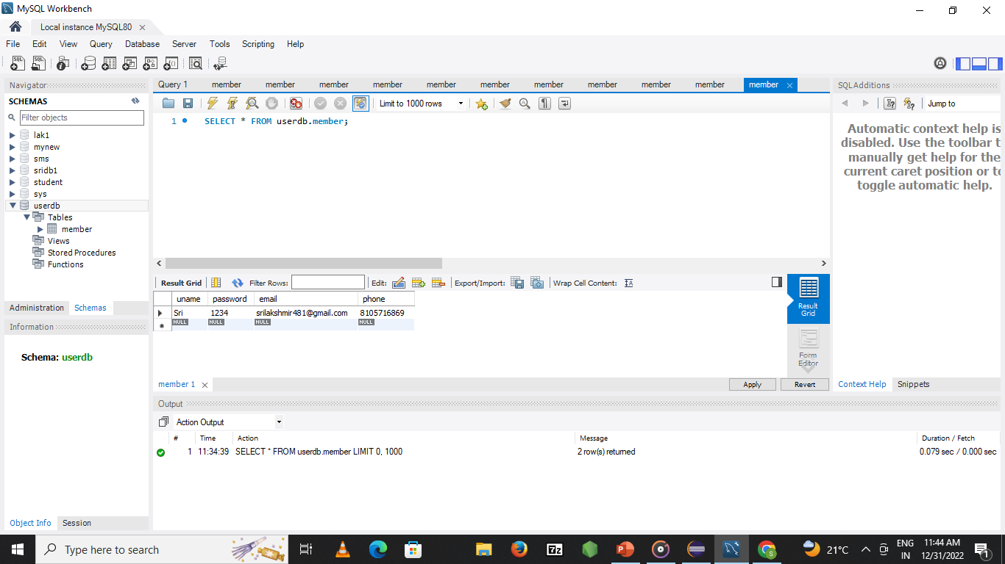
Stored Data

Slide 16
Advantages
Easy access of data
Easy modification/update of data
Retrieval of data made easy
Can be used anywhere irrespective of the field eg, hospitals/schools/stores etc.,
Reduces manual stress and burden.

Slide 17
Conclusion
Online Registration form is a web application which can be used anywhere and everywhere where the details has to be recorded and stored like in schools/educational institutions/hospitals/stores etc., without the fear of losing data and without the fear of not being able to update/modify/change the data, so as we can retrieve the required data whenever in need.

Slide 18
Thank you

