Slide 1
Multi-Agent Autonomous Warehouse Management
Reinforcement Learning | Semester VII
Problem: two warehouse robots must deliver packages to assigned destinations in a shared grid.
Challenges: obstacle avoidance, shared-space conflicts and efficient task completion.
Aim: learn a coordinated movement policy through interaction and reward feedback.
Environment: a 5 × 5 simulated warehouse with fixed obstacles and two delivery goals.

Slide 2
Method: MDP + Tabular Q-Learning
State: both robot positions and a delivery-completed flag for each robot.
Actions: move Robot 1 or Robot 2 one cell up, down, left or right.
Reward: step cost, distance-progress reward, invalid-move penalty and delivery rewards.
Learning: epsilon-greedy exploration and the Q-learning temporal-difference update.
Training: 9,000 episodes; α = 0.18; γ = 0.95; ε decays from 1.0 to 0.04.

Slide 3
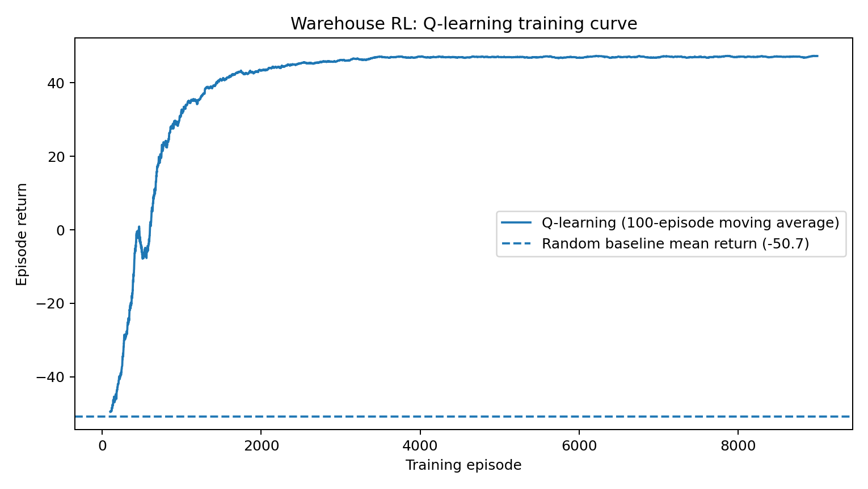
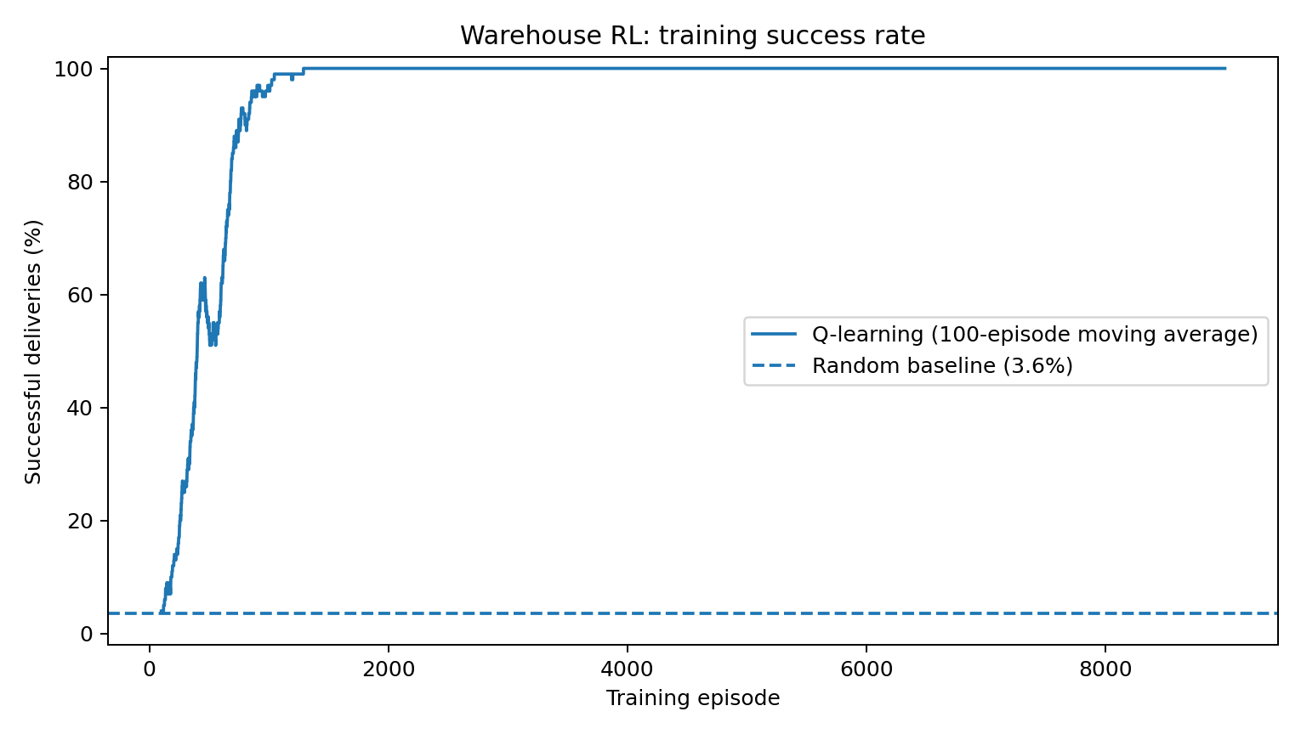
Results: Learning vs Random Baseline
Evaluation over 500 episodes after training
Mean return: Q-learning 47.6 vs random -50.7.
Successful deliveries: Q-learning 100.0% vs random 3.6%.

Slide 4
Limitations
Small 5 × 5 deterministic grid; real warehouses are larger and dynamic.
Grid movement ignores robot speed, turning radius, battery, sensor noise and communication delays.
Centralised controller: it chooses one robot's move at a time; decentralised coordination is not evaluated.
Tabular Q-learning scales poorly as state spaces grow; DQN or other function approximators are possible extensions.
Results depend on reward design, training settings and the chosen map.

Slide 5
Ethics, Safety and Conclusion
Safety: enforce collision constraints in the environment; do not rely only on learned reward penalties.
Validation: test across new maps and random seeds before considering physical deployment.
Ethics: disclose failures and limitations; avoid claiming simulated performance proves real-world safety.
Conclusion: Q-learning learned successful coordinated deliveries in the defined simulation and outperformed the random baseline.
Future work: partial observability, DQN/PPO, hierarchical task allocation and simulation-to-reality transfer.

