Slide 1

Mitron Bank Credit Card Strategy: Customer Spending Analysis & Business Insights
Presented By
G R S S SRI LALITHA

Slide 2
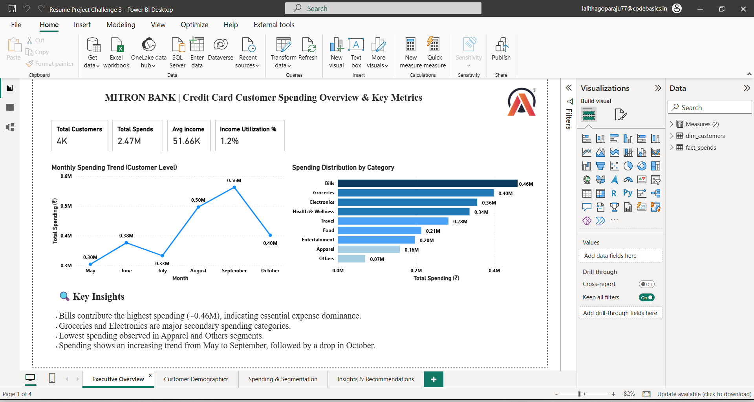

Slide 3
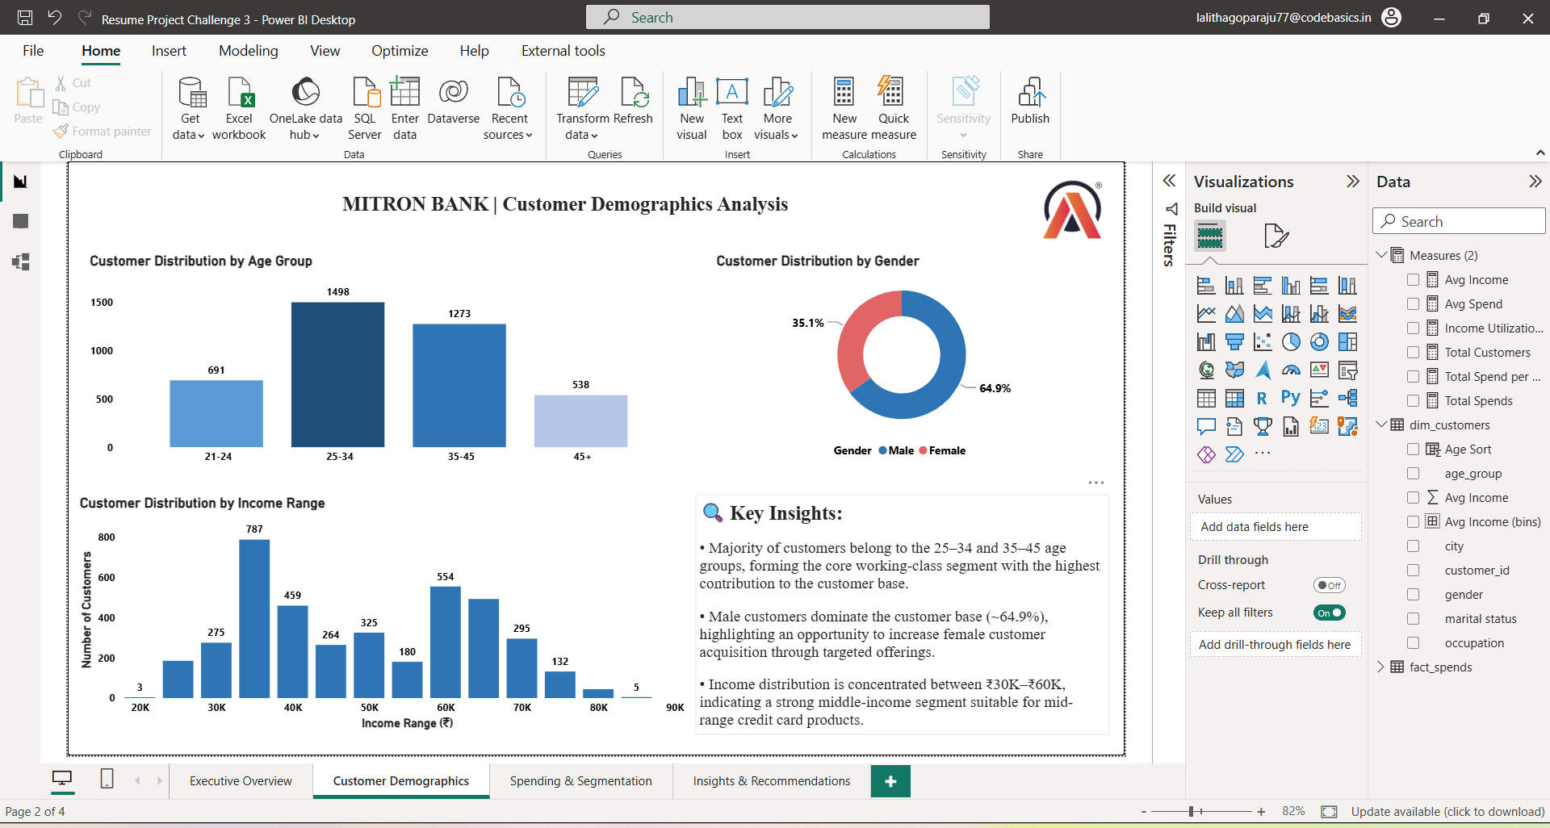

Slide 4
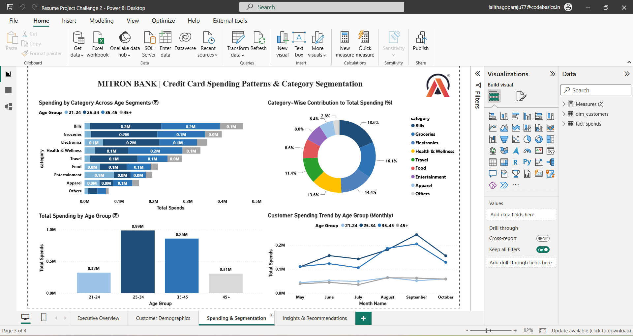

Slide 5
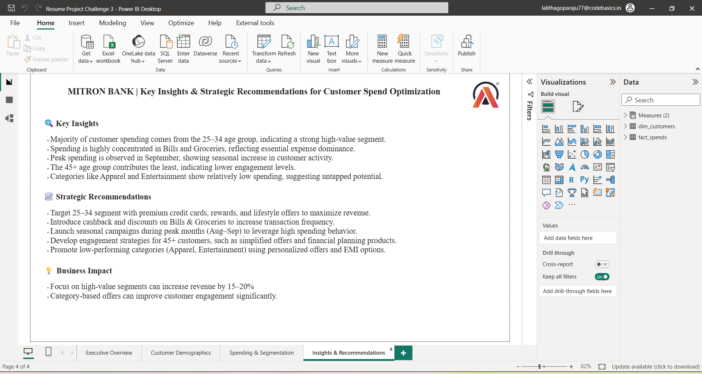

Slide 6
THANK YOU

