Slide 1

Executive Business Performance Dashboard – Shield Insurance
Presented By
G R S S SRI LALITHA

Slide 2
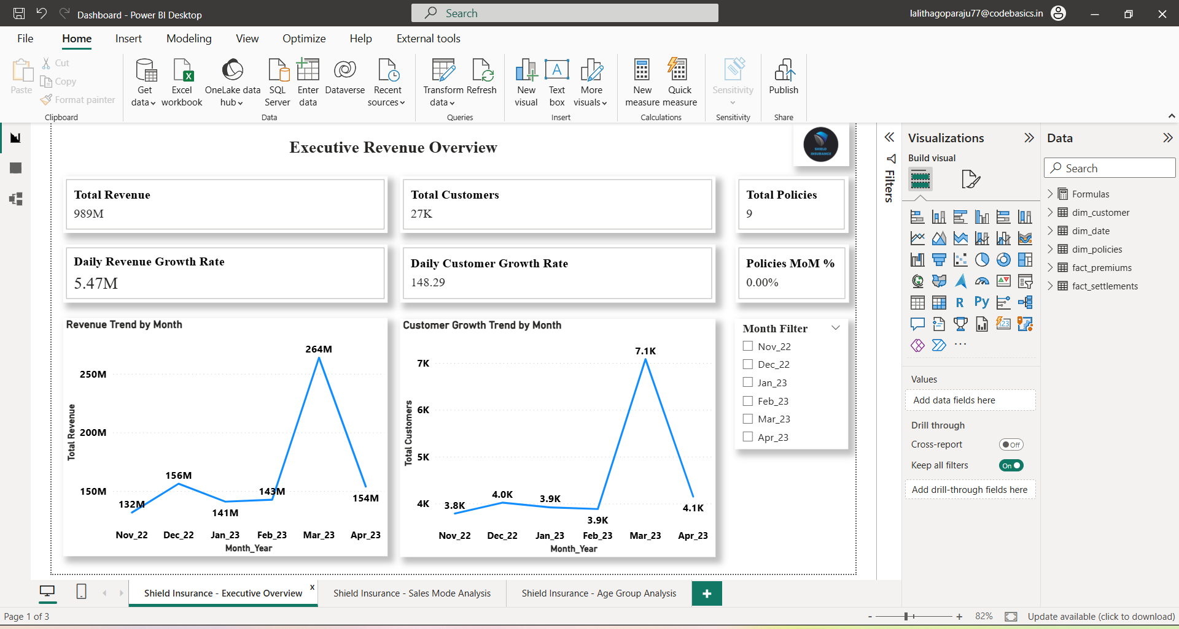
Key Insights :
• Revenue peaked in March 2023 reaching 264M.
• Customer growth also increased significantly in March.

Slide 3
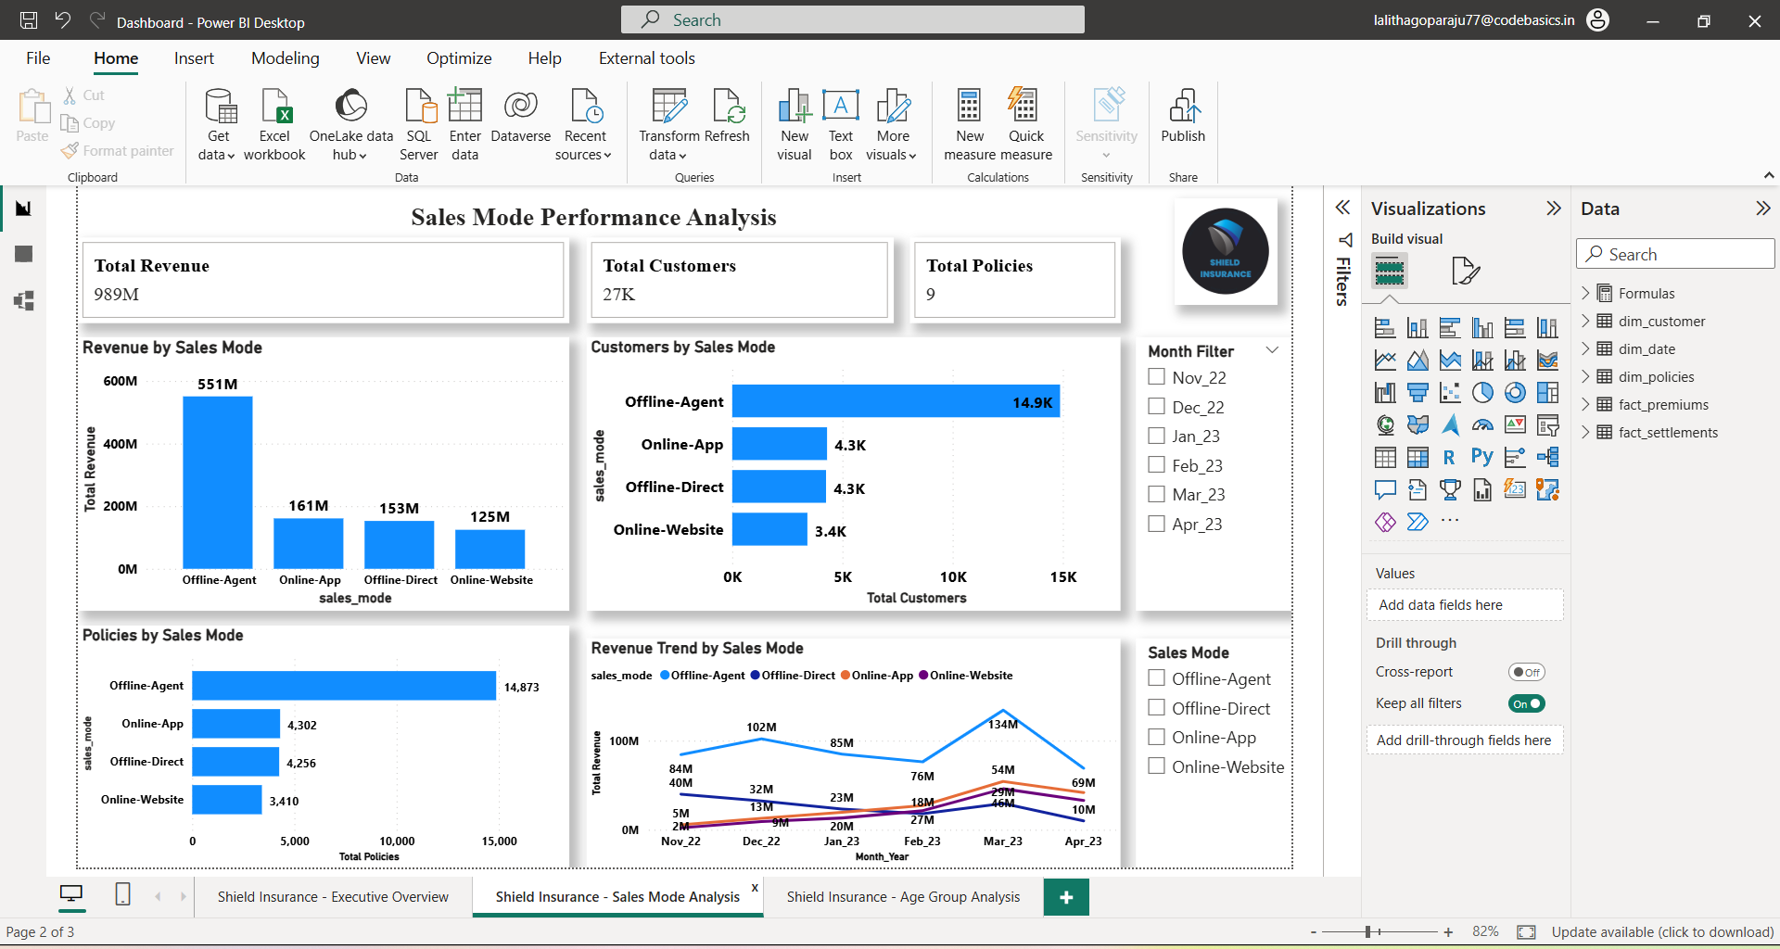
Key Insights :
• Offline Agent channel generates the highest revenue (551M).
• Online channels contribute lower revenue but steady customer acquisition.

Slide 4
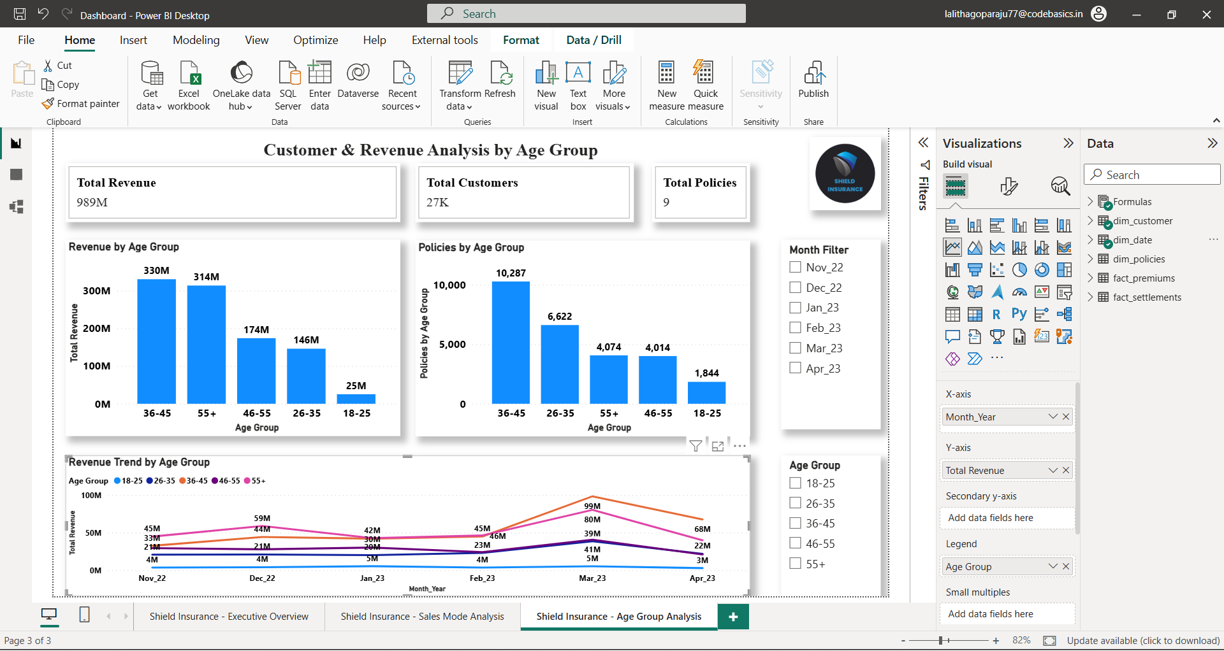
Key Insights :
• Customers aged 36–45 generate the highest revenue (330M).
• Younger customers (18–25) contribute the lowest revenue.

Slide 5
THANK YOU

