Slide 1


Predictive Maintenance
using
IoT Data
Srila Maiti

Slide 2

Agenda
1.
Business Problem
3.
data
5.
Model
7.
conclusions
2.
Business Impact
4.
Analysis
6.
evaluation

Slide 3


Business Problem
Notes:
Predictive maintenance helps organizations optimize their maintenance strategies, minimize downtime, and improve operational efficiency, ultimately leading to increased profitability and customer satisfaction. Appropriate predictive maintenance plan helps to reduce cost, increase equipment lifespan, improve efficiency, productivity, enhance safety.

Slide 4

Business impact
Notes:
Different types of machine failures are associated with various levels of downtime and shop floor loss. In our organization, machine failures over the last quarter incurred a loss of 25K USD.

Slide 5

Data
Notes:
We are ingesting the IoT data from various sensors. It captures air temperature, process temperature, rotational speed, torque, tool wear for three different product types ranging from low grade product to high grade product. It also captures machine failure status or not which can be related to tool wear failure, heat dissipation failure, power failure, overstrain failure and random failures.
The dataset we used has 10K data points, pertaining to highest number of low-grade products, followed by medium-grade products and then small number of high grade products.

Slide 6
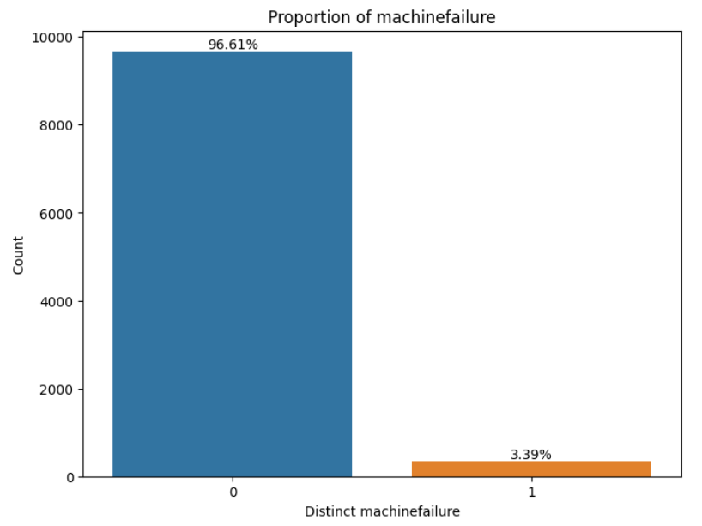
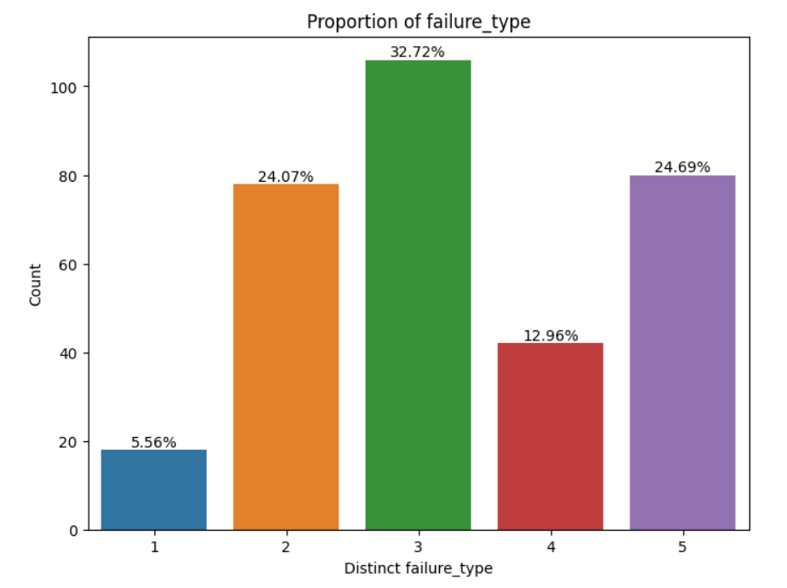
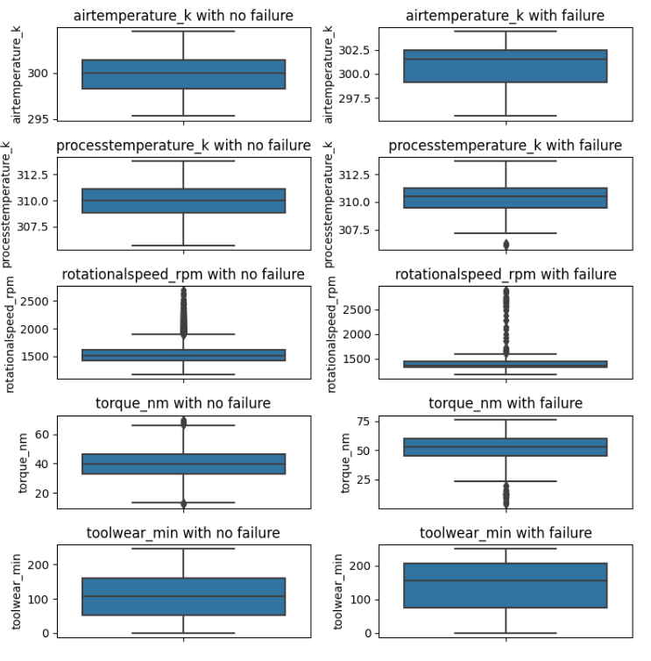
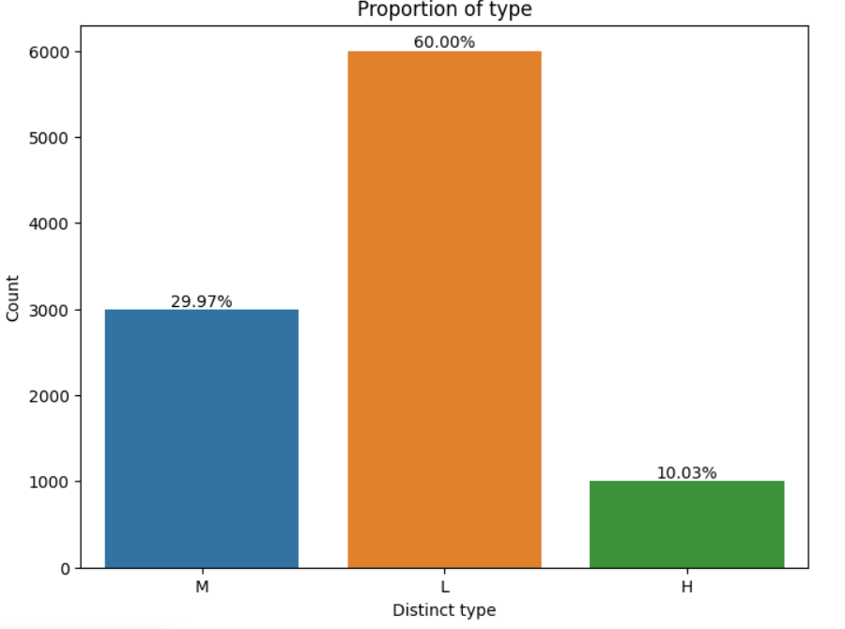
Analysis
10,000 iot data points
Three types of product data, predominantly low-grade products.
There can be 5 different types of machine failures.
Majority of the IoT data do not indicate any error.
amongst the error records, the majority are due to heat dissipation error followed by power wear failure and overstrain failure.
In case of error, we see average rotation and torque fluctuate from those without error.
Notes:
The dataset we used has 10K data points, pertaining to highest number of low-grade products, followed by medium-grade products and then small number of high grade products. The dataset is heavily imbalanced, most of our data points show no error.

Slide 7
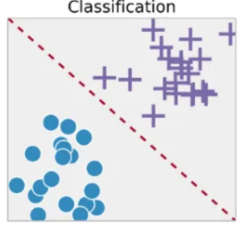
Model
We are aiming to find out the type of failure, rather than whether the machine will fail or not.
Output can be one of the failure types. The output value is mutually exclusive.
So, it is a multi-class classification problem.
We have tried several classification models ranging from logistic regression to tree-based classification methods and neural network classification models.
We have tried oversampling the less dominant classes.
We have done experiments with standardizing the values as well.
Logistic Regression
Support Vector Classifier
KNN Classifier
Random Forest Classifier
Decision Tree Classifier
Gradient Boost Classifier
XG Boost Classifier
Light GBM Classifier
Notes:
SMOTE (Synthetic Minority Over-sampling Technique) is a popular technique used to address class imbalance in machine learning datasets, particularly in binary classification problems where one class (the minority class) is significantly underrepresented compared to the other class (the majority class). It works by creating synthetic samples of the minority class to balance the class distribution.
Here's how SMOTE works:
Identify Minority Class: First, identify the minority class in the dataset, which typically has fewer instances.
Nearest Neighbor Selection: For each instance in the minority class, find its k nearest neighbors in the feature space. The number of neighbors, k, is usually chosen based on the level of imbalance in the dataset.
Synthetic Sample Generation: For each instance in the minority class, select one of its k nearest neighbors randomly. Then, create a synthetic sample along the line connecting the instance and its selected neighbor in the feature space. The synthetic sample is generated by randomly selecting points along this line.
Repeat: Repeat steps 2 and 3 until the desired balance between the minority and majority classes is achieved.
By generating synthetic samples, SMOTE effectively increases the number of instances in the minority class, making it more balanced with the majority class. This can help improve the performance of classification models by reducing bias towards the majority class and allowing the model to learn more effectively from the minority class.

Slide 8
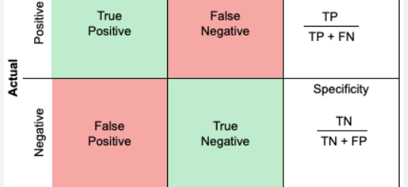
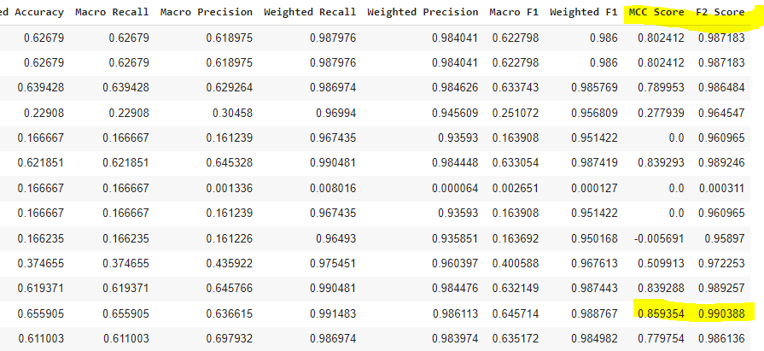
Evaluation
The choice between F2 score and MCC depends on the specific requirements and priorities of the classification task. If minimizing false negatives is critical, especially in imbalanced datasets, F2 score may be preferred. On the other hand, if the need is a comprehensive measure of classification quality that Considers all aspects of the confusion matrix, MCC is a good choice.
Notes:
Macro precision, within the context of classification evaluation, is a metric that calculates the average precision across all classes without considering class imbalance. It is calculated by taking the arithmetic mean of the precision scores for each class.
The F2 score is a metric used to evaluate the performance of a classification model, similar to the F1 score, but with a higher emphasis on recall. It is particularly useful in situations where recall is more important than precision, such as when the cost of false negatives (missed detections) is high.
The F2 score is calculated as the weighted harmonic mean of precision and recall, with more weight given to recall:
𝐹2=(1+𝛽2)×Precision×Recall(𝛽2×Precision)+RecallF2=(β2×Precision)+Recall(1+β2)×Precision×Recall​
Where:
Precision is the proportion of true positive predictions among all positive predictions.
Recall is the proportion of true positive predictions identified correctly out of all actual positives.
β (beta) is a parameter that controls the weight of recall in the calculation. For the F2 score, β = 2.
In essence, the F2 score penalizes false negatives (missed detections) more than false positives, making it suitable for scenarios where minimizing false negatives is crucial, such as medical diagnosis or fraud detection.
Macro recall, in the context of classification evaluation, is a metric that calculates the average recall across all classes without considering class imbalance. Recall, also known as sensitivity, measures the ability of a classifier to correctly identify all relevant instances (true positives) out of the total number of actual instances for a given class.
Weighted precision and recall are evaluation metrics used in the context of imbalanced classification problems. They are variants of precision and recall that account for class imbalance by weighting the scores based on the number of instances in each class.
Weighted precision calculates the precision for each class and then computes the average, weighted by the number of instances in each class. It gives more weight to classes with more instances, making it useful for imbalanced datasets.
Weighted recall calculates the recall for each class and then computes the average, weighted by the number of instances in each class. Like weighted precision, it gives more weight to classes with more instances, making it suitable for imbalanced datasets.
Balanced accuracy is a metric used to evaluate the performance of a classification model on imbalanced datasets. It provides a more accurate measure of a model's effectiveness when classes are imbalanced by taking into account the sensitivity to each class.
Balanced accuracy is calculated as the arithmetic mean of the sensitivity (true positive rate, recall) of each class:
Balanced Accuracy=1𝑁∑𝑖=1𝑁Recall𝑖Balanced Accuracy=N1​∑i=1N​Recalli​
Where:
𝑁N is the total number of classes.
Recall𝑖Recalli​ is the recall (true positive rate) for class 𝑖i.
Weighted F1-score is a metric used to evaluate the performance of a classification model on imbalanced datasets. It calculates the F1-score for each class and then computes the average, weighted by the number of instances in each class. This gives more weight to classes with more instances, making it suitable for imbalanced datasets.
F1-score is the harmonic mean of precision and recall. It provides a balance between precision and recall, making it a useful metric for binary and multiclass classification tasks.
Mathematically, the weighted F1-score is calculated as:
Weighted F1-score=∑𝑖=1𝑁F1-score𝑖×Support𝑖∑𝑖=1𝑁Support𝑖Weighted F1-score=∑i=1N​Supporti​∑i=1N​F1-scorei​×Supporti​​
Where:
𝑁N is the total number of classes.
F1-score𝑖F1-scorei​ is the F1-score for class 𝑖i.
Support𝑖Supporti​ is the number of instances of class 𝑖i.
The Matthews correlation coefficient takes into account true positives, true negatives, false positives, and false negatives and is calculated using the following formula:
MCC=𝑇𝑃×𝑇𝑁−𝐹𝑃×𝐹𝑁(𝑇𝑃+𝐹𝑃)(𝑇𝑃+𝐹𝑁)(𝑇𝑁+𝐹𝑃)(𝑇𝑁+𝐹𝑁)MCC=(TP+FP)(TP+FN)(TN+FP)(TN+FN)​TP×TN−FP×FN​
Where:
𝑇𝑃TP is the number of true positives.
𝑇𝑁TN is the number of true negatives.
𝐹𝑃FP is the number of false positives.
𝐹𝑁FN is the number of false negatives.
The MCC value ranges from -1 to +1, where:
+1 indicates perfect prediction.
0 indicates random prediction.
The F2 score and Matthews Correlation Coefficient (MCC) are both metrics used to evaluate the performance of classification models, but they emphasize different aspects of classification performance.
Emphasis on Recall: The F2 score is similar to the F1 score but gives more weight to recall. It is particularly useful when minimizing false negatives (missed detections) is more important than minimizing false positives.
Suitability for Imbalanced Data: The F2 score is beneficial in imbalanced datasets, where one class is much smaller than the other. It helps prioritize the correct classification of instances in the minority class.
Controlled by β Parameter: The F2 score allows controlling the balance between precision and recall through the β parameter. A higher β value (e.g., β = 2) places more emphasis on recall.
Matthews Correlation Coefficient (MCC):
Overall Measure of Quality: MCC takes into account all four elements of the confusion matrix (true positives, true negatives, false positives, and false negatives) and provides a balanced measure of classification quality.
Suitability for Balanced Data: MCC is suitable for both balanced and imbalanced datasets. It is particularly useful when both false positives and false negatives need to be minimized.
Range of Values: MCC ranges from -1 to +1, where +1 indicates perfect prediction, 0 indicates no better than random prediction, and -1 indicates inverse prediction. It provides a holistic view of the model's performance.
In summary, the choice between F2 score and MCC depends on the specific requirements and priorities of the classification task. If minimizing false negatives is critical, especially in imbalanced datasets, F2 score may be preferred. On the other hand, if you need a comprehensive measure of classification quality that takes into account all aspects of the confusion matrix, MCC is a good choice.

Slide 9

Observations
Logistic regression struggles with highly imbalanced datasets where the classes are disproportionately represented. In such cases, additional techniques like class weighting or resampling may be necessary to improve performance.
KNN did not perform well on imbalanced datasets, where one class is significantly more prevalent than the others. In such cases, the majority class dominates the predictions, leading to biased results.
Random forests and gradient boosting methods like XGBoost, LightGBM, and GBM often achieve better predictive performance compared to individual decision trees, but they may require more computational resources and hyperparameter tuning.

Slide 10

Enhancements
Predicting machine and failure type together
Use synthetic data to augment under-represented class
Include multi-modal data (engineer’s notes, image) along with tabular data to predict
Hyper-parmeter tuning

Slide 11


