Slide 1

Enhancing Call Center Efficiency with AI-Powered Topic Analysis
Using AI to analyze customer service calls and improve issue resolution.

Slide 2
Introduction
Objective: Improve call center efficiency by analyzing customer service calls using AI.
Solution: Gradio-powered application to process audio calls, extract key topics, and provide action plans.
Impact: Identify recurring issues, optimize responses, and enhance customer satisfaction.

Slide 3
Audience
Customer Service Team
Engineering Team
Efficiency team
Supply Chain Team
Quality Control Team

Slide 4
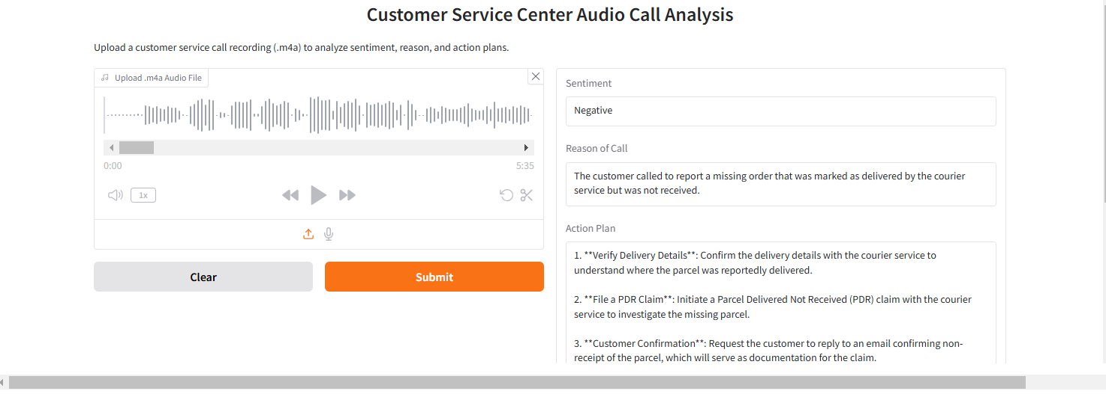
How the Gradio Application Works
User Uploads an Audio File (.m4a format)
AI Transcribes the Call
Sentiment Analysis (Positive, Neutral, Negative)
Reason Identification (Billing, Technical Issue, Complaint, etc.)
Action Plan Generation (Suggests steps to resolve the issue effectively)

Slide 5
Key Benefits
Streamlined Topic Analysis
Tracks trends in customer concerns over time.
Enhanced Customer Experience
Faster and more precise issue resolution.
Data-Driven Decision Making
Identifies major pain points and areas of improvement.
Product Issue Mapping
Detects which products/services have the most complaints.

Slide 6
Use Case: Identifying Major Issues Over Time
- The system builds a history of calls, categorizing them into key topics.
- Call data can be analyzed to find common patterns in customer complaints.
- Helps management focus on frequent issues per product/service.

Slide 7
Potential Insights Gained
- Which issues occur most frequently?
- Which product categories generate the most complaints?
- What are the common action plans needed for each issue?
- How do customer sentiment trends change over time?

Slide 8
Future Enhancements
- Multilingual Support: Expanding to analyze non-English calls.
- Integration with CRM Systems: Automating issue tracking and ticket creation.
- Predictive Analysis: Using AI to forecast potential future issues.
- Real-time Analysis: Immediate feedback on customer satisfaction.

Slide 9
Conclusion
- This AI-powered system enables call centers to focus on what matters most.
- Reduces repetitive issues, improves customer satisfaction, and enhances product quality.
- Long-term insights help businesses prioritize improvements and optimize resources.
- Next Steps: Implement and monitor data trends, optimize responses, expand AI capabilities.

