Slide 1

Energy Consumption Prediction Model for Efficient Resource Management
This presentation explores the development and application of an energy consumption prediction model. We will discuss the power of advanced time series models in optimizing resource management and driving sustainability.

Slide 2

Leveraging Advanced Time Series Models for Sustainability
Our objective is to create a tool that predicts energy consumption using historical data and time series models to enhance efficiency and sustainability.
Accurate Forecasting
Resource Optimization
Cost Reduction
Predicting energy consumption with a high degree of accuracy.
Efficiently managing resources, minimizing waste and maximizing efficiency.
Lowering energy costs by optimizing consumption and identifying potential savings.

Slide 3
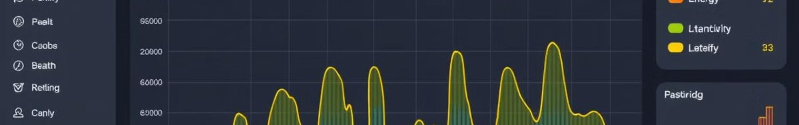
Accurate Energy Forecasting
Our model utilizes advanced time series models to analyze historical energy consumption data and identify patterns and trends.
Data Collection
Prediction Generation
Gathering comprehensive energy consumption data from various sources.
Generating accurate energy consumption predictions for future time periods.
1
2
3
Model Training
Training the model on historical data to learn patterns and dependencies.

Slide 4
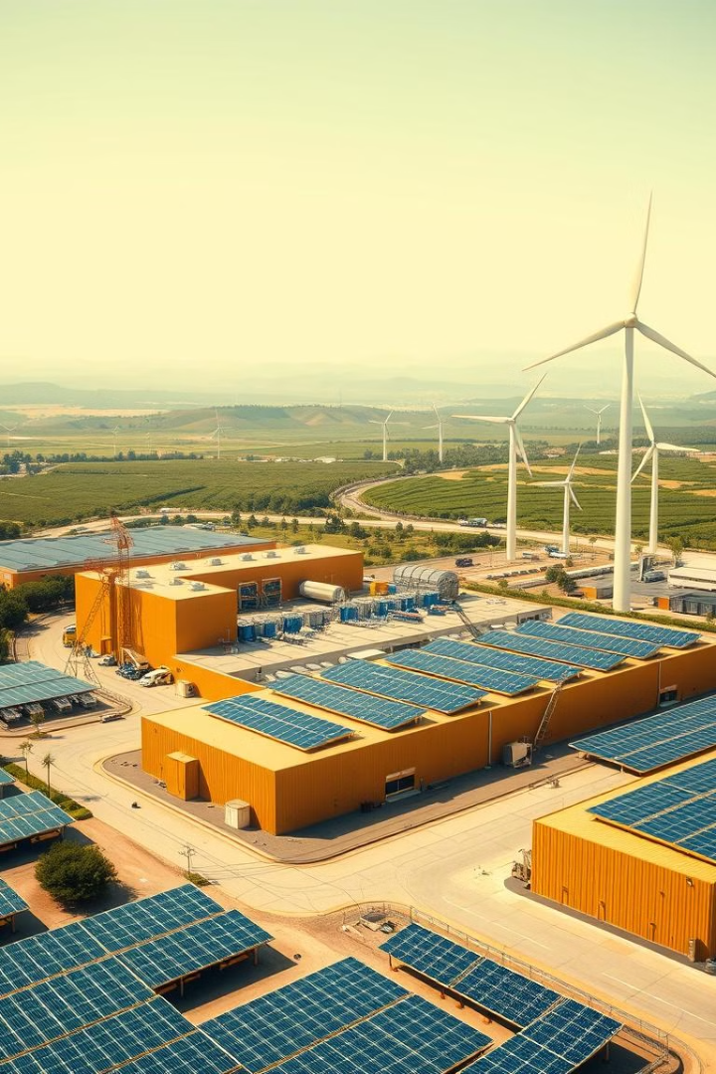
Efficient Resource Management and Cost Reduction
The model's predictions empower businesses to optimize resource allocation, reducing waste and energy consumption.
10%
$1M
Reduced Consumption
Cost Savings
The model is expected to reduce energy consumption by 10% or more.
This translates to substantial cost savings and a significant environmental impact.

