Slide 1
ETHER WALLET
UNDER THE GUIDANCE OF
Dr.David Liu ​
Presented by :
Sri Lasya B
Siddhartha Reddy R
Abhishek Prajwal K
S N Sai Subhank V
Sai Sathvik V
Sowmya C

Slide 2
Table of contents
01.
Introduction
03.
Technical Analysis
02.
Blockchain & Web3
04.
conclusion
What is Ether Wallet?
Problem Statement and Necessity.
Technologies used
Usage of Metamask and Ganache
Concluding the presentation
reference

Slide 3
OBJECTIVES
Creating a Decentralized Application for Ether Wallet platform in which we are using different tools and technologies like​
React.js for the user interface​
Solidity language for smart contracts​
With the help of this platform,one can contribute to the smart contract and can withdraw but everyone can’t withdraw.

Slide 4
Introduction
We have designed a blockchain based Ether Wallet page.This project ha a page to contribute and a page for withdrawal which only admin can do so.
Ether Wallet is one of the most popular ways to raise funds for any project, cause or for helping any individual in need.

Slide 5
Feasibility: Technical & Non-Technical
It is a ReactJS based application, which will be supported by any traditional web browser such as chrome , edge.
Anyone with an Internet connection can use this.
Users will require ‘Metamask’ browser extension to sign transactions.

Slide 6
02.
Blockchain & web3

Slide 7
Relationship between BlockChain and Web3
Blockchain and crypto eliminate the need to trust any third party, such as a bank or an individual intermediary. Web3 users can transact without the need to put trust in any entity but the network itself.
Web3
web3.js is a collection of libraries that allow you to interact with a local or remote ethereum node.

Slide 8
03.
Technical Analysis
Tech stack

Slide 9
Tech Stack Analysis
Optimized
For
speed
Efficient
Secure
In order to achieve the solution we have chosen a tech stack that is

Slide 10


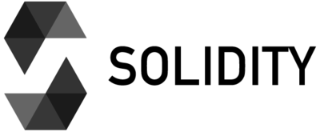
Tech Stack Analysis
The Technologies that we used to develop a web3 application :
REACT
It's used for building interactive user interfaces and web applications quickly and efficiently with significantly less code than you would with vanilla JavaScript
GANACHE
Ganache is a private Ethereum blockchain environment that allows to you emulate the Ethereum blockchain so that you can interact with smart contracts in your own private blockchain.
Solidity
It is the programming language for implementing Ethereum based Smart Contracts.

Slide 11
Features of our application

Slide 12
We will present the three major features in our application :
Connect Wallet
Contributing to a Campaign
Making a Withdrawal Request

Slide 13
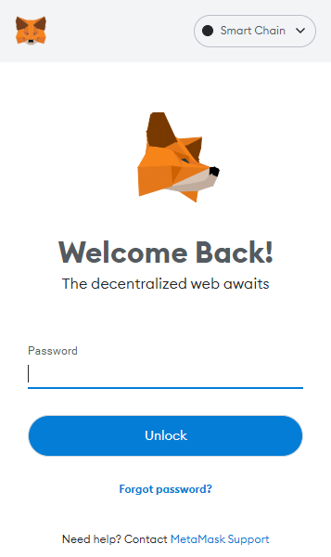
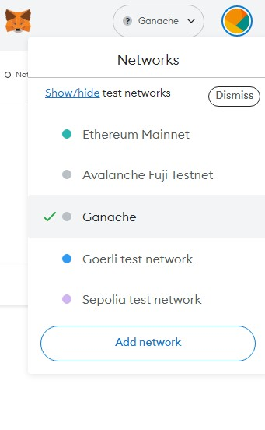
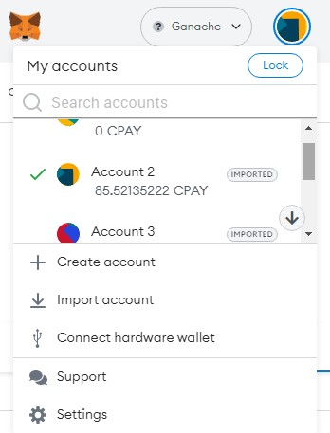
Connect Wallet
Login in to Metamask
Connect to a network
Connect a account of that network

Slide 14
04.
Concluding Presentation
Conclusion

Slide 15
Conclusion
We implemented a web3 application where anyone can contribute but only owner can withdraw
Conventional Ether Wallet methods have long suffered from lack of transparency and fraud. It is an avoidable problem, and we believe that we will implement a solid solution that can do away with these long-standing problems.
This project has covered the weak points of general Ether wallet platforms to provide transparency to the process of Ether Wallet and build trust among people, so that they may contribute their wealth to good causes without fear of fraud.

Slide 16
References
Blockchain & Smart Contracts: https://www.dappuniversity.com/articles/how-to-build-a-blockchain-app
CryptoRelief platform: https://cryptorelief.in
React js Documentation: https://reactjs.org/
Learning Solidity Language: https://cryptozombies.io/
web3.js - Ethereum JavaScript API: https://web3js.readthedocs.io/en/v1.3.4/
How data is stored in Ethereum Blockchain:
https://laurentsenta.com/articles/storage-and-dapps-on-ethereum-blockchain/
Metamask Ethereum Wallet : https://metamask.io/
Ganache : https://trufflesuite.com/docs/ganache/

Slide 17
THANK YOU

